Slide 1
Summer Student Series
2021

Slide 2
Getting Started!
Type your name and institution into the chat box!
Remember to keep yourself on mute.
Type your questions into the chat box.

Slide 3
Session 2: Healthy Food Retail

Slide 4
Healthy Food Retail!!!
HER NOPREN Summer Speaker Series for Students
June 23, 2021
Beth Racine, DrPH, RD

Slide 5
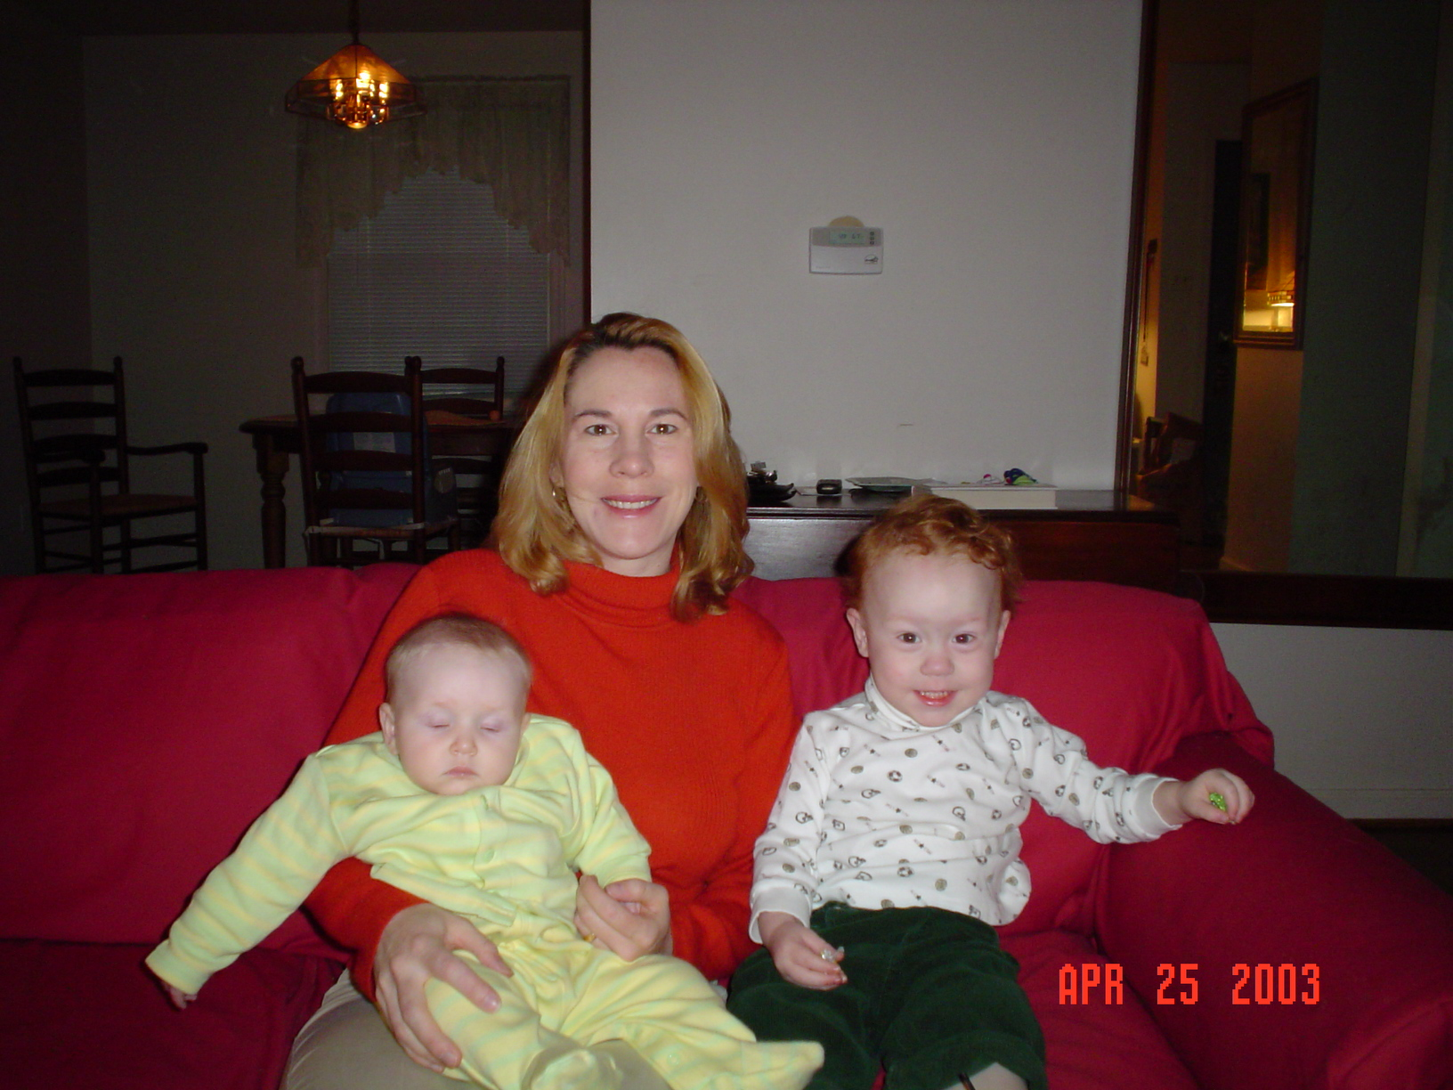
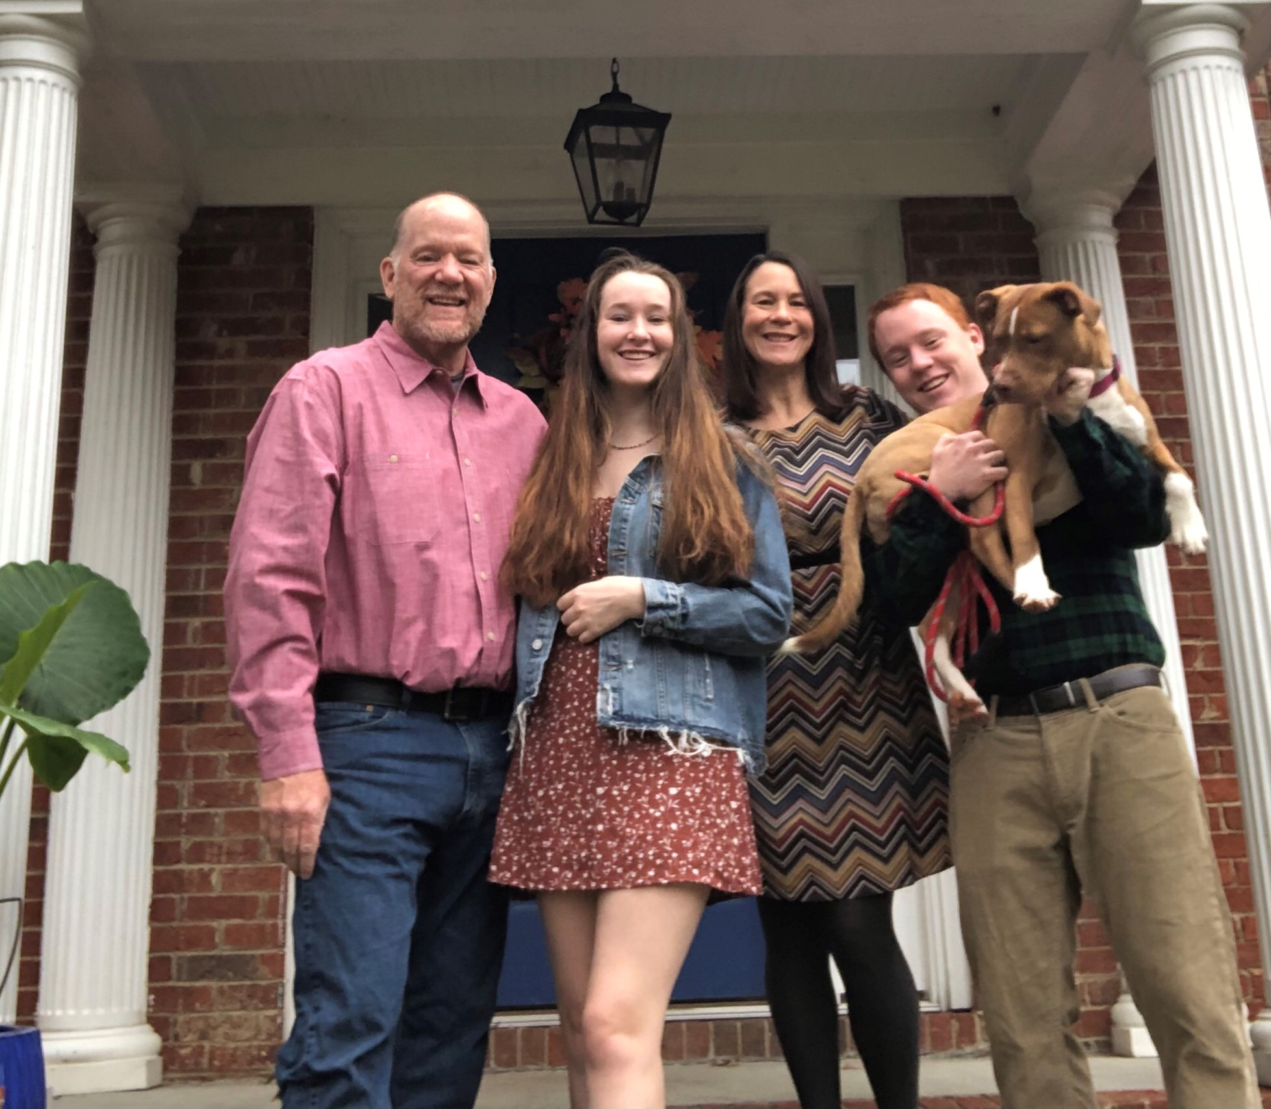
About me…
Johnson & Johnson Community Health Care Scholars Program at JHU

Slide 6
Healthy Food Retail What is it?
Why is this important?

Slide 7
How to make it a reality for everyone?

Slide 8
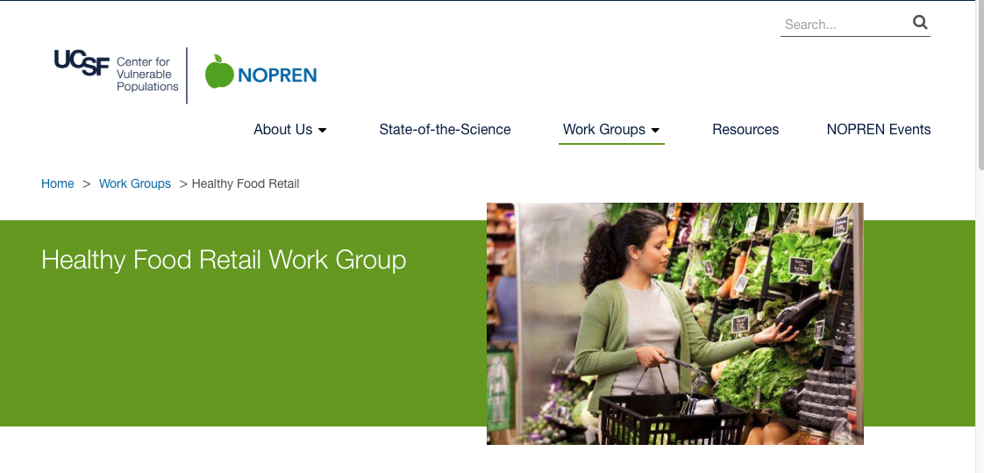

Slide 9
DNPAO-FUNDED healthy retail strategies
Diane Harris, PhD MPH
Senior Health Scientist and Team Lead, Healthy food environments
Div. Nutrition, Physical Activity and Obesity
NOPREN Summer Series
June 23, 2021

Slide 10
disclaimer
The conclusions in this presentation are those of the authors and do not necessarily represent the views of the Centers for Disease Control and Prevention.

Slide 11
topics
A little about me
HFR Action Guide
Overview of DNPAO programs
SPAN
HOP
REACH
Retail strategies
BRIC
Summary

Slide 12
A little about me
B.S. in Animal Science from the University of California, Davis
Ph.D. in Animal Nutrition from Cornell University
Postdoctoral Research Associate at Washington University and the University of California, Los Angeles
Research Faculty, UCLA School of Medicine
M.P.H. in Prevention Science from Emory University
CDC/DNPAO – Senior Health Scientist and Team Lead, Healthy Food Environments

Slide 13
Public health strategies for increasing F&V consumption
Food policy councils
Healthy food retail
Farm to institution
Promotion in schools and child care
Institutional food service guidelines
Farmers’ markets
Community supported agriculture
Community and home gardens
Inclusion in emergency food programs
http://www.cdc.gov/obesity/downloads/FandV_2011_WEB_TAG508.pdf

Slide 14
Healthier food retail (HFR) Action Guide (2014)
Partnerships, Assessment, and Evaluation
Grocery Stores
Small Stores
Farmers Markets
Mobile Food Retail
Transportation
Distribution
https://www.cdc.gov/nccdphp/dnpao/state-local-programs/healthier-food-retail.html

Slide 15
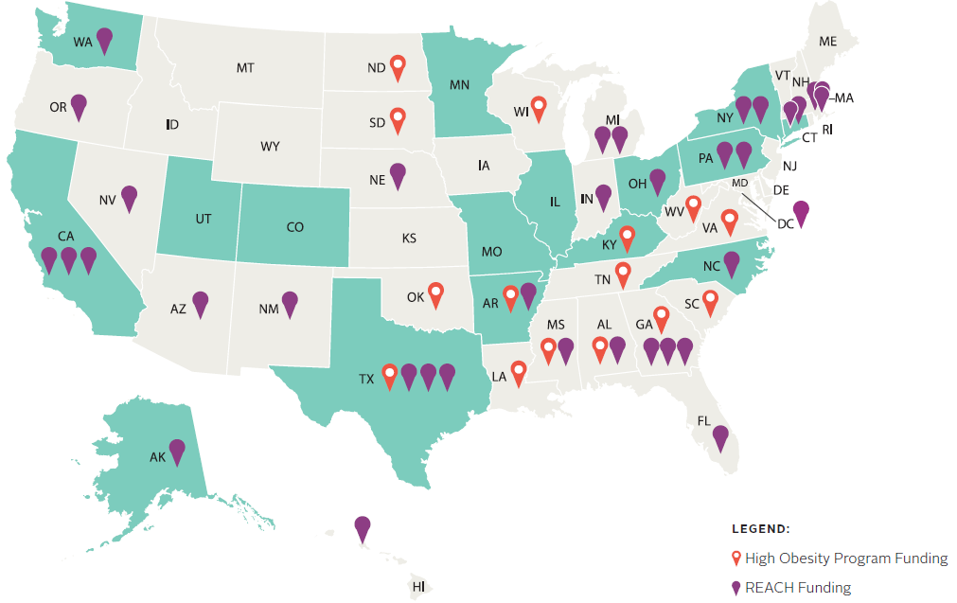
DNPAO’s funded Program recipients – FY20
https://www.cdc.gov/nccdphp/dnpao/state-local-programs/funding.html

Slide 16
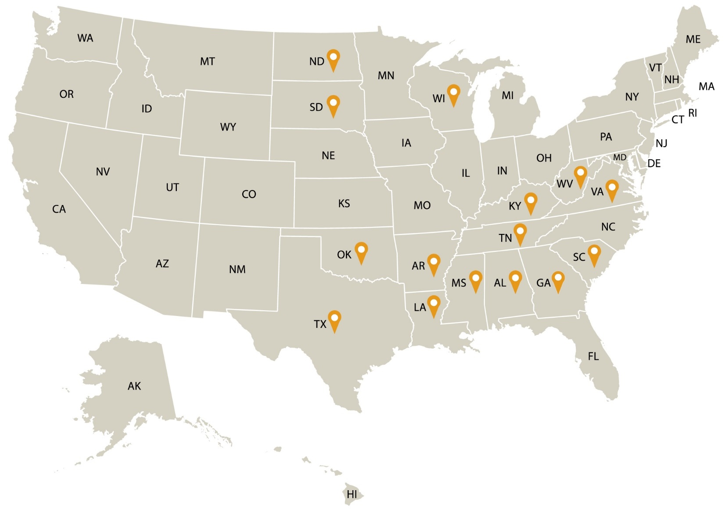
High Obesity Program (HOP)
HOP Funded Recipients (Fiscal Year 2018)
15 land grant universities leverage community extension services to increase access to healthier foods and opportunities for physical activity in counties that have more than 40% of adults with obesity
Residents of these communities may have less access to healthy foods and fewer opportunities to be physically active
Recipients implement evidence-based strategies to increase access to healthier foods and to safe places for physical activity through existing Cooperative Extension and outreach services
To learn more about the HOP program, please visit: https://www.cdc.gov/nccdphp/dnpao/state-local-programs/hop-1809/high-obesity-program-1809.html.
Notes:
The High Obesity Program (HOP) funds 15 land grant universities to leverage community extension services to increase access to healthier foods and opportunities for physical activity in counties that have more than 40% of adults with obesity. Residents of these communities may have less access to healthy foods and fewer opportunities to be physically active.
Recipients will implement evidence-based strategies to increase access to healthier foods and to safe places for physical activity through existing cooperative extension and outreach services. Strategies include:
Establishing healthy nutrition standards in settings such as workplaces, hospitals, afterschool and recreational programs, faith-based organizations;
Working with food vendors, distributors, and producers to increase fruit and vegetable procurement and sales;
Improving state and local programs that provide incentives to purchase fruit and vegetables; and
Implementing community planning and transportation plans that support safe and accessible physical activity by connecting sidewalks, paths, bike routes, public transit with homes, ECE, schools, parks and recreation centers.
Since 2014, CDC has funded land grant colleges and universities to work with existing county cooperative extension and outreach services in predominantly rural areas. We are pleased with communities’ progress to improve access to healthy foods and increase opportunities to be physically active across different settings. Accomplishments include:
implementing healthier nutrition standards for food and beverages available in public venues;
increasing access to healthier food retail and safe places for physical activity;
promoting farm to pre-school programs to increase access to fresh fruits and vegetables;
promoting physical activity and reducing screen time at early care and education centers; and
improving safe streets and community design initiatives.
CDC is excited about the opportunity to address the challenges of obesity in counties where the burden of obesity is greatest.
To learn more about this program, please visit: https://www.cdc.gov/nccdphp/dnpao/state-local-programs/hop-1809/high-obesity-program-1809.html. To learn more about previous work accomplished through the High Obesity Program, please visit: https://www.cdc.gov/nccdphp/dnpao/state-local-programs/high-obesity-program.html.

Slide 17
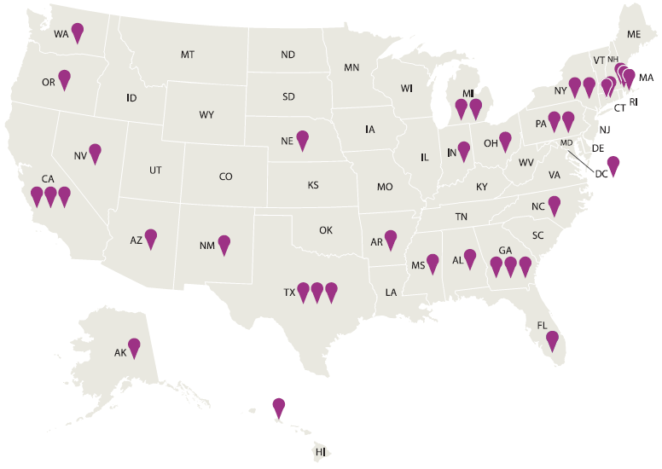
Racial and Ethnic Approaches to Community Health (REACH)
REACH Funded Recipients (Fiscal Year 2020)
The REACH program is one of the only CDC programs that explicitly focuses on improving chronic diseases for specific racial and ethnic groups in urban, rural, and tribal communities with high disease burden
36 organizations (5 new in FY20) across the country are addressing racial and ethnic health disparities
This program aims to improve health, prevent chronic diseases, and reduce health disparities among racial and ethnic populations with the highest risk, or burden, of chronic disease
To learn more about the REACH program, please visit: https://www.cdc.gov/nccdphp/dnpao/state-local-programs/reach/current_programs/index.html
Notes:
The Racial and Ethnic Approaches to Community Health (REACH) program is one of the only CDC programs that explicitly focuses on improving chronic diseases for specific racial and ethnic groups in urban, rural, and tribal communities with high disease burden. ​
The program funds 36 organizations across the country to address racial and ethnic health disparities. REACH aims to improve health, prevent chronic diseases, and reduce health disparities among racial and ethnic populations with the highest risk, or burden, of chronic disease, specifically for African Americans/Blacks, Hispanic Americans, Asian Americans, Native Hawaiian/Other Pacific Islanders, American Indians, and Alaska Natives. REACH targets risk factors such as obesity, physical inactivity, tobacco use, and poor nutrition.​
REACH recipients: ​
Increase community support for breastfeeding through lactation support services, trained health care providers, and peer support networks; ​
Establish healthy nutrition standards in settings such as workplaces, hospitals, afterschool and recreational programs, and faith-based organizations; ​
Increase fruit and vegetable procurement and sales by working with food vendors, distributors, and producers and by promoting programs that incentivize the purchase of fruit and vegetables; ​
Implement community planning and transportation plans that support safe and accessible physical activity by connecting sidewalks, paths, bike routes, and public transit with homes, early care education centers, schools, and parks and recreation centers; and​
Promote programs that connect health centers with community supports to help people manage diabetes and heart disease. ​
Since 1999, the REACH Program has been at the forefront of CDC’s efforts to address racial and ethnic disparities in health. Recipients have successfully implemented community-based approaches, including:​
increasing access to healthy foods and beverages, promoting opportunities for physical activity, reducing tobacco use and youth initiation, and eliminating exposure to secondhand smoke;​
expanding the use of clinical and preventive services, promoting health information technology and tools, and supporting collaborations between nurses, community health workers, and other health professionals to help people manage heart disease and diabetes. ​
Over time, REACH recipients have demonstrated that locally-based and culturally-tailored solutions can be effective in reversing gaps in health by race and ethnicity. REACH communities have seen decreases in smoking, reductions in obesity, increased fruit and vegetable consumption, and increased healthy behaviors such as changing eating habits, reducing salt and alcohol consumption, and adhering to prescribed blood pressure treatment regimens.​
CDC looks forward to continuing to support strategies to prevent chronic disease and to eliminate health gaps among racial and ethnic groups in the United States.​
To learn more about the new program, please visit: https://www.cdc.gov/nccdphp/dnpao/state-local-programs/reach/current_programs/index.html. To learn more about previous work accomplished through the REACH Program, please visit: https://www.cdc.gov/nccdphp/dnpao/state-local-programs/reach/index.htm.

Slide 18
HOP/REACH Community Nutrition strategies
Collaborate with partners to improve the food system to increase access to healthier foods:
Distribution and retail: Work with food vendors, distributors and producers to enhance healthier food procurement and sales: establish/support food hubs; establish a network of food sales outlets; establish a group purchasing collective; develop tools to match local producers with institutions; and explore innovative practices that can support this work
Nutrition standards: Establish healthy nutrition standards in key institutions such as hospitals, afterschool and recreation programs, community health centers, faith-based organizations, food banks/pantries, and early care and education
Access: financial and geographic: Make improvements to state and local programs/systems (e.g., voucher incentive programs, increased electronic benefit transfer acceptance where food is purchased, improved public transportation routes to food stores, access to healthier foods at community venues)
Notes:
Does NOT include healthy corner store makeover
Distribution
Retailers
Access to healthy food
Financial
Geographic
Nutrition standards

Slide 19
Strategy 1: Distribution and retail - Group purchasing collective model
Store A –
5 crates of apples
Mainline Distributor
Minimum Purchasing Requirement
(20 crates of apples)
Store B –
5 crates of apples
Store C –
5 crates of apples
Store D –
5 crates of apples
Notes:
Network of Sales Outlets – Community of Practice
Group purchasing collective
Not group purchasing organization

Slide 20
Strategy 1: distribution and retail food hub Collaboration

Slide 21
Strategy 3: access – geographic transportation and community access
Transportation: Connect with public (DOT) and private (grocery store) to assess and enhance transportation options to/from grocery stores
Community Access: Support/enhance CSA and grocery delivery locations
Notes:
- Bus routes, adequate sidewalks, connect trails or bike lane routes
Consider rural vs urban
-CSA (Community Supported Agriculture) is bag of (mostly) fruits and vegetables delivered regularly (e.g. weekly) from one or more farms
-Grocery delivery location examples: library, recreation center, senior apartments, food banks/pantries, churches, ECE
- Make sure route changes focus on priority populations.

Slide 22
Strategy 3: access - financial Healthy/NUTRITION incentive programs
Increase purchase of fruits and vegetables by consumers participating in SNAP through providing incentives at point of purchase
SNAP-authorized firms could be large supermarkets, grocery stores, small format stores and farmers markets
Program names include Double Up Bucks, DA BUX, Georgia Fresh for Less
Also produce prescription programs through partnerships with healthcare organizations
Vouchers given by provider to obtain fruits and vegetables at grocery or farmers markets
Program names include VeggieRx, Vouchers 4 Veggies
Grant funding available via USDA-NIFA Gus Schumacher Nutrition Incentive Program
Notes:
DNPAO project funds cannot be used for incentives
FINI or other sources can be used
Appropriate roles of grantees include:
Conduct assessment of ongoing incentive programs
Promote “matchmaking” for preparing FINI applications (funding match required)
Promote increased use of electronic benefits transfer (EBT) units in farmers markets and other outlets to enhance accessibility of SNAP and other benefits
Support/enhance double-value SNAP and WIC/Senior Farmers Market initiatives

Slide 23
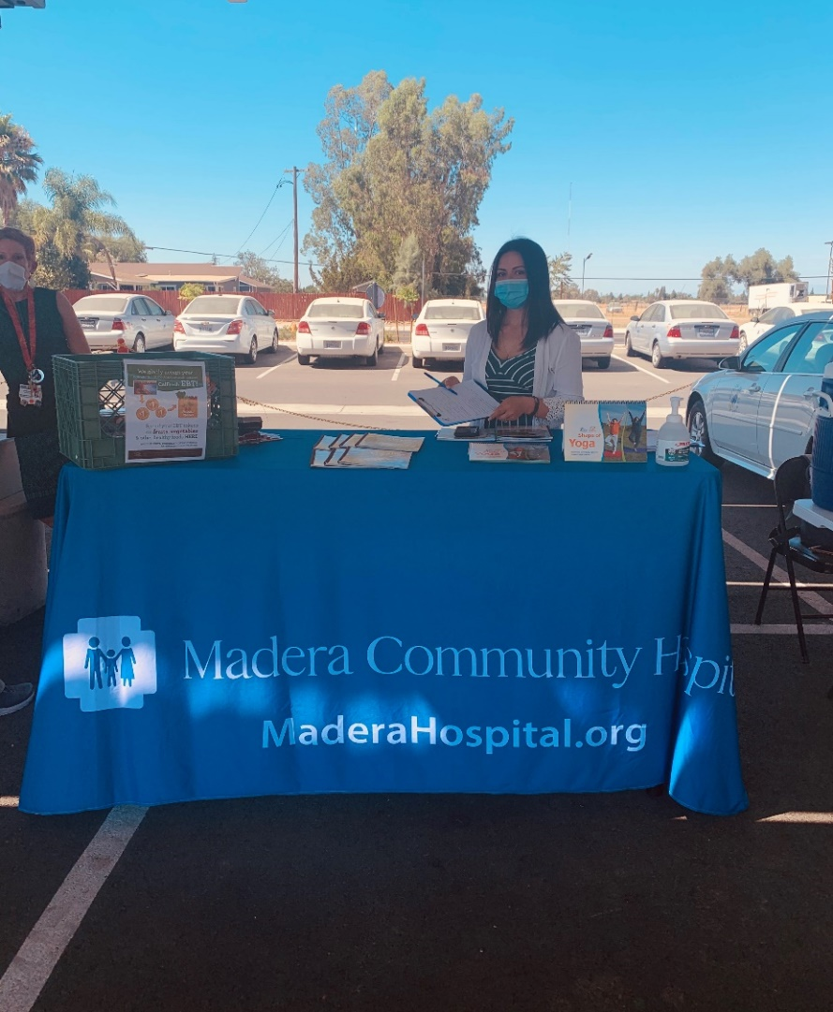
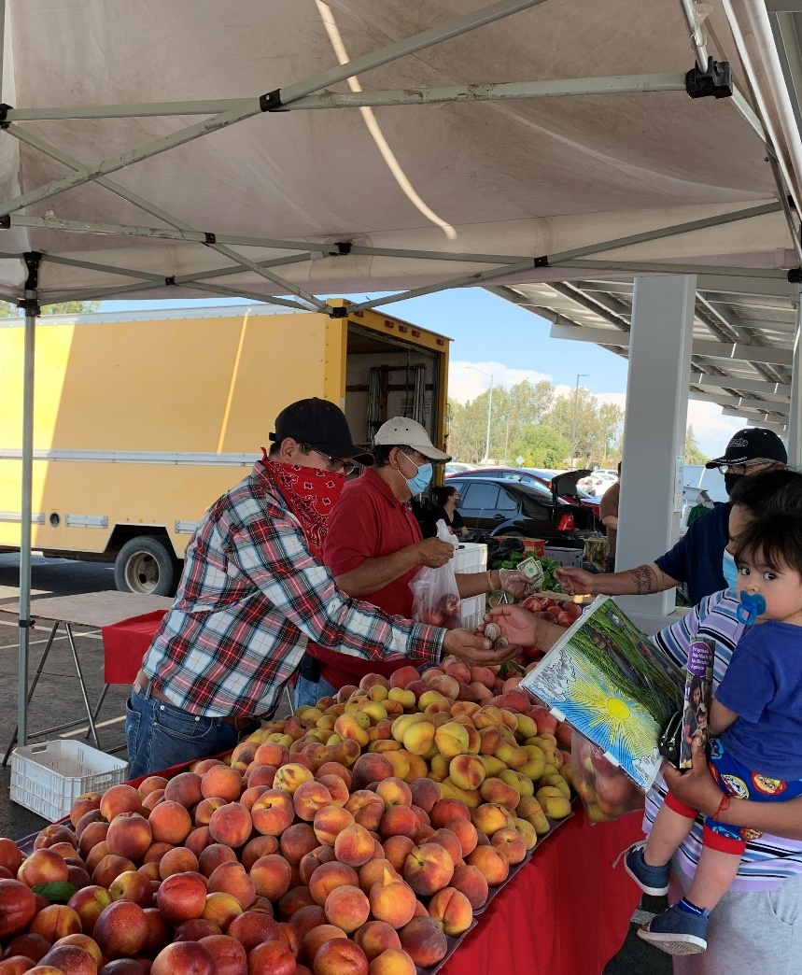
Recipient example - Madera County, CA California Department of Public Health, REACH
Increasing number of markets accepting SNAP, WIC, and SNAP incentives
Engage CHWs for health education and community-clinical linkages
Sites include both farmers markets and flea markets

Slide 24
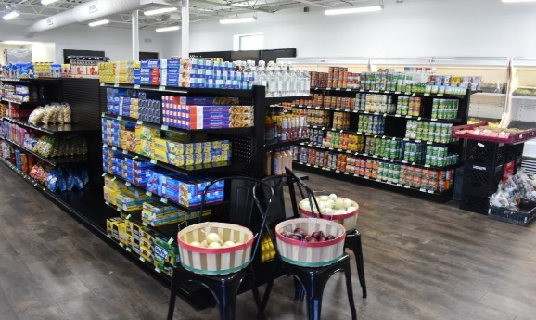
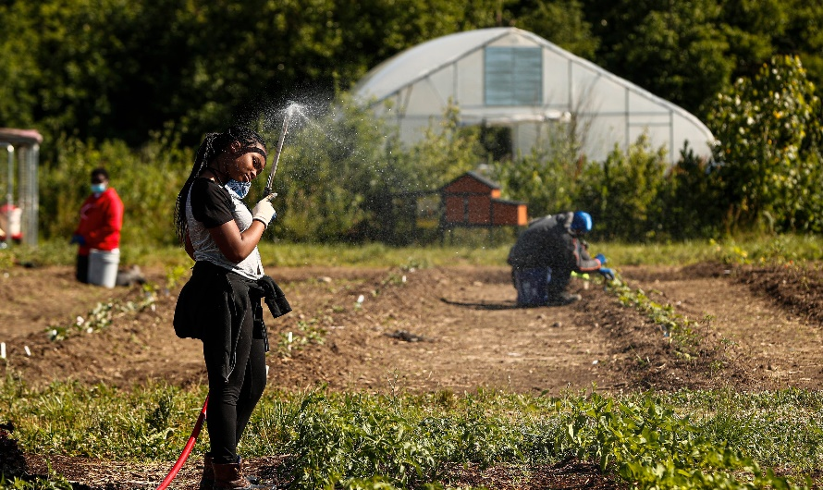
Recipient example - Marion County, IN (Indianapolis) Marion County Public Health Department, REACH
REACH grant is helping to fund their Produce Prescription program, called Produce Rx
BIPOC-owned food businesses are being connected to an affordable supply of local, in season vegetables sourced from urban growers including the Indiana Black Farmers Co-operative through a city-wide project called Seed to Store
Assisting these Seed to Store retail food sites at becoming additional redemption sites for Produce Rx

Slide 25
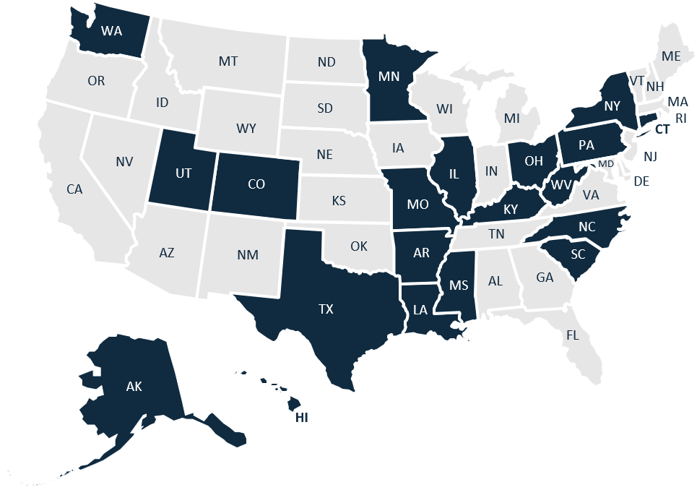
Building Resiliency In Communities (BRIC) Program
BRIC Funded Recipients (Fiscal Year 2020)
New community program responding to COVID-19
Program Focuses:
Food and Nutrition Security
Access to Safe Physical Activity
Social Connectedness
Goal: Help populations experiencing COVID-19 emerge better situated to address obesity and other chronic diseases through improved access to physical activity, social connectedness, and nutrition security
Objectives: Build sustainable programming into existing efforts in up to 20 states for up to 5 communities per state to address COVID-19, focusing on populations at high risk for chronic disease and COVID-19 impact
Recipients: 15 SPAN and 5 DNPAO Ambassador states
To learn more about the BRIC program, please visit:
https://chronicdisease.org/bric/.
Notes:
FY20 Funding: $7M for 15 SPAN and 5 DNPAO Ambassador states. Funding has been extended thru FY21.
Partner: National Association of Chronic Disease Directors (NACDD)
Technical assistance will be augmented by experts in health equity approaches for nutrition security, physical activity and social connectedness in populations experiencing COVID-19
Funding will assist in infrastructure development and project implementation
States will provide at least 25% in grants to support communities’ unique population needs
NACDD works with 15 DNPAO SPAN states and five SPAN Ambassador states to build sustainable programming into existing efforts and address COVID-19 in high risk areas focusing on vulnerable populations (African Americans, Hispanics, Native Americans, young children, aging adults, and people with disabilities. This is achieved by providing technical assistance (TA) to increase food security, access to safe physical activity, and social connectedness.

Slide 26
BRIC food and nutrition security outcomes
Collaborate with food council/coalition/task force on equitable nutrition security for food banks, pantries, and/or feeding sites during COVID-19
Efforts to increase the number of food banks, pantries or feeding sites adopting nutrition standards/guidelines
Efforts to support the increase in the number of people who receive healthier foods distributed by food pantries, food banks, or other feeding sites
Efforts to increase the number of community venues providing increased financial incentives to purchase healthier foods

Slide 27
Summary: DNPAO-FUNDED healthy retail STRATEGIES
Focus on PSE approaches
Moving beyond “corner store makeover” approach
Support small format store food retailers to:
Share lessons learned and best practices, e.g. learning collaboratives
Organize around collective purchasing
Nutrition incentive programs are a strategy to increase purchasing power of consumers to buy fruits and vegetables
Access can also be enhanced by programs to help people get to retail (routes to destinations) and to get food to people (online/delivery)

Slide 28
Thank you
For more information, contact: dmharris@cdc.gov
Help us keep America healthy and strong. See how at: cdc.gov/nccdphp/dnpao
Division of Nutrition, Physical Activity, and Obesity (DNPAO)

Slide 29
NEW FUNDING – Closing the Gap with Social Determinants of Health Accelerator Plans CDC-RFA-DP21-2111 NOFO Closes July 6, 2021
https://www.cdc.gov/nccdphp/dnpao/state-local-programs/sdoh-2111/SDOH-accelerator-planning.html

Slide 30
NOFO OVERVIEW
Purpose: Develop multisector accelerator plans to address the social determinants of health
Funding Mechanism:
Grant
Period of Performance:
12-month pilot
Award Ceiling
$125,000
Anticipated Number of Awards:
20
At least one territory
At least one tribe
No more than 3 state or local applicants per HHS region
Activities Outcomes
1
Convene and coordinate a leadership team consisting of multisectoral partners
Increased collaboration and engagement across multi-sector partners
2
Develop an implementation-ready SDOH Accelerator Plan
Complete implementation-ready SDOH Accelerator Plan, including all required components
Notes:
Applicants - Eligibility is limited to State Governments, County Governments, City ot Township Governments, Special District Governments, Native American tribal governments (Federally recognized), Native American tribal organizations (other than Federally recognized tribal governments), State governments or their bona fide agents (includes the District of Columbia), Local governments or their bona fide agents, Territorial governments or their bona fide agents in the Commonwealth of Puerto Rico, the Virgin Islands, the Commonwealth of the Northern Marianna Islands, American Samoa, Guam, the Federated States of Micronesia, the Republic of the Marshall Islands, and the Republic of Palau, American Indian or Alaska Native tribal governments (federally recognized or state-recognized) and American Indian or Alaska Native tribal governments (federally recognized or state-recognized) as authorized by the Division H-Departments of Labor, Health and Human Services, and Education, and Related Agencies Appropriations Act, 2021, Joint Explanatory Statement, includes funding to establish the social determinants of Health pilot program as directed in House Report 116-450.

Slide 31
sdoH Accelerator Food and nutrition security strategies
Work with community coalitions, food policy councils, and community sites to equitably increase durable access to quality fruits and vegetables (e.g., through retail outlets, farmers markets, food banks, health care systems, traditional foods distribution networks).
Increase acceptance of food assistance and nutrition incentive vouchers in communities that lack equitable access to healthy food.
Implement healthy food service guidelines at institutions such as worksites, early care and education centers, hospitals, and faith-based organizations.
Implement nutrition guidelines and environmental supports for food banks and pantries that account for the cultural preferences of people in the community.
Notes:
5 priority areas – built environment, food and nutrition security, social connectedness, tobacco-free policy, clinical-community linkages
Impact - durable access to and routine consumption of adequate, nutritious food supports overall health, reduces morbidity and mortality associated with chronic disease, and decreases health care utilization.

Slide 32
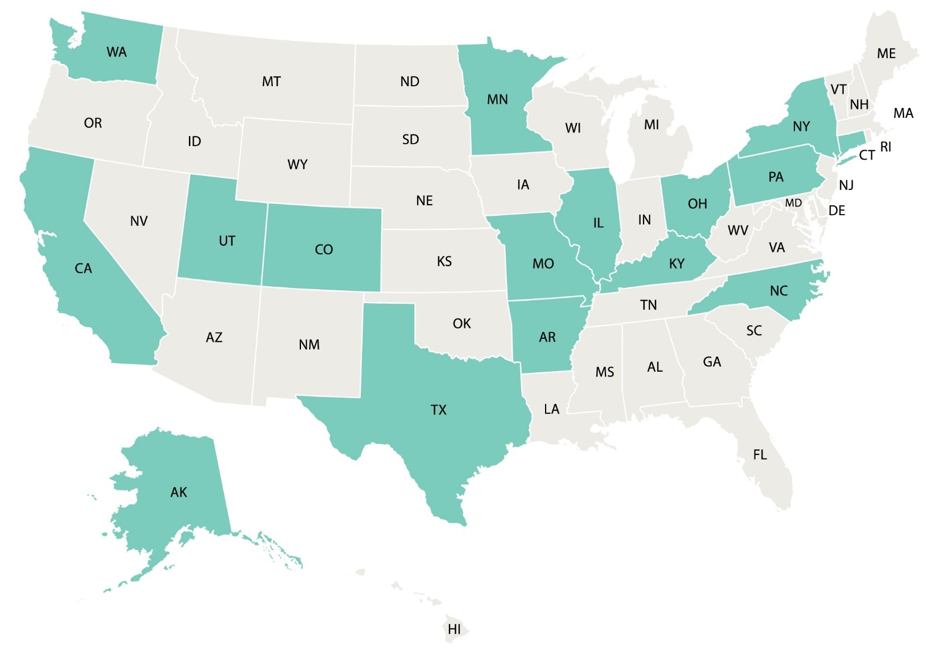
State Physical Activity and Nutrition Program (SPAN)
SPAN Funded Recipients (Fiscal Year 2018)
16 state and local recipients work in 152 communities across the country to strengthen efforts to implement interventions that support healthy nutrition, safe and accessible physical activity, and breastfeeding
This program supports state investments that benefit the whole state and that allow recipients to leverage public health systems at multiple levels, including local government
To learn more about the SPAN program, please visit:
https://www.cdc.gov/nccdphp/dnpao/state-local-programs/span-1807/index.html.
Notes:
The State Physical Activity and Nutrition Program (SPAN) funds 16 state and local recipients across the country to strengthen state and local efforts to implement interventions that support healthy nutrition, safe and accessible physical activity, and breastfeeding.
The program supports state investments that benefit the whole state and that allow recipients to leverage public health systems at multiple levels, including local government.
The average SPAN award is about $880,000. The level of the awards provided will allow each state to implement proven strategies at both the state and local levels, leading to more enhanced efforts to increase breastfeeding rates, access to healthy foods, and access to safe physical activity.
Building on the work of the State Public Health Actions (1305) Program, the SPAN program recipients will work in their states to support healthy eating and active living across the lifespan. Recipients will:
Implement food service guidelines in worksites and community settings to increase the availability of healthy foods.
Collaborate with partners to connect sidewalks, paths, bicycle routes, and public transit with homes, early care and education settings, schools, worksites, parks, or recreation centers by implementing master plans and land use interventions to increase physical activity.
Increase the number of early care and education settings that implement nutrition and physical activity standards.
Promote breastfeeding through supportive maternity care practices, workplace lactation accommodations, or community-wide lactation support services.
CDC is excited about the opportunity to support strategies for chronic disease prevention in states and communities across the country.
To learn more about the SPAN program, please visit: https://www.cdc.gov/nccdphp/dnpao/state-local-programs/span-1807/index.html. To learn more about previous work in chronic disease prevention through the State Public Health Actions program, please visit: https://www.cdc.gov/nccdphp/dnpao/state-local-programs/span-1807/past-program.html

Slide 33
SPAN Food service guidelines strategies
Implement food service guidelines (FSGs) in worksites (e.g., hospitals, universities/colleges, private workplaces, and state, local and tribal government facilities) and in community settings (e.g., parks, stadiums, buildings/areas where community organizations meet) in multiple venues (e.g., cafeterias cafes, grills, snack bars, concession stands and vending machines) to increase the availability of healthy foods.
https://www.cdc.gov/nutrition/healthy-food-environments/food-serv-guide.html

Slide 34
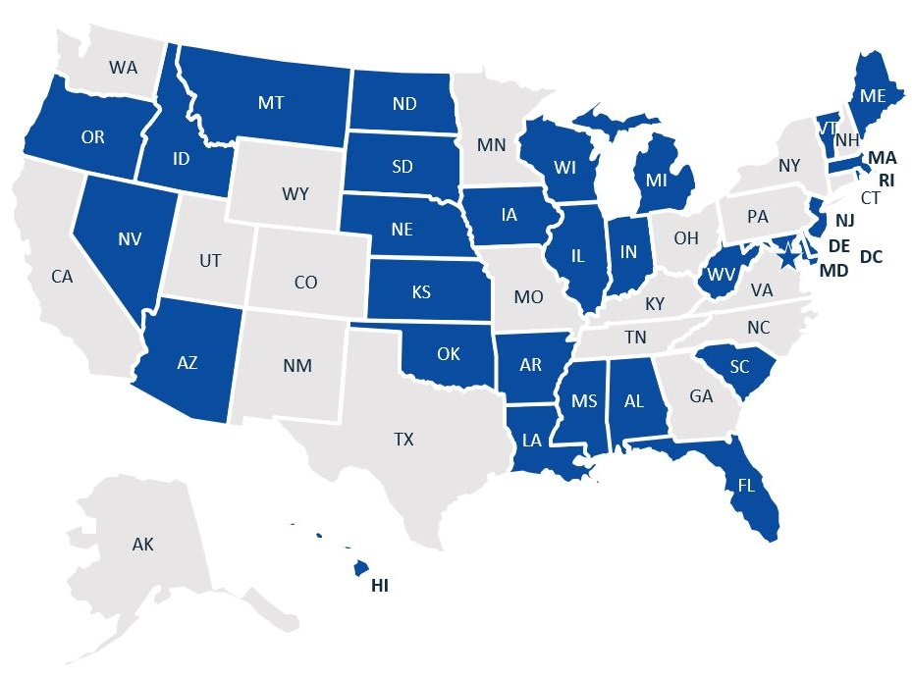
DNPAO Ambassador Program
DNPAO Ambassador States (2021)
Ensure appropriate DNPAO resources are available and accessible to Ambassadors (National Training meeting, webinars, networking calls)
Effectively coordinate with Ambassador program partners (NACDD and ASPHN) so that Ambassadors have expanded opportunities for supporting their nutrition, physical activity, and obesity work
31 states are actively participating
Notes:
Before we dive into the specifics of DNPAO’s funded programs, I want to mention our Ambassador Program:
DNPAO highly values its relationship with all states and wants to maintain strong connections with these states in order to address the public health crisis of obesity.
CDC developed the DNPAO Ambassador Program for the 31 states that are not current recipients of the SPAN cooperative agreement.
DNPAO is partnering with the National Association of Chronic Disease Directors (NACDD) and the Association of State Public Health Nutritionists (ASPHN) to provide ambassador states with technical assistance and support to maintain and advance states capacity to address obesity, poor nutrition and physical inactivity.
Working together, DNPAO, NACDD, and ASPHN have offered the 31 participating DNPAO Ambassadors
timely additional resources and professional development opportunities such as technical support through access to DNPAO project officer points of contact and DNPAO subject matter experts in physical activity, nutrition and state policy
peer-to-peer support through a SPAN-specific community of practice cohort
participation in DNPAO’s National Training meeting, webinars, networking calls, and NACDD and ASPHN engagement meetings with partners.
Ambassadors have remarked how the DNPAO Ambassador Program is providing important additional opportunities to meet their state’s needs to address this critical public health crisis.

Slide 35
Developing a National Research Agenda to Support Healthy Food Retail
Megan Lott, MPH, RD
June 23, 2021
Notes:
Introduce self/background
The retail environment is an important driver of dietary choices.
Consumers acquire more food from supermarkets and other grocery retailers than any other outlet (e.g., restaurants, schools)
Food and beverage manufacturers pay retailers billions of dollars each year to market their products in stores, including through prominent placement, pricing, and other aggressive promotion strategies.
Yet, there is very little to no regulation of these efforts/practices.

Slide 36
Objective
Develop national research agenda to identify policies and corporate practices that effectively promote healthy purchases and decrease unhealthy purchases
Notes:
In 2010, the Robert Wood Johnson Foundation (RWJF) and The Food Trust hosted the first convening of key stakeholders – including public health leaders, researchers, food retailers, manufacturers, and marketers – to discuss the role that supermarkets play in providing access to healthy food, and strategies they could use to promote healthy eating and discourage unhealthy options.
In 2015, HER and NOPREN created our current Healthy Food Retail Working Group to bring researchers working on identifying retail strategies that promote health together. This group continues to be an important mechanism for inter-disciplinary collaboration and the identification of healthy food retail research needs.
With increased recognition of healthy retail as a strategy to improve health and reduce disparities in diet-related chronic disease, there has been considerable investment in research in the field.
IN 2019, CSPI, Food Trust, and HER came together with the goal of better understanding current food retail practices and consumer behaviors and to identify potential retail strategies to support healthy eating, while reflecting advancements in research and changes in the food retail landscape.
While the convening was held prior to widespread awareness of the COVID-19 pandemic in the U.S., these research priorities are especially timely as a growing number of American families face food challenges as a result of the pandemic.
Special attention was also given to addressing racial and income disparities in diet quality and related diseases in the development of the research agenda. Research in these domains can guide changes to policy and corporate practice that improve the retail environment and promote health equity. This is the first national research agenda focused on healthy food retail.

Slide 37
Multi-Step Process
Advisory committee input solicited
Step 1. Convened scientific advisory committee
Step 2. Commissioned literature reviews
Step 3. In-person convening
Step 4. Thematic analysis of notes and refined research questions
Step 5. Follow-up survey
Notes:
The research agenda was developed using a structured, mixed-methods approach that included the following steps: (1) convening of a scientific advisory committee; (2) five commissioned literature reviews and one original research project; (3) in-person convening of expert stakeholders in January 2020; (4) thematic analysis of convening notes and research questions raised at the meeting; (5) follow-up survey of convening participants; and (6) refinement of the research agenda, including input from the scientific advisory committee. This iterative process builds on similar methods used by others to develop research agendas.
Commissioned Research:

Slide 38
Steps 1 & 2
1. Convening a scientific advisory committee
8 Researchers representing psychology, nutrition, health behavior, anthropology, public policy
Provided input on lit review topics, convening, follow-up survey, and final report
2. Commissioned Literature Reviews
Retail Environment and Practices
Consumer shopping patterns
Effectiveness of retail interventions
Notes:
The collaborative agenda setting process, which included perspective from experts in public health research, advocacy, food retail, and marketing, aimed to build consensus around key research gaps. The scientific advisory committee was selected based on published work in the field, leadership in related working groups and professional organizations (e.g., the HERNOPREN HFR Working Group), and history of work with RWJF/HER’s priority populations (see definition in call out box). Eight researchers from government and academia representing a variety of substantive areas related to psychology, nutrition, health behavior, anthropology, and public policy were included. Advisory committee members provided input on literature review topics and the convening structure, agenda, and guest list; played an active role in note-taking and guiding small group discussions at the convening; and provided critical feedback on the follow-up survey and final research agenda.
Five systematic reviews and one original analysis were commissioned for the in-person meeting, with the aim of providing an overview of the existing literature on key topics, guiding discussion at the convening, and informing research question generation. Commissioned papers were organized into three themes: (1) retail environment and practices, which included reviews on (a) the influence of food and beverage companies on food retail and (b) current practices in the stocking and marketing of sugar-sweetened beverages; (2) consumer shopping patterns, which included a literature review and original analysis of food purchasing trends by race/ethnicity, socioeconomic status, and geographic location (urban v. rural); and (3) effectiveness of retail interventions, which included two literature reviews on (a) governmental policies to improve healthy food access in supermarkets (e.g., sugary drink taxes, revisions to the USDA Special Supplemental Nutrition Program for Women, Infants and Children (WIC) food package) and (b) in-store interventions aimed at promoting healthy food and beverage purchases.
Findings from these commissioned research projects, which were completed by experts in the field, as well as an article that provides greater detail on the agenda-setting methods and survey results are published in the “Retail Strategies to Support Healthy Eating” special issue of the International Journal of Environmental Research and Public Health.

Slide 39
Steps 3 & 4
3. In Person Convening
Washington DC
January 29, 2020
This Photo by Unknown Author is licensed under CC BY
4. Analysis of Research Questions:
37 Research Questions
Organized into 10 Domains
Notes:
Forty-six expert stakeholders representing a wide range of academia, government, advocacy groups, and food and retail industry were convened for a full-day meeting in Washington, D.C. on January 29, 2020. The meeting aimed to: (1) summarize the effectiveness of government policies, corporate practices, and in-store pilots for promoting healthy food purchases and reducing unhealthy food purchases; (2) identify gaps in the healthy retail literature and generate questions for future research, with an intentional focus on reducing health disparities and improving equity; (3) highlight best practices for partnering with retailers and food manufacturers on healthy retail research; (4) facilitate relationships between retailers and researchers to implement and evaluate interventions; and (5) identify existing datasets, ongoing work, and new opportunities for retail-research partnerships.
The in-person meeting included brief presentations from academic researchers on preliminary findings from commissioned research and from industry partners about best practices for retailer researcher collaboration, facilitated group discussions, and guided research question generation. Notes and research questions from the in-person meeting were thematically analyzed and grouped by three authors collaboratively. Research questions were grouped into ten key themes and were refined by removing questions that were duplicates, overly vague or specific, and outside the scope of the research agenda.

Slide 40
Step 5. Follow Up Survey
Key Survey Domains
Feasibility: Likelihood that research can be conducted successfully and produce valid and reliable results?
Importance: Can research inform policy, programs, or retailer practice, given the state of the current evidence?
Equity: How impactful might research be in ensuring all people have a fair and just opportunity to be as healthy as possible
Notes:
A follow-up survey was sent to convening participants (26 respondents, 57% response rate) asking them to rank each question on a scale from 1 (lowest) to 5 (highest) in terms of feasibility, equity, and importance (see definitions in call-out box).
Survey respondents were also asked to identify gaps in the list of research questions and data sources identified at the meeting, which informed a new area of inquiry related to food retail changes due to the COVID-19 pandemic. Crosscutting research approaches emerging from the meeting were summarized and grouped into (a) partnerships; (b) data sources; and (c) study designs and settings.

Slide 41
Understanding the Current Food Retail Environment and Consumer Behavior
Retail Food Marketing Environment
Consumer Shopping Behavior
Impact of Retailer Marketing Strategies
Targeted Food Marketing
Role of Emerging Retail Formats in Healthy Food Access
Notes:
Ten key issue areas emerged as priorities for future research. Five of these issue areas focus on understanding the current food retail environment and consumer behavior:
1. Understanding and describing the retail food marketing environment
2. Understanding consumer shopping behavior
3. Impact of retail marketing strategies
4. Understanding targeted food marketing
5. Role of emerging retail formats in supporting healthy food access

Slide 42
Implementation and Effectiveness of Interventions and Policies
Support Healthy and Reduce Unhealthy Purchases
Leveraging SNAP to Support Healthy Eating
Limiting Unhealthy Food Establishments
Addressing Social Determinants of Health
Assessing Differential Impacts
Notes:
And five focus on assessing implementation and effectiveness of interventions and policies to attain healthier retail environments:
6. Supporting healthy purchases and reducing unhealthy purchases
7. Leveraging SNAP to support healthy eating
8. Limiting unhealthy food establishments
9. Addressing social determinants of health
10. Assessing differential impacts

Slide 43
Top 5 Questions by Composite Score
Note: Composite score calculated based on feasibility, health equity, importance. Importance ratings not displayed due to low variation among the top five questions.

Slide 44
Cross-Cutting Considerations
Research Partnerships
Build relationships with retailers and manufacturers
Collaborate with non-traditional partners
Data Sources
Increase access to federal data sources
Make data affordable and accessible through programs like RWJF’s Health Data for Action
Study Design and Setting
Study nontraditional retailers (e.g., dollar stores)
Use diverse study designs (e.g., pilots, longitudinal)
Promote innovative data collection (e.g., journalism)
Notes:
Three cross-cutting considerations emerged for future research: potential research partnerships, data sources, and possible study designs and settings.

Slide 45
Implications for Policy and Practice
Agenda can guide:
Researchers
Retailers
Funders
Advocacy Organizations
Notes:
public health and industry experts must work together to counter growing food insecurity and disparities by developing retail strategies and best practices that build a more equitable and healthful food system.

Slide 46
Related Publications
Notes:
IJERPH Special Issue and HER Issue Brief: Understanding the Value of Academic Research Partnerships with Food Retailers

Slide 47
Acknowledgments
This project was supported by:
Healthy Eating Research (a national program of the Robert Wood Johnson Foundation)
Johns Hopkins University Center for a Livable Future
Institute for Health and Social Policy, Johns Hopkins Bloomberg School of Public Health,
Bloomberg American Health Initiative, Johns Hopkins Bloomberg School of Public Health
Center for Science in the Public Interest
Organization and scientific input provided by:
Attendees of the January 2020 Healthy Retail Research Convening
Scientific Advisory Committee (Joel Gittelsohn, Karen Glanz, Lisa Harnack, Allison Karpyn, Anne Palmer, Kate Reddy, Christina Roberto, Shannon Zenk)
Expert reviewers (Betsy Anderson Steeves, Sheila Fleischhacker, Lucia Leone)
Staff of Healthy Eating Research, The Food Trust, Center for Science in the Public Interest

Slide 48
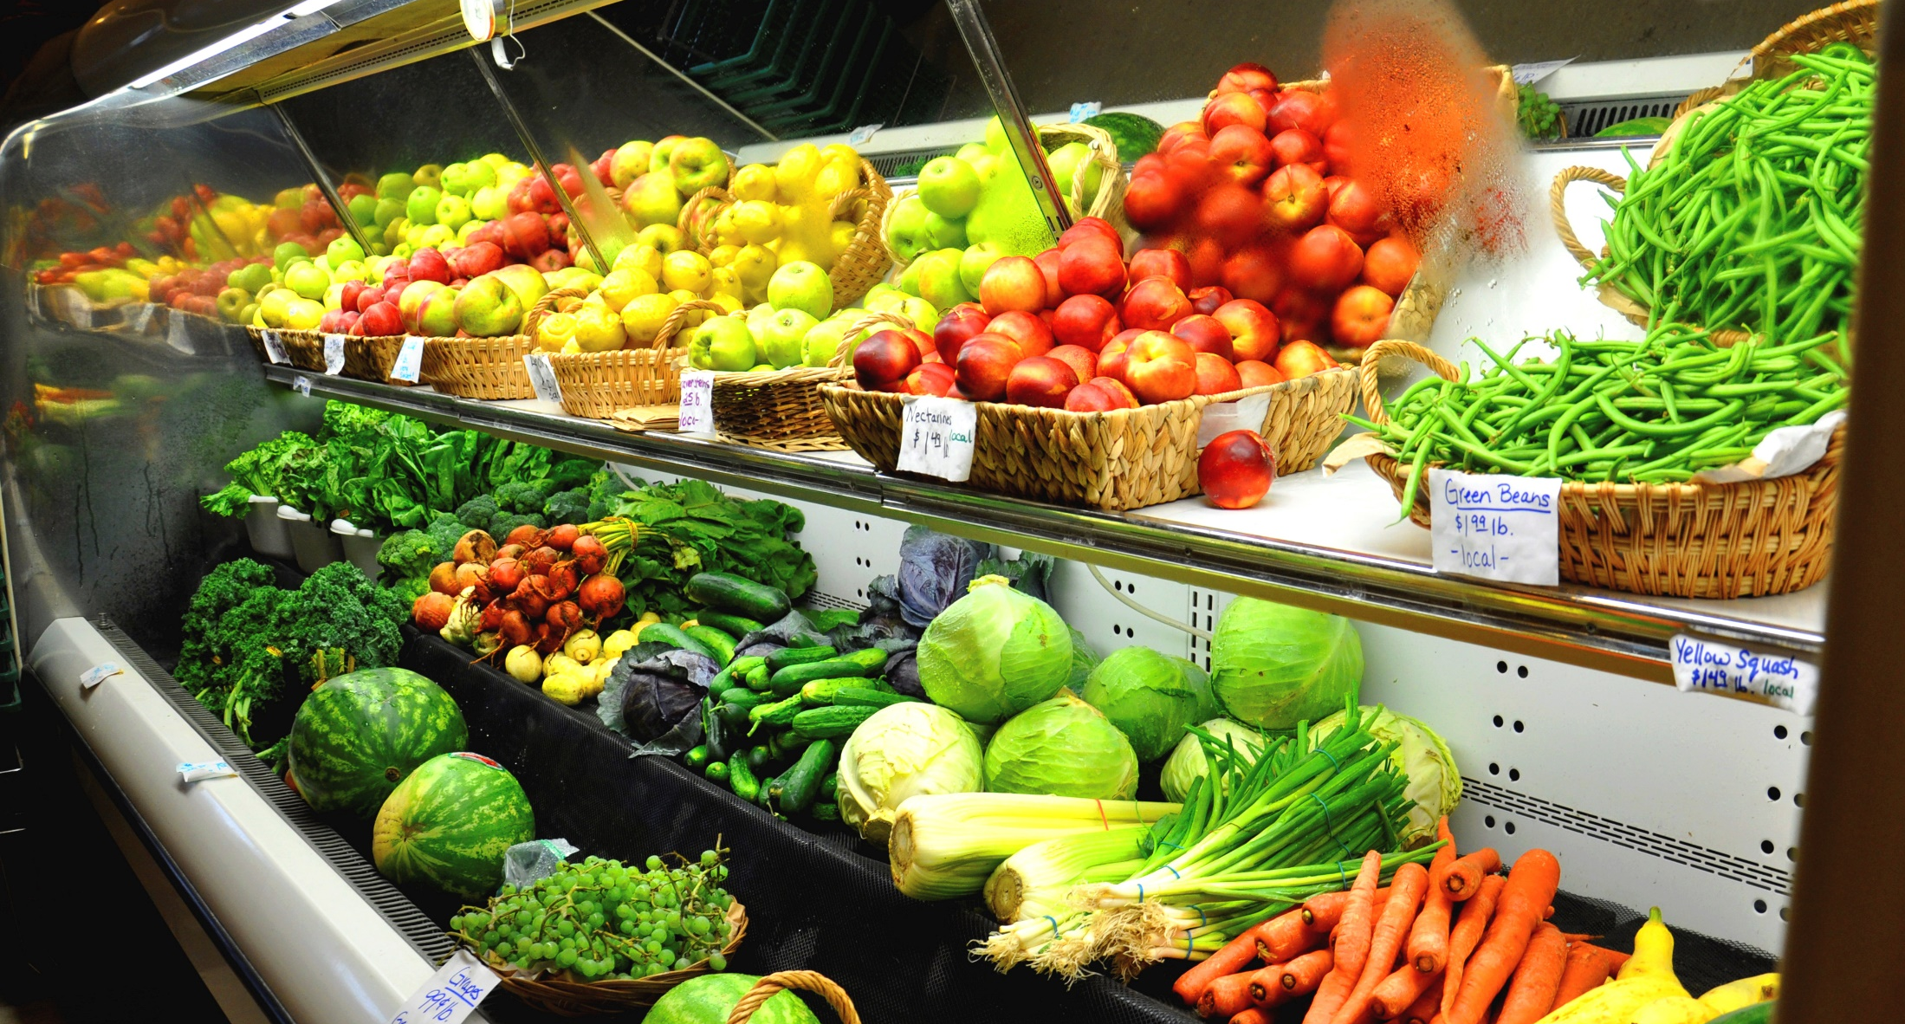
Megan.Lott@duke.edu healthyeatingresearch.org

Slide 49
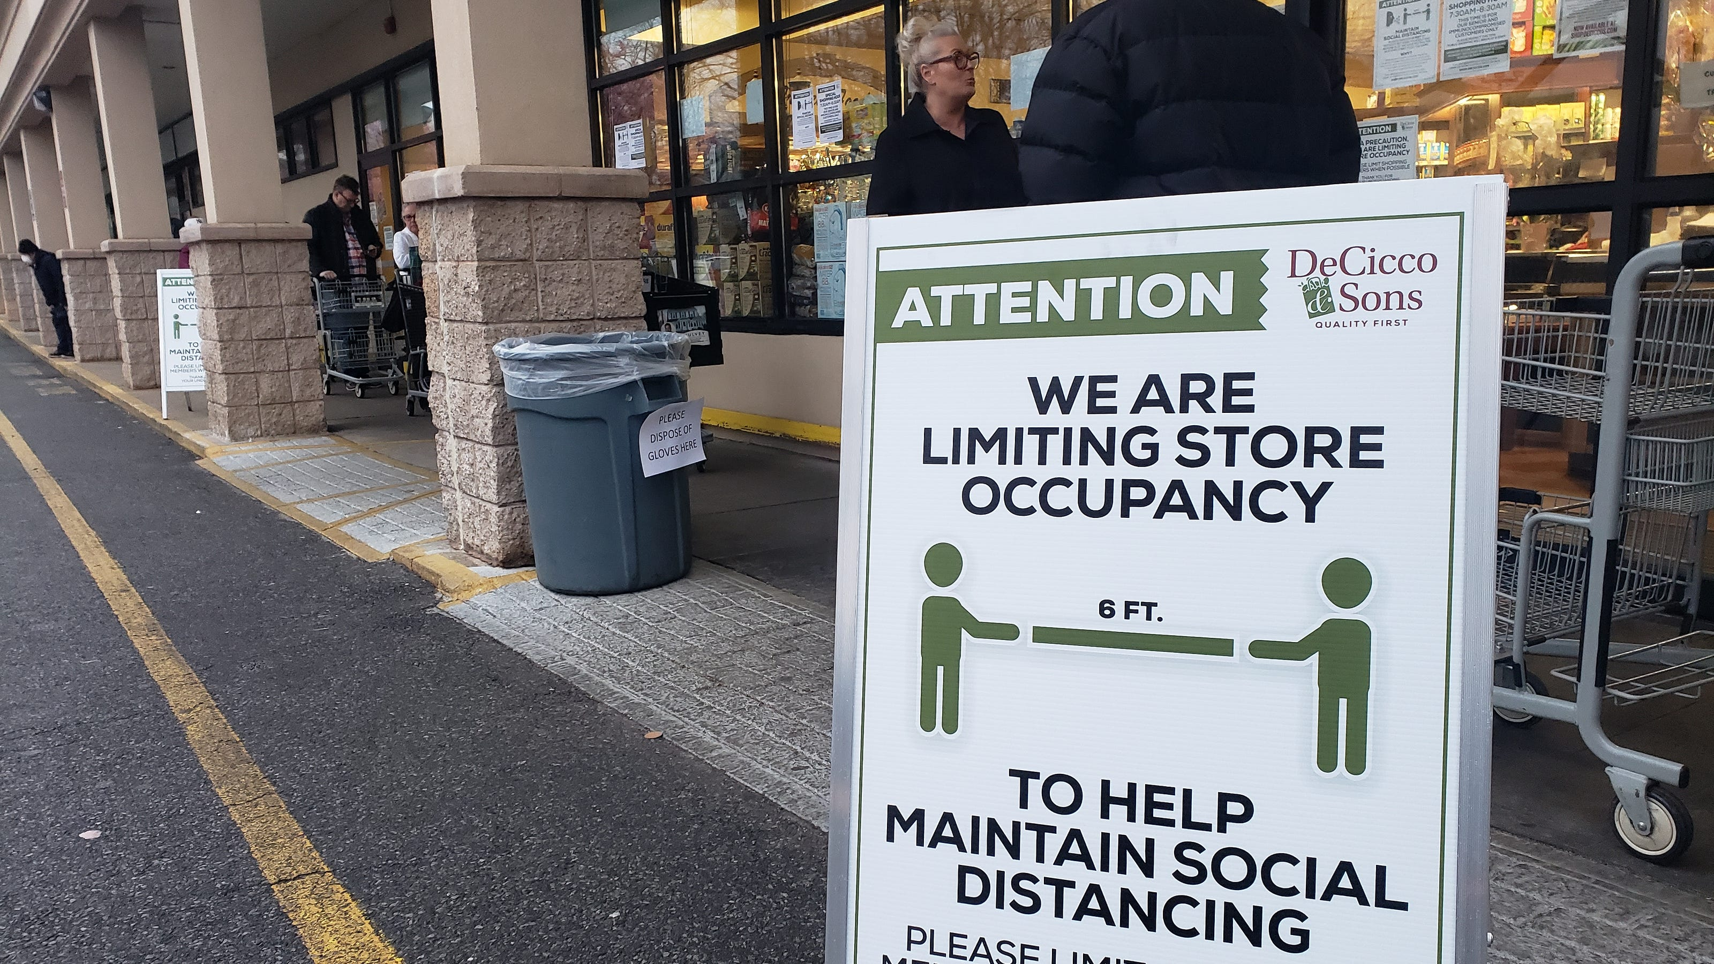
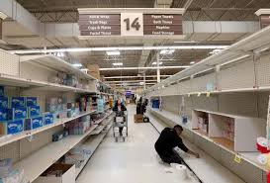
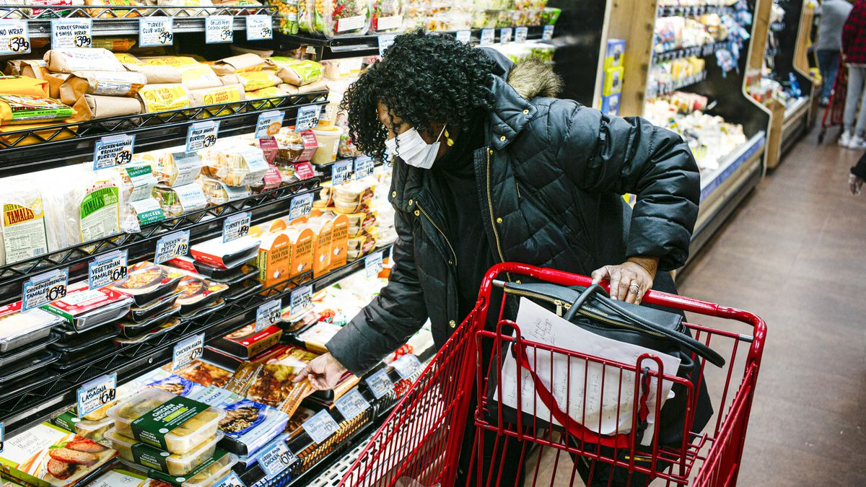
Healthy Food Retail during the COVID-19 Pandemic: Challenges & Future Directions
Lucia A. Leone, Sheila Fleischhacker, Betsy Anderson-Steeves, Kaitlyn Harper, Megan Winkler, Elizabeth Racine, Barbara Baquero, Joel Gittelsohn
The 2020 HER NOPREN Healthy Food Retail Leadership Team
Int J Environ Res Public Health. 2020;17(20):7397

Slide 50
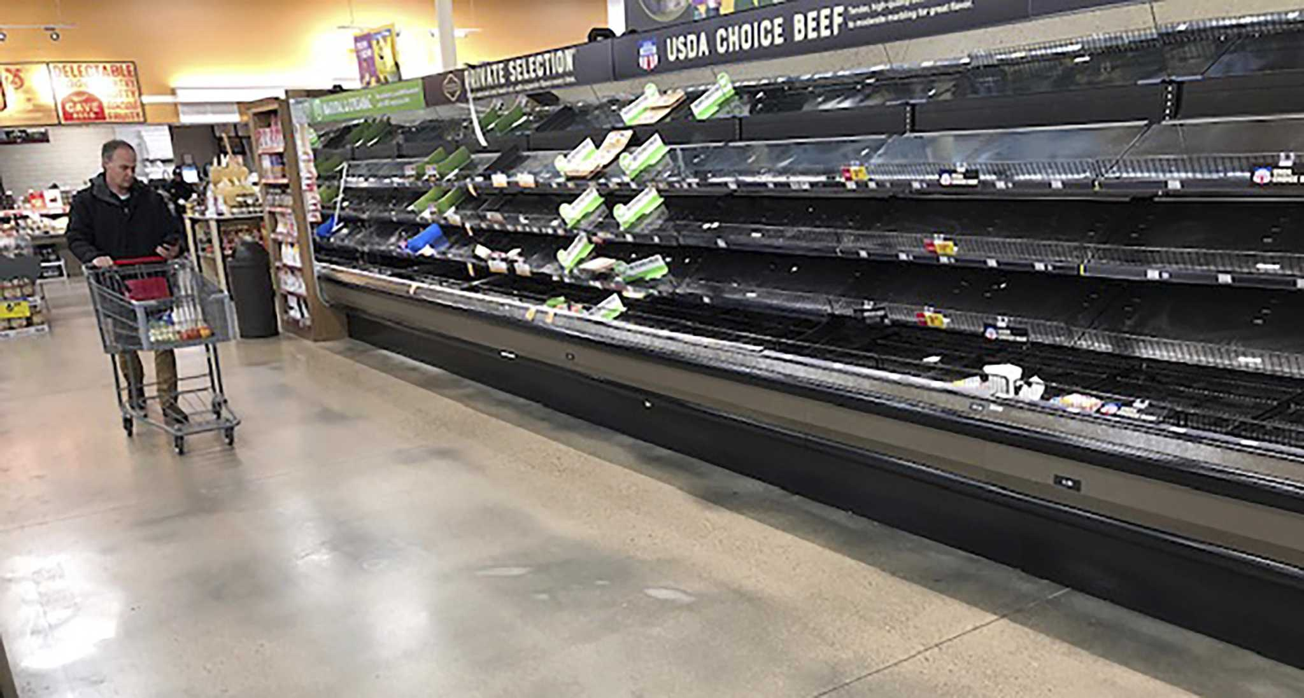
The Coronavirus Disease of 2019 (COVID-19) pandemic has led to major changes in the distribution, sale, purchase, preparation, and consumption of food in the United States (US)
Notes:
This paper reflects on those changes and provides recommendations for research to understand the impact of the pandemic on the retail food environment (RFE) and consumer behavior.

Slide 51
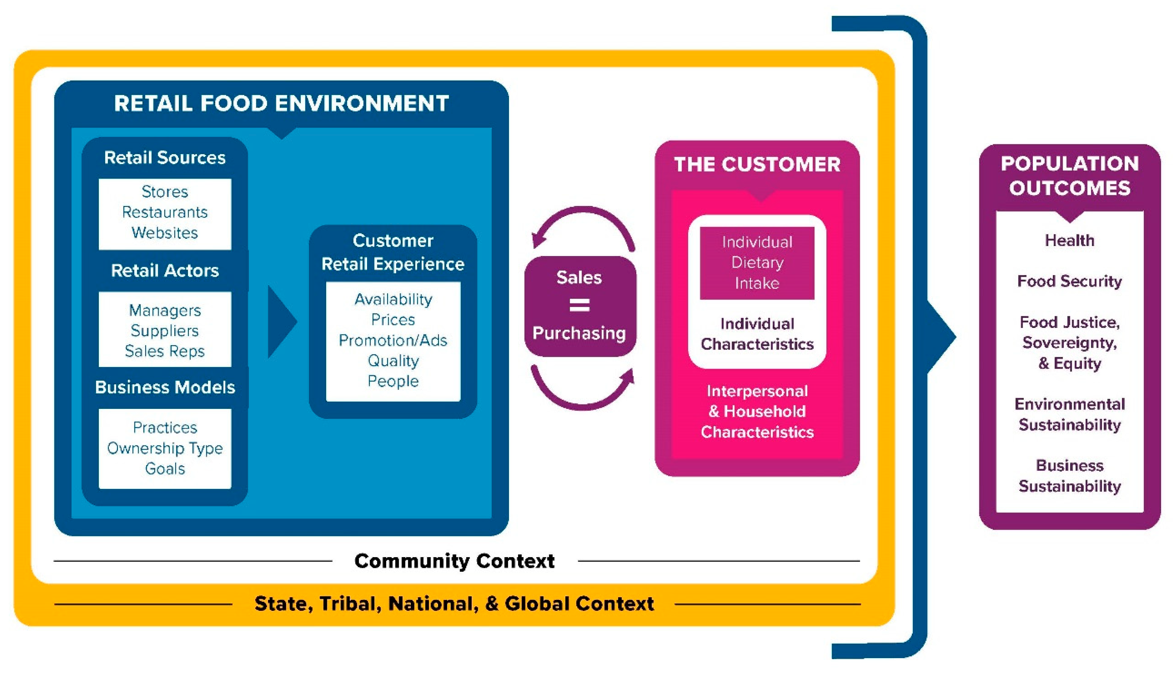
Commentary’s Aim
Using the Retail Food Environment and Customer Interaction Model, we describe the impact of COVID-19 in four key areas:
community, state, tribal, and federal policy;
retail actors, business models, and sources;
customer experiences; and
dietary intake
Winkler MR, Zenk SN, Baquero B, Steeves EA, Fleischhacker SE, Gittelshon J, Leone LA & Racine EF. Int J Environ Res Public Health. 2020;17(20):7591
Notes:
We discuss how previously existing vulnerabilities and inequalities based on race, ethnicity, class, and geographic location were worsened by the pandemic. We recommend approaches for building a more just and equitable RFE, including understanding the impacts of changing shopping behaviors and adaptations to federal nutrition assistance as well as how small food business can be made more sustainable. By better understanding the RFE adaptations that have characterized the COVID-19 pandemic, we hope to gain greater insight into how our food system can become more resilient in the future.

Slide 52
Table 2: Selected US federal government COVID-19 initiatives targeting the retail food environment & customers
Food Distribution & Donations
Retail Food Establishments
Charitable Food Network
Home Delivery
Export Services
State, Tribal & Local Governments
Household Food Handling & Eating Out
Federal Nutrition Assistance – Local Access & Purchasing
Federal Nutrition Education & Promotion

Slide 53
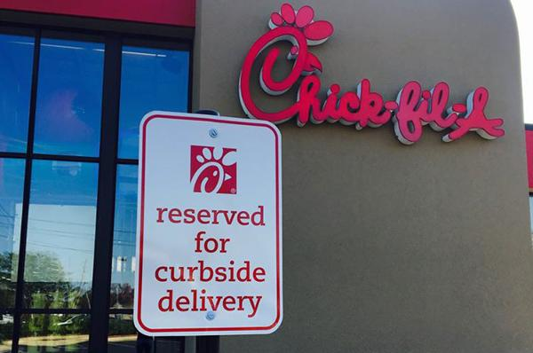
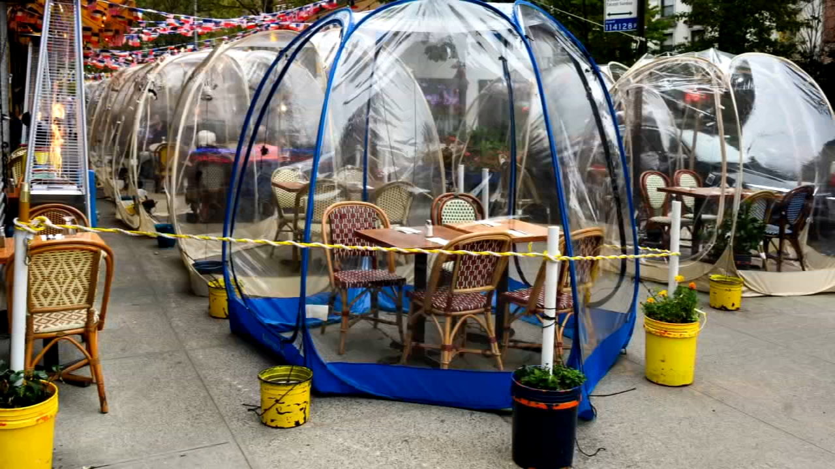
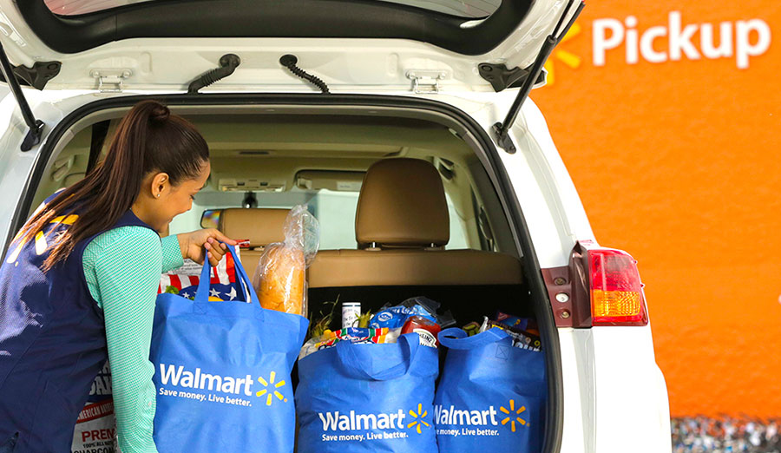
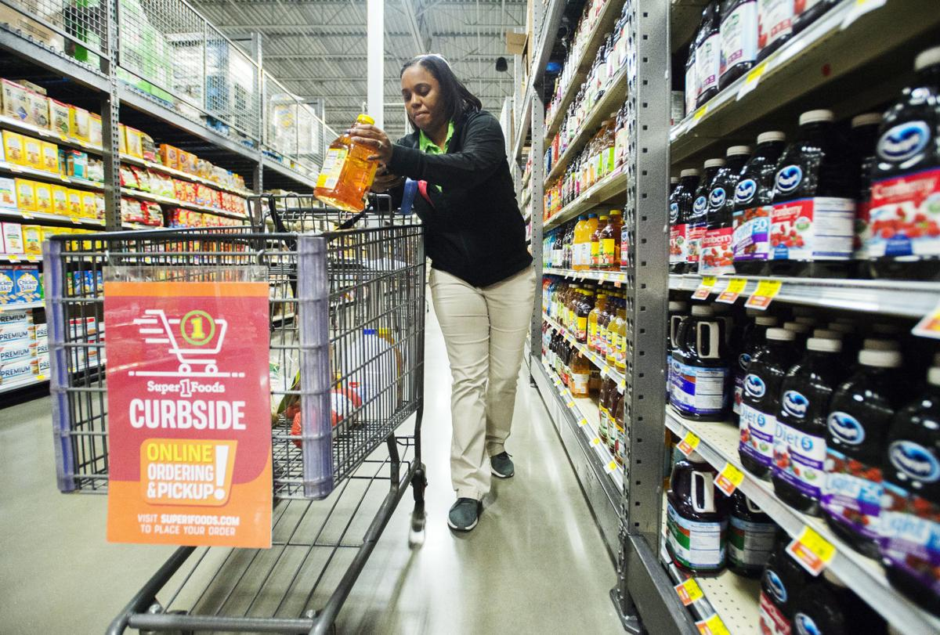

Slide 54
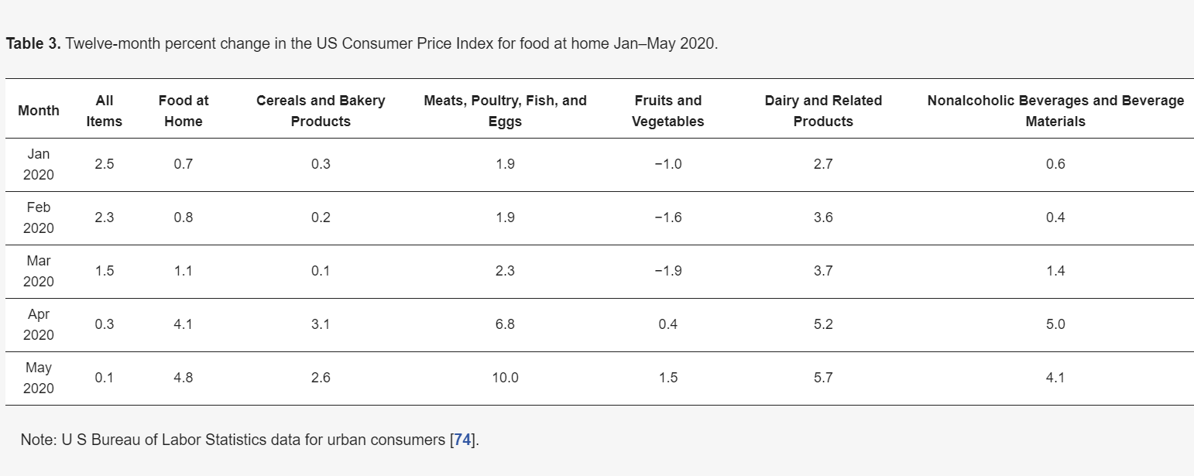

Slide 55
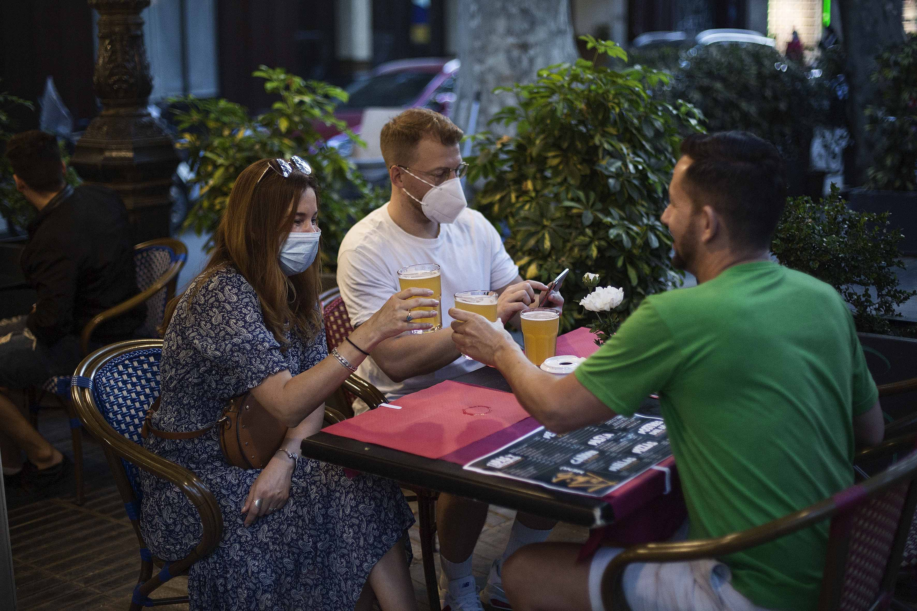
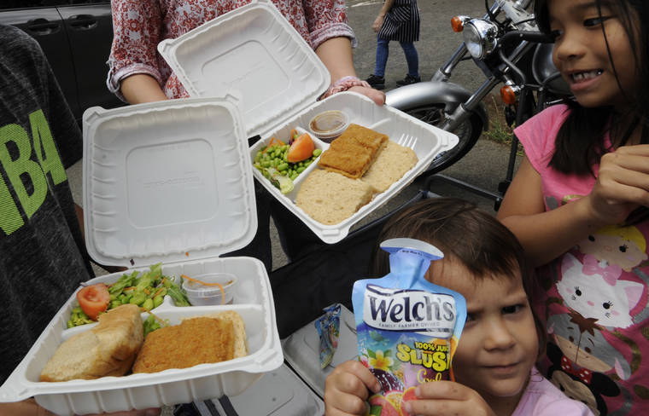

Slide 56
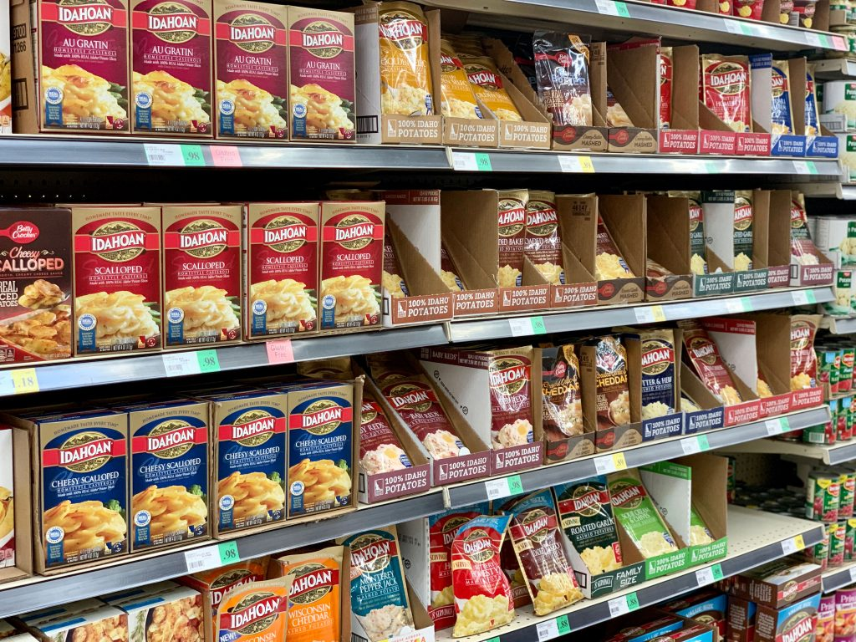
Future Directions
Study the direct impact of changes to the RFE during the pandemic, but also look at the implications for building more resilient food systems following the pandemic
Fewer shopping trips due to pandemic exposure concerns may have led to less purchasing of fresh foods, such as fruits and vegetables

Slide 57
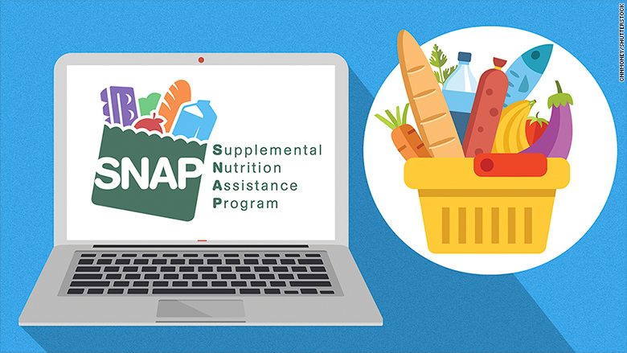
Future Directions
Research on online food purchasing behaviors is still nascent
Urgent need to better understand who is buying online and from what types of sellers (i.e., retailers, manufactures)
Need to better understand the role of marketing and other behavioral economic factors, especially given the reports of increased surveillance and marketing of unhealthy foods to SNAP participants shopping online

Slide 58
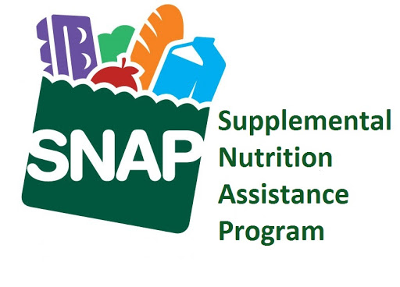
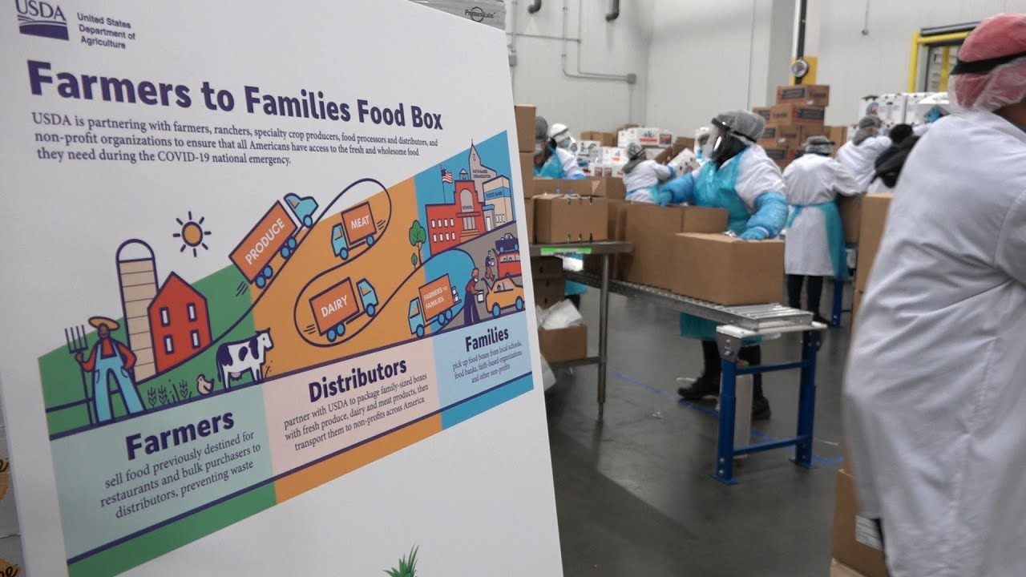
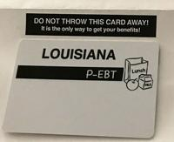
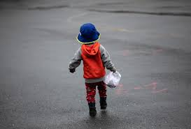
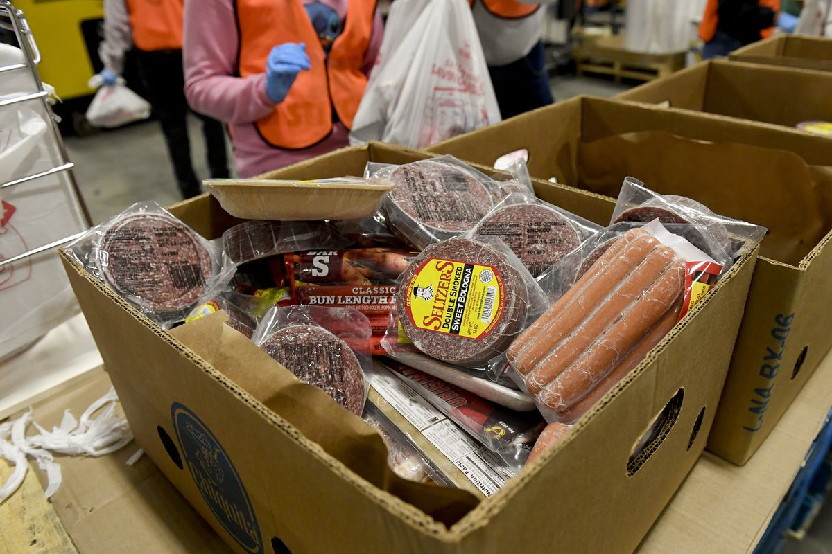
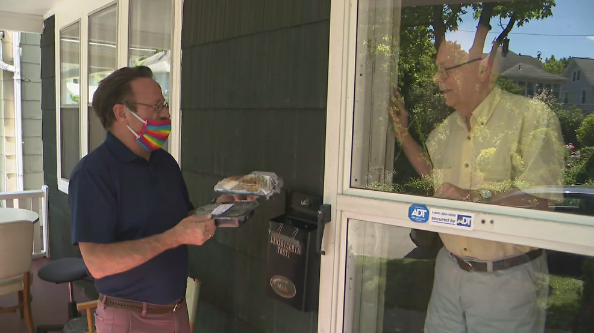
Notes:
At the federal level, we need to advance our understanding of the impacts on families and retailers, among others, of the quick and large-scale expansion of federal nutrition assistance.
We also need to understand the impact of the USDA Farmers to Families Food Box program on both food security and the broader RFE. It is still unclear how this large influx of free food affected small retailers and distributors in lower-income communities.

Slide 59
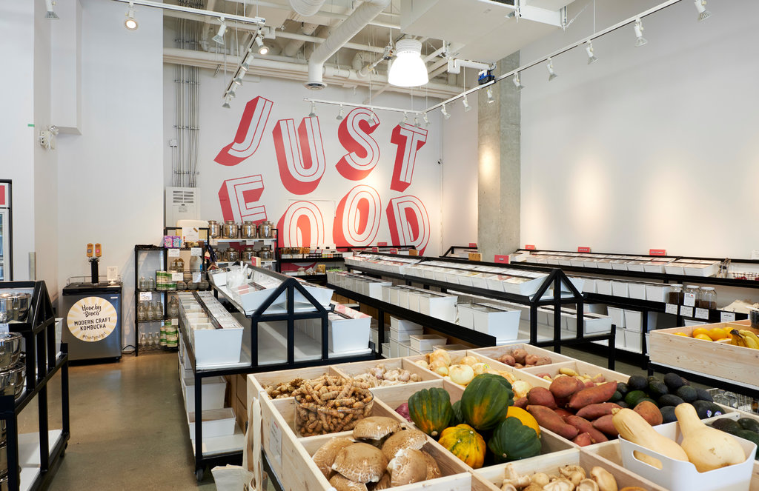
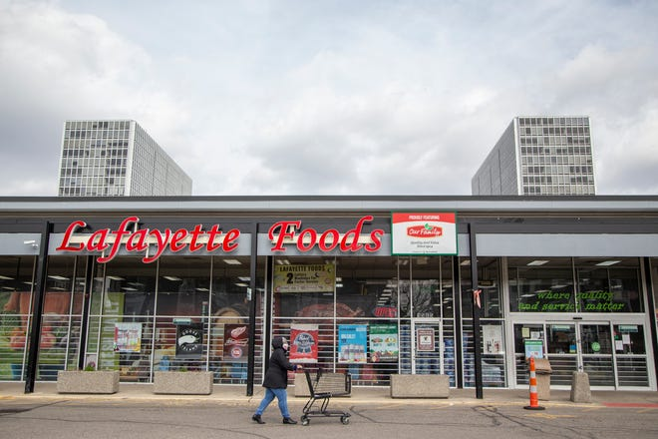
Future Directions
The movement of food retail towards alternative (and in some instances, more community-minded) models combined with the closure of many restaurants underscores a need for research looking at business sustainability, especially in lower-income and minority communities
In thinking about how we can build resilience in our food system and be better prepared for future crises, one possible food system adaptation may be referred to as “smaller is better.”

Slide 60
Healthy Food Retail during the COVID-19 Pandemic: Challenges & Future Directions
Lucia A. Leone, Sheila Fleischhacker, Betsy Anderson-Steeves, Kaitlyn Harper, Megan Winkler, Elizabeth Racine, Barbara Baquero, Joel Gittelsohn
The 2020 HER NOPREN Healthy Food Retail Leadership Team
Int J Environ Res Public Health. 2020;17(20):7397
lucialeo@buffalo.edu

Slide 61
Q&A

