Slide 1


Summer Student Series
2021

Slide 2
Housekeeping
Type your name and institution into the chat box!
Remember to keep yourself on mute.
Type your questions into the chat box.

Slide 3
Announcements
Please join us for the Virtual Student Presentation and Poster Session on August 11th
Students will briefly present on a project they worked on over the summer related to public health nutrition. We will also be hosting a series of posters on the NOPREN website that feature student research and projects.
More details to come!

Slide 4
Session 7: Food & Nutrition Security

Slide 5
Today’s Presenters
Moderator: Hilary Seligman, UCSF and NOPREN
Presenters:
Kathryn Law, USDA
Amy Yaroch, Gretchen Swanson Center for Nutrition and GusNIP Incentive Program Training, Technical Assistance, Evaluation, and Information Center
Colby Duren, Intertribal Agriculture Council
Nathalie Celestin, CDC

Slide 6
NOPREN Food Security Work Group
The mission of the Work Group is to build a network of researchers and leaders from academia, non-profit organizations, government, and other funding agencies to increase the amount and quality of research and evaluation in the area of nutrition and obesity prevention in the hunger safety net setting, and to support and facilitate the development and implementation of evidence-informed policies and practices.
Meets the 4th Monday of every other month from 12-1pm EST
Next meeting: September 27th @ 12pm EST
Topic: P-EBT (Lina Walkinshaw)
To join, email: Kaitlyn Harper Kaitlyn Harper (kharpe14@jhu.edu)

Slide 7

Supplemental Nutrition Assistance Program (SNAP) Overview
Kathryn Law
USDA Food and Nutrition Service
HER NOPREN Summer Speaker Series for Students

Slide 8
What is SNAP?
First line of defense against hunger for low-income people – $56 billion in benefits in FY 2019
Mandatory entitlement– available to nearly anyone with little income and few resources
Participating households receive monthly benefit allotments on EBT cards to be used at authorized retailers nationwide
Monthly benefit level depends on household size and income level
Benefits 100% Federally funded but program operated by each State

Slide 9
Who is eligible for SNAP?
Households must have a gross income below 130% of poverty and a net income (after various deductions) below 100% of poverty
Many States have a resource limit as well
Must be U.S. citizen or legal immigrant with 5 year residency in U.S.
Able-bodied adults without young children must meet work requirements

Slide 10
How large are SNAP benefits?
Monthly benefit level varies depending on income
  start with monthly household gross income
  subtract 20% of earned income
  subtract dependent care costs
  subtract child support payments (noncustodial parent)
  subtract medical expenses (elderly/disabled only)
  subtract deduction for high shelter costs (if applicable)
  arrive at monthly household net income

Slide 11
How large are SNAP benefits?
Monthly benefit varies depending on household size
  subtract 30% of household net income from maximum benefit to determine monthly SNAP benefit level
  maximum benefit based on the Thrifty Food Plan
People in Household | Maximum Benefit
1 | $204
2 | $374
3 | $535
4 | $680
5 | $807
6 | $969
7 | $1,071
8 | $1,224
Add’l person | $153
Average monthly benefit per person in FY 2019: $118

Slide 12
Who receives SNAP benefits?
Today over 42 million Americans receive SNAP

Slide 13
Who receives SNAP benefits?
SNAP supports households who wages are too low to lift them out of poverty
  29% of households have earnings from a job
  Average household income is 65% of poverty
19% of households have no gross income
Only 4% of households receive cash TANF benefits
24% receive SSI and 31% receive Social Security

Slide 14

How do you use SNAP benefits?
Benefits are automatically deposited on an Electronic Benefit Transfer (EBT) card each month
Can be redeemed at over 250,000 authorized food retailers nationwide
Can be spent on any eligible food item – excludes alcohol, tobacco, vitamins, non-food grocery items, or hot foods
78% of benefits are redeemed within two weeks of issuance

Slide 15
Why is SNAP important?
SNAP reduces food insecurity
  A recent USDA study found that participating in SNAP for 6 months is associated with a significant decrease in food insecurity
  The SNAP benefit increase in the American Recovery and Reinvestment Act of 2009 increased the food expenditures of low-income households by more than 5 percent and improved food security by more than 2 percentage points

Slide 16
Why is SNAP important?
SNAP has a powerful anti-poverty effect
  When SNAP benefits are added to gross income, 4 million people move above the poverty line, including 1.8 million children.
  SNAP’s impact on deep poverty is even greater. SNAP moves 5.8 million of the poorest participants above 50 percent of the poverty line.

Slide 17
Why is SNAP important?
SNAP responds to changing economic conditions
SNAP provides a fiscal boost to the economy during an economic downturn
  Every $1 in new SNAP benefits generates up to $1.54 in economic activity
  Every time a family uses SNAP benefits to put healthy food on the table it benefits…
    the store and its employees
    the truck driver who delivered the food
    the warehouses that stored it
    the plant that processed it
    the farmer who produced the food

Slide 18
HER NOPREN Summer Speaker Series:
Update on GusNIP
Amy Yaroch, PhD
Project Director, GusNIP NTAE Center
Executive Director, Gretchen Swanson Center for Nutrition
July 28, 2021

Slide 19
GusNIP Programs
Nutrition Incentive (SNAP Incentive)
Increase value of SNAP benefits at point of purchase often by providing “incentives” such as doubling the value of SNAP $ when spent on FVs
Produce Prescription (PPR)
Allow healthcare professionals to prescribe FVs for patients experiencing food insecurity and often chronic disease condition
(e.g., type 2 diabetes)

Slide 21
Coalition of Partners
Nutrition Incentive Hub

Slide 22
GusNIP Funding to Date

Slide 25
The Power of Universal Tools to Collect Data
Economic Impact of GusNIP Projects in Year 1 (2019-2020)
Local Economic Impact of Nutrition Incentive and Produce Prescription Projects

Slide 26
Release of Year 1 Impact Findings
Visit the Nutrition Incentive Hub website (nutritionincentivehub.org) to view the report
Another notable highlight: 68.5% of GusNIP funds were used directly for incentives, and nearly 90% of incentives issued were redeemed

Slide 27
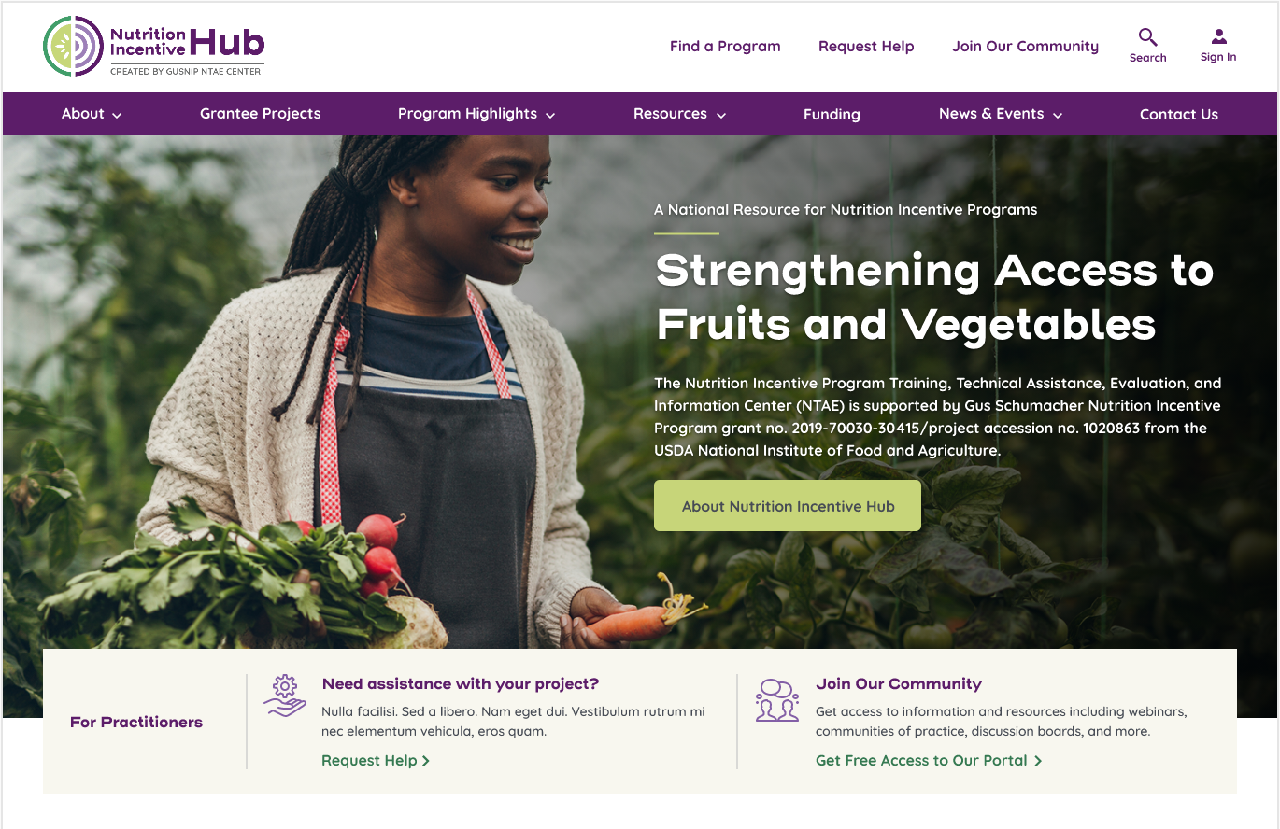
In Progress
Release of a new website and secure portal to support:
  Streamlined reporting
  Dashboards/data visualization
  Peer-to-peer learning
  Resources
  Technical assistance and training
  Program information dissemination to public

Slide 28
Contact
Amy Yaroch, PhD
Project Director, GusNIP NTAE Center
Executive Director, Gretchen Swanson Center for Nutrition
ayaroch@centerfornutrition.org
(531) 895 4030

Slide 29


DNPAO-FUNDED BRIC PROGRAM ADDRESSING FOOD AND NUTRITION SECURITY
NATHALIE CELESTIN, MPH,
CHES
ORISE FELLOW, HEALTHY FOOD ENVIRONMENTS
DIV. NUTRITION, PHYSICAL ACTIVITY AND OBESITY
NOPREN Summer Series
July 28, 2021

Slide 30




DISCLAIMER
The conclusions in this presentation are those of the authors and do not necessarily represent the views of the Centers for Disease Control and Prevention.

Slide 31


TOPICS
About Me
Overview of DNPAO programs
  SPAN, HOP and REACH
BRIC
  Program Overview
  Food and Nutrition Security
Terminology
  Food and Nutrition Security Team
  BRIC Nutrition Strategies
  Current Themes and
Opportunities
Summary

Slide 32
ABOUT ME

Slide 33
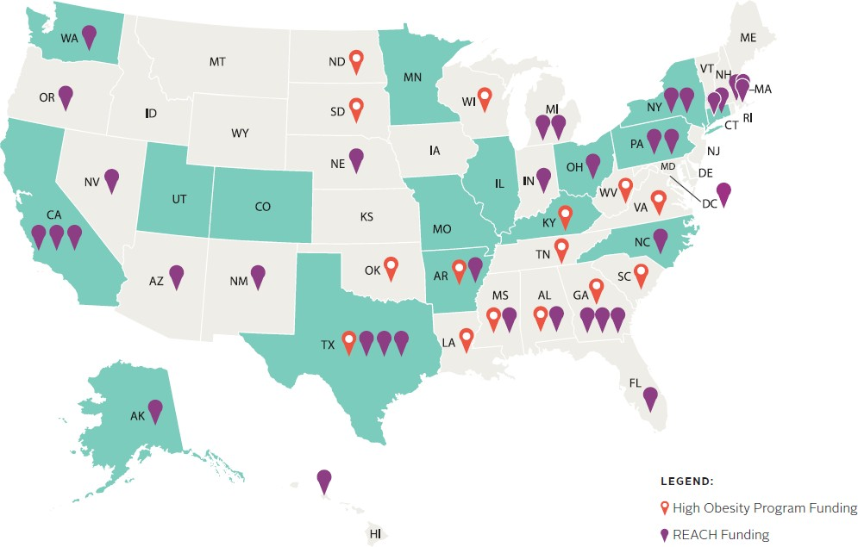
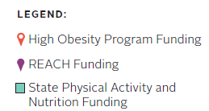
DNPAO’S FUNDED PROGRAM RECIPIENTS – FY20
https://www.cdc.gov/nccdphp/dnpao/ state-local-programs/funding.html

Slide 34


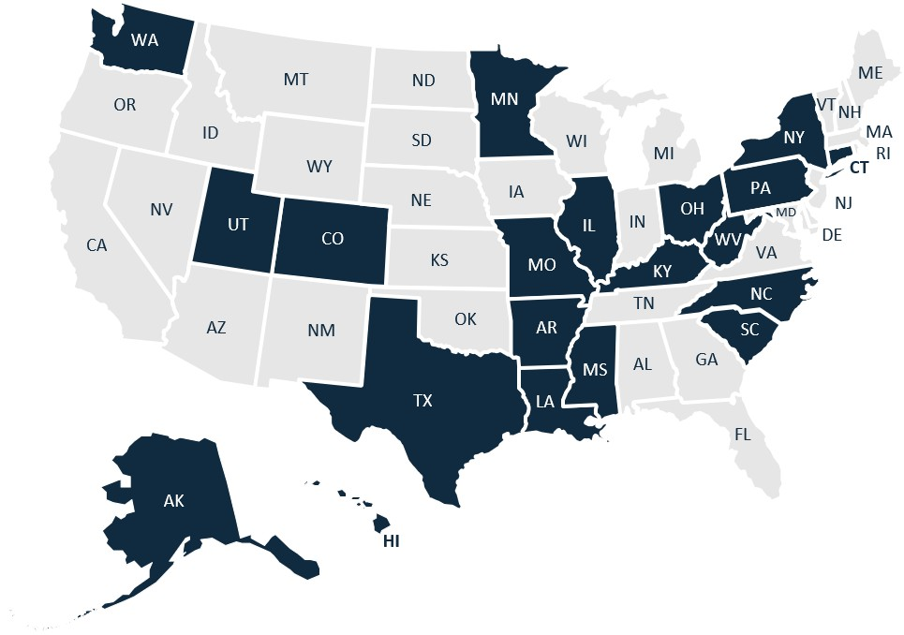
Building Resiliency In Communities (BRIC)
Program
BRIC Funded Recipients (Fiscal Year 2020)
New community program responding to COVID-19
Program Focuses:
  Food and Nutrition Security
  Access to Safe Physical Activity
  Social Connectedness
Goal: Help populations experiencing COVID- 19 emerge better situated to address obesity and other chronic diseases through improved access to physical activity, social connectedness, and nutrition security
Objectives: Build sustainable programming into existing efforts in up to 20 states for up to 5 communities per state to address COVID- 19, focusing on populations at high risk for chronic disease and COVID-19 impact
To learn more about the BRIC program, please visit: https://chronicdisease.org/bric/.
Recipients: 15 SPAN and 5 DNPAO Ambassador states
6

Slide 35

NEW TERM: FOOD AND NUTRITION SECURITY
In March 2021, DNPAO transitioned term to food and nutrition security:
“Food and nutrition security exists when all people, at all times, have physical, social
and economic access to food which is safe and
consumed in sufficient quantity and quality
to meet their dietary needs and food preferences, and is supported by an environment of adequate sanitation, health services and care, allowing for a healthy and active life”. (FAO, 2012)
  Reframes discussion from quantity to quality of food
  Highlights the importance of nutrition when
thinking about food policies and programs

Slide 36

FOOD AND NUTRITION SECURITY TEAM
Association of State Public Health Nutritionist
Centers for Disease Control and Prevention
Feeding America
National Association of
Chronic Disease Directors

Slide 37

BRIC FOOD AND NUTRITION SECURITY OUTCOMES
Collaborate with food council/coalition/task force on equitable nutrition security for food banks, pantries, and/or feeding sites during COVID-19
Efforts to increase the number of food banks, pantries or feeding sites adopting nutrition standards/guidelines
Efforts to support the increase in the number of people who receive healthier foods distributed by food pantries, food banks, or other feeding sites
Efforts to increase the number of community venues providing increased financial incentives to purchase healthier foods

Slide 38

HER NUTRITION GUIDELINES
In 2019, Healthy Eating Research (HER/RWJF) convened a panel of experts in the charitable food system, nutrition, and food policy fields
Tasked to create clear, specific recommendations for evidence-based nutrition guidelines for the charitable food system
Goal: Improve the quality of foods in food banks and pantries to increase access to and promote healthier food choices
https://healthyeatingresearch.org/wp- content/uploads/2020/02/her-food-bank_FINAL.pdf

Slide 39




COMMON THEMES, OPPORTUNITIES AND CHALLENGES
Assessment
Identify key cross-sector partners including donors
Conduct needs assessment, including foods
offered and storage/refrigeration capacity
Define sources of food procurement - purchased and donated
Choose priority nutrition policies and standards to implement
Identify evaluation instrument and measures
Implementation
Leverage culturally appropriate outreach
activities in different settings
Implement preferred client choice model
Increase access to healthy options and strengthen translation of nutrition standards across food bank and pantries
Re-assess needs and distribution infrastructure
Strengthen and adapt new standards
Sustainability
Evaluate nutrition quality, cultural
acceptability metrics
Disseminate evaluation results
Update written policies to reflect adopted policies and standards

Slide 40

SUMMARY: DNPAO-FUNDED STRATEGIES
DNPAO funding can play a supporting role for healthy incentive work
BRIC funding responds to COVID-19 impact related to food and nutrition security, physical activity and social connected
Focus on not only food security and access but nutrition security
Emphasis on multi-sectoral partnerships, PSE approaches

Slide 41






THANK YOU
For more information, contact: ncelestin2@cdc.gov
Help us keep America healthy and strong. See how at: cdc.gov/nccdphp/dnpao
Centers for Disease Control and Prevention
National Center for Chronic Disease Prevention and Health Promotion
Division of Nutrition, Physical Activity, and Obesity (DNPAO)
The findings and conclusions in this report are those of the authors and do not necessarily represent the official position of the Centers for Disease Control and Prevention.

Slide 42

Want to learn more about NOPREN or join the network?
https://nopren.ucsf.edu
or contact NOPREN@ucsf.edu
Ways to engage with NOPREN:
Sign up for the listserv to receive newsletters and network info
Attend monthly State-of-the-Science webinars
Join a Work Group
Work Group Fellows program

