Slide 1

Summer Speaker Series for Students
2024
Notes:
Session lead

Slide 2


Getting Started!
Update your name on Zoom, if needed
  Right click on your Zoom box, click “rename”
Type your name and institution into the chat box!
  Question: Which best describes you?
    Ex. Undergraduate Student, Dietetic Intern, Masters Student, Doctoral Student, Post Doc, Public Health Practitioner, Researcher/Professor, Other
Remember to keep yourself on mute.
Type your questions into the chat box.
Notes:
HER/NOPREN staff
Each session there will be a different question of the day:
What are you looking forward to this summer?
What is the weather like today where you are?
What is your go-to morning beverage?
What’s the best book you’ve ever read?
If you were a fruit or vegetable, what would you be?
What would be the title of your autobiography?
What’s your dream vacation destination?
Who performed at the last concert you went to?

Slide 3
NOPREN HER Summer Series for Students
Explore various public health topics related to:
  Food and nutrition security
  Federal nutrition assistance programs
  Nutrition equity
This series is a collaborative effort of Healthy Eating Research (HER) and Nutrition and Obesity Policy Research and Evaluation Network (NOPREN).
Notes:
HER/NOPREN staff
Weekly speaker series that explores various public health topics related to food and nutrition security, federal nutrition assistance programs, COVID-19 implications, and nutrition equity through research, policy, and practice.
Students will hear from experts and leaders in the field who will present on the fundamentals of each topic, along with relevant professional opportunities in research, policy, and practice.
This series is a collaborative effort of Healthy Eating Research, a national program of the Robert Wood Johnson Foundation, and the Centers for Disease Control and Prevention’s (CDC) Nutrition and Obesity Policy Research and Evaluation Network (NOPREN).

Slide 4
NOPREN HER Summer Series for Students
The series will take place on Wednesdays from
4:00 - 5:00 pm EST
Schedule and Topics
June 12: Food Policies in Schools - More than just Lunch!
June 26: Food is Medicine: What does it mean?
Where are we going?
July 10: Leveraging Food Service Contracts at 4-year Public Universities to
Understand Meal Plan Costs and Affordability
July 24: Policy Systems and Environmental Strategies to Support Young Children's Diet and Health
August 7: Collaborating Successfully across Sectors toward Nutrition Security
August 14: Student Presentations
For more information or to register: https://nopren.ucsf.edu/her-nopren-summer-speaker-series-students-2024
Notes:
HER/NOPREN staff
Put registration link in chat box: https://nopren.ucsf.edu/student-resources

Slide 5
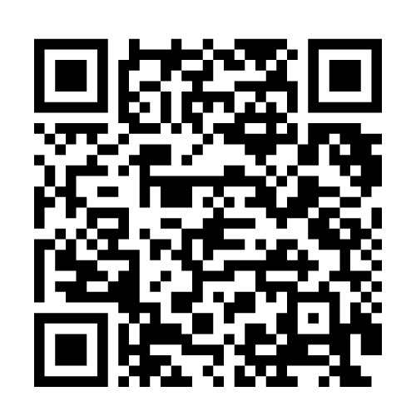
Student Presentations!
The HER/ NOPREN Summer Speaker Series will end with Student Presentations and Poster Sessions on August 14!
Selected students will give a presentation on a public health nutrition-related project or research they worked on over the summer. Applications are due July 17th. To apply, scan the QR code below:
Notes:
HER/NOPREN staff
Put application link in chat:
Reminder: Student presentations - application due Wednesday, July 13 at 5pm EST: https://unc.az1.qualtrics.com/jfe/form/SV_cSJdvAqdmlQXicK

Slide 6
Session 3: Leveraging Food Service Contracts at 4-year Public Universities to Understand Meal Plan Costs and Affordability
Notes:
Session lead to introduce session topic and moderator

Slide 7
Healthy Food Retail Work Group
The mission of the HFR Work Group is to build a network of researchers and leaders from academia, non-profit organizations, government, and funders focused on increasing the quantity and quality of research in the area of childhood obesity and nutrition in the food retail setting to:
• Influence purchases by children and their families toward healthier foods and beverages that align with the DGA by increasing demand for these options;
• Improve access to healthier foods and beverages by working directly with retailers;
• Facilitate the development and implementation of evidence-informed policies.
Special emphasis is placed on equity and addressing needs of communities and people at highest risk for obesity, especially lower-income & racial/ethnic populations.
https://nopren.ucsf.edu/healthy-food-retail
Contact: Alex Ross: aaross@email.unc.edu
Notes:
Moderator to give very brief background on WG they are representing

Slide 8
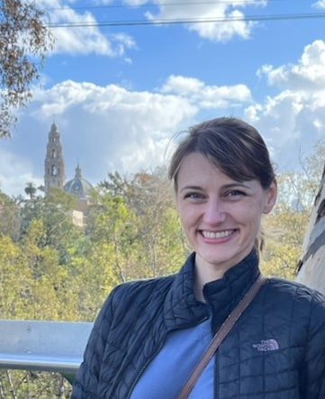

Today’s Presenters
Caitlin Lowery, PhD
National Poverty Fellow
Institute for Research on Poverty
University of Wisconsin-Madison
cmlowery@wisc.edu
Jennifer Falbe, ScD, MPH
Associate Professor
Department of Human Ecology
University of California, Davis
jfalbe@ucdavis.edu
Notes:
Moderator to introduce session speakers
Replace with speaker pictures

Slide 9
Learning Objectives for the Session:
1. Learn about the freedom of information (FOI) laws and how they can be used to obtain information about the food and beverage environment at public institutions.
2. Describe the variability in food costs on public university campuses and factors associated with higher costs.
Notes:
Speaker Two (if applicable) to input slides

Slide 10
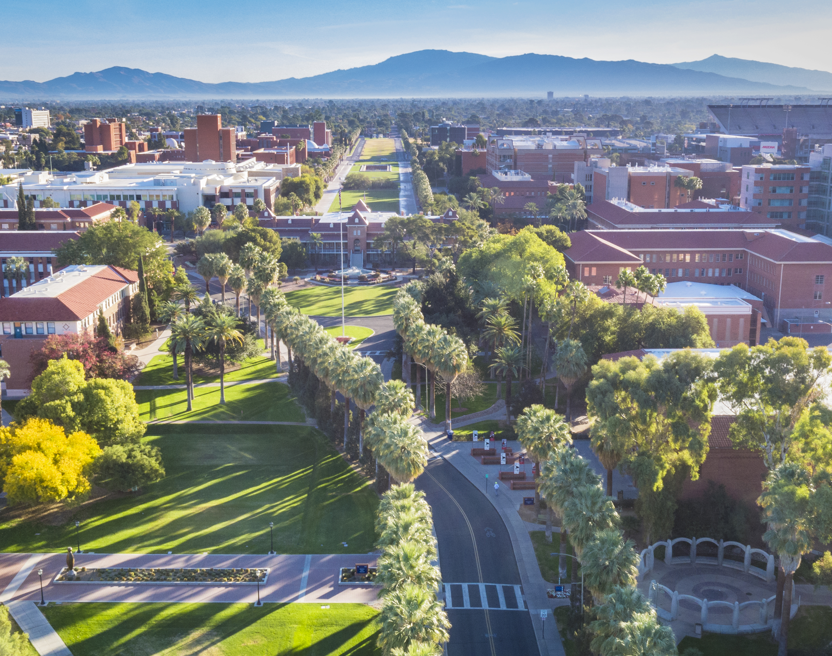
Goal of this Project:
Introduction
Obtain food service contracts from large, 4-year public universities in the U.S. using freedom of information laws
to explore factors related to meal plan costs and affordability
Third party dining operators (not self-operated dining)
Notes:
This session will focus on the cost and affordability of meal plans at public universities in the U.S. Presenters will describe how they used the Freedom of Information laws to obtain university contracts with food service providers and how they are using these contracts to understand the financial incentives and costs of student meal plans.

Slide 11
Introduction
How this project came to be
NOPREN Healthy Food Retail Working Group surveyed member interests
Leadership reached out to me to kick-start contracts project
Convened interested members, narrowed focus, applied for funding
Hired and trained students to request and code contracts
Notes:
This session will focus on the cost and affordability of meal plans at public universities in the U.S. Presenters will describe how they used the Freedom of Information Act (FOIA) to obtain university contracts with food service providers and how they are using these contracts to understand the financial incentives and costs of student meal plans.

Slide 12
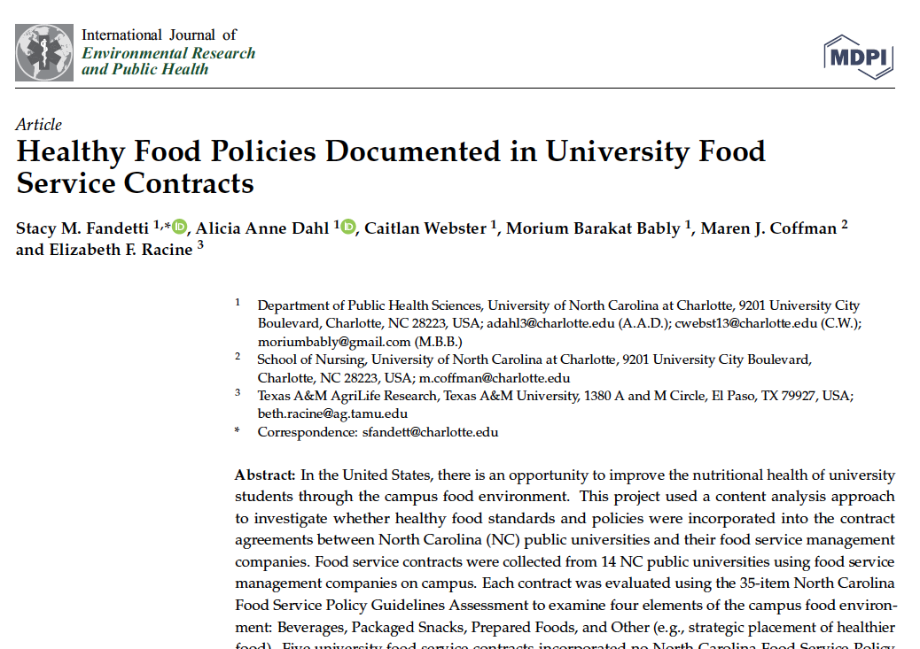
Inspiration for this research
Introduction
Notes:
Food service contracts were collected from 14 NC public universities using food service management companies on campus
Extent to which they incorporated North Carolina Food Service Policy Guidelines

Slide 13
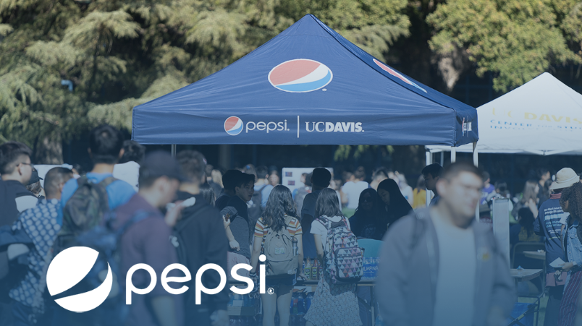
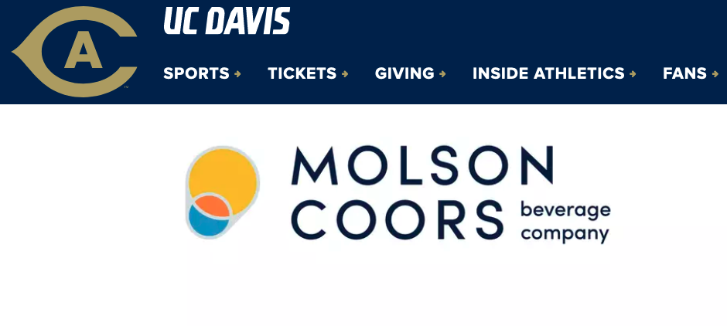
Inspiration for this research cont
Introduction
My ongoing work studying pouring rights contracts (PRCs) in public universities:
Soda PRCs: FOI laws and interviews
    University service
Alcohol PRCs and sponsorship agreements: FOI laws
Notes:
Food service contracts were collected from 14 NC public universities using food service management companies on campus
Extent to which they incorporated North Carolina Food Service Policy Guidelines

Slide 14

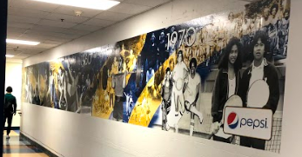
Soda PRCs
University of California contracts
  “Wellness Happens Here sponsorship: (1) Presenting sponsor designation/placement on all Wellness Happens Here...materials”
  “Up to six (6) logo inclusions on murals throughout the [gyms]”
Introduction
Notes:
Speaker One to input slides

Slide 15
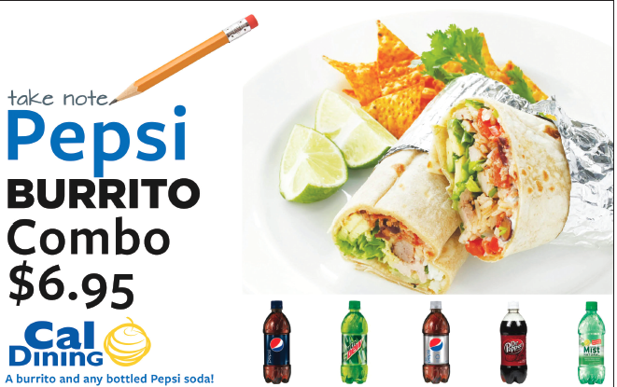
Soda PRCs
Introduction
Cannot always get all the info from contracts alone
“We wanted to introduce spa water... We put those things next to the [soda] machine...and [the soda company] threatened us...”
Notes:
Speaker One to input slides

Slide 16
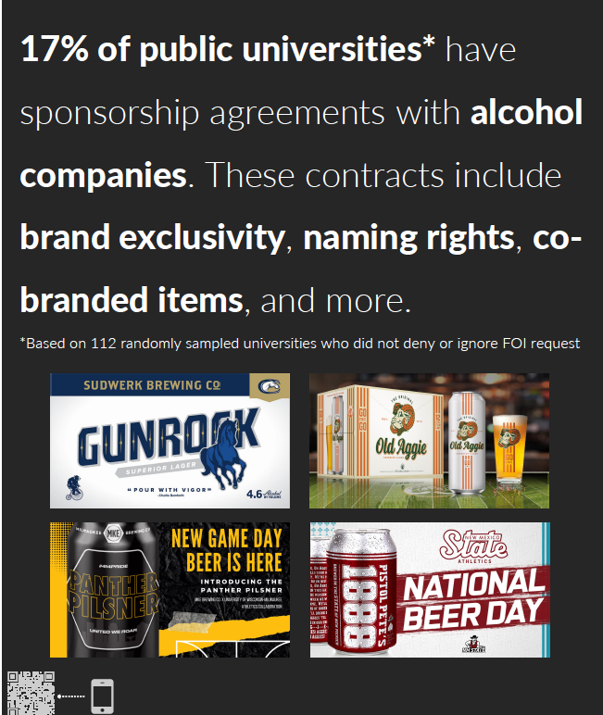
Alcohol contracts:
162 public 4-year universities
Introduction
“The [University] shall provide the [Company] with exclusive naming rights to the area located underneath the football scoreboard”
Research in-progress
Notes:
Speaker One to input slides

Slide 17
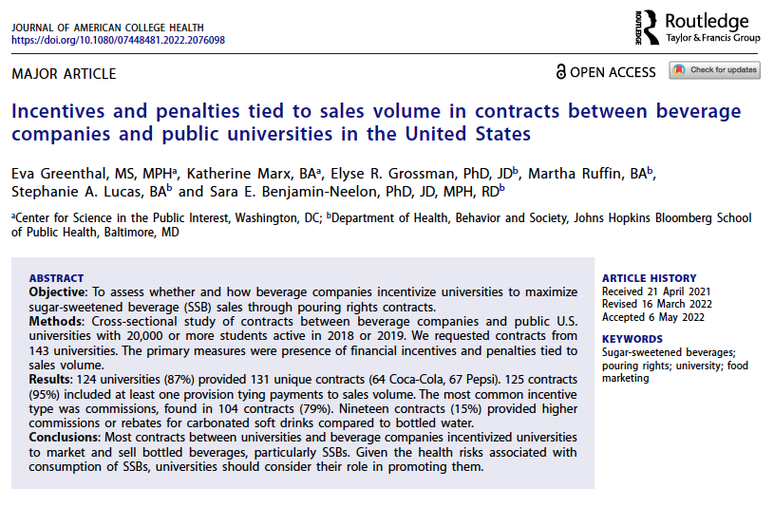
Inspiration
Introduction
Notes:
Speaker One to input slides

Slide 18
Food service contracts
Request contracts
Data management
Create codebook
Code (& double-code) the data
Analyze the data
Notes:
This session will focus on the cost and affordability of meal plans at public universities in the U.S. Presenters will describe how they used the Freedom of Information Act (FOIA) to obtain university contracts with food service providers and how they are using these contracts to understand the financial incentives and costs of student meal plans.

Slide 19

How did we request food service contracts?
Federal: The Freedom of Information Act (FOIA) provides “the public the right to request access to records from any federal agency.”
“The basic function...is to ensure informed citizens, vital to the functioning of a democratic society.” (FOIA.gov)
States have FOI laws for state government records.
Public universities included in most states
Submitted requests under the relevant state law
Look-up your state here: https://www.nfoic.org/state-sample-foia-request-letters/
Notes:
Note that the gov’t is not required to provide access to all records; there are 9 categories of exemptions at the federal level, including trade secrets.
There is some variability by state in terms of the types records they are required to provide and to whom the records must be provided (e.g., only state residents and media).
This is a U.S. law. Non-U.S. students can choose a state they’ve visited or would like to visit.

Slide 20
How did we request food service contracts? (cont)
Submission: Emails or online forms
“I am a student from UC Davis. I am conducting research in the public interest to study...
Under the Alabama Open Records Law § 36-12-40 et seq. We request copies of the following:
Any contracts or agreements...signed and/or active as of July 1, 2023, between [University] and food service contractors or providers...
.....
If this request is denied in whole or in part, please state in writing the specific statutory exemption upon which you have relied (as required by law) and notify me of the appeal procedures available to me under the law.
Please waive any costs associated with this request, or first inform me prior to taking any action that would incur costs. Our research team does not seek the records for commercial purposes.
Please respond in a timely manner upon your receipt of this letter, as required by A.L. § 36-12-40. If other requested documents will take longer to produce, please send the documents in request (1) first, rather than waiting to produce all requested documents at one time.
Notes:
Note that the gov’t is not required to provide access to all records; there are 9 categories of exemptions at the federal level, including trade secrets.
There is some variability by state in terms of the types records they are required to provide and to whom the records must be provided (e.g., only state residents and media).
This is a U.S. law. Non-U.S. students can choose a state they’ve visited or would like to visit.

Slide 21

What is a food service contract?
An agreement between a university and food services contractor, in which the contractor agrees to operate the university’s dining services.
How are food services contracts created?
University puts out a “request for proposals” (RFP).
Companies submit proposals in response to the RFP.
The university awards the contract to the company with the highest ranked proposal, based on the university’s own criteria.

Slide 22
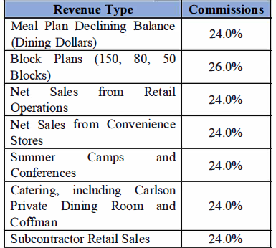
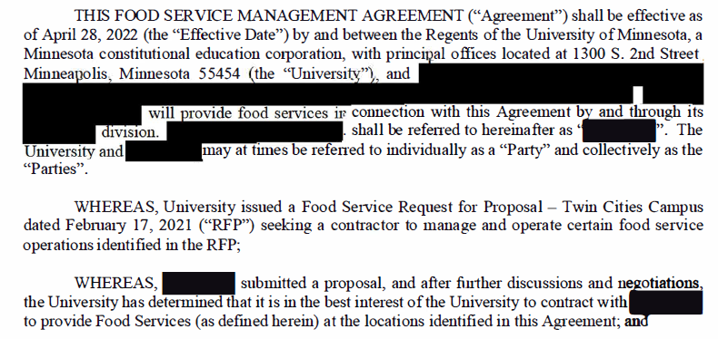
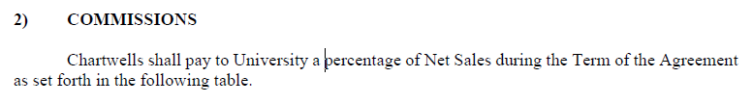
Contract Examples

Slide 23
Meal Plans & Affordability
What is a meal plan?
A pre-paid account that provides students with access to dining services on campus
Common types include: “unlimited”, weekly, and “block” plans
Often associated with “all-you-can-eat” dining halls
Why are we interested in meal plan costs?
High rates of food/nutrition insecurity
Rising costs of attending university
Student debt crisis
Notes:
Equity issue

Slide 24
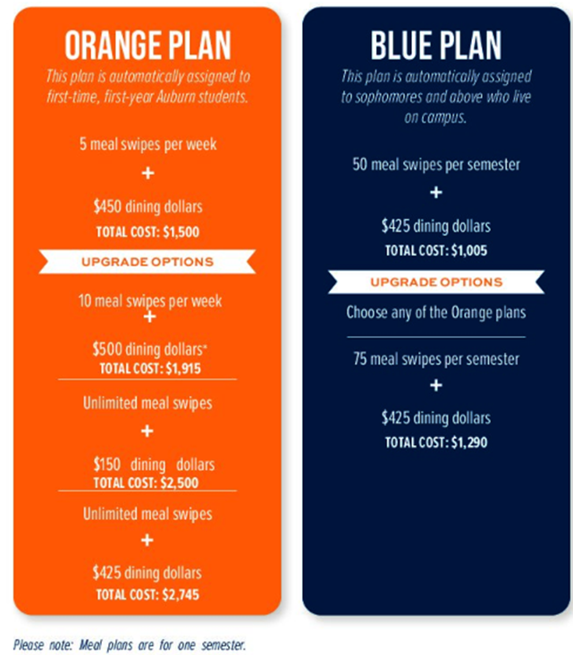
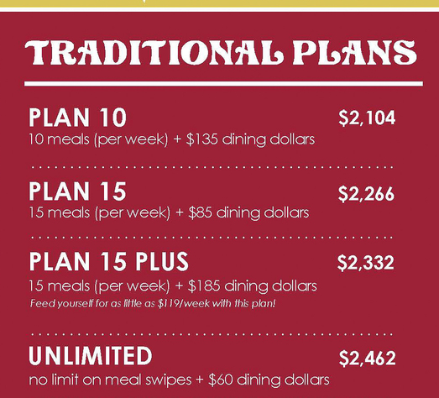
Meal Plan Examples
Introduction

Slide 25
Research Process
Request contracts
Data management
Create codebook
Code (& double-code) the data
Analyze the data
Notes:
Content analysis approach – mostly descriptive

Slide 26
Our Sampling Criteria
University size (≥20,000 students)
Public universities
4-Year degree-granting
Excluded online-only schools and community colleges

Slide 27
Our Sample
Response to FOIA Request:
Self-operated, n=55
Fulfilled, n=52
Pending, n=11
Denied, n=8
Total, n=126
Notes:
Denied requests: State residency required, Contract not supported by state funding, Contracts not considered “open records”

Slide 28
Our Sample (cont)
Food Service Contractor:
Company A, n=22
Company B, n=7
Company C, n=23

Slide 29
Coding Process
Contract Terms
Contractor
University Incentives
Commissions
Consumer Cost
Meal plan types & costs
Start date
Duration
Capital investment
Other financial incentives
Mandatory v. optional meal plans
Cash charges per meal
Renewal terms
Notes:
Two coders review and code all contracts independently.

Slide 30

Next steps: Data Analysis
Meal Plans
  Average cost of a meal plan for students living on campus
  Who is required to purchase a meal plan
  Cost comparison of meal plans at self-operated v. contract-operated dining services
  Financial Incentives
Types of financial incentives provided (student scholarships, catering donations, etc.)
Average commission for university on meal plan sales
Average amount of capital investment by contractor per year

Slide 31
Future Directions
Adherence to Food Service Guidelines
Nutrition Standards
Menu Labeling
Sustainability, Local Foods, & Food Waste Prevention
Occupational Health & Safety

Slide 32
Lessons learned
Need a detailed system for tracking FOI requests, responses, and follow-up requests
Many universities provide irrelevant documents
The fewer documents requested, the faster it takes
For some states, you must be a resident
Anticipate costs: Most do not charge, but some some universities request unreasonable $ to provide requested documents

Slide 33
Acknowledgments
Collaborators: Drs. Megan Winkler, Beth Racine, Alicia Dahl, Sumathi Venkatesh, and Bree Bode, Stacy Fandetti, Sarah Solar, and the HER NOPREN Healthy Food Retail Work Group
Research Assistants: Dominique Pace, Mercedes Pace, Cynthia Hoang-Duong, Adithi Sumitran, Cathy Nguyen, Maha Raya, and Rosalba Chavarria
This work was supported by supported by the Nutrition and Obesity Policy Research and Evaluation Network (NOPREN). NOPREN is supported by Cooperative Agreement Number U48DP006374 funded by the Centers for Disease Control and Prevention’s (CDC) Division of Nutrition, Physical Activity, and Obesity and Prevention Research Centers Program. The findings and conclusions in this publication are those of the author(s) and do not necessarily represent the official position of CDC or DHHS.

Slide 34
Q&A
Notes:
Moderator to lead Q/A

Slide 35
Breakout Rooms
Notes:
Moderator to lead breakout session

Slide 36
Breakout room instructions
Take a moment to look up the 2024-2025 cost of an “unlimited” (or highest cost) meal plan at the university of your choice.
  Is the meal plan cost listed per semester, per year, or per quarter? Determine the annual cost.
  Calculate the (approximate) cost per meal of the plan:
    (Cost/year) / [20 meals/week * 32 weeks]
  Who is required to purchase a meal plan?
  Compare your findings with others in your group.
Bonus: Can you tell if your university’s dining services program is operated by a contractor, and if so, which company?
(Hint: Check the “Staff” or “Meet the Team” page of the campus dining site)
Notes:
You do not need to choose a public university for this activity. However, not all schools post this information clearly on their websites (some combine it with housing info), so you may need to select another school if you aren’t able to find the meal plan cost at your first choice. If you aren’t based on the US or are having trouble, you can use the University of Delaware as an example (link: https://udel.campusdish.com/en/mealplans/ in the chat).
Follow-up questions: Highest cost? Lowest cost? Large differences in your group? Not really? Any surprises? Was anyone able to determine if their school is self-operated or not?

Slide 37
Additional Questions
What questions do have about your university’s food services program?
Do you think this information would be available in a food services contract? If not, how could you access this information?

Slide 38
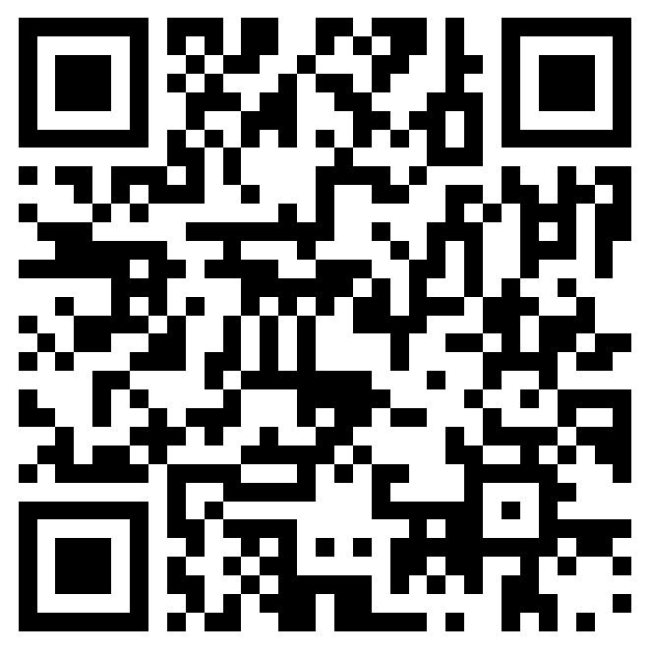
To view past recordings, visit https://nopren.ucsf.edu/her-nopren-summer-speaker-series-students-2024
Announcements
Please fill out the session evaluation after today’s session.
You should be directed to fill it out after the call ends OR you may scan the QR code on the right.
Apply for the Student Presentations:
Applications due on July 17
Join us for the next session of the speaker series!
Wednesday, July 24 from 4:00 - 5:00 PM ET
Title: Policy Systems and Environmental Strategies to Support Young Children's Diet and Health
Notes:
Session lead
Reminder: Student presentations - application due Wednesday, July 13 at 5pm EST: https://unc.az1.qualtrics.com/jfe/form/SV_cSJdvAqdmlQXicK
Reminder: please fill out the session evaluation for today: https://duke.qualtrics.com/jfe/form/SV_4SmhYaB4MN4pdn8

