Slide 1

Summer Speaker Series for Students
2025
(The contents and findings of this presentation are those of the speakers and do not represent the official views of the Centers for Disease Control & Prevention or Department of Health and Human Services.)
Notes:
Session Lead: HER
Hello Everyone! My name is Lindsey Reed, and I’m a Senior Research Analyst with Healthy Eating Research, which is based at Duke University. HER and our NOPREN partners are so excited that you are all here to join us for the second session of the HER NOPREN Summer Speaker Series for Students.
Please note: The contents of these sessions are those of the speakers and do not represent the official views of the Centers for Disease Control & Prevention or Department of Health and Human Services.

Slide 2
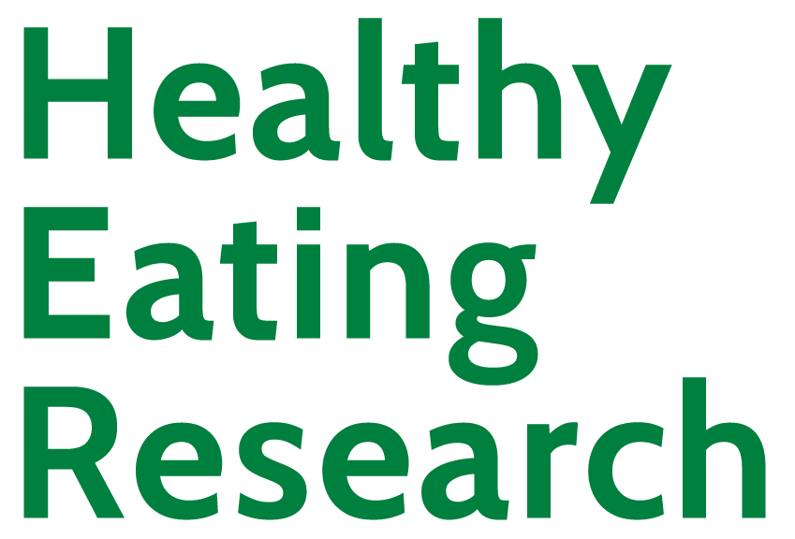

Getting Started!
Update your name on Zoom, if needed
  Right click on your Zoom box, click “rename”
Type your name and institution into the chat box!
  Question: Which best describes you?
    Ex. Undergraduate Student, Dietetic Intern, Masters Student, Doctoral Student, Post Doc, Public Health Practitioner, Researcher/Professor, Other
Remember to keep yourself on mute.
Type your questions into the chat box.
Notes:
Before we get started, we want to get a sense of who is joining us today. Please type your name, institution, and how best you describe yourself (as a undergrad student, masters, doctoral, etc.) into the chat box so we can know who is here.
That being said, we do encourage an active chat box. Please use the chat box to input questions and comments for the speakers.

Slide 3
NOPREN HER Summer Series for Students
Explore various public health topics related to:
  Food and nutrition security
  Federal, state, and local policy
  Strategies to support young children’s health
  And more!
This series is a collaborative effort of Healthy Eating Research (HER) and Nutrition and Obesity Policy Research and Evaluation Network (NOPREN).
Notes:
We are thrilled for the 6th Annual HER NOPREN Summer Speaker Series. This started 6 years ago and is a place for HER and NOPREN to utilize our platforms and networks to reach students and early career professionals who are interested in food and nutrition and provide a series that gives a comprehensive overview over several topics essential to policy, systems, and environments that are impacting public health nutrition related policy research. You will see that we will cover topics around food and nutrition security, Federal, state, and local policy, strategies to support young children’s health and more.
This series is put on jointly and is a collaborative effort of Healthy Eating Research (HER) and Nutrition and Obesity Policy Research and Evaluation Network (NOPREN). We will hear a brief overview of both of these amazing organizations shortly.

Slide 4
NOPREN HER Summer Series for Students Agenda
The series will take place on Wednesdays from
4:00 - 5:00 pm EST
Schedule and Topics
June 11: Policy, Systems, and Environmental (PSE)
Strategies to Support Young Children’s Diet and Health
June 25: Federal, State, and Local Nutrition Policy Updates
July 9: Food Policies in Schools
July 23: Building Resilient Food Systems
August 6: Interventions to Improve Food and Nutrition Security
August 13: Student Presentations
For more information or to register: https://nopren.ucsf.edu/her-nopren-summer%C2%A0speaker-series-students-2025
Notes:
This biweekly series will be on Wednesdays at 4-5pm Eastern. Today, we will hear about Federal, state, and local nutrition policy updates. Sessions throughout the series will cover topics such as school meal policies, resilient food systems, and food is medicine. We will end with Student presentations.
For more information about the series, please visit the link on the slide. One of my colleagues here can also put the link in the chat for you all to easily access.

Slide 5

Student Presentations!
The HER/ NOPREN Summer Speaker Series will end with Student Presentations and Poster Sessions on August 13. Applications are due July 18th. To apply, scan the QR code below:
QR code
Selected students will give a presentation on a nutrition-related project or research they worked on over the summer.
The HER/ NOPREN Summer Speaker Series will end with Student Presentations and Poster Sessions on August 13. Applications are due July 18th. To apply, scan the QR code below:
QR code
Selected students will give a presentation on a nutrition-related project or research they worked on over the summer.
Notes:
We invite students at varying stages to submit abstracts on exciting projects or research that they are involved in this summer and have the opportunity to present or have a poster featured on the NOPREN website. Applications are due July 18th. You can scan the QR code on the slide to access the application.
We want to emphasize this amazing opportunity for you to showcase your public health nutrition related project or research to a broad, national audience!
Reminder: Student presentations - application due Wednesday, July 18 at 5pm EST: https://duke.qualtrics.com/jfe/form/SV_eKhMbtCWFp6ezsy

Slide 6
Session 2: Federal, State, and Local Nutrition Policy Updates
Notes:
Today we are excited to be joined by Drs. Jim Krieger and Aline D’Angelo Campos to present on federal, state, and local nutrition policy updates.
Jim Krieger: Jim is Executive Director of Healthy Food America and Clinical Professor Emeritus at the University of Washington School of Public Health. He previously worked for 25 years at Public Health – Seattle & King County as Chief of Chronic Disease Prevention and as an attending physician at the University of Washington Harborview Medical Center. He supports policy change to promote healthy eating and health equity through research, provision of technical assistance to policy makers and advocates, direct advocacy, and teaching. He has contributed to implementation of the nation’s second menu labeling regulation, adoption of sweetened beverage taxes, development of sugary drink counter-marketing campaigns, consideration of front of package food labels by FDA, and developing policies focused on non-sugar sweeteners and ultra-processed foods. His research has included evaluation of sweetened beverage taxes, food package warning labels, and policies to address non-sugar sweeteners. He teaches graduate health policy at University of Washington. He received his undergraduate degree at Harvard, MD at the University of California, San Francisco, and MPH at University of Washington.
Aline D’Angelo Campos: Aline is a post-doctoral fellow at the Global Food Research Program. Her research is concerned with food policy and food environments in Latin America and the US. Her work is particularly focused on labeling and communication around ultraprocessed foods, unintended effects of nutrition communication on weight stigma, and food retail environments. Aline earned her Ph.D in Health Behavior from UNC-Chapel Hill’s Gillings School of Global Public Health. She also holds a Master of Public Policy from Duke University. Her previous professional experiences include roles at the Duke World Food Policy Center, Global Alliance for Improved Nutrition (GAIN), and the World Bank.

Slide 7
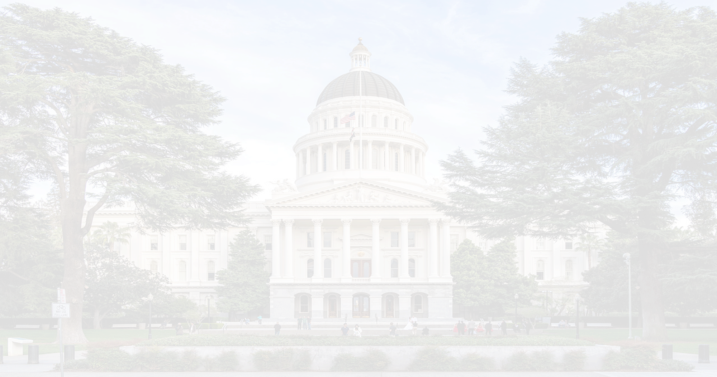


Nutrition Policy in a New Era:
Opportunities and Challenges
(with a closer look at the state and local scene)
JIM KRIEGER, MD, MPH
June 25, 2025

Slide 8

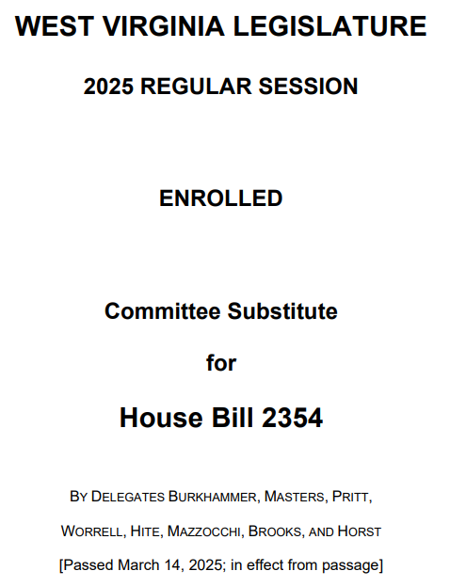
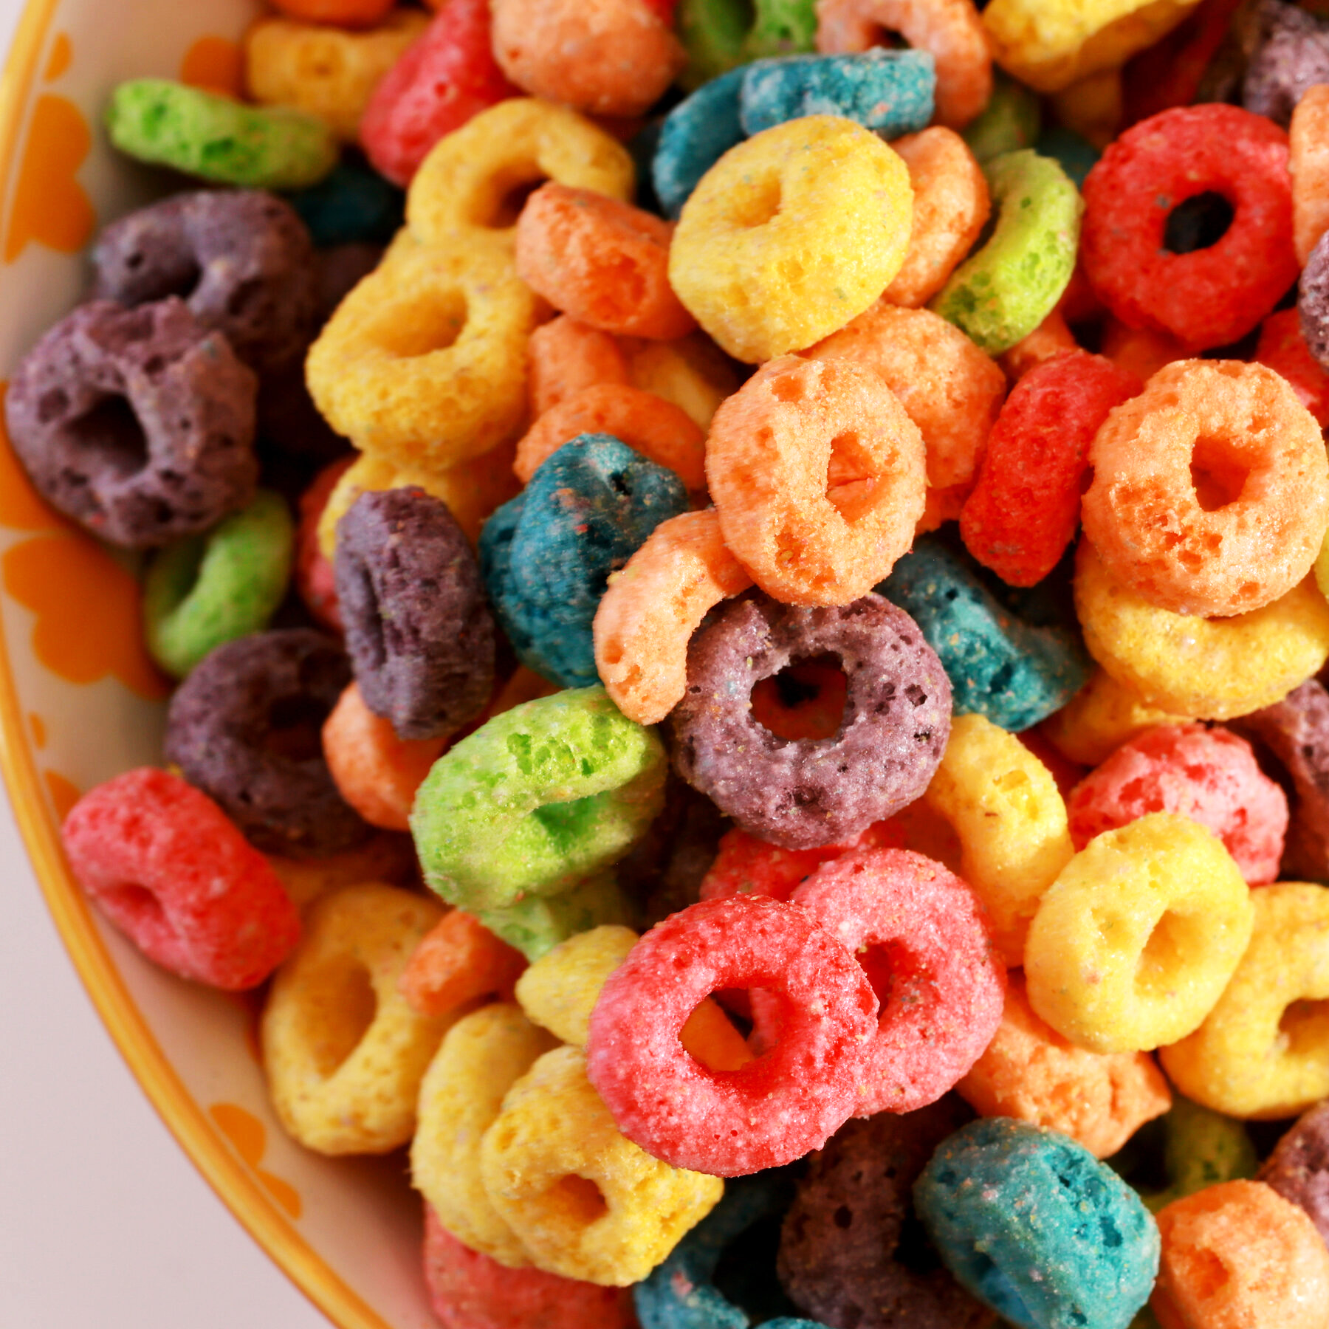
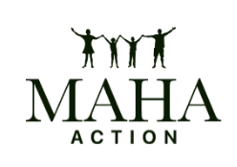
Kingdon’s Multiple Streams Policy Model
Policy Stream:
Ban
Problem Stream
Additives
Politics Stream:
MAHA
Policy Window

Slide 9
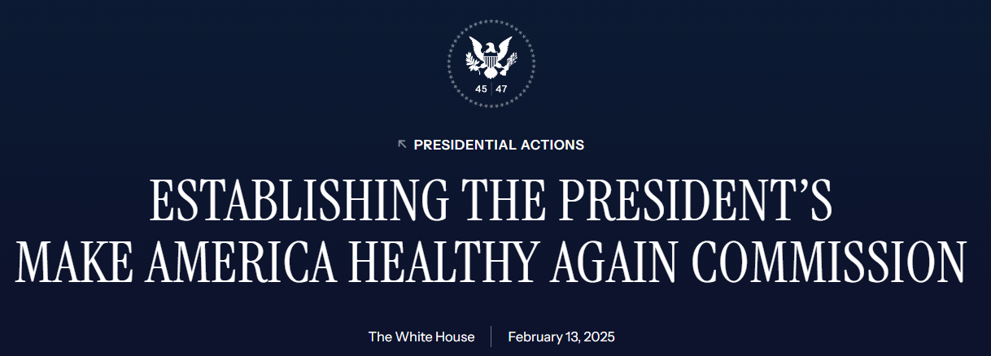
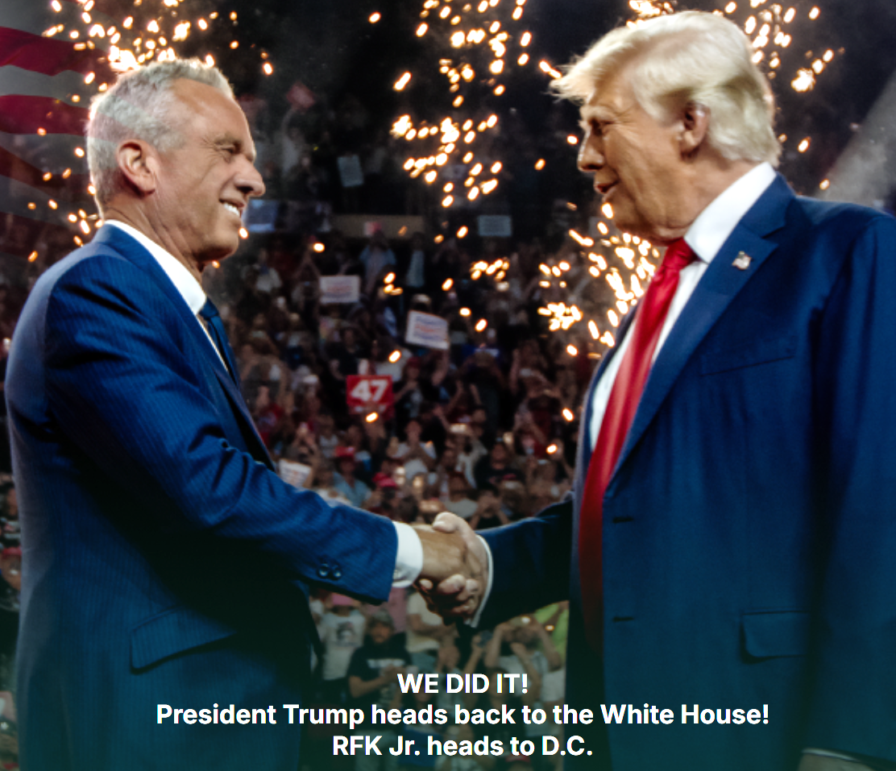
MAHA Commission
“Study the scope of the childhood chronic disease crisis and any potential contributing causes, including the American diet, absorption of toxic material, medical treatments, lifestyle, environmental factors, Government policies, food production techniques, electromagnetic radiation, and corporate influence or cronyism”
https://www.whitehouse.gov/presidential-actions/2025/02/establishing-the-presidents-make-america-healthy-again-commission/
Notes:
MAHA – make America healthy again – is a movement led by RFK Jr. It’s core tenets are in the orange box. After failing in the primaries and as an independent candidate, RFK cut deal with Trump as way to advance MAHA agenda – you support it, I give my followers’ votes.
A month ago, Trump issued EO establishing MAHA Commission It’s scope is on the slide – focused on childhood chronic diseases which it attributes to American diet, absorption of toxic material, medical treatments, lifestyle, environmental factors, Government policies, food production techniques, electromagnetic radiation, and corporate influence or cronyism”
Commission = Cabinet secretaries (HHS, HUD, Education, Ag, VA), EPA Admin, OMB Director. FDA CDC, NIH, Council Ec advisors, etc
Report on strategies due in 180 days (August)
https://www.whitehouse.gov/presidential-actions/2025/02/establishing-the-presidents-make-america-healthy-again-commission/
closed-door inaugural meeting on March 11,
The MAHA commission should focus on the primary drivers of chronic diseases, but its priorities depart from the known causes of chronic diseases. For example, there is no mention of added sugars in food, reducing sodium intake, or the use of alcohol or tobacco. Instead, the charge includes issues that contribute to chronic diseases in limited ways (food additives), rest on shaky evidence (causes of autism), or represent the Secretary’s long-held views (opposition to weight-loss medications). The executive order also refers to “over-utilization of medication, certain food ingredients, certain chemicals,” and calls out “selective serotonin reuptake inhibitors, antipsychotics, mood stabilizers, stimulants, and weight-loss drugs.” The relationship between these concerns and chronic disease is uncertain.
Even though the MAHA commission is off to an inauspicious start, in theory, it could become a catalyst for evidence-based investments and policies to reduce the burden of chronic diseases. But the MAHA commission may instead cast doubt on current scientific knowledge, while promoting tangential issues or unscientific policies. Most concerning, however, is that the MAHA commission could distract from the well-studied root causes of chronic diseases as well as from the policy solutions that scientists have promoted for decades.
Published: March 27, 2025. doi:10.1001/jamahealthforum.2025.1304
++++++
Kennedy: MAHA website https://www.mahanow.org/issues: With President Trump’s backing, he will reorient federal health agencies toward chronic disease and rid them of Big Pharma’s influence. He will ban the hundreds of food additives and chemicals that other countries have already prohibited. He will change regulations, research topics, and subsidies to reduce the dominance of ultra-processed food. He will clean up toxic chemicals from our air, water, and soil. He will ensure that research into pharmaceutical drugs, pesticides, additives, and environmental chemicals is scientifically unbiased.

Slide 10
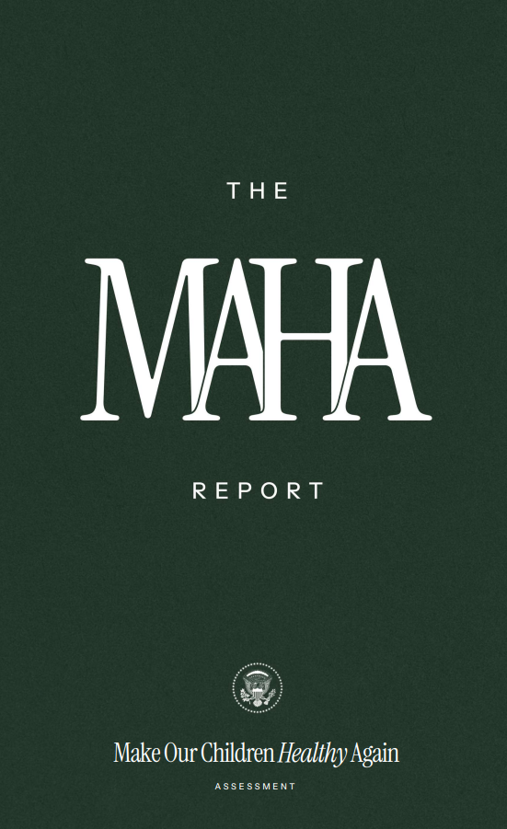
Maha report
America’s children are facing an unprecedented health crisis.
Over 40% have at least one chronic health condition – including obesity, diabetes, neurodevelopmental disorders, cancer, mental health, allergies.
Poor Diet: The American diet has shifted dramatically toward ultra-processed foods (UPFs), leading to nutrient depletion, increased caloric intake, and exposure to harmful additives.
Environmental Chemicals: exposure to an increasing number of synthetic chemicals.
Pervasive technology use: leading to a sedentary, technology-driven lifestyle
Overmedicalization: Overprescribing medications, often driven by conflicts of interest in medical research, regulation, and practice.
Drivers of Shift to Ultraprocessed Food
Corporatization and consolidation in food system
Distorted nutrition research and marketing shaped by food industry
Compromised dietary guidelines (ignore processing and do not explicitly address UPF) unduly influenced by corporate interests
Misdirected government programs, including crop subsidies, use of SNAP for unhealthy products, inadequate standards for school meals
Notes:
Next steps focused on research – policy recs due in August
1. Addressing the Replication Crisis: NIH should launch a coordinated initiative to confront the
replication crisis, investing in reproducibility efforts to improve trust and reliability in basic
science and interventions for childhood chronic disease.
2. Post-Marketing Surveillance: NIH and FDA should build systems for real-world safety
monitoring of pediatric drugs and create programs to independently replicate findings from
industry-funded studies.
3. Real-World Data Platform: Expand the NIH-CMS autism data initiative into a broader, secure
system linking claims, EHRs, and environmental inputs to study childhood chronic diseases.
4. AI-Powered Surveillance: Create a task force to apply AI and machine learning to federal health
and nutrition datasets for early detection of harmful exposures and childhood chronic disease
trends.
5. GRAS Oversight Reform: Fund independent studies evaluating the health impact of selfaffirmed
GRAS food ingredients, prioritizing risks to children and informing transparent FDA
rulemaking.
6. Nutrition Trials: NIH should fund long-term trials comparing whole-food, reduced-carb, and
low-UPF diets in children to assess effects on obesity and insulin resistance.
7. Large-scale Lifestyle Interventions: Launch a coordinated national lifestyle-medicine
initiative that embeds real-world randomized trials—covering integrated interventions in
movement, diet, light exposure, and sleep timing—within existing cohorts and EHR networks.
8. Drug Safety Research: Support studies on long-term neurodevelopmental and metabolic
outcomes of commonly prescribed pediatric drugs, emphasizing real-world settings and
meaningful endpoints.
9. Alternative Testing Models: Invest in New Approach Methodologies (NAMs), such as organon-
a-chip, microphysiological systems, and computational biology, to complement animal
testing with more predictive human-relevant models.
10. Precision Toxicology: Launch a national initiative to map gene–environment interactions
affecting childhood disease risk, especially for pollutants, endocrine disruptors, and
pharmaceuticals.

Slide 11


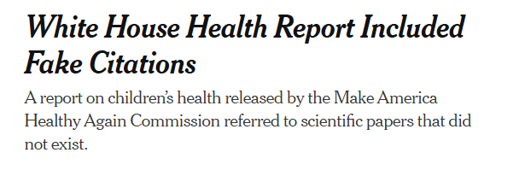
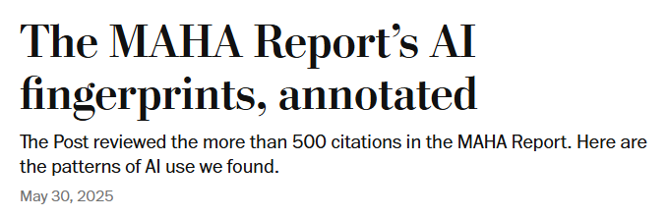
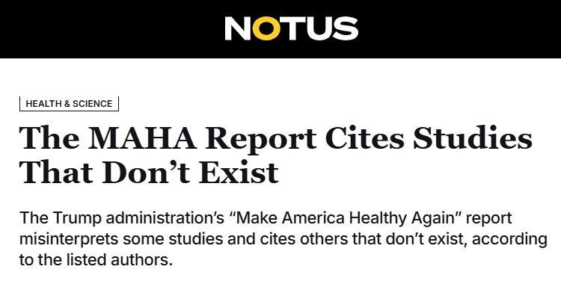
News articles

Slide 12
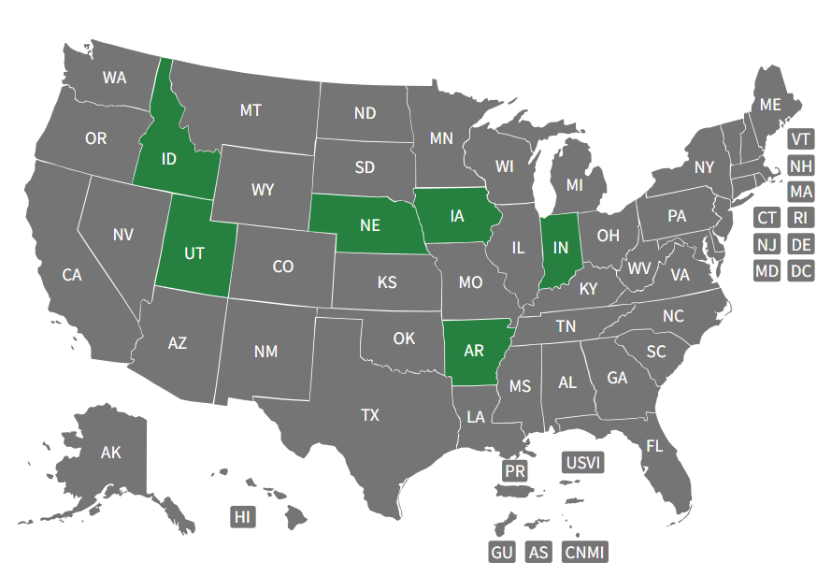
SNAP restrictions
At least 12 states have proposed or introduced waiver bills
6 states have approved waivers
4 states have submitted waiver requests (CO, LA, TX, West Virginia)
Sweetened beverages
Candy
All taxable food items (IA)
Notes:
IA - This includes any item subject to sales tax, notably: Sweetened beverages (carbonated and non‑carbonated) Candy and snack foods (e.g., chips, baked goods)
Chocolate and chocolate-covered fruit Sweetened water and artificially sweetened beverages
Pending waivers: Texas, West Virginia, Colorado, Kansas, Florida, Louisiana, Ohio. Texas has proposed banning sweetened drinks, candy, energy drinks, chips, and cookies; others remain under USDA review. Gemini says only, CO, LA, TX, WV
(Chat GPT – 6.20.25)
++++++
MAHA is also showing up in a plethora of state bills (19 to be exact) to restrict purchase of certain foods with SNAP benefits. All target sweetened bev and candy (with NSS or sugar)., and some also include chips, desserts or other junk food.
WV adopts along with work requirements.
ABA opposes – they sell $6B per year via SNAP - Americans who need help buying groceries deserve the freedom to choose foods that best meet their families’ needs. Proposals to restrict SNAP purchases won’t make anyone healthier or save $1 in taxes, but they would create an army of government bureaucrats to designate ‘good’ and ‘bad’ foods while treating Americans facing hard times like second-class citizens.”
Soda restrictions on tap: In a school gymnasium packed with children, supporters and presumably parents, Republican Gov. Patrick Morrisey announced a new MAHA campaign following the state’s recent ban on synthetic food dyes and two food preservatives. The MAHA campaign includes exercise and healthy food initiatives, but the big news is that the state is seeking two major changes to the Supplemental Nutrition Assistance Program (SNAP): stricter work requirements and a ban on soda.
Stiffening work requirements for SNAP beneficiaries is a longtime Republican goal, but it’s often criticized by Democrats and anti-hunger groups as a blunt tool to drop large numbers of vulnerable people from food aid. The governor did not give much detail on what the state has planned, but his office said it would implement “work, training, and education requirements for SNAP recipients.” “Outside of limited exceptions, if you have the ability to work, you should,” Morrisey said.
Food industry groups could sue to try to stop West Virginia’s ban on additives as well as a future ban on SNAP restrictions (if USDA approves this down the line, which sure seems like a safe bet). I asked the governor about this today, and he seemed confident that the state would ultimately prevail.
Arkansas Gov. Sarah Huckabee Sanders vowed in December to pursue a waiver. And Democratic Govs. Gavin Newsom of California and Jared Polis of Colorado have indicated that they might also be open to similar restrictions — a sign that the approach could win some bipartisan support. (Politico 3.26.25
Also federal bills (Self R-TX Funding Is Zero for Zero Nutrition Options (FIZZ-NO) Act of 2025, which would block purchases of sodas with SNAP benefits — the text defines soda as "a carbonated beverage that contains more than 1 gram of added sugar, artificial sweetener, or flavoring per serving.“
Lee R-UT and Brecheen R-OK: A group of GOP lawmakers in both chambers of Congress are pushing the Healthy SNAP Act of 2025. The measure would target "soft drinks, candy, ice cream, prepared desserts such as cakes, pies, cookies, or similar products," and call for the Agriculture Secretary to "conduct a scientific review" of foods allowed under SNAP at least every 5 years.
Rand Paul - The Nutritious SNAP Act of 2025 would put the kibosh on SNAP purchases of "any nonalcoholic beverage that is not water, cow’s milk, a milk-substitute beverage (such as almond milk, soy milk, and coconut milk), or 100 percent juice," plus "snack and dessert food items," described in the U.S. Department of Agriculture Food and Nutrition Service "Accessory Foods List."
Splits advocates – SNAP as anti-poverty income program, SNAP participants should have same freedom to choose foods vs. spending tax dollars on unhealthy goods (SSB sales alone are $6B). Not surprising that ABA is opposed, Funded a poll showing 64% of Americans believe food stamps should be allowed to purchase the drinks: https://acrobat.adobe.com/id/urn:aaid:sc:US:93aecb77-c2c8-467a-8668-cc88f49845e9
Kennedy: We shouldn't be spending 10% of the SNAP program on sugared drinks, which we have a direct ability to change things there,” he said.
Look at data on SNAP spending form USDA report
Per article: 2016 study by the Department of Agriculture found that while meat, poultry, and seafood made up the highest percentage of SNAP household expenditures by volume and cost, sweetened beverages were the second largest category of purchases, making up 9.3% of total expenditures. For non-SNAP households, sweetened beverages were ranked No. 5.
Additionally, sugary drinks, desserts, salty snacks, candy, and sugar made up 23% of total expenditures for SNAP households
However, limiting SNAP spending on those items would not be easy. It could be tricky for policymakers to decide what should be allowed and what should not. Banning certain items would also put a lot of pressure on grocery store cashiers.
Shawn Fremstad, director of law and political economy at the left-leaning Center for Economic and Policy Research, told the Washington Examiner that while he does think soda consumption is a problem, he thinks it should be addressed through the tax system rather than through SNAP. What to do is you tax it, and so there’s a disincentive to use it instead of trying to kind of ban it for particular categories of people.”
+++++++
The survey found that 64% of Americans believe food stamps should be allowed to purchase the drinks, including 58% of those who voted for Trump in 2024. Also, 58% of Trump supporters agreed, in addition to 64% of adults who have a favorable view of Make America Healthy Again.
A total of 59% of Republicans and 74% of Democrats said that people should be allowed to use food stamps to purchase soft drinks and sugar-sweetened beverages.
The group that was the least favorable toward food stamps being used to purchase these beverages was MAGA supporters, with 57% believing the money should be allowed to be used for sugary drinks, compared to 43% who disagreed. The most favorable group regarding food stamps being allowed to be used to buy soft drinks was black adults, who made up 13% of the survey respondents, with 85% believing that food stamps should be allowed to be used for sugary drinks, compared to 15% who didn’t.
+++++
19 states?
Governor EO or requests – IA, AR, IN, and NE (as of 4.26.25). Arkansas wants to ban soda and candy from the program and include hot rotisserie chicken, according to an April 15 statement. ndiana hopes to remove candy and soft drinks from SNAP benefits, with Indiana Gov. Mike Braun signing an executive order banning them “so that taxpayer funds are helping low income Americans afford nutritious food, not junk.” Nebraska Gov. Jim Pillen sent a letter of intent to Rollins on April 7 notifying her of the state’s intent to pursue a waiver removing soda and energy drinks from SNAP allowable purchases.
According to Food Dive, governors from Arkansas, Idaho, Indiana, and West Virginia have asked the USDA to approve restrictions over the last month. Reuters also reported that Nebraska plans to ask for its own restrictions
AZ HB2165 – Passed house 32-27-1 > Senate HHS Committee– see NSS files for bill – waiver request candy and soft drink (std candy def, soft drink = NON-ALCOHOLIC BEVERAGE THAT CONTAINS NATURAL OR ARTIFICIAL SWEETENERS. DOES NOT INCLUDE A BEVERAGE THAT CONTAINS: MILK OR MILK PRODUCTS, SOY, RICE OR SIMILAR MILK SUBSTITUTES. MORE THAN FIFTY PERCENT OF VEGETABLE OR FRUIT JUICE BY VOLUME
AL HB579 - For the purposes of this section, the term "soda" means a carbonated beverage that contains more than one gram of added sugar or any artificial sweetener.
Indiana HB1505: (1) energy drinks; (2) sweetened beverages (natural or artificial sweetener is added;); (3) soft drinks; (carbonated beverage to which sugar or an artificial sweetener has been added) (4) corn or potato chips; and (5) prepared desserts, including cookies, candy, ice cream, cakes, and pies.
NYA04416 – both healthy and unhealthy - This bill requires the Department of Social Services to apply for a federal waiver or authorization to create a list of healthy and nutritious foods and beverages that can be purchased using Supplemental Nutrition Assistance Program (SNAP) benefits. The bill aims to improve the health of SNAP beneficiaries by restricting the use of benefits to more nutritious food items. The proposed list of approved foods includes infant and adult cereals, fruits, vegetables, nuts, meats, fish, bread, rice, flour, spices, tortillas, fruit and vegetable juices, eggs, milk, cheese, peanut butter, jelly, dried beans, soy beverages, and tofu. The bill specifically excludes foods with significant amounts of added sugar, artificial sweeteners, or sodium, such as soft drinks, confectionery products, desserts, and processed foods with high salt content. The department will develop this list in consultation with the Department of Health, considering items approved for the Women, Infants, and Children (WIC) program. The bill will take effect immediately, but the specific provisions related to the food list will only be implemented after receiving federal approval.
MO SB354/HB1222 - This bill proposes to amend Missouri's existing laws regarding the Supplemental Nutrition Assistance Program (SNAP), commonly known as food stamps, by restricting the purchase of certain food items. Specifically, the bill defines "candy" as any food product containing sugar or sweeteners combined with chocolate, fruit, nuts, or other ingredients in bar, drop, or piece form, and "soft drinks" as non-alcoholic beverages with artificial or natural sweeteners (excluding milk-based drinks, milk substitutes, and beverages with over 50% vegetable or fruit juice). The bill requires the director of the Department of Social Services to request a waiver from the U.S. Department of Agriculture to exclude candy and soft drinks from eligible food items under SNAP regulations. If the waiver is granted, the director must prohibit SNAP beneficiaries from using their benefits to purchase these items. If the initial waiver request is denied, the director is mandated to continue requesting the waiver annually until it is ultimately approved. The overall intent of the bill appears to be to promote healthier food choices among SNAP recipients by limiting their ability to purchase sugary foods and beverages.
MT SB354 – same in house committee (3/27)
OH HB96 - The bill defines “sugar-sweetened beverages” as nonalcoholic, carbonated drinks flavored with a food additive and added sugar or artificial sweetener. It states that this does not include milk, soy, rice, other milk substitutes, beverages containing more than 50 percent vegetable or fruit juice, and those with less than five grams of added sugar.
SC H4061 – same
TN – HB1070 - on hold until 2026 – Bev Assoc led oppo (https://www.aol.com/bill-ban-junk-food-purchases-165443527.html)
WV HB2350 – same > died
WY HB0323 - same
OR SB1018 – BROADER This bill
Before implementation, DHS must submit a request for USDA approval within 90 days of the bill's effective date and will be required to report to the state Legislative Assembly during the 2026 regular legislative session about the status of the approval and pilot program. The bill is declared an emergency measure, meaning it will take effect immediately upon passage, with the stated purpose of preserving public peace, health, and safety.
TX HB2955 candy and soft drinks
TX HB 5243/SB 379 (out of Senate HHS Services committee) This bill proposes to restrict the types of food and beverages that can be purchased using Supplemental Nutrition Assistance Program (SNAP) benefits in Texas. Specifically, recipients would be prohibited from buying sweetened beverages, candy, potato or corn chips, and cookies that are packaged for immediate consumption. The bill provides detailed definitions for these items, including defining a "sweetened beverage" as any non-alcoholic drink with added natural or artificial sweeteners. Notably, the idea has found support across party lines. State Rep. Richard Raymond (D–Laredo) introduced HB 3188, which proposes a similar restriction on the purchase of sweetened beverages, candy, chips, and cookies using SNAP funds. While Raymond’s bill does not address energy drinks or carbonated sodas specifically, it reflects the same underlying concern about poor nutrition choices subsidized by public dollars​.
UT HB0403 soft drinks only (Newsweek says candy too) > to governor
ID0109
KS – ADD BS2015.SB79 same
AR - Governor Sarah Huckabee Sanders said in a letter to Health Secretary Robert F. Kennedy Jr. that she "intends to pursue a SNAP Waiver
IA –SNAP benefits can only be used for purchasing "modify SNAP-eligible foods to include only "healthy foods and beverages" based on nutritional needs, such as healthy grains, dairy, meat, eggs, peanut butter, nuts, pasta, rice, legumes, and fruits and vegetables. . If Iowa HHS receives federal approval for the new SNAP restrictions, the bill outlines that $1 million should be set aside for the Double Up Food Bucks program. > passed house 3.27. The bill passed 56-40, with eight Republicans joining Democrats in voting against. Next, it will head to the Senate.
NC - https://www.wspa.com/video/republicans-push-to-ban-junk-food-purchases-with-snap-benefits/10573125/
SC – soft drinks and candy > pening in house ways and means
LA SB14 soft drinks
NJ S4348

Slide 13
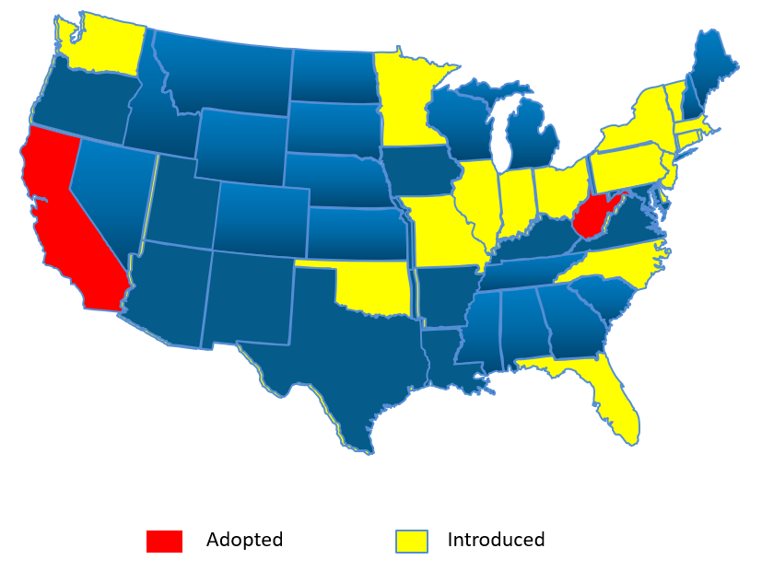
Food additive bans - statewide
ABA: We want to be really clear about the impact of this sweeping ban. It will hurt West Virginians, both consumers and workers, and the overall economy — all over ingredients that have been proven safe. This law will force everyday families to pay more for their groceries.
WV Gov Morrisey: By eliminating harmful chemicals from our food, we’re taking steps toward improving the health of our residents and protecting our children from significant long-term health and learning challenges. Thank you … HHS Secretary Robert Kennedy and the entire Trump administration for helping us launch this movement right here in West Virginia.
Most frequently included chemicals:
Dyes
Potassium bromate
Propylparaben
BVO
Titanium dioxide
BHT
ADA
At least 20 bills introduced
Notes:
ASTHO: In total, during the current legislative year, at least 30 states considered bills limiting the use of certain additives and dyes in food products. Twenty six of the bills would prohibit certain additives in any food in the state, 45 bills would ban food additives or dyes in foods served or sold at schools or limit ultra-processed foods in schools, and nine bills would require warning labels or notification of certain additives in food products or establish legislative commissions to make assessments and recommendations about food additives. The bills are also supported by members of both major political parties: Republicans sponsored 34 of the bills, Democrats sponsored 16, and 26 bills are bipartisan. (as of 4/18/25)
https://www.astho.org/communications/blog/2025/states-moving-to-prohibit-additives-and-dyes-in-food/#:~:text=Beginning%20May%207%2C%202025%2C%20Utah's,Yellow%205%2C%20or%20Yellow%206.
+++++
https://schoolnutrition.quorum.us/foodadditiveslegislation/
++++++
RFK after meeting with Big Food: And after Mr. Kennedy instructed food executives to rid the food supply of artificial dyes, he followed up with a video message on social media: “They understand that they have a new sheriff in town.”
NCA: “While there is a role for state legislators and public health officials to play inthe ongoing conversation about food additives, decision-making should be left to FDA
ABA also leading opposition here too – key member of Americans for Food and Beverage Choice (ABA, American Bakers Association, the Corn Refiners Association, FMI – The Food Industry Association, the Consumer Brands Association, the National Confectioners Association, the National Grocers Association and The Sugar Association. Americans for Food and Beverage Choice seeks to protect the rights of Americans to choose healthy, sustainable and affordable grocery items.
+++++
Tracker: https://ewg.maps.arcgis.com/apps/dashboards/64f81d77752347138e57fde7a285c8ee
2 adopted as of 3/27, 53 active. Map as of 3/31
WV adopts - bans from foods sold in this state: adulterated if it contains any added substance or ingredients which are poisonous or injurious to the health, including butylated hydroxyanisole, propylparaben, FD&C Blue No. 1, FD&C Blue No. 2, FD&C Green No. 3, FD&C Red No. 3, FD&C Red No. 40, FD&C Yellow No. 5, and FD&C Yellow No. 6; and bans in school meals the dyes. https://legiscan.com/WV/bill/HB2354/2025: Senate 26 Y, 4 N, House 88-8. The ban in connection with school lunches will go into effect Aug. 1, and the ban for items sold commercially will go into effect Jan. 1, 2028.
The lawmakers who crafted the bill, Sen. Jason Barrett, R-Berkeley, and Del. Evan Worrell, R-Cabell, said the legislation was inspired by the “MAHA movement” and “MAHA moms.” “Before we even walked into session, we knew we were going to go after some good ideas that were coming from MAHA and the MAHA moms that are out there,” Worrell said during a recent webinar on the bill. The law applies to around 50% of products currently distributed by the Coca-Cola Company and Pepsi Co., Farley (Teamsters) said.
West Virginia Governor Patrick Morrisey brought up the “make America healthy again” movement promoted by Robert F. Kennedy Jr., secretary for the US Department of Health and Human Services, when signing House Bill 2354 into law on March 24.
“West Virginia ranks at the bottom of many public health metrics, which is why there’s no better place to lead the make America healthy again mission,” he said. “By eliminating harmful chemicals from our food, we’re taking steps toward improving the health of our residents and protecting our children from significant long-term health and learning challenges. Thank you to the legislature, HHS Secretary Robert Kennedy and the entire Trump administration for helping us launch this movement right here in West Virginia.”
The Washington-based Americans for Food and Beverage Choice spoke against the West Virginia law.
“Every West Virginian should be deeply troubled that their elected representatives have enacted a sweeping food and beverage ban that effectively makes 60% of grocery store products illegal,” the group said. “This unprecedented prohibition on food and beverages will disrupt the lives of families and businesses across the state by driving up food prices, emptying grocery store shelves, and crippling the state’s food and beverage sector. “In fact, five of the seven food dyes have been rigorously evaluated and approved as safe for consumption by leading regulatory bodies worldwide, including in the US, Canada and the EU. A sixth dye included in the bill has been rigorously evaluated and approved for use in both the US and Canada, among many other countries, while the seventh dye isn’t even on the market in the US. This raises questions about whether West Virginia lawmakers conducted even the most elementary research on these common ingredients before outlawing them.”
“As the full consequences of this law come into focus, West Virginians will be shocked to learn that lawmakers rushed this bill through the process — probably the most consequential vote many of them will ever take, as one state senator acknowledged — without conducting so much as a basic economic or scientific analysis. Not a single politician in Charleston has provided information around how this sweeping ban will be enforced, what resources will be required, and how much it will cost West Virginians in terms of higher prices, shuttered businesses and lost jobs.”
NCA: “While there is a role for state legislators and public health officials to play inthe ongoing conversation about food additives, decision-making should be left to FDA,” the NCA said.
Partners of Americans for Food and Beverage Choice include the American Beverage Association, the American Bakers Association, the Corn Refiners Association, FMI – The Food Industry Association, the Consumer Brands Association, the National Confectioners Association, the National Grocers Association and The Sugar Association. Americans for Food and Beverage Choice seeks to protect the rights of Americans to choose healthy, sustainable and affordable grocery items.
RFK after meeting with Big Food: And after Mr. Kennedy instructed food executives to rid the food supply of artificial dyes, he followed up with a video message on social media: “They understand that they have a new sheriff in town.” (https://www.nytimes.com/2025/03/25/us/politics/formula-fries-rfk-kennedy-vaccines-measles.html?smid=nytcore-ios-share&referringSource=articleShare)
CA led the nation in 2023 with a ban on 4 food additives. And now CA has banned all except titanium dioxide, - that got dropped when candy makers protested and framed the bill as a “Skittles ban.” If just CA and IL have bans, this may lead to federal action as the food industry is faced with a hodgepodge of state regulations, which complicates manufacturing with multiple formulations.
After CA banned Red 3 and BVO, FDA finally followed suit. FDA waited 35 years on red 3 after concluding it caused cancer in animals and subsequently banned in cosmetics. And over 50 years after first became aware of BVO safety concerns
Red dye No. 3 is used in nearly 3,000 food products, including icings, nutritional shakes, maraschino cherries and peppermint-, berry- and cherry-flavored candies. It has been shown to cause cancer in animals, which prompted the U.S. Food and Drug Administration to ban its use in cosmetics in 1990. At the time, the agency said it would work to extend the ban to food, but the chemical remains in use today. There are also concerns that it and other synthetic food dyes may contribute to behavioral problems, such as hyperactivity, in children.
Titanium dioxide acts as a whitener, color enhancer and anti-caking agent in thousands of food items. It’s present in many candies, as well as baked goods, creamy salad dressings and frozen dairy products, like cheese pizza and ice cream. A safety assessment conducted by the European Food Safety Authority in 2021 concluded that titanium dioxide damages DNA and can harm the immune system, resulting in its ban in the E.U. in 2022.
Brominated vegetable oil serves as an emulsifier in fruit drinks and sodas. Research in rats — including a study published by the F.D.A. in 2022 — suggests that brominated vegetable oil acts as an endocrine disrupter, especially affecting the thyroid hormone. An earlier study found that it can also harm the reproductive system. Because of its potential risks, many large brands, including Coca-Cola and Pepsi, recently stopped using the chemical, but it’s still in some smaller and grocery store beverage brands.
Potassium bromate is primarily found in baked goods, including breads, cookies and tortillas, where it acts as a leavening agent and improves texture. The additive is classified as being “possibly carcinogenic to humans” by the International Agency for Research on Cancer, based on studies conducted in animals.
Propylparaben is a preservative used in packaged baked goods, particularly pastries and tortillas. It’s also present in many cosmetics and personal care products. Numerous studies, in humans and animals, indicate that propylparaben acts as an endocrine disrupter and affects male and female reproductive health.
+++++
2025 Bill trackr CT, DE, FL (warning, ban), IN HB1247. KY 895 (Red 3), NY Red, OK SB4, specifically targeting 21 substances including artificial colors (like Red dye 3, Blue dye 1), preservatives (such as sodium benzoate), and other chemicals like aspartame and brominated vegetable oil. Beginning
CT HB6808 - prohibit the manufacture, processing, sale, delivery, distribution, or sale of specific food additives in the state, namely brominated vegetable oil, potassium bromate, propylparaben, red dye number three, and titanium dioxide
DE –SB41 Ban Red 3
FL - H641 Label Blue 1, Blue 2, Green 3, Red 40, Yellow 5, Yellow 6, and titanium dioxide) to display a warning label that reads: "WARNING: This product contains synthetic colors, which may have an adverse effect on activity and attention in children.“
IN – HB1247 (introduced) prohibited food additives include various artificial food colorings (Blue 1, Blue 2, Green 3, Red 3, Red 40, Yellow 5, and Yellow 6) and brominated vegetable oil, propylparaben, potassium bromate
KY – HB95 - Red 3 = adulterated
NY 1556- prohibits the use of red dye 3, K Bromate., propylparaben a food color additive, in food products within New York State
OK SSB4 –
1. Aspartame;
2. Azodicarbonamide (ADA);
3. Blue dye 1;
4. Blue dye 2;
5. Brominated vegetable oil (BVO);
6. Butylated hydroxyanisole (BHA);
7. Butylated hydroxytoluene (BHT);
8. Ethylene dichloride;
9. Green dye 3;
10. Methylene chloride;
11. Potassium bromate;
12. Propyl gallate;
13. Propylparaben;
14. Red dye 3;
15. Red dye 40;
16. Sodium benzoate;
17. Sodium nitrate;
18. Titanium dioxide;
19. Trichloroethylene;
20. Yellow dye 5; or
21. Yellow dye 6.
For older 2024 - https://www.cspinet.org/page/where-red-3-legal-see-where-your-state-stands
Note in EU – required to show is safe. And more than 20 banned.
Note FDA finally bans Red 3 (FDA has data about cancer in rats in 1980s and banned in cosmetics in 1990 – 34 years later…) and BVO
2025:
In addition to bans, NYS has proposed Food Safety and Chemical Disclosure Act (A1556/S1239),
In addition to banning
Red 3 – cancer, neurobehavior, K Bromate – cancer, IARC possible carcinogen, kidney thyroid animal research, may cause DNA damage and oxidative stress. Also kidney and thyroid dysfunction in animal and models. Found in many baked goods. Becomes reactive oxidative species -oxidation – cell membrane damage and apoptosis.
Propylparaben – endocrine disruptor. Used as preservative in dairy, bev, , frozen meals, sauces, dressings, etc. Can contribute to breast cancer development. Also may affect other hormone sent cancers like ovarian and prostate. EU regulates, banned in CA. FDA consider safe in small amounts and “monitoring.”
NY has targeted the ones with most science, also requires greater transparency in chemical added to food – compnaies required to disclose the evidence and rationale for how they determined a chemical is GRAS when they use secret GRAS loophole in federal regulations on food additive. Secret GRAS in effect allow companies to self-assess chemical as GRAS and use them in foods without even notifying FDA.Public database. In process – not sure if it will make it.
NYS schools already ban synthetic dyes, propylparaben, K Bromate and some in NYS leg looking at school ban as well
Sourece – CSPI webinar 3.25
+++
https://www.food-safety.com/articles/10173-texas-west-virginia-progress-state-bills-to-ban-harmful-food-additives-dyes
WV: ban 7 dyes (impacting 30 producrts) in school meals – SB 545: Red 3, 40, Yellow 5,6, Blue 1,2,3, Green 3 > passed Senate Health Comm unanimous (look up on legiscan next week), main concern is behavioral issues. House 2354 passed house and Senate passed 31-2, bans in all food (adulterated) effective 2027
Red Dye No. 3
Red Dye No. 40
Yellow Dye No. 5
Yellow Dye No. 6
Blue Dye No. 1
Blue Dye No. 2
Green Dye No. 3
Also butylated hydroxyanisole, propylparaben,
Bans dyes in schools 8/1/25
leven other states have proposed legislation to ban different food dyes,
TX SB 25warning label for FOOD CONTAINING ARTIFICIAL COLOR,
ADDITIVES, OR CERTAIN BANNED CHEMICALS.
(a)
A food manufacturer
shall label each product the manufacturer offers for sale with a
warning label disclosing the use of any:
(1) artificial color;
(2) food additive; or
(3)
other chemical ingredient banned by Canada, the
European Union, or the United Kingdom.
At elast one of these labels: "WARNING: This product may expose you to [Name of Chemical], which is banned by [Name of Country]."; AND/OR "WARNING: This product contains artificial color or a food additive. Some scientific research suggests artificial colors and food additives may affect individuals with certain health conditions. For more information, visit [insert link to the United States Food and Drug Administration's Internet website].";
++++
CA schools - California School Food Safety Act, which bans RedDye No. 40, Yellow Dyes No. 5 and No. 6, Blue Dyes No. 1 and No. 2 and Green Dye No. 3 fromfood served in the state’s public schools beginning Dec. 31, 2027. Adopted 10/24. EWG and CR supported. Unless reformulated, some sports drinks, juices and sodas as well popular snacks, like HotCheetos, Doritos and M&M’s, currently available in California schools could no longer be sold inCalifornia schools after the ban goes into effect.
++++++
And yet another example of the interplay between state and federal policy is removing harmful food additives. The FDA has been very slow to address titanium dioxide, BVO, potassium bromate, propylparaben and Red Dye #3.
The EU has banned all of them. And now CA has banned all except titanium dioxide, - that got dropped when candy makers protested and framed the bill as a “Skittles ban.” Bills have been introduced to ban all five in NY and IL and the same 4 as in CA in WA, SD and MO. in current leg session. If just CA and IL have bans, this may lead to federal action as the food industry is faced with a hodgepodge of state regulations, which complicates manufacturing with multiple formulations.
FDA intends to revoke the approval of brominated vegetable oil finally and is finally reviewing the safety red dye No. 3. 35 years after it declared in a carcinogen in 1990 and eliminated it from cosmetics and drugs applied to the skin.
++++++++
Red dye No. 3 is used in nearly 3,000 food products, including icings, nutritional shakes, maraschino cherries and peppermint-, berry- and cherry-flavored candies. It has been shown to cause cancer in animals, which prompted the U.S. Food and Drug Administration to ban its use in cosmetics in 1990. At the time, the agency said it would work to extend the ban to food, but the chemical remains in use today. There are also concerns that it and other synthetic food dyes may contribute to behavioral problems, such as hyperactivity, in children.
Titanium dioxide acts as a whitener, color enhancer and anti-caking agent in thousands of food items. It’s present in many candies, as well as baked goods, creamy salad dressings and frozen dairy products, like cheese pizza and ice cream. A safety assessment conducted by the European Food Safety Authority in 2021 concluded that titanium dioxide damages DNA and can harm the immune system, resulting in its ban in the E.U. in 2022.
Brominated vegetable oil serves as an emulsifier in fruit drinks and sodas. Research in rats — including a study published by the F.D.A. in 2022 — suggests that brominated vegetable oil acts as an endocrine disrupter, especially affecting the thyroid hormone. An earlier study found that it can also harm the reproductive system. Because of its potential risks, many large brands, including Coca-Cola and Pepsi, recently stopped using the chemical, but it’s still in some smaller and grocery store beverage brands.
Potassium bromate is primarily found in baked goods, including breads, cookies and tortillas, where it acts as a leavening agent and improves texture. The additive is classified as being “possibly carcinogenic to humans” by the International Agency for Research on Cancer, based on studies conducted in animals.
Propylparaben is a preservative used in packaged baked goods, particularly pastries and tortillas. It’s also present in many cosmetics and personal care products. Numerous studies, in humans and animals, indicate that propylparaben acts as an endocrine disrupter and affects male and female reproductive health.
++++++
https://www.dailymail.co.uk/health/article-12619767/Food-additive-titanium-dioxide-BANNED-EU-UK-US.html
CA: In his statement on signing the bill, Governor Newsom implied that the ban is temporary, pending the FDA’s setting safe levels for these additives. He also said the ban would not need to be implemented until 2027.https://candyusa.com/news/nca-statement-on-california-governor-newsom-signing-bill-ab-418-to-ban-certain-food-ingredients/
California’s AB 418, the California Food Safety Act, is now law.
Commencing January 1, 2027, a person or entity shall not manufacture, sell, deliver, distribute, hold, or offer for sale, in commerce a food product for human consumption that contains any of the following substances:
Brominated vegetable oil [Emulsifies citrus-flavored drinks, but can cause heart lesions and fatty liver in children and headaches, dizziness, and memory loss among other problems in adults]
Potassium bromate [Used as a dough conditioner, but is a possible human carcinogen]
Propylparaben [A preservative but disrupts endocrine function]
Red dye 3 [Banned in cosmetics because of its carcinogenic potential]
The bill addresses additives banned in Europe on the basis of various health concerns. Originally it also included titanium dioxide, but that got dropped when candy makers protested and framed the bill as a “Skittles ban.”
https://www.nytimes.com/2023/04/13/well/eat/food-additive-ban.html
Red dye No. 3 is used in nearly 3,000 food products, including icings, nutritional shakes, maraschino cherries and peppermint-, berry- and cherry-flavored candies. It has been shown to cause cancer in animals, which prompted the U.S. Food and Drug Administration to ban its use in cosmetics in 1990. At the time, the agency said it would work to extend the ban to food, but the chemical remains in use today. There are also concerns that it and other synthetic food dyes may contribute to behavioral problems, such as hyperactivity, in children.
Titanium dioxide acts as a whitener, color enhancer and anti-caking agent in thousands of food items. It’s present in many candies, as well as baked goods, creamy salad dressings and frozen dairy products, like cheese pizza and ice cream. A safety assessment conducted by the European Food Safety Authority in 2021 concluded that titanium dioxide damages DNA and can harm the immune system, resulting in its ban in the E.U. in 2022.
Brominated vegetable oil serves as an emulsifier in fruit drinks and sodas. Research in rats — including a study published by the F.D.A. in 2022 — suggests that brominated vegetable oil acts as an endocrine disrupter, especially affecting the thyroid hormone. An earlier study found that it can also harm the reproductive system. Because of its potential risks, many large brands, including Coca-Cola and Pepsi, recently stopped using the chemical, but it’s still in some smaller and grocery store beverage brands.
Potassium bromate is primarily found in baked goods, including breads, cookies and tortillas, where it acts as a leavening agent and improves texture. The additive is classified as being “possibly carcinogenic to humans” by the International Agency for Research on Cancer, based on studies conducted in animals.
Propylparaben is a preservative used in packaged baked goods, particularly pastries and tortillas. It’s also present in many cosmetics and personal care products. Numerous studies, in humans and animals, indicate that propylparaben acts as an endocrine disrupter and affects male and female reproductive health.
++++++++
2024
the Illinois Food Safety Act (SB 2637)would ban brominated vegetable oil, potassium bromate, propylparaben, red dyeNo.3 and titanium dioxide from retail food products -- potentially making it thestrictest food additive ban in the country next to California’s Food Safety Act, whichexcluded titanium dioxide. Illinois lawmakers cite health concerns surrounding the use of the five additives , "all of whichhave been linked to serious health problems, including hyperactivity, nervous system damage,reproductive issues, hormonal damage and increased risk of cancer.“Because of health concerns, the use of these chemicals in food items is already prohibited in the European Union and several other countries (intro, in committee)
A similar bill introduced in New York by Sen. Brian Kavanaugh (D-District 27) proposes the sameban for all five ingredients , for the same reasons. https://legislation.nysenate.gov/pdf/bills/2023/S6055A (intro)
MO- HB 2474 – all but titanium (intro)
WA – HB1921 - Red 3, brominated vegetable oil,propylparaben, and potassium bromate
While FDA intends to revoke the approval of brominated vegetable oil in food and beverageproducts and is reviewing the safety red dye No. 3 , the agency still maintains the safety oftitanium dioxide at 1% or less by weight of the food.
CSPI:
Red 3 is a particularly egregious case of regulatory failure. The FDA learned Red 3 was a carcinogen in the 1980s and declared it as such in 1990. For that reason, the agency eliminated Red 3 from cosmetics and drugs applied to the skin. The same year, the FDA said it would “takesteps” to ban the use of Red 3 in foods, ingested drugs, and dietary supplements. That ban never arrived, and Red 3 is still used
Brominated vegetable oil, or BVO, is an emulsifier that’s used to mix citrus flavors into liquids,usually in soft drinks. BVO leaves residues in body fat and fat in the brain, liver, and otherorgans. Animal studies indicate that BVO is transferred to nursing infants and can causemicroscopic changes to heart cells, fatty changes in the liver, and impaired growth andbehavioral development. An animal study that fed rats BVO at quantities similar to what somepeople might consume through food and beverage sources also showed changes in somelevels of thyroid hormones and impacts on the thyroid gland; the thyroid gland and itshormones play a number of very important roles in the body, such as regulating metabolismand brain development. In December 2023, the FDA proposed a ban on BVO.
Potassium bromate has been banned virtually worldwide except in Japan and the United States.Most bromate rapidly breaks down to form innocuous bromide. However, bromate itself causescancer in animals, and the cumulative effect of consuming tiny amounts of bromate poses asmall risk to consumers. In 1999, CSPI petitioned the FDA to ban bromate. Since then,numerous millers and bakers have stopped using it
Parabens are used as preservatives in personal care products, some household products likecleaners and soaps, and in some processed foods. Propylparaben, along with some otherparaben ingredients, has been banned from food products in Europe due to healthconcerns involving endocrine disruption and fertility issues.
Titanium dioxide is a color additive currently approved for use in the U.S. in human food, drugs,cosmetics, and medical devices like contact lenses. It can be found in baked goods, chewinggum, chocolate, puddings, hard-shelled candies, frosting, dressings, sauces, and coffeecreamers, among other food products, where it imparts a white color. Titanium dioxidewas recently banned from use in food in Europe over concerns that it could harm human health.Based on evidence that titanium dioxide nanoparticles present in food-grade titanium dioxidecan accumulate in the body and cause DNA damage, CSPI rates titanium dioxide as “Avoid.”

Slide 14
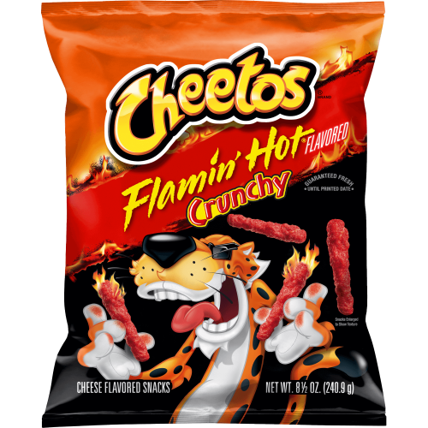
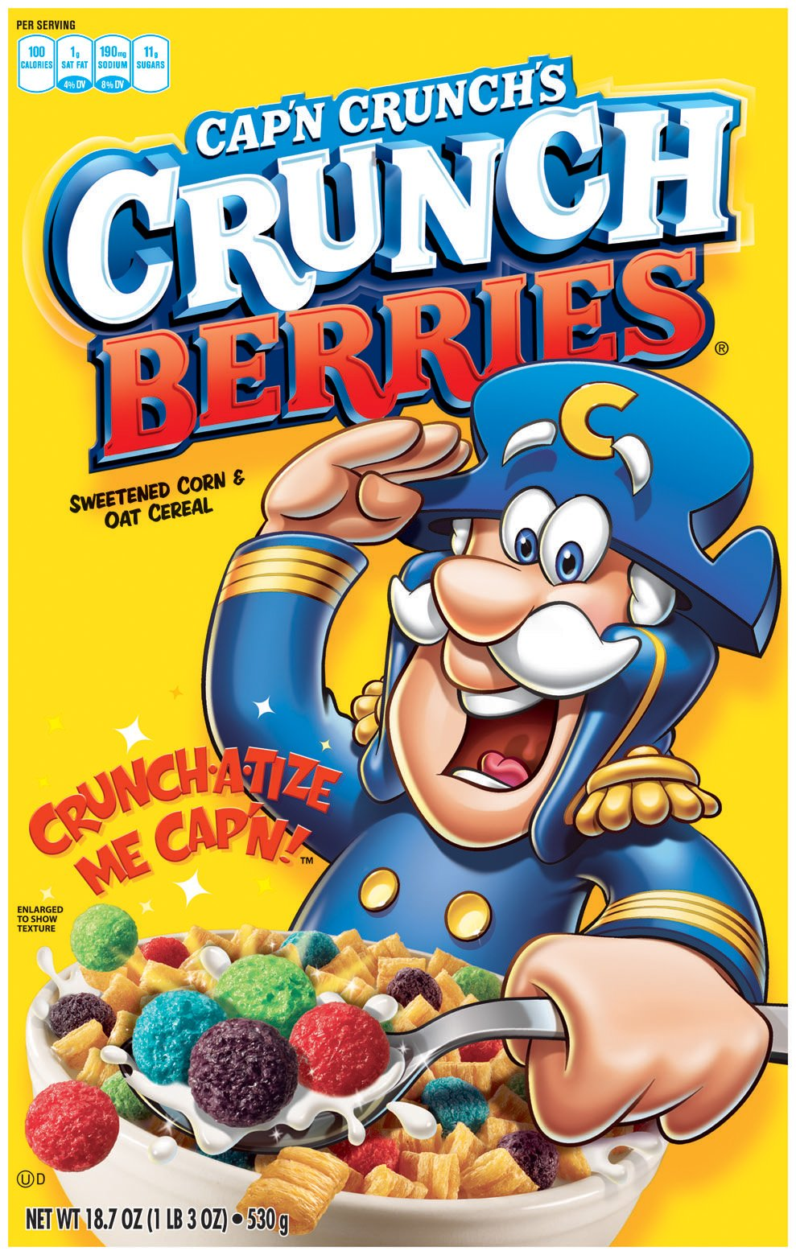
Food additive bans in school meals
Red 40, Yellow 5 and 6
Red 40, Yellow 5 and 6, Blue 1
California School Safety Act (2024)
Prohibits schools K-12 from offering foods or beverages containing
red 40
yellow 5 and 6
blue 1 and 2
green 3
Notes:
Again, CA led way in 2024 with ban on dyes in school foods
+++++
Sen Booker introduced the Federal Safe School Meals Act (): Directing FDA to reevaluate 15 food additives (including dyes, titanium, K Bromate, propylparaben, and others) with known carcinogenic, reproductive, or developmental health harms, such as artificial food dyes, and ban their use in school meals prior to the completion of FDA’s analysis.
Butylated hydroxyanisole.
22 (II) Butylated hydroxytoluene.
23 (III) Tert-butylhydroquinone.
24 (IV) Sodium benzoate.
25 (V) Propyl gallate.
1 (VI) Titanium dioxide.
2 (VII) FD&C Red 3.
3 (VIII) FD&C Red 40.
4 (IX) FD&C Yellow 5.
5 (X) FD&C Yellow 6.
6 (XI) FD&C Green 3.
7 (XII) FD&C Blue 1.
8 (XIII) FD&C Blue 2.
9 (XIV) Azodicarbonamide.
10 (XV) Potassium bromate.
11 (XVI) Propyl paraben
https://www.cnn.com/2024/08/30/health/california-food-dye-ban-schools-wellness/index.html
prohibits a school district, county superintendent of schools or charter school with grades kindergarten through 12th from offering foods or beverages containing red dye No. 40, yellow dyes Nos. 5 and 6, blue dyes Nos. 1 and 2, and green dye No. 3. Some of these dyes are found in some, but not all, products under the Cheetos, Doritos, Skittles, M&Ms, Starburst, Gatorade, Mountain Dew, Cap’n Crunch, Ruffles and Takis brands. The bill stems from concerns these dyes would harm children’s ability to learn, as they have been linked to behavioral difficulties and decreased attention among children, according to a 2021 study by the California Office of Environmental Health Hazard Assessment.

Slide 15
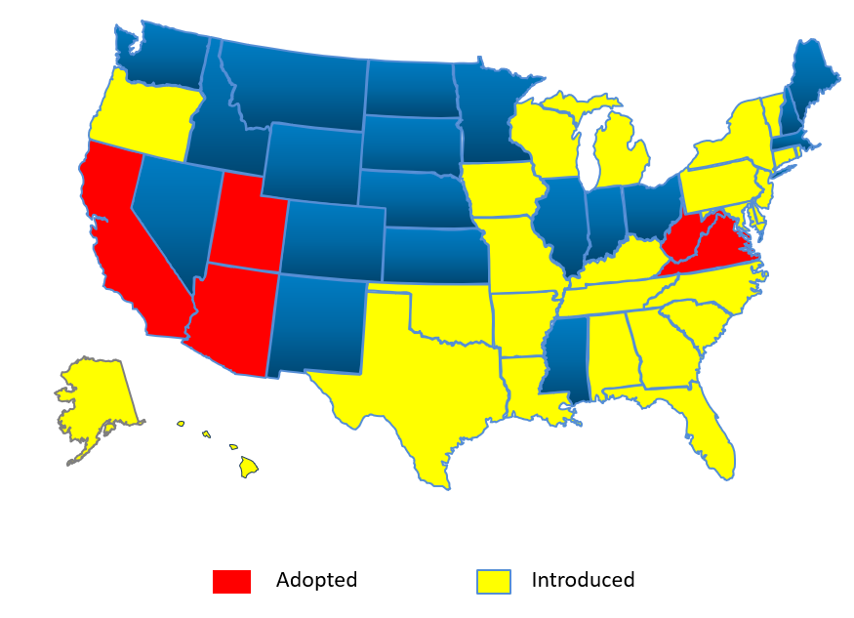
Additive Bans in Schools - 2025
At least 30 bills introduced
Red 3, red 40, yellow 5 and 6, blue 1 and 2, green 3,
BVO, potassium bromate propylparaben, titanium dioxide,
(ADA, BHA, BHT, caramel color)
Notes:
AND and chat GPT 6.22.25
Bill track search dye school* 3.31: passed VA and WV, passed house AZ, in committee other states,
And XX states have followed suit, building on MAHA energy
Passed and signed: Food and beverage companies have deadlines to meet if they want to keep offering items containing certain synthetic colors at public schools in Virginia and West Virginia. Governors of both states have signed laws that ban seven synthetic dyes: Red No. 3 or No. 40, Yellow No. 5 or No. 6, Blue No. 1 or No. 2, or Green No. 3.
The Virginia law, which only covers food sold at school, goes into effect July 1, 2027. Virginia Governor Glenn Youngkin signed House Bill No. 1910 and Senate Bill No. 1289 into law on March 21. It prohibits any public elementary or secondary school from offering or making available to any student any food served as part of a school meal or any competitive food that contains any of the seven food colors.
++++++++
Emily Broad Lieb 6.2.25
Here are the state UPF in school bills that I have been tracking:
Arizona (HB2164) ENACTED: Prohibits schools from providing ultraprocessed foods
Ultraprocessed = foods containing Red 3, Red 40, Yellow 5, Yellow 6, Blue 1, Blue 2, Green 3, potassium bromate, propyl paraben, titanium dioxide and BVO
California (AB1264): prohibits schools from providing ultraprocessed foods
Ultraprocessed = food that has the following technical effects: surface-active agents, stabilizers and thickeners, propellants, aerating agents, and gases, color and coloring adjuncts, emulsifiers and emulsifier salts, non-natural flavoring agents, non-natural flavor enhancers, surface-finishing agents, non-nutritive sweeteners
Massachusetts (HB539): “No food service provider may sell or serve in Massachusetts public schools, school districts, or other entities more than 20% of entrée items that meet one or more of the following: qualify as ultra-processed; have a nutritional composition that includes more than 30 milligrams of cholesterol more than 5% of the entrées’ total calories come from saturated fat as part of a weekly reimbursable meal offering within the federal National School Lunch”
ultra-processed = industrial formulations of food substances never or rarely used in kitchens (such as high-fructose corn syrup, hydrogenated or interesterified oils, and hydrolysed proteins), or classes of additives designed to make the final product palatable, appealing, or preservable (such as flavours, flavour enhancers, colours, emulsifiers, emulsifying salts, sweeteners, thickeners, nitrates, nitrites, preservatives, and anti-foaming, bulking, carbonating, foaming, gelling and glazing agents
Missouri (2 bills)
(HB1412): For the 2026-27 school year and all subsequent school years, no public school 18 or school district shall serve or sell ultraprocessed food on school grounds during the 19 regular school day.
ultraprocessed = food containing ADA, BVO, BGA, Potassium bromate, Propylparaben, Titanium dioxide, Blue 1, Blue 2, Green 3, Red 3, Red 40, Yellow 5, Yellow 6
(SB802): Beginning in the 2026-2027 school year and for all 18 subsequent school years, any school that participates in a SB 802 2 19 federally funded or assisted meal program shall not serve, 20 sell, or allow a third party to sell ultraprocessed food on 21 the school campus during the school day.
ultraprocessed = foods containing potassium bromate, propyl paraben, titanium dioxide, BVO, Yellow 5, Yellow 6, Blue 1, Blue 2, Green 3, Red 3, or Red 40
Pennsylvania: A public school may not sell or offer a competitive food on school grounds during the school day if the competitive food contains an “unhealthy ultra-processed food.”
"Unhealthy ultra-processed food" = means an ultra-processed food that does not comply with the requirements under 21 CFR 101.65(d) (relating to implied nutrient content claims and related label statements) , as of the effective date of this section, for use of the term "healthy" as an implied nutrient content claim on the label or in labeling of a food.
Ultraprocessed food = food containing any of surface-active agents, stabilizers and thickeners, propellants, aerating agents, and gasses, colors and color adjunts, emulsifiers and emulsifier salts, flavoring agents and adjuvants, flavor enhancers, surface-finishing agents, non-nutritive sweeteners, or “A substance available in the Food and Drug Administration Substances Added to Food database that are designated as having any of the technical effects listed in paragraph (1), excluding spices and other natural seasonings and flavorings, as listed in 21 CFR 182.10 as of the effective date of this section”
+++++
Add CT HB05869 blue dye number one, blue dye number two, green dye number three, red dye number forty, yellow dye number five, yellow dye number six, and ti dioxide. In committee
DE SB65– red 40 committee
FL S1826 – “ultraprocessed” Potassium bromate. 2. Propylparaben. 3. Titanium dioxide. 4. Brominated vegetable oil. 5. Yellow dye 5. 6. Yellow dye 6. 7. Blue dye 1. 8. Blue dye 2. 9. Green dye 3. 10. Red dye 3. 11. Red dye 40. in senate committee > dead
GA HB642 - Blue 1, Blue 2, Green 3, Red 3, Red 40, Yellow 5, and Yellow 6) introduced
IA HF212 -blue dye 1, blue dye 2, brominated vegetable oil, green dye 3, margarine, potassium bromate, propylparaben, red dye 3, red dye 40, yellow dye 5, or yellow dye 6.
KY HB439 – “ultraprocessed” BVO, K bromate, propyl, titanium, dyes in committee
MO SB802 potassium bromate, propylparaben, titanium dioxide, brominated vegetable oil, and various artificial food dyes (including Yellow dye 5 and 6, Blue dyes 1 and 2, Green dye 3, and Red dyes 3 and 40). Committee -
RI H5115 Blue No. 1 and 2, Green No. 3, Red No. 40, and Yellow No. 5 and 6 committee
SC H4263 Blue dye 1, Blue dye 2, Green dye 3, Red dye 40, Yellow dye 5, and Yellow dye 6 committee
New LA SB 14: Blue dye 1 (CAS 3844-45-9). 6 (2) Blue dye 2 (CAS 860-22-0). 7 (3) Green dye 3 (CAS 2353-45-9). 8 (4) Red dye 3 (CAS 16423-68-0). 9 (5) Red dye 40 (CAS 25956-17-6). 10 (6) Yellow dye 5 (CAS 1934-21-0). 11 (7) Yellow dye 6 (CAS 2783-94-0). 12 (8) Azodicarbonamide. 13 (9) Butylated hydroxyanisole (BHA). 14 (10) Butylated hydroxytoluene (BHT). 15 (11) Potassium bromate.
WI – new - https://www.weau.com/2025/03/28/lawmakers-look-clean-up-school-lunches/
AZ HB2164- : Potassium bromate. 2. Propylparaben. 3. Titanium dioxide. 4. Brominated vegetable oil. 5. Yellow dye 5. 6. Yellow dye 6. 7. Blue dye 1. 8 . Blue dye 2. 9. Green dye 3. 10. Red dye 3. 11. Red dye 40. – passed house > Senate considering with both caucuses saying do pass (3.25) > signed by gov 4/14
HI SB682 - This bill prohibits the use of synthetic substances in school meals at both the Hawaii Department of Education and public charter schools. Specifically, the bill defines "synthetic substances" as food coloring, color additives, or colorants that impart color when added to food or beverages. The legislation would apply to all school meal programs in these educational settings, effectively banning artificial colors from meals served to students.
NYA1556 - FD&C Red No. 3 27 b. FD&C Red No. 40 28 c. FD&C Blue No. 1 29 d. FD&C Blue No. 2 30 e. FD&C Green No. 3 31 f. FD&C Yellow No. 5 32 g. FD&C Yellow No. 6
TX HB1637 - his bill prohibits school districts and open-enrollment charter schools from serving or selling ultraprocessed food on school campuses during regular school hours, specifically targeting foods containing certain chemical additives such as brominated vegetable oil (BVO), potassium bromate, various food coloring agents (like red 3, red 40, yellow 5 and 6, blue 1 and 2, green 3), propylparaben, titanium dioxide, and other substantially similar additives. The bill defines these foods as "ultraprocessed food" and explicitly states that parents or guardians are still permitted to provide such foods to their children during school hours. The legislation is set to take effect for the 2025-2026 school year, with the potential for immediate implementation if it receives a two-thirds vote from members of the Texas legislature. By targeting specific chemical additives, the bill aims to improve the nutritional quality of food served in public schools and potentially reduce students' exposure to certain potentially harmful substances.
TX3736 - This bill prohibits school districts and open-enrollment charter schools from providing meals or drinks containing specific food additives and artificial colors. The banned substances include several color additives with their Chemical Abstracts Service (CAS) registry numbers: red 3, red 40, yellow 5, yellow 6, blue 1, blue 2, green 3, and caramel coloring. The bill also broadly prohibits any additive substantially similar to those listed, effectively creating a comprehensive ban on these potentially harmful food colorings and additives. The new regulation will take effect with the 2025-2026 school year, giving schools time to adjust their food and beverage offerings. The bill aims to improve the nutritional quality of school meals by removing artificial colors and potentially harmful additives, with the goal of promoting student health. If the bill receives a two-thirds vote in the Texas Legislature, it will take effect immediately; otherwise, it will become law on September 1, 2025.
VAHB1910 - Blue No. 1, Blue No. 2, Green No. 3, Red No. 3, Red No. 40, Yellow No. 5, and Yellow No. 6 – adopted 3/21
ORHB3015 - This bill modifies Oregon's existing school nutrition regulations by prohibiting three specific chemical additives (Red Number 3, potassium bromate, and propylparaben) from being included in food and beverage items sold to students in public schools during the regular or extended school day. The bill builds upon existing nutritional standards that already regulate the calorie, fat, sugar, and serving size of food and beverage items sold in schools, which vary depending on the grade levels of students. These standards apply to food and beverage sales during school hours, including before and after classes and during school-related activities like clubs and practices, but do not apply to events where parents or other adults are present or to meals served as part of federal school lunch and breakfast programs. The restrictions do not prevent school districts from adopting even more stringent nutritional guidelines, and schools are required to annually report their compliance with these standards to the Department of Education.
IL SB2637 - Brominated vegetable oil, potassium bromate, propylparaben, or red dye 3 2024 - died
SD HB1169 2024 – BVO, K Bromate, Propylparaben. ,Red 3 die
MO 2024 – HB2474 BVO, K Bromate, Propylparaben. ,Red 3 die but senate still alive

Slide 16
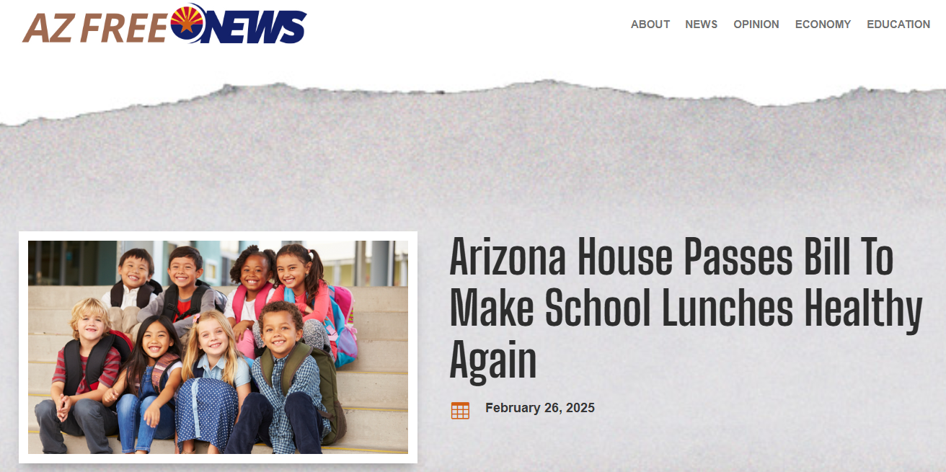
Ban ultraprocessed foods – school meals
Enacted
The legislature finds that:
2. Ultraprocessed, industrially manufactured, nutrient-depleted food with synthetic additives is undernourishing minors at public schools and contributing to childhood obesity.
3. Any taxpayer-funded meal or snack program offered to minors at public schools in this state should be nutritious and made primarily of whole, minimally processed plant or animal products
AL
AR
AZ
CA
FL
KY
LA
MA
MO
NC
PA
SC
TX
US HR2530
Schools participating in school meals program shall not serve or sell ultraprocessed food on the school campus during the normal school day. “Ultraprocessed food" means a food or beverage that contains one or more of the following ingredients:
1. Potassium bromate
2. Propylparaben
3. Titanium dioxide
4. Brominated vegetable oil
5. Yellow dye 5 and 6
6. Blue dye 1 and 2
7. Green dye 3
8. Red dye 3 and 4
Nutrition advisory committee to examine impact of UPF on health and develop guidelines
TX
Notes:
Let’s start with UPFs. There has been a proliferation of bills that purport to tackle UPF, primarily in schools. This slide show the AZ bill, which is typical. Note the While they use term UPF, they are mostly focused on additives.
+++++
Searched in bill track –ultraprocessed and also searched ultra-processed: 4/13/25
++++
Emily Broad Lieb 6.2.25
Here are the state UPF in school bills that I have been tracking:
Arizona (HB2164) ENACTED: Prohibits schools from providing ultraprocessed foods
Ultraprocessed = foods containing Red 3, Red 40, Yellow 5, Yellow 6, Blue 1, Blue 2, Green 3, potassium bromate, propyl paraben, titanium dioxide and BVO
California (AB1264): prohibits schools from providing ultraprocessed foods
Ultraprocessed = food that has the following technical effects: surface-active agents, stabilizers and thickeners, propellants, aerating agents, and gases, color and coloring adjuncts, emulsifiers and emulsifier salts, non-natural flavoring agents, non-natural flavor enhancers, surface-finishing agents, non-nutritive sweeteners
Massachusetts (HB539): “No food service provider may sell or serve in Massachusetts public schools, school districts, or other entities more than 20% of entrée items that meet one or more of the following: qualify as ultra-processed; have a nutritional composition that includes more than 30 milligrams of cholesterol more than 5% of the entrées’ total calories come from saturated fat as part of a weekly reimbursable meal offering within the federal National School Lunch”
ultra-processed = industrial formulations of food substances never or rarely used in kitchens (such as high-fructose corn syrup, hydrogenated or interesterified oils, and hydrolysed proteins), or classes of additives designed to make the final product palatable, appealing, or preservable (such as flavours, flavour enhancers, colours, emulsifiers, emulsifying salts, sweeteners, thickeners, nitrates, nitrites, preservatives, and anti-foaming, bulking, carbonating, foaming, gelling and glazing agents
Missouri (2 bills)
(HB1412): For the 2026-27 school year and all subsequent school years, no public school 18 or school district shall serve or sell ultraprocessed food on school grounds during the 19 regular school day.
ultraprocessed = food containing ADA, BVO, BGA, Potassium bromate, Propylparaben, Titanium dioxide, Blue 1, Blue 2, Green 3, Red 3, Red 40, Yellow 5, Yellow 6
(SB802): Beginning in the 2026-2027 school year and for all 18 subsequent school years, any school that participates in a SB 802 2 19 federally funded or assisted meal program shall not serve, 20 sell, or allow a third party to sell ultraprocessed food on 21 the school campus during the school day.
ultraprocessed = foods containing potassium bromate, propyl paraben, titanium dioxide, BVO, Yellow 5, Yellow 6, Blue 1, Blue 2, Green 3, Red 3, or Red 40
Pennsylvania: A public school may not sell or offer a competitive food on school grounds during the school day if the competitive food contains an “unhealthy ultra-processed food.”
"Unhealthy ultra-processed food" = means an ultra-processed food that does not comply with the requirements under 21 CFR 101.65(d) (relating to implied nutrient content claims and related label statements) , as of the effective date of this section, for use of the term "healthy" as an implied nutrient content claim on the label or in labeling of a food.
Ultraprocessed food = food containing any of surface-active agents, stabilizers and thickeners, propellants, aerating agents, and gasses, colors and color adjunts, emulsifiers and emulsifier salts, flavoring agents and adjuvants, flavor enhancers, surface-finishing agents, non-nutritive sweeteners, or “A substance available in the Food and Drug Administration Substances Added to Food database that are designated as having any of the technical effects listed in paragraph (1), excluding spices and other natural seasonings and flavorings, as listed in 21 CFR 182.10 as of the effective date of this section”
+++++
Except for the MA H539 (uses Nova and no more than 20% of entrees can be UPF – in committee), CA study bill and TX bill which sets up a committee to develop guidelines.
+++++++
On the Arizona Legislature’s Request to Speak system, representatives from the Arizona Association of County School Superintendents, Arizona Public Interest Research Group, indicated their groups’ support for the bill; while representatives from Save Our Schools Arizona and Consumer Brands Asso
ciation, signed in to oppose the proposal. Representatives from the Arizona Food Bank Network, Arizona School Administrators, Arizona Education Association, and Arizona School Boards Association, noted their organizations’ neutrality on the bills.
Representative Biasiucci credited the national Make America Healthy Again movement, as well as parents, health advocates, and public figures, for rallying behind the effort. “This is a public health issue,” he said. “We now have overwhelming evidence that these chemicals can contribute to everything from hyperactivity to increased cancer risk—yet they remain in school meals. We hope to end that today.” https://www.azleg.gov/press/house/57LEG/1R/250224BIASIUCCIHB2164.pdf
+++++
Emiuly Broad Leib 6.2.25
Here are the state UPF in school bills that I have been tracking:
Arizona (HB2164) ENACTED: Prohibits schools from providing ultraprocessed foods
Ultraprocessed = foods containing Red 3, Red 40, Yellow 5, Yellow 6, Blue 1, Blue 2, Green 3, potassium bromate, propyl paraben, titanium dioxide and BVO
California (AB1264): prohibits schools from providing ultraprocessed foods
Ultraprocessed = food that has the following technical effects: surface-active agents, stabilizers and thickeners, propellants, aerating agents, and gases, color and coloring adjuncts, emulsifiers and emulsifier salts, non-natural flavoring agents, non-natural flavor enhancers, surface-finishing agents, non-nutritive sweeteners
Massachusetts (H539): “No food service provider may sell or serve in Massachusetts public schools, school districts, or other entities more than 20% of entrée items that meet one or more of the following: qualify as ultra-processed; have a nutritional composition that includes more than 30 milligrams of cholesterol more than 5% of the entrées’ total calories come from saturated fat as part of a weekly reimbursable meal offering within the federal National School Lunch”
ultra-processed = industrial formulations of food substances never or rarely used in kitchens (such as high-fructose corn syrup, hydrogenated or interesterified oils, and hydrolysed proteins), or classes of additives designed to make the final product palatable, appealing, or preservable (such as flavours, flavour enhancers, colours, emulsifiers, emulsifying salts, sweeteners, thickeners, nitrates, nitrites, preservatives, and anti-foaming, bulking, carbonating, foaming, gelling and glazing agents
Missouri (2 bills)
(HB1412): For the 2026-27 school year and all subsequent school years, no public school 18 or school district shall serve or sell ultraprocessed food on school grounds during the 19 regular school day.
ultraprocessed = food containing ADA, BVO, BGA, Potassium bromate, Propylparaben, Titanium dioxide, Blue 1, Blue 2, Green 3, Red 3, Red 40, Yellow 5, Yellow 6
(SB802): Beginning in the 2026-2027 school year and for all 18 subsequent school years, any school that participates in a SB 802 2 19 federally funded or assisted meal program shall not serve, 20 sell, or allow a third party to sell ultraprocessed food on 21 the school campus during the school day.
ultraprocessed = foods containing potassium bromate, propyl paraben, titanium dioxide, BVO, Yellow 5, Yellow 6, Blue 1, Blue 2, Green 3, Red 3, or Red 40
Pennsylvania: HB1132 public school may not sell or offer a competitive food on school grounds during the school day if the competitive food contains an “unhealthy ultra-processed food.”
"Unhealthy ultra-processed food" = means an ultra-processed food that does not comply with the requirements under 21 CFR 101.65(d) (relating to implied nutrient content claims and related label statements) , as of the effective date of this section, for use of the term "healthy" as an implied nutrient content claim on the label or in labeling of a food.
Ultraprocessed food = food containing any of surface-active agents, stabilizers and thickeners, propellants, aerating agents, and gasses, colors and color adjunts, emulsifiers and emulsifier salts, flavoring agents and adjuvants, flavor enhancers, surface-finishing agents, non-nutritive sweeteners, or “A substance available in the Food and Drug Administration Substances Added to Food database that are designated as having any of the technical effects listed in paragraph (1), excluding spices and other natural seasonings and flavorings, as listed in 21 CFR 182.10 as of the effective date of this section”
++++++
++++
AR HB1962 - Ultra-processed food — Prohibition — Definition. (a) The General Assembly finds that: (1) Childhood obesity, morbidity, and wellness are matters of statewide concern; (2) Ultra-processed, industrially manufactured, nutrient- depleted food with synthetic additives is undernourishing to students at schools and contributes to childhood obesity; and (3) A meal or snack offered to students at schools in this state should be nutritious and made primarily of nutrient-dense plant or animal products. (b) As used in this section: (1) "School" means: HB1962 (A) A public school district; (B) An open-enrollment public charter school; or (C) A private school; and (2) "Ultra-processed food" means a food or beverage that contains one (1) or more of the following ingredients: (A) Potassium bromate; (B) Propylparaben; (C) Titanium dioxide; (D) Yellow dye 5; (E) Yellow dye 6; (F) Blue dye 1; (G) Blue dye 2; (H) Green dye 3; (I) Red dye 3; or (J) Red dye 40. (c) A school shall not serve or sell on the school campus during the normal school day ultra-processed food that is produced after January 1, 2028. (d) This section does not prevent a parent, legal guardian, or person standing in loco parentis to a student from providing ultra-processed food to his or her child during the normal school day. (e) The Department of Education may promulgate rules to implement this section.
AZ HB 2164 – bans UPF from schools – defined by food additives (K Bromate, propylparaben, titanium dioxide, BVO, yellow 5, 6, blue 1,2m green 3, red 3, 40m > MAHA frame > passed house andi n Senate
AZ2213 - This bill introduces two key provisions related to school nutrition in Arizona. First, it prohibits public schools from serving, selling, or allowing the sale of ultraprocessed foods on school campuses during the normal school day, with a specific list of banned ingredients including various food dyes, preservatives, and additives like potassium bromate, propylparaben, and titanium dioxide. The Department of Education is required to create and post a standardized certification form for schools and maintain a list of schools complying with this restriction. Second, the bill appropriates $3,800,000 from the state general fund in fiscal year 2025-2026 to provide free school lunches for children who meet income eligibility requirements under national school lunch programs. The legislature intends this funding to be ongoing in future years, ensuring continued support for students from lower-income families. Parents are still allowed to provide ultraprocessed foods to their children during the school day, despite the ban on such foods being served or sold by the school.
MA H539/S401 - Section 100. (a) The purpose of this section is to ensure that the students of the Commonwealth are appropriately nourished in order to support a healthier, livable and more equitable future for all. (b) For the purposes of this section, the following words shall have the following meanings:- (i) food service management company is defined as a commercial enterprise or a nonprofit organization which is or may be contracted with by the school food authority to manage any aspect of the school food service (ii) entrée is defined as the meat/meat alternate category within the USDA’s Federal Nutrition Standards (iii) Fiber-rich” is defined as an entrée item that contains at least 14 g of fiber per 1000kcal from whole food sources such as whole grains, legumes, beans, pulses, fruits, and vegetables (iv) “Reimbursable meal” is any meal that meets the United States Department of Agriculture (USDA) National School Lunch Program nutritional requirements for federal reimbursement at the annual allotted rate of any of the following: (a) free lunch; (b) reduced- price lunch; or (c) paid lunch (v) “ultra-processed food” is defined as industrial formulations of food substances never or rarely used in kitchens (such as high-fructose corn syrup, hydrogenated or interesterified oils, and hydrolysed proteins), or classes of additives designed to make the final product palatable, appealing, or preservable (such as flavours, flavour enhancers, colours, emulsifiers, emulsifying salts, sweeteners, thickeners, nitrates, nitrites, preservatives, and anti-foaming, bulking, carbonating, foaming, gelling and glazing agents) (c) Any food service management company selling food to Massachusetts public schools for our children to consume shall ensure that at least 50% of the entrées sold and served for lunch within school hours in schools, school districts, or other entities over the course of each week are healthy foods containing whole grains, vegetables, fruits, legumes and other fiber-rich proteins as part of a reimbursable meal offering within the federal National School Lunch Program. (d) No food service provider may sell or serve in Massachusetts public schools, school districts, or other entities more than 20% of entrée items that meet one or more of the following: qualify as ultra-processed; have a nutritional composition that includes more than 30 milligrams of cholesterol more than 5% of the entrées’ total calories come from saturated fat as part of a weekly reimbursable meal offering within the federal National School Lunch (e) Each food service provider selling food to Massachusetts public schools for school children to consume, shall keep itemized nutrition data that is made publicly available on a monthly basis to demonstrate compliance with this statute. (f) Each food service management company will have a phase in period of three years following the initial date of their most recent contract with their respective school food authority or by the first day of the school calendar year 2033-2034, whichever comes first.
MO1412 - As used in this section, "ultraprocessed food" means an article or item commonly used for food or drink as part of a product or meal that contains at least one of the following ingredients or color additives: (1) Azodicarbonamide (ADA) (CAS 123-77-3); (2) Brominated vegetable oil (BVO); (3) Butylated hydroxyanisole (BHA) (CAS 25013-16-5); (4) Potassium bromate (CAS 7758-01-2); (5) Propyl p-hydroxybenzoate or Propylparaben (CAS 94-13-3); (6) Titanium dioxide (CAS 13463-67-7); (7) FD&C Blue No. 1 (CAS 3844-45-9); (8) FD&C Blue No. 2 (CAS 860-22-0); (9) FD&C Green No. 3 (CAS 2353-45-9); (10) FD&C Red No. 3 (CAS 16423-68-0); (11) FD&C Red No. 40 (CAS 25956-17-6); (12) FD&C Yellow No. 5 (CAS 1934-21-0); or (13) FD&C Yellow No. 6 (CAS 2783-94-0). HB 1412 2. For the 2026-27 school year and all subsequent school years, no public school or school district shall serve or sell ultraprocessed food on school grounds during the regular school day. 3. Nothing in this section shall be construed to prevent a student's parent, legal guardian, or other person having charge, custody, or control of the student from providing the student with food or drink that contains ultraprocessed food during the regular school day. 4. (1) Before August first of each school year, each school district shall submit a comprehensive list of all food and drink items intended to be served during the current school year to the department of elementary and secondary education for approval. The list shall include a statement, signed by an authorized school district representative, affirming that each listed food or drink item has been reviewed and is not ultraprocessed food. (2) Upon receipt of the list and statement, the department shall grant a one-year preliminary approval to the school district. (3) (a) If a school district fails to submit the required list and statement or a food inspection reveals the presence of ultraprocessed food in violation of subsection 2 of this section, the department shall notify the general assembly of the school district's noncompliance. (b) If a school district fails to submit the required list and statement or fails a food inspection as described in paragraph (a) of this subdivision for two consecutive years, the department shall withhold any allocated moneys from the school district until the district is in compliance with this section
NC H874 - 115C-264.6. Prohibition on ultra-processed foods. (a) Local boards of education shall not allow a school food authority or a third party to serve or sell ultra-processed food on school grounds during the school day. (b) The Department of Public Instruction shall create a standardized form through which a local board of education can certify that no ultra-processed foods are being served or sold in any school under jurisdiction of the board. The Department shall publish and maintain a list on its website of all public schools that are certified as not serving or selling ultra-processed foods. (c) Nothing in this section shall be construed as preventing the parent or guardian of a student from providing the student ultra-processed foods during the school day. (d) For purposes of this section, "ultra-processed food" means any food or beverage that contains one or more of the following ingredients: (1) Potassium Bromate. (2) Propylparaben. (3) Titanium Dioxide. (4) Brominated Vegetable Oil. (5) Yellow Dye 5. (6) Yellow Dye 6. (7) Blue Dye 1. (8) Blue Dye 2. (9) Green Dye 3. (10) Red Dye 3. (11) Red Dye 40.“
NJ S4560
UPF = potassium bromate, propylparaben, titanium dioxide, brominated vegetable oil, and various synthetic dyes such as FD&C Yellow 5 and 6, Red 3 and 40, Green 3, and Blue 1 and 2.
SC H4339 For the purposes of this section, "ultraprocessed food" means any food or beverage that contains one or more of the following additives:
(1) Potassium bromate;
(2) Propylparaben;
(3) Titanium dioxide;
(4) Brominated vegetable oil;
(5) Yellow Dye 5 (Tartrazine);
(6) Yellow Dye 6 (Sunset Yellow);
(7) Blue Dye 1 (Brilliant Blue);
(8) Blue Dye 2 (Indigo Carmine);
(9) Green Dye 3 (Fast Green);
(10) Red Dye 3 (Erythrosine);
(11) Red Dye 40 (Allura Red).
TX SB25 – nutrition advisory committee to examine impact of UPF on health, including artificial color and food additives and develop nutriotn guidelines and excludes committee members who own 3%+ in food, bev or pharm company or whose relatives do and requires disclosures of affiliations with these industries or other COI
TX HB3292 This bill prohibits school districts and open-enrollment charter schools from serving or selling ultraprocessed food on school campuses during regular school hours, specifically targeting foods containing certain chemical additives such as brominated vegetable oil (BVO), potassium bromate, various food coloring agents (like red 3, red 40, yellow 5 and 6, blue 1 and 2, green 3), propylparaben, titanium dioxide, and other substantially similar additives. The bill defines these foods as "ultraprocessed food" and explicitly states that parents or guardians are still permitted to provide such foods to their children during school hours
TX HB25 – Established TEXAS NUTRITION ADVISORY COMMITTEE - The advisory committee shall: (1) examine the impact of nutrition on human health and examine the connection between ultra-processed foods, including foods containing artificial color and food additives, and the prevalence of chronic diseases and other chronic health issues; (2) provide an independent review of scientific studies analyzing the effects of ultra-processed foods on human health; (3) provide education on the effects of ultra-processed foods on human health; and (4) develop and maintain dietary and nutritional guidelines based on the consensus of available scientific studies and information concerning diet and nutrition.
MO SB802 – same as TX
FL S1826 – same as TX
KY HB439 - "Ultra-processed food" means a food product for human consumption that contains any of the following substances: 1. Brominated vegetable oil, chemical abstracts service number 8016-94- 2; 2. Potassium bromate, chemical abstracts service number 7758-01-2; 3. Propylparaben, chemical abstracts service number 94-13-3; 4. Titanium dioxide, chemical abstracts service number 13463-67-7; 5. Red dye 3, chemical abstracts service number 16423-68-0; 6. Red dye 40, chemical abstracts service number 25956-17-6; 7. Yellow dye 5, chemical abstracts service number 1934-21-0; 8. Yellow dye 6, chemical abstracts service number 2783-94-0; 9. Blue dye 1, chemical abstracts service number 3844-45-9; 10. Blue dye 2, chemical abstracts service number 860-22-0; and 11. Green dye 3, chemical abstracts service number 2353-45-9. (2)[Beginning with the 2006-2007 school year, ]Each school shall limit access to no more than one (1) day each week to retail fast foods in the cafeteria, whether sold by contract, commercial vendor, or otherwise. (3) Beginning with the 2026-2027 school year, a school shall not sell or provide ultra-processed foods to students during the school day. This subsection applies to the availability of food in cafeterias, vending machines, school stores, XXXX 2/12/2025 11:29 AM Jacketed canteens, food sold through fundraisers hosted by students, teachers, or groups, or any other mechanism for providing food to students during the school day. (4) This section shall not be construed to limit the sale of any food or beverages at fundraisers off school property or outside of the school day.
LA SB14 - Ultra processed foods; prohibition A.(1) No public school governing authority shall serve an ultra processed food to students in schools under its jurisdiction. (2) No nonpublic school that receives state funds shall serve an ultra processed food to students. (3) The provisions of this Subsection shall apply to breakfasts and lunches served as part of a school food program. B. For the purposes of this Section, "ultra processed food" means a food or beverage that contains one or more of the following ingredients: (1) Blue dye 1 (CAS 3844-45-9). (2) Blue dye 2 (CAS 860-22-0). (3) Green dye 3 (CAS 2353-45-9). (4) Red dye 3 (CAS 16423-68-0). (5) Red dye 40 (CAS 25956-17-6). (6) Yellow dye 5 (CAS 1934-21-0). (7) Yellow dye 6 (CAS 2783-94-0). (8) Azodicarbonamide. (9) Butylated hydroxyanisole (BHA). (10) Butylated hydroxytoluene (BHT). (11) Potassium bromate. (12) Propylparaben. (13) Titanium dioxide.
LA HB 117 / B117 - R.S. 17:192.3 is hereby enacted to read as follows: §192.3. Healthy school lunches; ultra-processed food prohibited A. The legislature hereby finds that: (1) Childhood obesity, morbidity, and wellness are matters of statewide concern. (2) Ultra-processed, industrially manufactured, nutrient-depleted food with synthetic additives is undernourishing minors at public schools and contributing to childhood obesity. (3) Any taxpayer funded meal or snack program offered to minors at public schools in this state should be nutritious and made primarily of whole, minimally processed plant or animal products. B. Beginning in the 2026-2027 school year, any public school that participates in a federally funded or assisted meal program shall not serve or sell, nor allow a third party to serve or sell ultra-processed food on the school campus during a regular school day. This Subsection does not prevent a student's parent or guardian from providing ultra-processed food to the student during a regular school day. C. The state Department of Education shall post on the department's website the following: (1) A standardized form that a public school may use to certify that the public school is complying with the requirements prescribed by this Section. (2) A list of each public school that has certified to the department that the public school is complying with the requirements prescribed by this Section. D. For the purposes of this Section, "ultra-processed food" means a food or beverage that contains one or more of the following ingredients: (1) Aspartame. (2) Blue dye 1. (3) Blue dye 2. (4) Brominated vegetable oil. (5) Cottonseed oil. (6) Grapeseed oil. (7) Green dye 3. (8) Potassium bromate. (9) Propylparaben. (10) Red dye 3. (11) Red dye 40. (12) Safflower oil. (13) Titanium dioxide. (14) Yellow dye 5. (15) Yellow dye 6.
HI SR82 – RESOLUTION urging the Director of Health and the Director of Corrections and Rehabilitation to encourage hospitals and prisons to offer more healthy food options that consist of minimally-processed fruits, vegetables, whole grains, legumes, nuts and seeds, herbs and spices, and non-dairy beverages, rather than ultra-processed foods.
CA- AB 1264 This bill would state the intent of the Legislature to enact future legislation limiting the sale of ultraprocessed foods in California schools.
US HR2530: NUTRITIONAL AND OTHER REQUIREMENTS. Section 9(a)(1)(A) of the Richard B. Russell National School Lunch Act is amended— (1) in clause (i), by striking ‘‘and’’ at the end; (2) in clause (ii), by striking the period at the end and inserting ‘‘; and’’; and (3) by adding at the end the following: ‘‘(iii) shall prohibit— ‘‘(I) ultraprocessed foods (as described in group 4 of the NOVA classification system); and ‘‘(II) foods containing— ‘‘(aa) potassium bromate; ‘‘(bb) propylparaben; ‘‘(cc) titanium dioxide; ‘‘(dd) brominated vegetable oil; ‘‘(ee) yellow dye 5; ‘‘(ff) yellow dye 6; ‘‘(gg) blue dye 1; ‘‘(hh) blue dye 2; ‘‘(ii) green dye 3; ‘‘(jj) red dye 3; or ‘‘(kk) red dye 40.’’ In committee 4/1 – Mike Kennedy (R) is sole sponsor
IN SCR - That the Indiana General Assembly supports and adopts the following principles and priorities for a healthier citizenry: 1. Reform the Food Economy: The Supplemental Nutrition Assistance Program should exclude ultra-processed, high-sugar, and high-fat junk foods while incentivizing fresh, nutrient- dense options; state partnerships with local farmers, grocers, and schools should seek to increase access to healthy, affordable food in underserved areas; and crop subsidies should incentivize healthy, whole foods instead of ultra-processed foods.
++++
SNAP UPF resolutions
TB HJR0069 - BE IT RESOLVED BY THE HOUSE OF REPRESENTATIVES OF THE ONE HUNDRED FOURTEENTH GENERAL ASSEMBLY OF THE STATE OF TENNESSEE, THE SENATE CONCURRING, that the State support and adopt the following principles and priorities for a healthier citizenry: 1. Reform the Food Economy. a. The Supplemental Nutrition Assistance Program (SNAP) should exclude ultra- processed, high-sugar, and high-fat junk foods while incentivizing fresh, nutrient-dense options. b. State partnerships with local farmers, grocers, and schools should seek to increase access to healthy, affordable food in underserved areas. c. Crop subsidies should incentivize healthy, whole foods instead of ultra- processed foods. 2. Support Lifestyle Medicine and Education. a. Integration of health and wellness curricula into K-12 schools, focusing on nutrition, exercise, and the long-term benefits of healthy living, would make our children healthier. b. Greater public access to lifestyle medicine practitioners through state healthcare programs and partnerships with medical schools would improve health outcomes. c. Utilization of health savings accounts and flexible spending accounts to cover more holistic and preventative care, such as exercise costs and nutritional supplements, would create opportunities for better health. 3. Encourage Good Governance. a. Conflicts of interest in the FDA, USDA, and other regulatory agencies lead to flawed nutrition standards and must be eliminated. b. Toxins banned in other developed countries are poisoning our food, water, and consumer goods and should be banned here as well. c. The FDA's slow and costly approval process stifles healthcare innovation. 4. Lead by Example in State Institutions. a. Food served in state facilities, including schools and government offices, should meet high nutritional standards. b. Wellness programs and resources for state employees reduce healthcare costs and improve productivity.
An overhead close up view of a tray containing an unhealthy school lunch consisting of a personal size pepperoni pizza, salty chips, a chocolate doughnut, chocolate pudding and chocolate flavored milk. Isolated on white.“https://www.gettyimages.com/photos/unhealthy-school-lunch

Slide 17
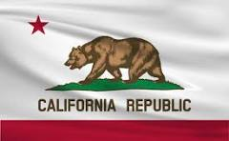
CA AB 1264
UPF defined as Nova 4 additives with cosmetic functions or NSS
Particularly harmful UPF: UPF product that is particularly harmful, as determined by regulations adopted by the Office of Environmental Health Hazard Assessment considering:
  Substance banned in other jurisdictions or product carry warning label
  Substance linked to health harms based on scientific evidence
  Substance is hyperpalatable or addictive based on scientific evidence
  Product is high in fat, sugar or salt
January 1, 2028: Begin to phase out particularly harmful UPF.
January 1, 2032, prohibit a vendor from offering particularly harmful UPF to a school.
It is the intent of the Legislature to reduce the consumption of ultraprocessed foods by the children of California, and to encourage schools and school districts to promote and provide healthier options in school meals
Notes:
The CA bill (Rep Gabriel) is taking a broader view of what UPF is…and one more likely to yield meaningful health benefits since based on the Nova classification, which is the definition of UPF used in 100s of research studies demonstrating link of UPF to a range of chronic health conditions.
+++++
UPF defined as Nova 4 additives with cosmetic functions or NSS (did not include food substances of no culinary use component)
Cosmetic: flavours, flavour enhancers, colours, emulsifiers, emulsifying salts, sweeteners, thickeners and anti-foaming, bulking, carbonating, foaming, gelling and glazing agents
no culinary use: (varieties of sugars such as fructose, high-fructose corn syrup, ‘fruit juice
concentrates’, invert sugar, maltodextrin, dextrose and lactose; modified starches; modified oils such as hydrogenated or interesterified oils; and protein sources such as hydrolysed proteins, soya protein isolate, gluten, casein, whey protein and ‘mechanically separated meat

Slide 18
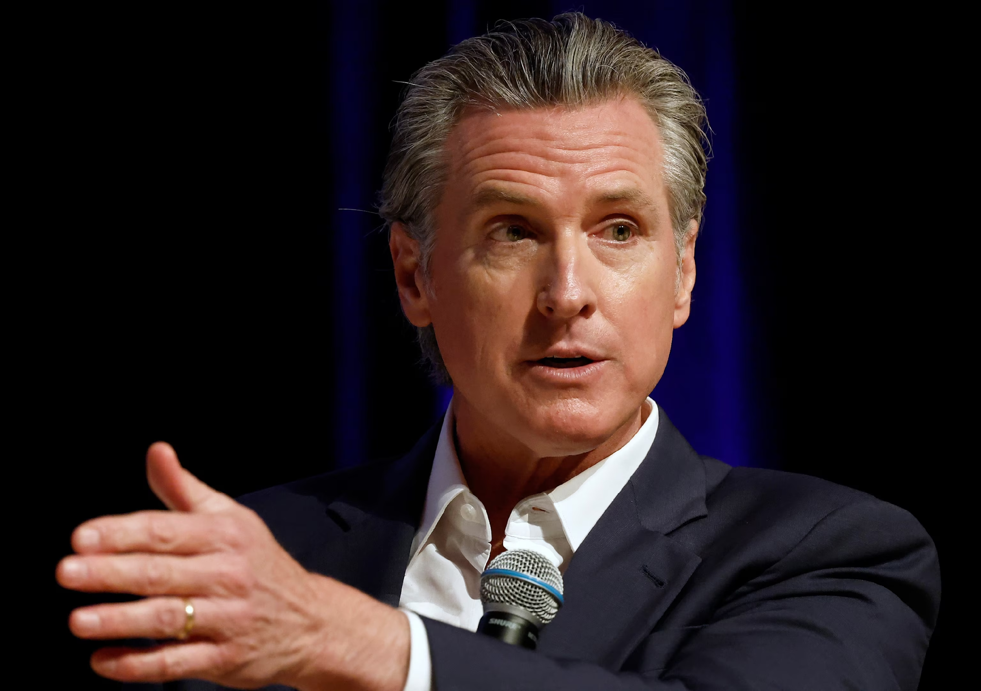
California Executive Order N-1-25
Recommendations to the Governor's Office regarding potential action to limit the harms associated with "ultra­processed foods" and other food ingredients May include warning labels for certain ultra­processed foods.
Investigate adverse health impacts of food dyes
Explore evaluation of GRAS food additives and state-level action if companies fail to notify the FDA of certain food additives through the voluntary GRAS process.
Reduce state purchases of soda, candy, other ultra-processed foods and/or foods with synthetic food dye or other additives.
Require or encourage Medi-Cal managed care plans and hospitals to fund access to fresh, healthy foods, mitigate the impacts of "food deserts," and otherwise promote public health at the local level.
Adopt higher standards for healthy school meals than USDA standards’
School food programs have fresh ingredients and options grown in California and shall redouble to support for farm-to-school program
Notes:
Gov Newsom issued an EO in January calling on multiple state agencies to develop proposals to reduce harms from UPF broadly as well as additives specifically. and increase access to healthier foods. What California does is significant – it can drive change across the country and even globally. It is, after all, the 5th largest economy in the world after US, China, Germany, and Japan.

Slide 19
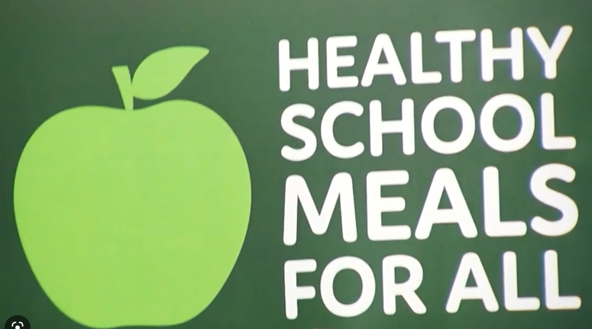
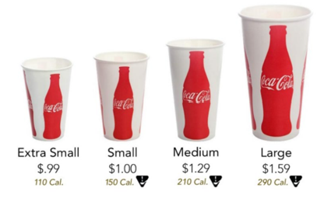
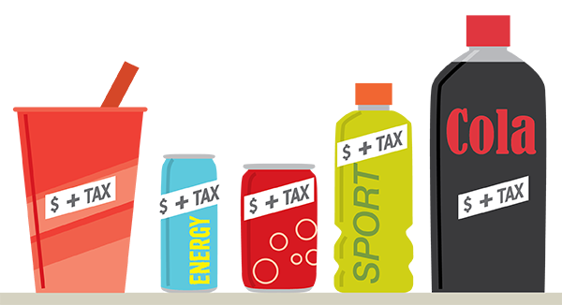
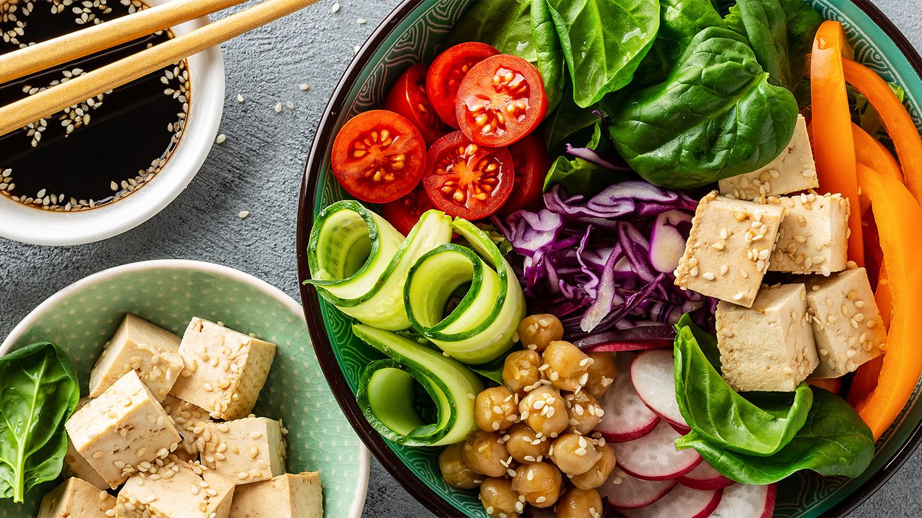
State and local healthy food policies
Availability/Quality
Acceptability/Appeal
Affordability
Food System
Food additives
Kids’ meals
School meals
Summer EBT
Healthy checkout policies
Retail marketing
Pouring rights
Procurement & nutrition standards
Early learning food
Healthy Food Financing/Incentives
Healthy corner stores
Stocking requirements
Water access
Tax incentives for food donations
Fast food zoning and permitting
Mobile food vendors
Portion size
Warning labels
Menu labels
Meat alternative labels
Marketing restrictions
Countermarketing
Sweetened beverage tax
Summer EBT
Universal free school meals
Nutrition incentives/Produce Rx
Food as Medicine
SNAP restrictions and enhancements
Minimum pricing
Plant-based foods
Food waste and rescue
Food hubs
Urban agriculture
Local/regional food system policy
Food Policy Councils
Right to Food
Farm to Table
Land use and zoning
Farmers markets
HEALTHY FOOD AMERICA
Notes:
There are many, many policies in play and I can’t cover all of them today. The list goes far beyond the narrow MAHA focus. They include policies more likely to have real health and enviromental benefits.
Policy at state and local level can build on and address gaps in federal policy, and is often the source of innovative polices.
It is often more politically feasible to adopt a policy at the local or state level. And easier to for people from impacted communities to engage and play leadership roles, making it easier to authentically center policy work in equity.
This is a partial list - there is no source that comprehensively describes them all, so there is much going on that I don’t know about.
I will go into a more detail about the ones that are in bold.

Slide 20
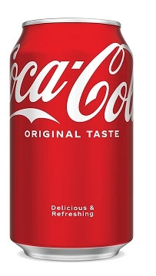
Warning labels
Additives
(Texas SB25) (similar LA SB14)
Food and beverage packages
WARNING: This product may expose you to [Name of Chemical], which is banned by [EU, UK, or Canada].“
and/or
WARNING: This product contains artificial color or a food additive. Some scientific research suggests artificial colors and food additives may affect individuals with certain health conditions. For more information, visit [insert link to the United States Food and Drug Administration's Internet website]
Synthetic Colors
(Florida S764)
Food and beverage packages
"WARNING: This product contains synthetic colors, which may have an adverse effect on activity and attention in children."
Added Sugars
(New York State AB 5305/SB 2087)
Beverage containers
“SAFETY WARNING: This beverage contains 100% or more of the FDA's recommended daily intake of added sugar.“
Vending, dispensers, menu, menu board
SAFETY WARNING: The Food and Drug Administration recommends limiting added sugars to 50 grams per day based on a 2,000 calorie diet
Sodium
(New York State SB 448)
Menus
WARNING: Contains more than total daily recommended limit (2300 mg) 100% of sodium. High sodium intake can increase blood pressure and the risk of heart disease and stroke (with icon)
SAFETY WARNING:
This beverage contains 100% or more of the FDA's recommended daily intake of added sugar
Notes:
It has been a busy year for Warning Labels as well. Bills in several states call for warning labels for added sugars and sodium (NY), and additives (TX and FL). For example, TX will require an additive warning on products banned in the EU, UK, Canada. The EU has banned dozens of additives – many more than the FDA has taken action on.
+++++++
TX SB/HB 25 passed 6.1 and sent to governor
WARNING: This product contains an ingredient that is not recommended for human consumption by the appropriate authority in Australia, Canada, the European Union, or the United Kingdom.";
(1) acetylated esters of mono- and diglycerides (acetic acid ester);
(2) anisole;
(3) azodicarbonamide (ADA);
(4) butylated hydroxyanisole (BHA);
(5) butylated hydroxytoluene (BHT);
(6) bleached flour;
(7) blue 1 (CAS 3844-45-9);
(8) blue 2 (CAS 860-22-0);
(9) bromated flour;
(10) calcium bromate;
(11) canthaxanthin;
(12) certified food colors by the United States Food and Drug Administration;
(13) citrus red 2 (CAS 6358-53-8);
(14) diacetyl;
(15) diacetyl tartaric and fatty acid esters of mono- and diglycerides (DATEM);
(16) dimethylamylamine (DMAA);
(17) dioctyl sodium sulfosuccinate (DSS);
(18) ficin;
(19) green 3 (CAS 2353-45-9);
(20) interesterified palm oil;
(21) interesterified soybean oil;
(22) lactylated fatty acid esters of glycerol and propylene glycol;
(23) lye;
(24) morpholine;
(25) olestra;
(26) partially hydrogenated oil (PHO);
(27) potassium aluminum sulfate;
(28) potassium bromate;
(29) potassium iodate;
(30) propylene oxide;
(31) propylparaben;
(32) red 3 (CAS 16423-68-0);
(33) red 4 (CAS 4548-53-2);
(34) red 40 (CAS 25956-17-6);
(35) sodium aluminum sulfate;
(36) sodium lauryl sulfate;
(37) sodium stearyl fumarate;
(38) stearyl tartrate;
(39) synthetic trans fatty acid;
(40) thiodipropionic acid;
(41) titanium dioxide;
(42) toluene;
(43) yellow 5 (CAS 1934-21-0); and
(44) yellow 6 (CAS 2783-94-0).
LA: requires label on long list (based on EU/Canada/Australia/UK https://legiscan.com/LA/text/SB14/2025
FL S0764: This bill creates a new law requiring food and drink products containing certain synthetic color additives to display a warning on their packaging about potential adverse effects on children's activity and attention. Starting July 1, 2026, products containing specific synthetic colors like Blue 1, Blue 2, Green 3, Red 40, Yellow 5, Yellow 6, and titanium dioxide must include a warning statement: "WARNING: This product contains synthetic colors, which may have an adverse effect on activity and attention in children." Manufacturers can use adhesive stickers for the warning until December 31, 2028, after which the warning must be printed directly on the packaging. T
NY AB 91/SB 2087: warning on beverage container, "SAFETY WARNING: This beverage contains 100% or more of the FDA's recommended daily intake of added sugar." For, vending machines:, self service bev dispensing machine, men u, meun-board>100% DV sugar :"SAFETY WARNING: The Food and Drug Administration recommends limiting added sugars to 50 grams per day based on a 2,000 calorie diet." Menus:
NYS SB 448 – Menu warning if 100% or more of DV. No later than one year after the effective date of this section,
44 the department shall promulgate rules and regulations designating a
45 warning and factual warning statement.NYS Sb – 100% or more sodium warning label with icon, develop details wijtin one year buy DOH
NYS AB 5305 Requires chain restaurants to display an added sugars warning next to or directly under the name of each food item withhigh added sugars (100%+ DV)content wherever such food item is listed on a menu, menu board, or food tag, and by any self-serve dispensingpoint at which such food item is dispensed.
TX SB 25warning label for FOOD CONTAINING ARTIFICIAL COLOR,
ADDITIVES, OR CERTAIN BANNED CHEMICALS.
(a)
A food manufacturer
shall label each product the manufacturer offers for sale with a
warning label disclosing the use of any:
(1) artificial color;
(2) food additive; or
(3)
other chemical ingredient banned by Canada, the
European Union, or the United Kingdom.
At elast one of these labels: "WARNING: This product may expose you to [Name of Chemical], which is banned by [Name of Country]."; AND/OR "WARNING: This product contains artificial color or a food additive. Some scientific research suggests artificial colors and food additives may affect individuals with certain health conditions. For more information, visit [insert link to the United States Food and Drug Administration's Internet website].";
NYS SB42: 100% or more DV of added sugars > NY DOH shall develop regs for warning within one year –
MA – 2023-34 SB reintroduce – menu warnings/icon of > DV of added sugars: :this item may exceed the total daily recommended limit for added sugars based on a 2,000 calorie diet. AND shall encourage school districts
97 to implement instruction in media literacy skills from the third grade to the twelfth grade, and in
98 any of the core subjects or other subjects, to equip students with skills for accessing, analyzing,
99 evaluating, and creating all types of media. Instruction shall include, but not be limited to,
100 teaching of skills for analyzing and evaluating advertising content for food, beverages, drugs and
101 alcohol.
+++++
2015 New York City adopts a sodium
icon on restaurant menus for items
contain 100% or more of the daily
value for sodium (2,300mg).
• 2019 Philadelphia adopts a similar
icon
• 2021/2023 New York City Sweet
Truth Act
• “Safety warnings” not preempted by
federal law
Warning: indicates that the
sodium (salt) content of this item is higher
than the total daily recommended limit
(2,300 mg). High sodium intake can
increase blood pressure and risk of heart
disease and stroke.
+++++
NY city sweet tritu act
On September 3, 2024 , New York City marked a significant milestone in its public health efforts to reduce added sugars consumption by issuing a final rule implementing the Sweet Truth Act, a bill requiring sugar warnings for chain restaurant menus. This landmark regulation mandates that food service establishments with 15 or more locations display clear and visible added sugar warning icons on menus, menu boards, and self-service food areas for items exceeding the recommended daily limit of 50 grams.
++++++
Cleeland 50% sodium DV _DeAnna

Slide 21
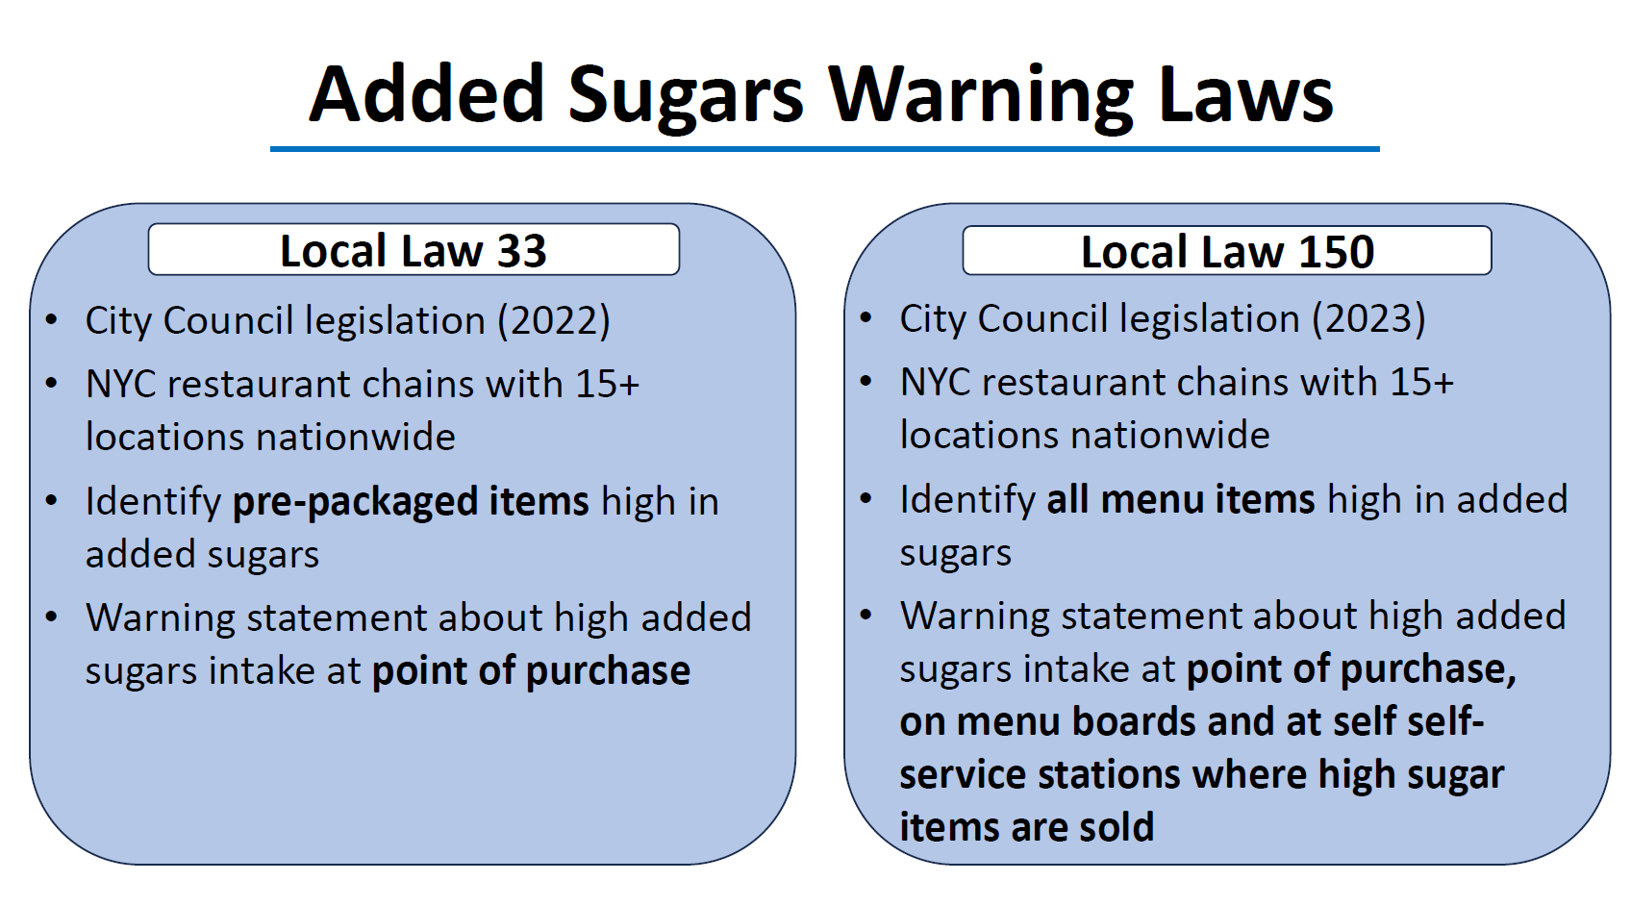
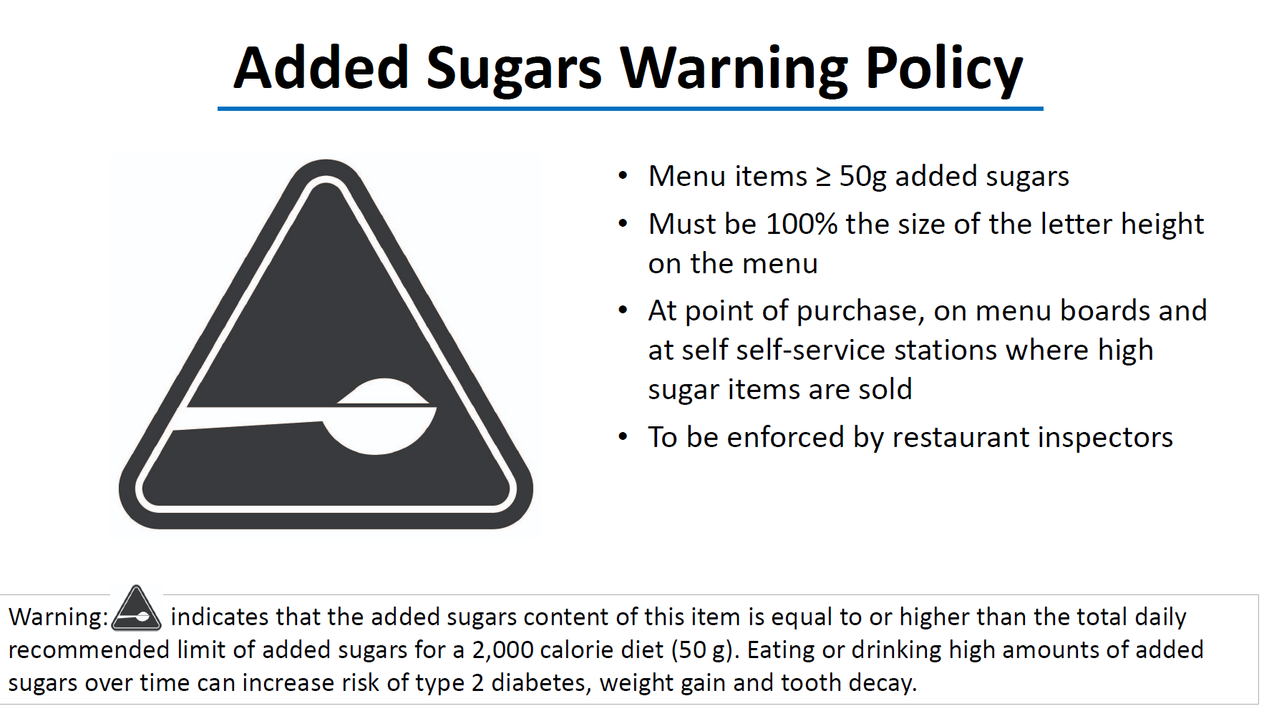
New York City
Added Sugars Warnings
New – MA S1571
Icon
“This item may exceed the total daily recommended limit for added sugars based on a 2,000 calorie diet”
Notes:
NYC has adopted an added sugars warning label for menus and pre-packaged items.
Because the FDA currently only requires added sugars information for prepackaged foods and not restaurant menu items, the added sugars content is not known. The New York City rule will at first only apply to prepackaged items as well as fountain sodas and other menu items with an identical prepackaged version. Once the FDA updates its menu labelling rules to require restaurants to disclose added sugars, the warnings will be required to appear on all high sugar menu items.
+++++
Notice of adoption 9/3/24. https://www.nyc.gov/assets/doh/downloads/pdf/cdp/added-sugars-warning-rule.pdf AND https://www.nyc.gov/assets/doh/downloads/pdf/about/healthcode/health-code-chapter39.pdf
The warning statement must be posted in a clearly visible place at the point of purchase and on menus, menu boards and self-service food locations.
Law expands to qualifying non-packaged food items one year after restaurants are required to disclose added sugars content
Post a warning icon next to prepackaged food items — those with a Nutrition Facts label — that have 50 grams (g) or more of added sugars and food items identical to prepackaged food items that have 50 g or more of added sugars on menus (including print, electronic and online menus), menu boards and item tags. Menu items include combination meals. • Post an added sugars warning statement at the point of purchase and on menus, menu boards and self-service food locations. The statement explains that items with the icon contain as much as or more than the daily recommended limit of added sugars per day and that consuming too much added sugar is a health risk.

Slide 22
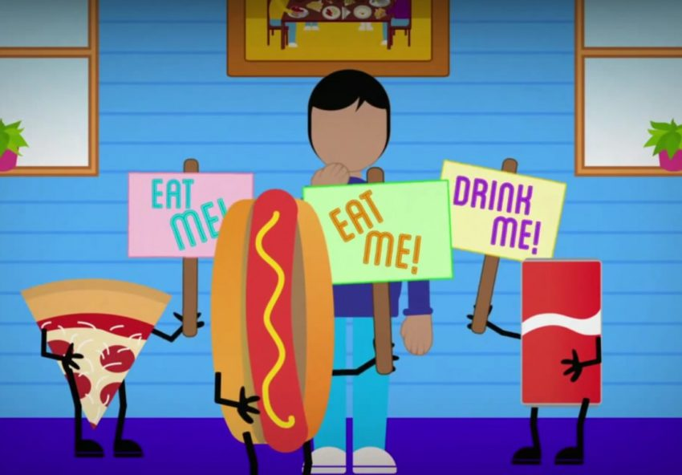
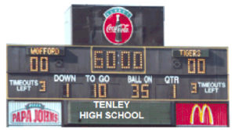
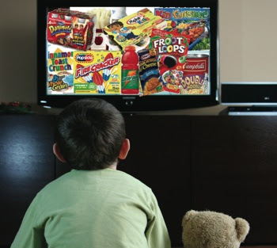
Marketing to kids
Predatory Food Marketing
(NYS397)
Restrict advertising in schools
(MA SD2536)
Restrict TV advertising from 6AM to 9PM of junk food with HFSS
(NY A5862)
Notes:
Bills have been introduced in several states to address marketing of unhealthy food to children. While other countries like the UK have adopted and implemented such policies, the US has not. The first amendment protects corporate free speech, including advertising, so this has made it hard to emulate the UK and others. But states have been creative. NY has the Predatory food marketing bill, which I’ll discuss in a moment. MA has a bill that bans advertising in schools and incentive programs related to bevs not meeting stds of HHFKA or brands that make or market noncompliant bevs. A bill in NY is modeled on the UK ban on advertising on TV, in committee, but its legality is in question.
+++++
NY A5862 - Prohibits advertising for certain junk foods from being shown on television between the hours of six A.M. and nine P.M. Junk food defined as sodium, sat fat, , calories, trans fat, total sugars, fat – legality?
MA Senate Docket 2536 filed 1/17/25 same as 2023-24 SB 1396: bans advertising in schools, incentive programs. Of bevs not meeting stds of HHFKA or brands that make/market noncompliant bevs
NYC predatory marketing – see class slide? S00397 This bill aims to regulate food and food product advertising, particularly targeting advertisements directed at children, by establishing new guidelines for determining whether an advertisement is false or misleading. The legislation introduces comprehensive factors for evaluating advertising, with special emphasis on protecting children from marketing that could manipulate them into developing unhealthy eating habits. Specifically, the bill provides a detailed list of considerations for assessing whether an advertisement is inappropriately targeting children, including elements like subject matter, visual content, use of animated characters, music, celebrity endorsements, language, physical location of the advertisement, and communication medium. The bill also amends existing laws in the general business law, agriculture and markets law, and public health law to incorporate these new standards. The legislative findings emphasize that children are a vulnerable population who may lack the ability to resist marketing cues, and that the state has a strong interest in protecting children from potentially exploitative food marketing that could lead to long-term health issues like obesity, malnutrition, and diet-related illnesses. Additionally, the bill seeks to align with the Convention on the Rights of the Child by ensuring access to nutritious foods and protecting children from potentially harmful marketing practices.
In determining whether any advertising concerning a food or food
4 product is false advertising, factors shall include, but not be limited
5 to:
6 (a) Whether the advertisement targets a consumer who is reasonably
7 unable to protect their interests because of their age, illiteracy,
8 inability to understand the language of an agreement or similar factor.
9 (b) For the purposes of this subdivision and subdivision five of this
10 section, a "consumer" is defined as a person who is targeted by an
11 advertisement, or those acting on such a person's behalf.
12 5. For purposes of paragraph (a) of subdivision four of this section,
13 special consideration shall be given to advertisements directed at a
14 child as defined in section three hundred seventy-one of the social
15 services law. In determining whether an advertisement concerning a food
16 or food product is directed at a child, factors shall include, but not
17 be limited to:
18 (a) Subject matter;
19 (b) Visual content;
20 (c) Use of bright colors and animated characters or child-oriented
21 activities and incentives;
22 (d) Music or other audio content;
23 (e) Age of models;
24 (f) Presence of child celebrities or celebrities who appeal to chil-
25 dren;
26 (g) Language including claims, buzzwords, sayings, and/or phrases that
27 are trending such as common colloquial words specific to the age group;
28 (h) Competent and reliable empirical evidence regarding audience
29 composition and evidence regarding the intended audience composition and
30 evidence regarding the intended audience;
31 (i) Physical location of advertisement, including, but not limited to,
32 proximity to schools or other institutions frequented by children;
33 (j) Medium by which the advertisement is communicated, including, but
34 not limited to, social media, or television/commercial advertising; and
35 (k) Other similar factors including price, products that offer conven-
36 ience in financial savings, and saving time such as easy-to-make or
37 purchase meals.
Asks courts to consider above:
In determining whether a violation of this section has occurred,
41 the court shall consider factors and special consideration given to
42 advertising directed at a child pursuant to section three hundred
43 fifty-a of the general business law.
https://www.nysenate.gov/legislation/bills/2025/S397

Slide 23
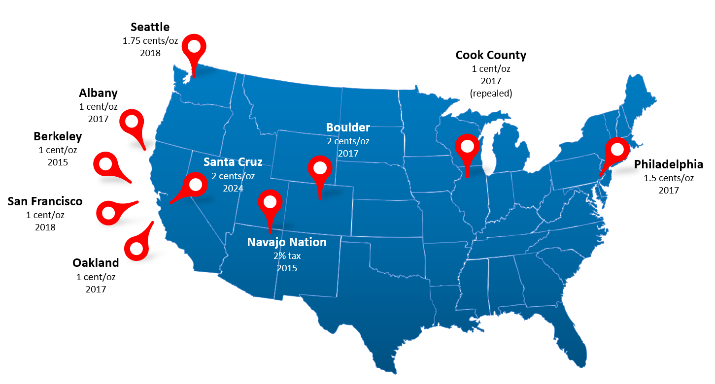
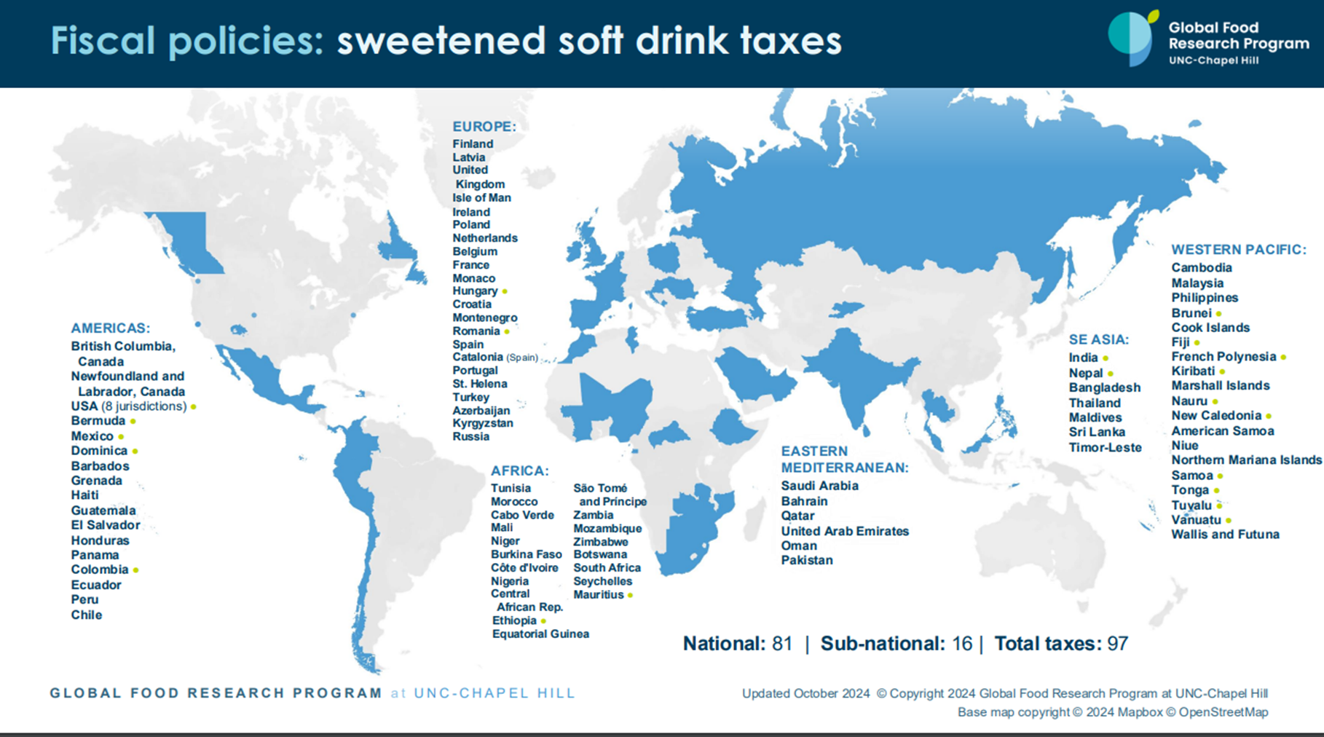
Sweetened Beverage Taxes
8 US Cities
1 Tribe
97 places globally
57% of world population
Notes:
Arguably the most evidence-based, effective policy of all I’ve mentioned thus far.
Now 8 US cities – In 2024, Santa Cruz became first US since 2018 to adopte a new - one was passed by a ballot measure in Santa Cruz. Industry spent 2.6M while the proponents, led by city council members, spent $60K. They won with dedicated volunteers and deep connections and outreach to community and linked industry to environmental plastic concerns in this coastal town,. Industry came in with big spends, outside consultants and was widely seen as overreaching, spending too much. Able to move ahead because of favorable court ruling against the penalties in an industry sponsored preemption laws – no longer feared losing local tax revenues if passed a tax,.
++++

Slide 24
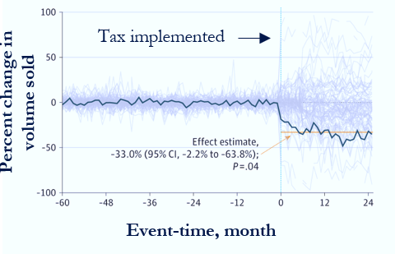
Tax impacts in 5 US cities
Changes in Volume Sales
33% increase in price
33% decrease in sales
Kaplan JAMA Health Forum 2024
Notes:
+++++
Graph from Penn health outcomes review
Article:
Question: What changes occurred in sugar-sweetened beverage (SSB) prices and purchase volume after SSB taxes were implemented in 5 large US cities?
Findings In this cross-sectional study, SSB taxes in Boulder, Colorado; Philadelphia, Pennsylvania; Oakland, California; San Francisco, California; and
Seattle, Washington, were associated with a 33.1% composite increase in SSB prices (92%pass-through of taxes to consumers) and a 33%
reduction in purchase volume, without increasing cross-border purchases. The results were sustained in the months following tax implementation.
Meaning The results suggest substantial, consistent declines in SSB purchases across several US cities; insofar as reducing SSB consumption
can improve population health, scaling SSB taxes more broadly should be considered.
IMPORTANCE Sugar-sweetened beverage (SSB) taxes are promoted as key policies to reduce
cardiometabolic diseases and other conditions, but comprehensive analyses of SSB taxes in the US
have been difficult because of the absence of sufficiently large data samples and methods
limitations.
OBJECTIVE To estimate changes in SSB prices and purchases following SSB taxes in 5 large US cities.
DESIGN, SETTING, AND PARTICIPANTS In this cross-sectional study with an augmented synthetic
control analysis, changes in prices and purchases of SSBs were estimated following SSB tax
implementation in Boulder, Colorado; Philadelphia, Pennsylvania; Oakland, California; Seattle,
Washington; and San Francisco, California. Changes in SSB prices (in US dollars) and purchases
(volume in ounces) in these cities in the 2 years following tax implementation were estimated and
compared with control groups constructed from other cities. Changes in adjacent, untaxed areas
were assessed to detect any increase in cross-border purchases. Data used for this analysis spanned
from January 1, 2012, to February 29, 2020, and were analyzed between June 1, 2022, and
September 29, 2023.
MAIN OUTCOMES AND MEASURES The main outcomes were the changes in SSB prices and
volume purchased.
RESULTS Using nutritional information, 5500 unique universal product codes were classified as
SSBs, according to tax designations. The sample included 26 338 stores—496 located in treated
localities, 1340 in bordering localities, and 24 502 in the donor pool. Prices of SSBs increased by an
average of 33.1% (95%CI, 14.0%to 52.2%; P < .001) during the 2 years following tax
implementation, corresponding to an average price increase of 1.3¢ per oz and a 92%tax passthrough
rate from distributors to consumers. SSB purchases declined in total volume by an average
of 33.0% (95% CI, −2.2% to −63.8%; P = .04) following tax implementation, corresponding to a
−1.00 price elasticity of demand. The observed price increase and corresponding volume decrease
immediately followed tax implementation, and both outcomes were sustained in the months
thereafter. No evidence of increased cross-border purchases following tax implementation
was found.
CONCLUSIONS AND RELEVANCE In this cross-sectional study, SSB taxes led to substantial,
consistent declines in SSB purchases across 5 taxed cities following price increases associated with
those taxes. Scaling SSB taxes nationally could yield substantial public health benefits.
JAMA Health Forum. 2024;5(1):e234737. doi:10.1001/jamahealthforum.2023.4737

Slide 25
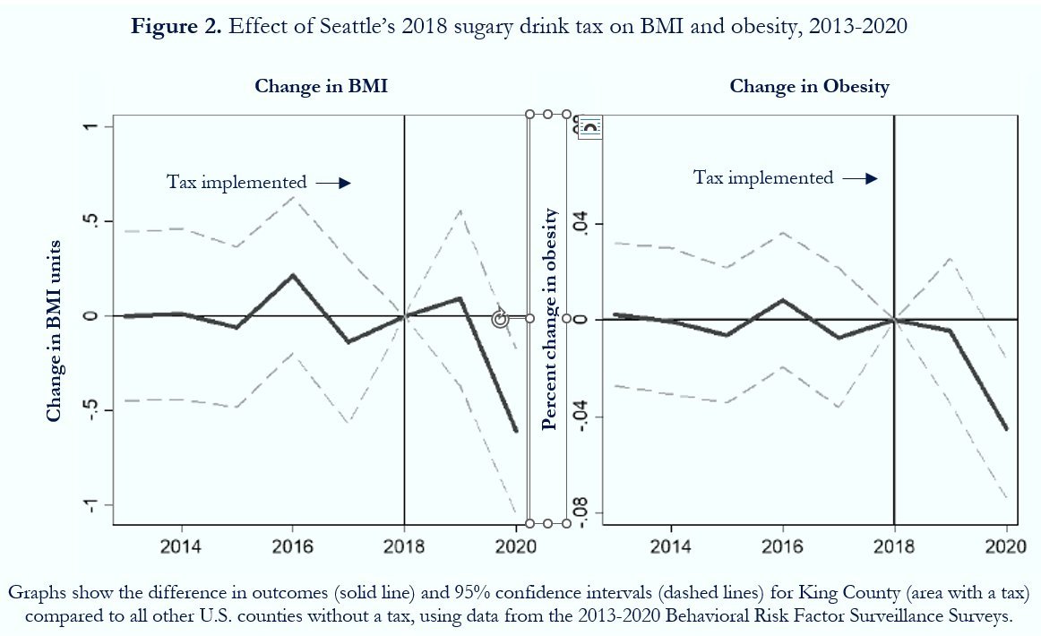
Growing evidence from quasi-experiments:
Taxes may improve weight outcomes
Seattle: 4.5% reduction in adult obesity and 0.61 in BMI
Seattle: prevented 19% of expected adult BMI gain per year
Seattle: 1.1% decline in child adiposity
Four CA cities: 2.8% decline in child and adolescent BMI percentile
Philadelphia: 1.1% decline in adult BMI
Philadelphia: no effect on children
Philadelphia/Oakland/SF: 1.1% decline in high school student BMI
Pooled national data: 1 cent/oz tax associated with 1.7% decline in adolescent obesity
Flynn J, Gruber A. IZA DP No 17617. January 2025
Notes:
Growing evidence of health benefits from taxes. This slide summarizes the evidence about weight outcomes. Multiple studies in adults and children show significant and meaningful decreases in BMI and obesity. For example, the chart shows at 4.5% decrease in obesity and a 0.61 decrease in BMI in Seattle after the tax, using BRFSS data to compare Seattle to places without a tax. Other studies have shown benefits in oral health and birth outcomes.
++++++
Jones-Smith JC. Knox MA, Chakrabarti S, et al. Sweetened beverage tax implementation and change in body mass index among children in Seattle. JAMA Netw Open. 2024;7(5):e2413644
Flynn J, Gruber A. Soda Taxes, BMI and Obesity: Evidence from Seattle. IZA DP No 17617. January 2025.
Young DR, Hedderson MM, Sidell MA, et al. City-level sugar-sweetened beverage taxes and youth body mass index percentile. JAMA Netw Open. 2024 Jul 1;7(7):e2424822
Liu EF, Young DR, Sidell MA, et al. City-level sugar-sweetened beverage taxes and changes in adult body mass index. JAMA Netw Open. 2025 Jan 2;8(1):e2456170.
Petimar J, Roberto CA, Block JP, et al. Associations of the Philadelphia sweetened beverage tax with changes in adult body weight: an interrupted time series analysis. Lancet Reg Health Am. 2024 Oct 12:39:100906.
Gregory F, Roberto CA, Mitra N, et al. The Philadelphia Beverage Tax and pediatric weight outcomes. JAMA Pediatr. 2025 Jan 1;179(1):46-54.
Flynn J. Do sugar-sweetened beverage taxes improve public health for high school aged adolescents? Health Econ. 2023;32(1):47-64.
Cui D, Baum CF, Hawkins SS. Associations between sugar-sweetened beverage taxes and weight outcomes among US adolescents. J Public Health Manag Pract. 2025 Jan 17.
Seattel 19%: For an individual with a BMI of 27 who weighed 167 pounds and was 5 foot 6 inches tall this would equate to reduction in BMI gains of 0.19 pounds per year.
Jones-Smith JC, Chakrabarti S, Knox M, Mooney S, Walkinshaw LP, Arterburn D, Eavey J, Godwin J, Chan NL, Saelens BE. Association Between Seattle's Sweetened Beverage Tax and Change in BMI Among a Patient Population of Youth - The Evaluation of Seattle's Sweetened Beverage Tax. Report for City of Seattle and Seattle City Council. March 2023.

Slide 26
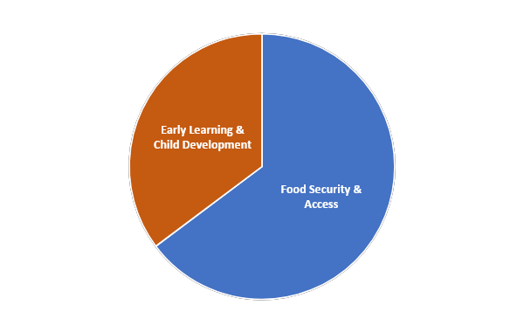
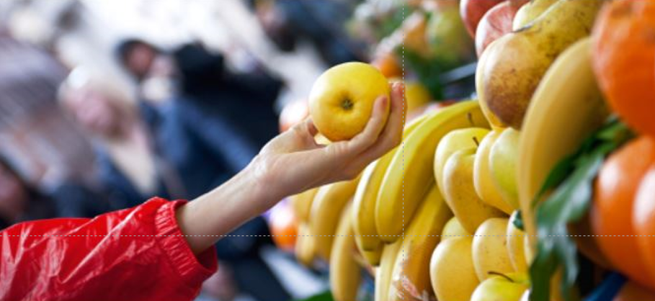

Seattle tax revenue allocations
2023: $22M
Notes:
Source 2023 CAB annual report and see spreadsheet in CAB/reports folder

Slide 27
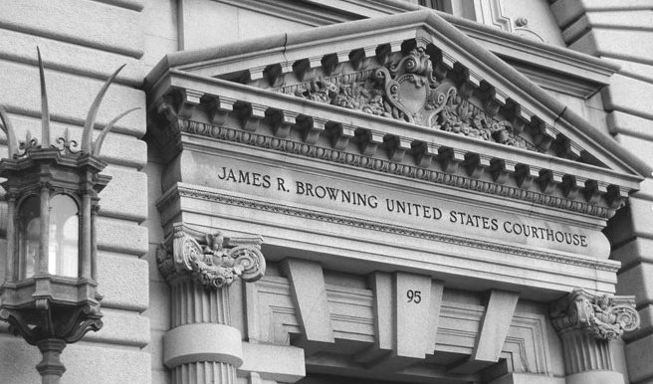
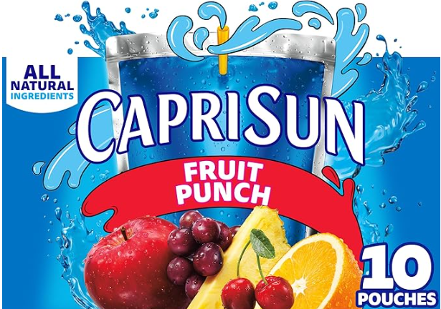
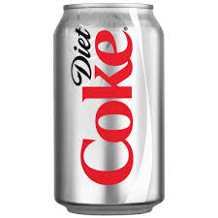
What’s next for taxes?
Santa Cruz
Preemption goes to court
Non-Sugar Sweetened Beverages
Notes:
At least five states have considered sweetened beverage taxes this year.
CT and MD – dedicate to school meals and MD also to child care subsidies, as well as GF, 2 cents, NSS included, CPI.
MA – dedicate to school meals, tiered, early ed meals and investments in communities most impacted by healthy inequities such as obesity, DM and heart dis) 1 and 2 cents/oz, excludes NSS
The Santa Cruz tax will likely be challenged in court by the ABA later this year and will be an important test of the state preemption law. Legal experts at ChangeLab feel confident the city will prevail, preemption will be voided. That will open the door to several CA cities that have been waiting to try to pass taxes.
Of note is that several of the state bills this session include beverages with NSS – recognizing the growing evidence of harm from NSS,. The potential for greater revenue collections, and the more equitable impact of including them – since people who are white and higher income consume more diet beverages.
++++++
The growing momentum for taxes in CA came to a halt when industry blackmailed the legislature in to passing a preemption bill that blocked cities from adopting taxes until 2031 and imposed a severe penalty on any that did – taking away the city's sales tax revenues, which are collected by the state.
The good news it a Superior Court ruled the penalty provision unconstitutional. Although the decision does not affect the underlying prohibition of local sugary drink taxes, the elimination of the penalty now allows charter cities to adopt a tax without risking their city’s sales tax revenues. Quite a few cities are discussing ballot measures for this fall. If passed, they will provide opportunity to test the legality of the preemption law.
+++++
In 2017, the beverage industry circulated a statewide proposition called “The Tax Fairness, Transparency and Accountability Act of 2018” (the “Proposition”), which acquired enough signatures to be placed on the November 2018 ballot. If passed, the Proposition would have amended the State Constitution to, inter alia, raise the voter approval requirements from 50% to two-thirds for all new local tax measures. (Ibid.) The proponents of the Proposition agreed to withdraw it from the November 2018 ballot if the Legislature and the Governor agreed to enact AB 1838, the “Keep Groceries Affordable Act of 2018” (“AB 1838”). In essence, AB 1838 would prohibit local governments from enacting any new taxes on “groceries” until January 1, 2031. Under AB 1838, “groceries” expressly includes “carbonated and noncarbonated nonalcoholic beverages,” such as sugary beverages. Faced with the risk of the Proposition passing, the Legislature passed AB 1838, and the Governor signed it into law on June 28, 2018. The effect of the Penalty Provision would be to deprive a city of all of its sales and use tax revenue.
“The industry is aiming basically a nuclear weapon at government in California and saying, ‘If you don’t do what we want, we’re going to pull the trigger and you’re not going to be able to fund basic government services,'” said state Sen. Scott Wiener (D-San Francisco). “This is a ‘pick your poison’ kind of a situation, a Sophie’s Choice, if you will.” The American Beverage Association had poured $7 million into the “tax fairness” initiative since January, according to filings with the secretary of state. By comparison, opponents including the Service Employees International Union California and the California League of Cities gave just slightly more than half a million dollars to defeat it. SEIU California Executive Director Alma Hernandez said the initiative would have compromised local emergency services, parks, libraries and other crucial community investments.
(https://californiahealthline.org/news/under-pressure-california-lawmakers-ban-soda-taxes-for-12-years/)
In 2018, the beverage industry pressured the California legislature into passing a law that prevents cities from enacting new sugary drink taxes until 2031. The legislature enacted the law under the threat of an industry-funded state ballot initiative that, if passed, would have drastically curtailed local governments’ ability to raise revenue for critical services like public health, education, and transportation. This case — as intended — removes the possibility that a California charter city could lose its sales tax revenue should it choose to move forward with a sugary drink tax.

Slide 28
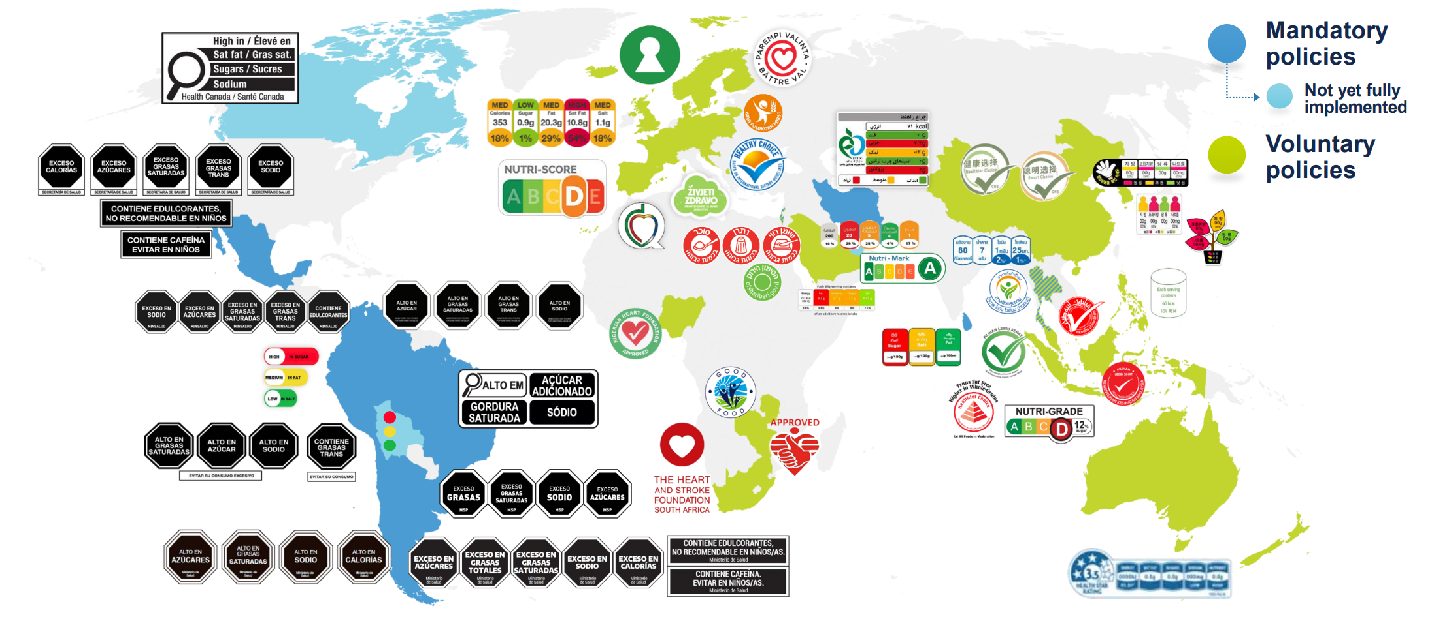
Front-of-Package Labels (FOPLs)
Notes:
Front of the package rather than back
Most are interpretive (although some easier to interpret than others) – except Thailand, Indonesia
Some mandatory, some voluntary
All nutrient-based, some mention NNS (ingredient)

Slide 29

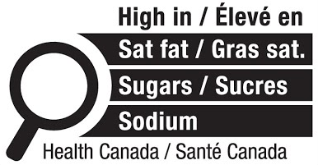
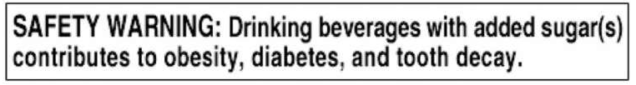
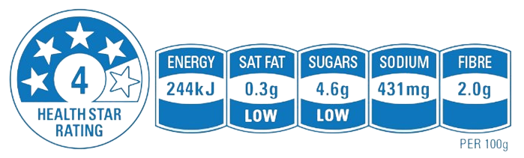
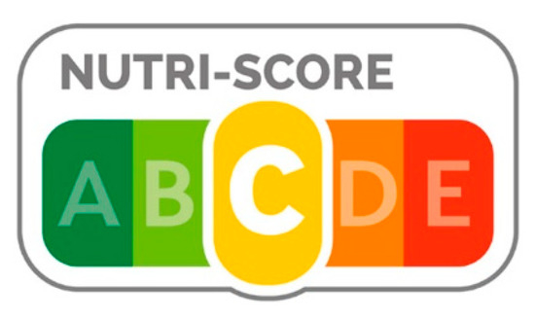
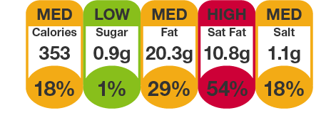
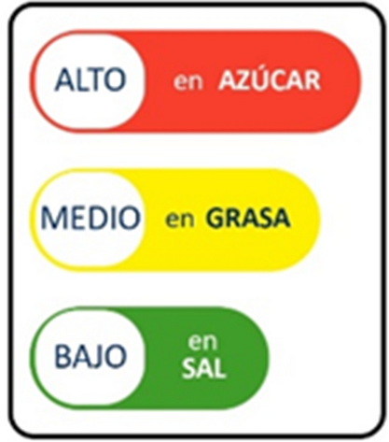
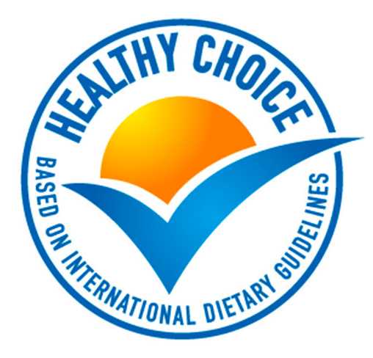

Types of interpretive FOPLs
Negative framing only:
Nutrient warnings
Health warnings
Negative and positive framing:
Summary labels/single traffic light
Multiple traffic lights
Positive framing only:
Endorsement labels
Notes:
Positive vs. negative: effective at different things
Negative especially effective at discouraging consumption of the unhealthiest foods (arguably most important)
Positive can create health halo
Multiple traffic lights can send mixed messages

Slide 30
How do warning FOPLs work?
cognitive responses
(e.g., changes in healthfulness perceptions, reminder of health goals)
Individual level:
Structural level:
emotional responses
(e.g., fear, discomfort)
improved dietary behavior
social interactions and injunctive social norms
improved food supply
product reformulation
Roberto at al. (2021), Rebolledo et al. (2025), Saavedra-Garcia et al. (2023)

Slide 31
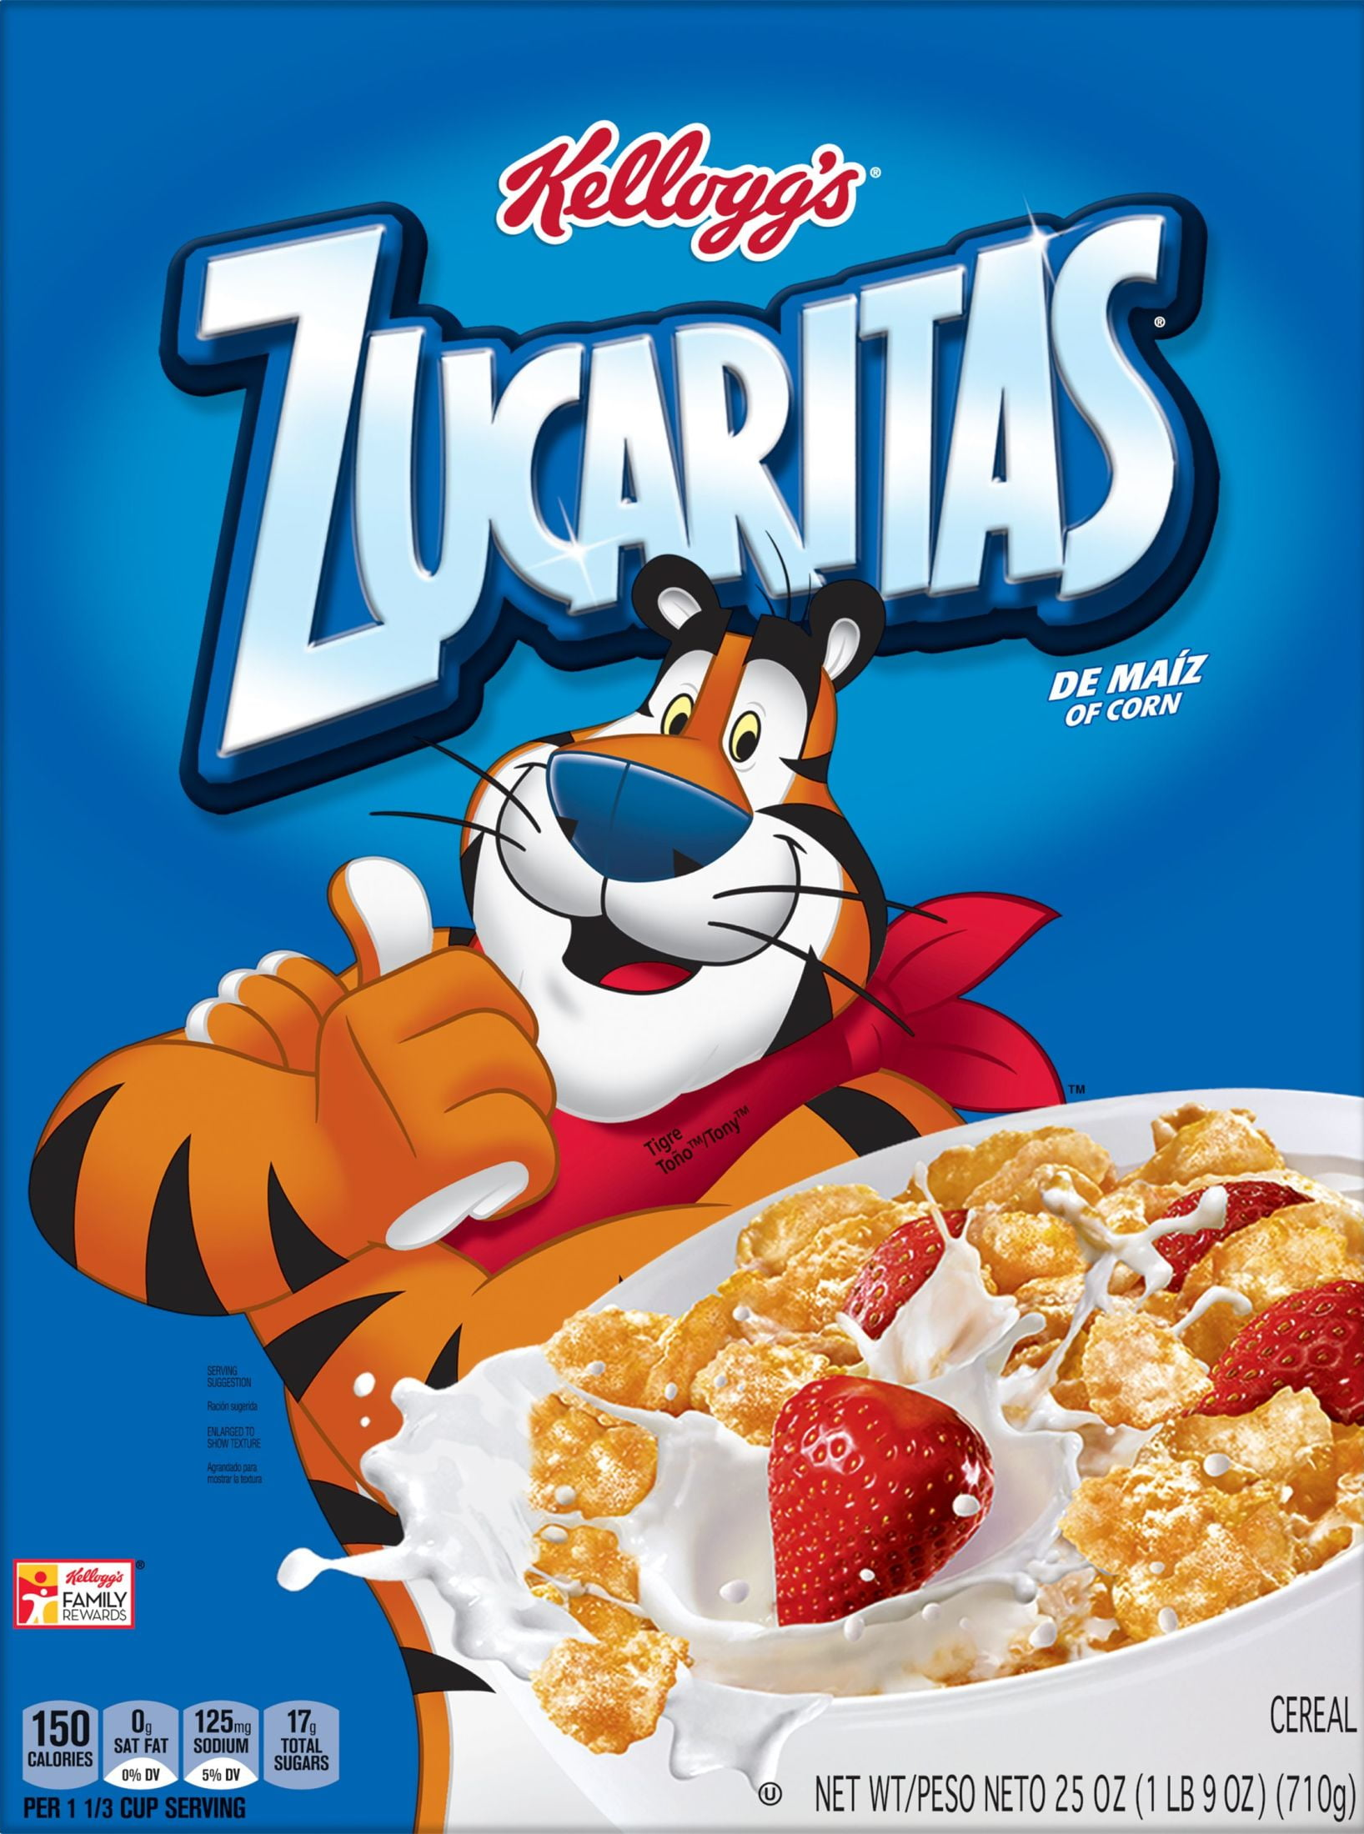
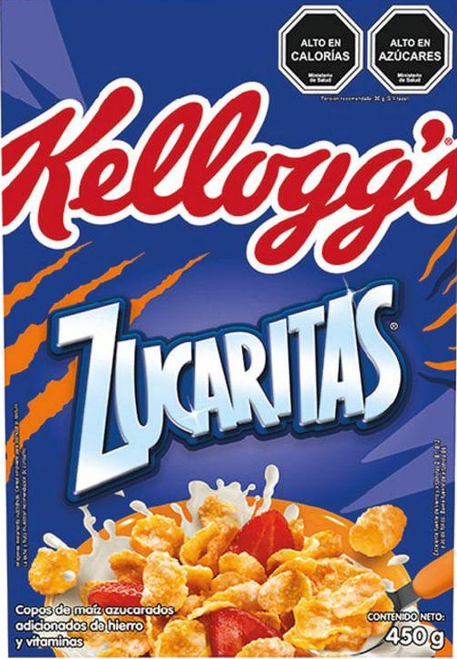
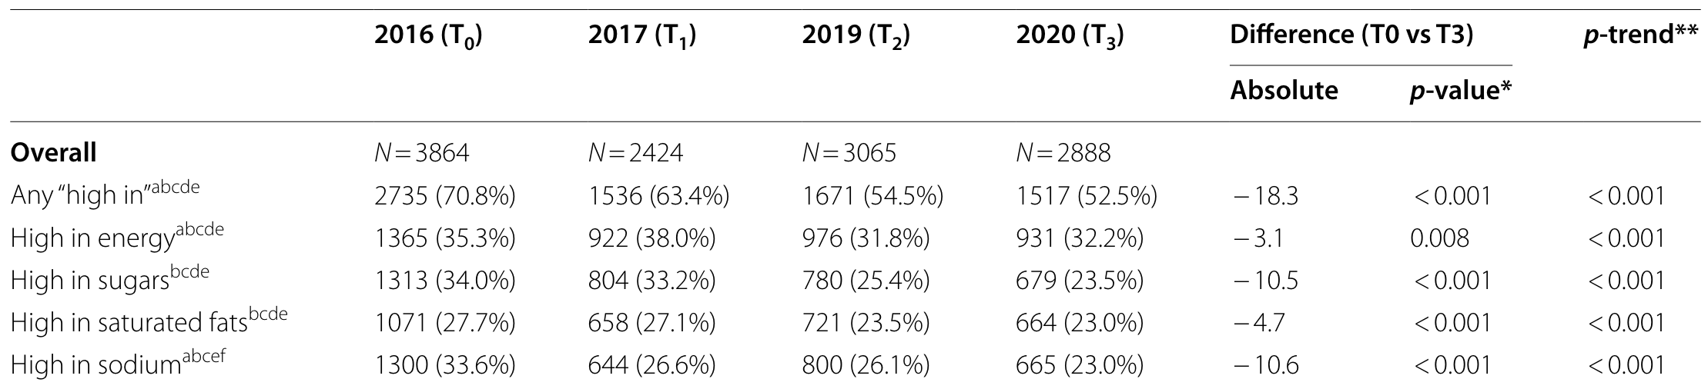
Chile
2016 Law of Food Labeling and Advertising: front-of-package nutrient warning labels + restrictions to child-directed marketing of labeled foods + prohibited sale of labeled foods in schools
Changes in the packaged food supply:
(from product reformulations and introduction of new products)
Rebolledo et al. (2025)

Slide 32
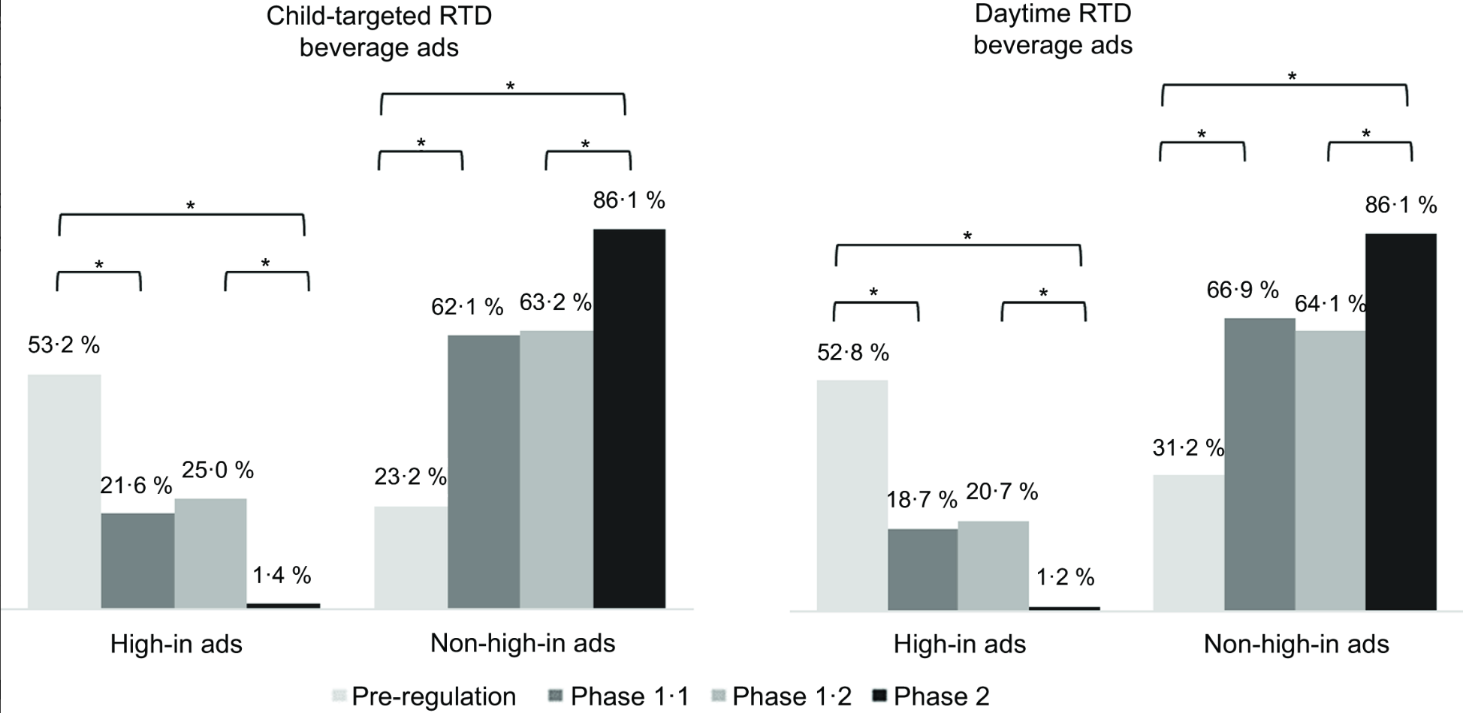
Chile cont.
Changes in ready-to-drink beverage marketing on television
Stoltze et al. (2023)

Slide 33

Chile – Changes in intake of nutrients of concern
Changes in intake of nutrients of concern
(per person per day)
8% reduction in energy intake
20% reduction in sugar intake
14% reduction in sodium intake
10% reduction in saturated fat intake
Phase 1 results driven by immediate reduction in purchases, phase 2 results driven by declining trends
Small differences by SES (slightly larger effects for high-SES households)
Tailiie et al. (2024)

Slide 34
Chile – Qualitative reports
Qualitative reports from Chilean mothers
After a while, FOPLs “faded to the background,” but information learned about products has become ingrained
Mothers started valuing more “natural” foods due to label oversaturation
Lower-SES mothers report that healthier (unlabeled) foods are still less accessible, price remains an important barrier
Correa et al. (2024)

Slide 35


Chile – Future Directions
Unintended effects and future directions
11 p.p. increase in share of products containing non-nutritive sweeteners (NNS) in the food supply
12 p.p. increase in share of households purchasing only NNS-only beverages, 5 p.p. increase in NNS+sugar
NNS intake increased by 15%-84% (depending on type) per person per day
15 p.p. increase in share of preschoolers who consume NNS
Ricardo et al. (2021), Rebolledo et al. (2022, 2023)

Slide 36
Other countries
Peru, changes in the packaged food supply:
Beverages, high in sugar : 28 p.p. decline
Foods, any label: 20 p.p. decline
Uruguay
Eye-tracking technology revealed that consumers used FOPLs more often than back-of-package nutrition info or ingredients lists
Mexico, changes in the packaged food supply:
Products containing NNS:
  Desserts: 11 p.p. decline
  Dairy beverages: 14 p.p. decline
  Dairy foods: 29 p.p. decline
  Candies: 6.6 p.p, decline
Saavedra-Garcia et al. (2023), Manchín et al. (2023), Salgado et al. (2025)

Slide 37


New FOPL policies under development
Lacking interpretive shapes, icons, or colors
Allows for conflicting information
Numeric information

Slide 38

Subnational FOPLs policies in the US (current and proposed)
SAFETY WARNING: This beverage contains 100% or more of the FDA's recommended daily intake of added sugar.
States: CA, OR, WA, MA, NY, VT, HI
Cities: San Francisco, Baltimore
WARNING: This product contains synthetic colors, which may have an adverse effect on activity and attention in children.
WARNING: This product may expose you to [name of chemical], which is banned by [EU, UK, or Canada].

Slide 39
References
Correa T, Fierro C, Reyes M, Taillie LS, Carpentier FRD, Corvalán C. Why Don’t You [Government] Help Us Make Healthier Foods More Affordable Instead of Bombarding Us with Labels? Maternal Knowledge, Perceptions, and Practices after Full Implementation of the Chilean Food Labelling Law. International Journal of Environmental Research and Public Health. 2022;19(8):4547. doi:10.3390/ijerph19084547
Machín L, Alcaire F, Antúnez L, Giménez A, Curutchet MR, Ares G. Use of nutritional warning labels at the point of purchase: An exploratory study using self-reported measures and eye-tracking. Appetite. 2023;188:106634. doi:10.1016/j.appet.2023.106634
Rebolledo N, Bercholz M, Adair L, Corvalán C, Ng SW, Taillie LS. Sweetener Purchases in Chile before and after Implementing a Policy for Food Labeling, Marketing, and Sales in Schools. Current Developments in Nutrition. 2023;7(2):100016. doi:10.1016/j.cdnut.2022.100016
Rebolledo N, Ferrer-Rosende P, Reyes M, Smith Taillie L, Corvalán C. Changes in the critical nutrient content of packaged foods and beverages after the full implementation of the Chilean Food Labelling and Advertising Law: a repeated cross-sectional study. BMC Med. 2025;23(1):1-18. doi:10.1186/s12916-025-03878-6
Rebolledo N, Reyes M, Popkin BM, et al. Changes in nonnutritive sweetener intake in a cohort of preschoolers after the implementation of Chile’s Law of Food Labelling and Advertising. Pediatric Obesity. 2022;17(7):e12895. doi:10.1111/ijpo.12895
Roberto CA, Ng SW, Ganderats-Fuentes M, et al. The Influence of Front-of-Package Nutrition Labeling on Consumer Behavior and Product Reformulation. Annu Rev Nutr. 2021;41(1):529-550. doi:10.1146/annurev-nutr-111120-094932

Slide 40
Presentation References
Saavedra-Garcia L, Meza-Hernández M, Diez-Canseco F, Taillie LS. Reformulation of Top-Selling Processed and Ultra-Processed Foods and Beverages in the Peruvian Food Supply after Front-of-Package Warning Label Policy. International Journal of Environmental Research and Public Health. 2023;20(1):424. doi:10.3390/ijerph20010424
Salgado JC, Pedraza LS, Contreras-Manzano A, Aburto TC, Tolentino-Mayo L, Barquera S. Product reformulation in non-alcoholic beverages and foods after the implementation of front-of-pack warning labels in Mexico. PLOS Medicine. 2025;22(3):e1004533. doi:10.1371/journal.pmed.1004533
Stoltze FM, Correa T, Aguilar CLC, Taillie LS, Reyes M, Carpentier FRD. Beverage industry TV advertising shifts after a stepwise mandatory food marketing restriction: achievements and challenges with regulating the food marketing environment. Public Health Nutrition. 2024;27(1):e26. doi:10.1017/S1368980023002872
Taillie LS, Bercholz M, Popkin B, Rebolledo N, Reyes M, Corvalán C. Decreases in purchases of energy, sodium, sugar, and saturated fat 3 years after implementation of the Chilean food labeling and marketing law: An interrupted time series analysis. PLOS Medicine. 2024;21(9):e1004463. doi:10.1371/journal.pmed.1004463
Zancheta Ricardo C, Corvalán C, Smith Taillie L, Quitral V, Reyes M. Changes in the Use of Non-nutritive Sweeteners in the Chilean Food and Beverage Supply After the Implementation of the Food Labeling and Advertising Law. Front Nutr. 2021;8. doi:10.3389/fnut.2021.773450

Slide 41
Q & A

Slide 42
Breakout Rooms
Discuss current policy research opportunities and/or challenges related to today's topic. What are the opportunities/challenges at the local, state, and federal levels?
What are the considerations for practitioners (i.e., healthcare providers, school districts, SNAP or WIC agencies) implementing programs or policies discussed today? What do we still need to know to implement and scale these programs or policies?
Discuss how you've interacted with this topic in your professional career (i.e., current coursework, study, grant).
What are you currently working on that's exciting you?
What advice/questions do you have for people in your breakout?

Slide 43
Announcements
Join us for the next session of the speaker series!
Wednesday, July 9th from 4:00 - 5:00 PM ET
Food Policies in Schools
Notes:
Thank you all so much for attending the second session of the Summer Speaker Series! Our next session will be in two weeks on July 9th and we will be hearing about Food Policies in Schools. See you all then! Bye :)

Slide 44
Extra – will not show in initial presentation

Slide 45


NY Food Disclosure
A1557
Reporting requirements for substances Generally Recognized as Safe (GRAS):
Companies must submit detailed reports about these substances to the state commissioner, including information about their safety, dietary exposure, and manufacturing methods
Data made available in public database
Cannot sell products with GRAS substance if not reported
Shining light on “secret” GRAS
Notes:
Status – referred to committee in 1.10.25 > no progress
CA EO also addresses this
NYH is taking a different and innovative approach – it is attempting to address shortcomings in the FDA food additive process through state action. The FDA allows manufacturers in effect to to self certify an additive is safe, and add it to the foods supply without even notifying the FDA, and only indicating on the ingredient list a generic term like artificial color. The is know as the GRAS loophole. NY will require a company to submit its internal documents demonstrating safety of any GRAS additive they use, which will be made publicly available. If they don’t report, they can’t sell the product in NY.
This is an opportunity to use precautionary principle as basis for allowing chemicals in food, like EU. To require proof of safety rather than presume safe/innocent until evidence of harm emerges.
+++++++
Certain substances are exempt from reporting, including those already approved by the FDA and substances used in food prior to 1958 without known health risks. Small businesses are also exempt from these requirements. The goal is to enhance food safety oversight by ensuring that GRAS substances are thoroughly evaluated and their safety information is publicly accessible
+++
A01556This bill enacts the "Food Safety and Chemical Disclosure Act" which introduces comprehensive new regulations for food additives and substances in New York State. Specifically, the bill prohibits the manufacture, sale, and distribution of certain food additives including FD&C Red No. 3, Potassium bromate, and Propylparaben after one year of the law's effective date. The bill also establishes strict reporting requirements for substances Generally Recognized as Safe (GRAS), mandating that companies submit detailed reports about these substances to the state commissioner, including information about their safety, dietary exposure, and manufacturing methods. For public schools, the bill further restricts the sale of foods containing specific synthetic color additives like FD&C Red No. 40 and Yellow No. 5. The commissioner is required to create a public, searchable database of GRAS substances, which must be updated with safety information and allows for redaction of trade secrets. Small businesses with ten or fewer employees are exempted from some of the reporting requirements. The bill aims to enhance food safety by providing more transparency about food additives and giving the state more oversight of substances used in food production.
S01239- This bill establishes new regulations on food additives and color additives in New York State, focusing on consumer safety and transparency. Specifically, the bill prohibits the manufacture, sale, and distribution of certain food additives like FD&C Red No. 3, potassium bromate, and propylparaben one year after the law's effective date. For public schools, the bill bans the sale of foods containing several synthetic color additives, including various FD&C Red, Blue, Green, and Yellow numbered colors. The legislation also introduces comprehensive reporting requirements for "Generally Recognized as Safe" (GRAS) substances, mandating that manufacturers submit detailed reports about such substances to the state commissioner, including information about their safety, dietary exposure, and manufacturing processes. Small businesses with ten or fewer employees are exempt from these reporting requirements. The commissioner must create a public, searchable database of these GRAS substance reports, which will be accessible online and periodically updated. Importantly, the bill stipulates that in enforcement actions, the federal Food and Drug Administration's recognition of a substance as safe cannot be used as a defense. The law is set to take effect 180 days after becoming law, giving businesses time to adjust to the new regulations.
S03214 This bill establishes comprehensive reporting requirements for Generally Recognized as Safe (GRAS) substances used in food products in New York State. The legislation defines GRAS substances as food additives that are considered safe by scientific experts through scientific procedures or historical use before 1958. Under the bill, companies must submit detailed reports to the state commissioner before selling or using a GRAS substance, including information such as the substance's identity, method of manufacture, intended use, dietary exposure estimates, and a narrative explaining its safety. The reports must be complete, balanced, and include both favorable and unfavorable information. The commissioner will create a public, searchable database of these reports and has the authority to redact trade secrets while keeping safety data transparent. Certain substances are exempt from reporting, including those already approved by the FDA and substances used in food prior to 1958 without known health risks. Small businesses are also exempt from these requirements. The goal is to enhance food safety oversight by ensuring that GRAS substances are thoroughly evaluated and their safety information is publicly accessible
Image https://blogs.edf.org/health/2024/06/10/broken-gras-how-a-food-award-competition-revealed-a-secret-gras-ingredient/

Slide 46

Healthy School Meals for All
Limited progress – funding in difficult fiscal times
“Healthy School Meals for All has allowed Massachusetts to increase participation, expand Farm to School, address staff shortages, replace aging equipment and enhance scratch cooking. All of this is helping to revolutionize menus and change opinions about the nutritional quality of school meals.”
— Massachusetts Department of
Elementary and Secondary Education
https://frac.org/healthy-school-meals-for-all
Notes:
Healthy School Meals for All. Since last year, no additional states adopted this policy. Many states are considering it (about the same number as last year) but state budgets are tight in challenging fiscal times, and finding revenues will be tough. That’s why CT and MD turned to a SBT
And on the worrisome side, a House R proposal has proposed huge cut to the CEP program by proposing to increase %FRFPL population from 25% to 60%. If enacted, more than half of the participating schools — 24,000 schools spread across every state, serving more than 12 million children — would no longer be able to use CEP. These schools would be mired in unnecessary paperwork and children in low-income families would likely miss out on meals, jeopardizing their health and learning.
=++++
2024
Moving on to a policy that has rapidly gained momentum across the US – provision of free school meals to all students. 8 states have passed policies already (same as last year) and many more are considering them in the current legislative session. New this year are AK. KS, AR, FL, VA,
HSMFA reduces food insecurity, removes stigma and shaming associated with “charity” meals, ends lunch debt, reduces costs and admin burden, increases school meal participation, and boosts academic performance and school attendance. (see v3 for more)
A federal Universal School Meals Program Act has been reintroduced by Sen. Sanders (I-VT) and Rep. Omar (D-MN0)
HSMFA also presents opportunities to support strategies like plant-based meals and procurement from local and regional food systems., For example ,CA has budgeted $600 million for school kitchen upgrades and increasing meals that include minimally processed, plant-based California-grown foods.
There are lots of policy evaluation questions to explore - If you want to learn more, look at recent systematic review by Amelie Hecht, Juliana Cohen and collagues. In JAND.
(https://ebudget.ca.gov/2022-23/pdf/Enacted/BudgetSummary/K-12Education.pdf)
New this year – Alaksa, Arkansas
++++++
Look for updates: https://frac.org/healthy-school-meals-for-all – chart last updated 1/25 and map 1/14. Quote is from FRAC report
Tried legiscan – too many results with school AND meals AND all. Tried "healthy school meals for all“ and gotonly 7 hits. “universal school meals” > 30 hits – none of these came up with those other than in map
Four states — California, Maine (in 2021) Massachusetts, and Vermont — passed policies. Nevada used pandemic relief funds to extend Healthy School Meals for All through the 2022–2023 and 2023–2024 school years. CT used pandemic funds for 2022-23.
Four additional states — Colorado, Minnesota, Michigan, and New Mexico — have also passed Healthy School Meals for All policies that started with the 2023– 2024 school year
(https://frac.org/wp-content/uploads/HSMFALegislativeChart2.1.23.pdf)
Six of these states with statewide universal meal programs mandate district participation, while the programs in Colorado and Michigan are optional. Six states pay for their programs through general revenue fund or education fund appropriations, the exceptions being he exceptions being Colorado and Massachusetts. Colorado directly funds universal meals through a new voter-passed tax measure that reduces income tax deductions available to households earning $300,000 or more. Massachusetts funds its program using a portion of the revenue generated from the state’s new voter-approved 4% tax on incomes over $1 million. https://www.ncsl.org/state-legislatures-news/details/new-state-and-federal-policies-expand-access-to-free-school-meals
++++++++
Some states have made only school breakfasts free for all students, either permanently or temporarily. The District of Columbia has required free school breakfasts since 2010, and Connecticut and Pennsylvania will have free breakfasts for all students during the 2023-24 schoolyear.
The pandemic highlighted the critical role that school meals play for children and acted as a trial run for Healthy School Meals for All nationwide. Students, parents, teachers, administrators, school nutrition professionals, and other stakeholders realized they did not want to go back to a tiered payment system for school meals, driving energy and support for statewide Healthy School Meals for All campaigns. USDA waivers allowing schools to offer meals at no charge to all students expired in June 2022. Unless states had enacted a Healthy School Meals for All policy, most schools went back to normal school nutrition operations for the 2022–2023 school year: offering meals at no charge to some students; charging a reduced-price fee to some; and charging others for the cost of their meal.
+++++++++++++++++++++
https://frac.org/wp-content/uploads/HSMFA-Report-2024.pdf (2.7.24)
School lunch participation in California, Maine, Massachusetts, Nevada, and Vermont increased during the 2022-2023 school year compared to pre-pandemic levels (2018-19). ​
School breakfast participation increased in four of the five states. ​
The five Healthy School Meals for All states still have room for growth in the School Breakfast Program, as there is a gap between breakfast and lunch participation.
At its core, state Healthy School Meals for All policies dedicate state funds to cover the cost between offering free meals to all students and the school meal reimbursements that the state receives from the federal government through the School Breakfast Program and the National School Lunch Program. Other possible components of the legislation can include state funding for staff training, cafeteria equipment, local food procurement, school nutrition wages, evaluation, and more. States have passed free school meal policies through:
standalone bills (i.e., Minnesota)
budget bills (i.e., California)
a ballot measure (one state to date: Colorado)
Federal: Universal School Meals Program Act (S. 1568/H.R. 3204), which would create Healthy School Meals for All nationwide. The bill has been reintroduced by Sen. Sanders (I-VT) and Rep. Omar (D-MN), along with Sens. Gillibrand (D-NY) and Heinrich (D-NM) and Reps. McGovern (D-MA) and Moore (D-WI).
Link to other policies and budget
CA 2022 budget: Additionally, the Budget includes $600 million one-time Proposition 98 General Fund, available over three years, for school kitchen infrastructure upgrades and equipment, food service employee training, and compensation for work related to serving universal meals using more fresh, minimally processed California-grown foods. The Budget also includes $100 million one-time Proposition 98 General Fund to support local educational agency procurement practices for plant-based or restricted diet meals, to procure California-grown or California-produced, sustainably grown, whole or minimally processed foods, including for use in plant-based or restricted-diet meals, or to prepare meals fresh onsite. Both of these programs are complementary to the provision of school meals for all students as well as the Farm to School Program. (https://ebudget.ca.gov/2022-23/pdf/Enacted/BudgetSummary/K-12Education.pdf)

Slide 47

Summer EBT
Notes:
Thirty-eight states, Washington D.C., five Indian Tribal Organizations, and all five U.S. territories submitted a notice of intent by the January 1 deadline and are poised to implement Summer EBT this year. This includes two states — Alabama and Utah — that will be operating Summer EBT for the first time
+++++
https://frac.org/summer-ebt/families 3.27.25 - map
Thirty-eight states, Washington D.C., five Indian Tribal Organizations, and all five U.S. territories submitted a notice of intent by the January 1 deadline and are poised to implement Summer EBT this year. This includes two states — Alabama and Utah — that will be operating Summer EBT for thefirst time.
Twelve states have chosen not to participate: Alaska, Florida, Georgia, Idaho, Iowa, Mississippi,Oklahoma1, South Carolina, South Dakota, Tennessee (Tennessee participated in 2023 but chosenot to operate again), Texas, and Wyoming. This means that approximately 9.5 million children will miss out on nutrition benefits they would otherwise be eligible to receive, and states are leaving over $1.1 billion in benefits on the table. https://frac.org/blog/9-5-million-children-will-miss-out-on-summer-ebt-nutrition-benefits-in-2025

Slide 48

Federal Food Policies
Front of package labels?
Healthy label?
Sodium reduction targets?
UPF warning?
SNAP restrictions; Healthy SNAP Act, Nutritious SNAP Act?
Nutrition program funding: SNAP, WIC, Summer EBT
School meals – CEP reduction, whole milk, cheese
Changes to DGA process?
GRAS overhaul and post-market assessment?
Notes:
AHA: Some of the agriculture appropriations riders we’re watching: • Cheese carve out • Whole milk in schools • Shenanigans with WIC food package • Rolling back or hindering FDA work on Definition of Healthy, Front of Pack • Changes to the DGA process • SNAP restrictions
Lee R-UT and Brecheen R-OK: A group of GOP lawmakers in both chambers of Congress are pushing the Healthy SNAP Act of 2025. The measure would target "soft drinks, candy, ice cream, prepared desserts such as cakes, pies, cookies, or similar products," and call for the Agriculture Secretary to "conduct a scientific review" of foods allowed under SNAP at least every 5 years.
Rand Paul - The Nutritious SNAP Act of 2025 would put the kibosh on SNAP purchases of "any nonalcoholic beverage that is not water, cow’s milk, a milk-substitute beverage (such as almond milk, soy milk, and coconut milk), or 100 percent juice," plus "snack and dessert food items," described in the U.S. Department of Agriculture Food and Nutrition Service "Accessory Foods List."
HHS Secretary Robert F. Kennedy Jr. is directing the acting FDA commissioner to take steps to explore potential rulemaking to revise its Substances Generally Recognized as Safe (GRAS) Final Rule and related guidance to eliminate the self-affirmed GRAS pathway. This will enhance the FDA’s oversight of ingredients considered to be GRAS and bring transparency to American consumers.
Eliminating the self-affirmation process would require companies seeking to introduce newingredients in foods to publicly notify the FDA of their intended use of such ingredients, alongwith underlying safety data, before they are introduced in the food supply.
“

Slide 49

Predatory Marketing Prevention Act
(NY State S397/A2584 – 2025-2026)
An advertisement concerning a food or food product shall not be false or misleading
Defines false or misleading:
  Targets a consumer who is reasonably unable to protect their interests because of their age (especially children), illiteracy, inability to understand the language
  Special attention to ads directed at children
  E.g., animated characters, music, child celebrities, location, etc.
Notes:
In committee 3.29.25
The NY Predatory Marketing Prevention Act has been reintroduced by Sen Myrie. It defines false and misleading advertising, and further calls for special attention to ads aimed at children and provides criteria for determining whether an ad targets children, such as use of animated characters or other child-oriented activities and incentives, music, use of child celebrities/celebrities who appeal to children or location near schools.
+++++
Research needs – definition of predatory, even term to use, extent, effects/impact, ability to show intent by advertiser
Zellnor Myrie Brooklyn
The department, in conjunction with the department of health, shall annually produce to the legislature a report detailing a determination as to which foods may be unwholesome or deleterious according to generally accepted nutritional standards.
An advertisement concerning a food or food product shall not be false or misleading. Factors to consider:
Whether advertiser knowingly used false or misleading content to target a consumer reasonably unable to protect their interests because of their age, physical infirmity, ignorance, illiteracy, inability to understand the language of an agreement, or similar factor.
extent to which the advertising fails to reveal facts material to the food or food product
Special consideration given to ads directed at children. Determining direction to children based on:
Subject matter/visual content
Use of animated characters or other child-oriented activities and incentives
Music/audio content
Age of models
Use of child celebrities/celebrities who appeal to children
Language
Evidence on audience composition
Location near schools or other institution frequented by children
(old bill) The attorney general, or a city may bring an action in the supreme court or federal district court to enjoin and restrain such violations and to obtain restitution and damages.
(old bill) Any person, firm, corporation or association that has been damaged as a result of violations of this section shall be entitled to bring an action for recovery of damages or to enforce this section in the supreme court or federal district court.

