Slide 1

Summer Speaker Series for Students
2024
Notes:
Session lead

Slide 2


Getting Started!
Update your name on Zoom, if needed
  Right click on your Zoom box, click “rename”
Type your name and institution into the chat box!
  Question: Which best describes you?
    Ex. Undergraduate Student, Dietetic Intern, Masters Student, Doctoral Student, Post Doc, Public Health Practitioner, Researcher/Professor, Other
Remember to keep yourself on mute.
Type your questions into the chat box.
Notes:
HER/NOPREN staff
Each session there will be a different question of the day:
What are you looking forward to this summer?
What is the weather like today where you are?
What is your go-to morning beverage?
What’s the best book you’ve ever read?
If you were a fruit or vegetable, what would you be?
What would be the title of your autobiography?
What’s your dream vacation destination?
Who performed at the last concert you went to?

Slide 3
NOPREN HER Summer Series for Students
The series will take place on Wednesdays from
4:00 - 5:00 pm EST
Schedule and Topics
June 12: Food Policies in Schools - More than just Lunch!
June 26: Food is Medicine: What does it mean?
Where are we going?
July 10: Leveraging Food Service Contracts at 4-year Public Universities to
Understand Meal Plan Costs and Affordability
July 24: Policy, Systems, and Environmental Strategies to Support Young
Children's Diet and Health
August 7: Collaborating Successfully across Sectors toward Nutrition Security
August 14: Student Presentations
For more information or to register: https://nopren.ucsf.edu/her-nopren-summer-speaker-series-students-2024
Notes:
HER/NOPREN staff
Put registration link in chat box: https://nopren.ucsf.edu/student-resources

Slide 4
Policy Systems and Environmental Strategies to Support Young Children's Diet and Health
Kate Bauer, PhD
Leslie Hodges, PhD
Alison Tovar, PhD
NOPREN Early Childhood Work Group and
WIC Learning Collaborative
Notes:
3:45 – 4:00 pm EST: Moderator and presenters join early for tech check
4:00-4:05 pm EST:
HER/NOPREN Staff to open session and introduce session moderator
Kate Bauer to introduce session, presenters, and WG they represent
4:05-4:30pm EST: Presentations
Alison Tovar: Overview of policy, systems, and environmental approaches to improve nutrition security and reduce nutrition inequities among young children.
4:30 – 4:55 pm EST: Questions/Discussion and Networking and Professional Development Breakout Session
Kate Bauer facilitates Q&A
Kate Bauer, Alison Tovar, WG fellow, HER and NOPREN staff to be available for general networking with students
4:55-5:00pm EST: Closing
HER/NOPREN staff to provide closing remarks and invitation to participate in networking and professional development breakout session, reminder of next session date/topic

Slide 5
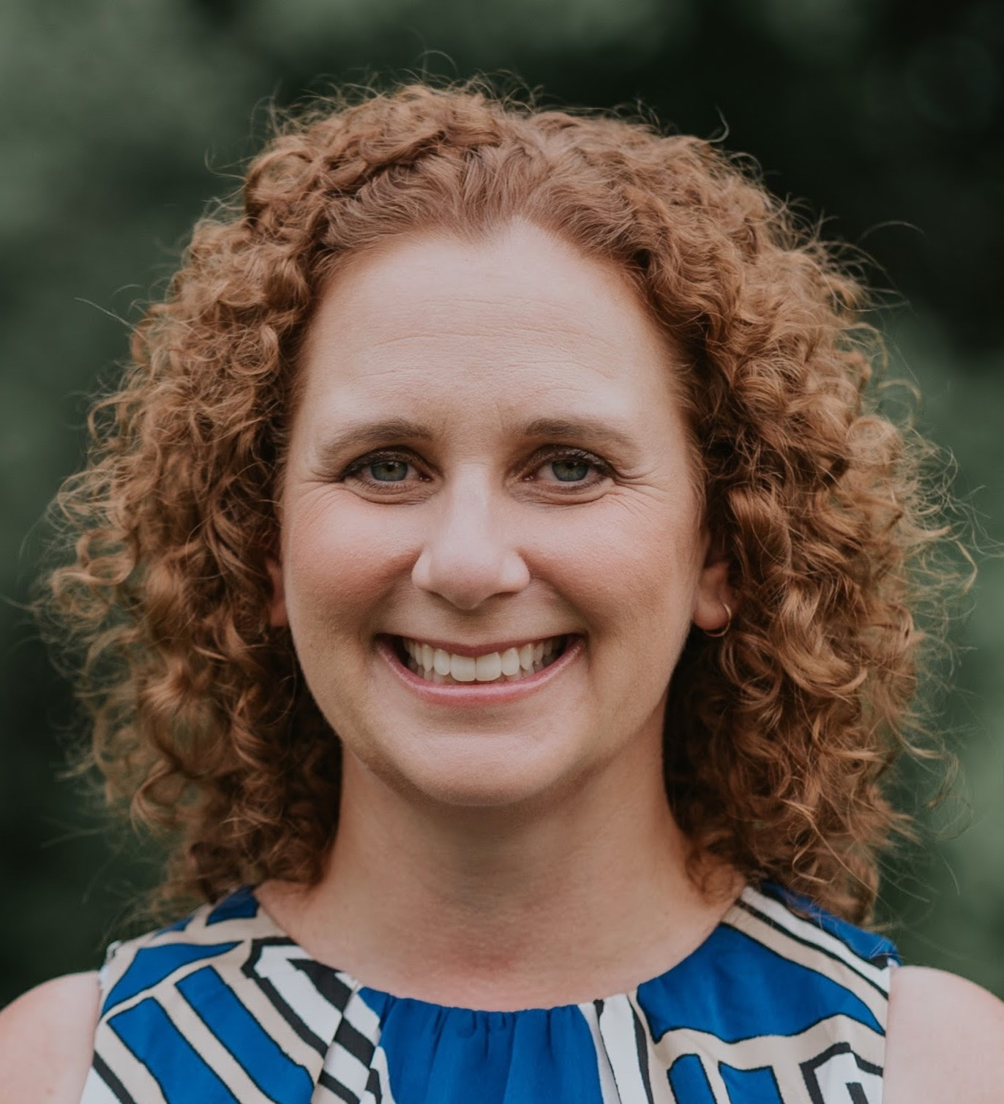
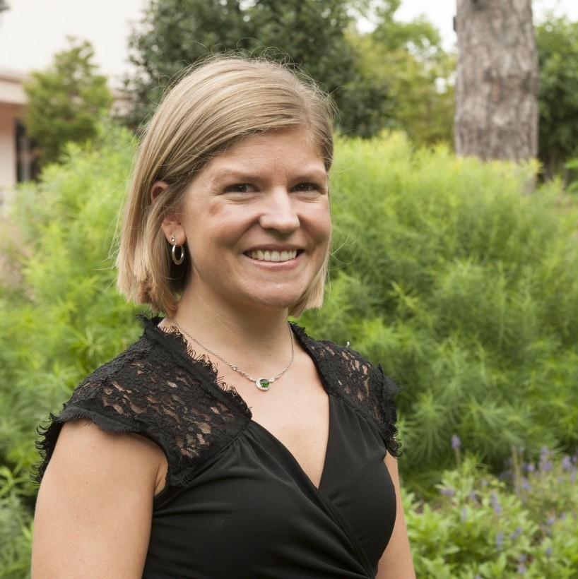
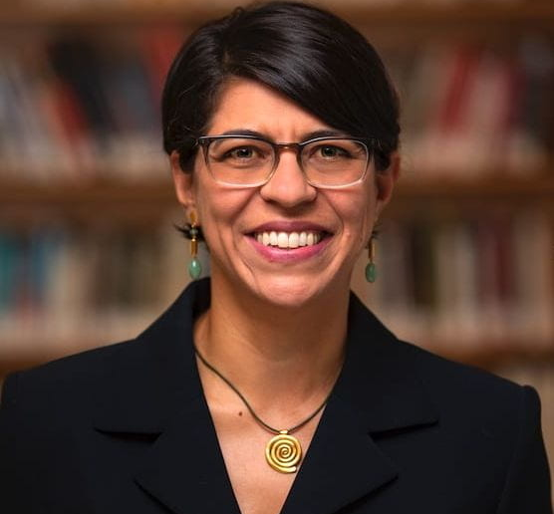
Introductions
*Disclaimer: The findings and conclusions in this presentation are those of the presenters and should not be construed to represent any official USDA or U.S. Government determination or policy.

Slide 6
NOPREN/HER Early Childhood Work Group
The objective of the EC Work Group is to provide a platform for networking, information sharing, and collaboration that will increase the quality, effectiveness, and reach of nutrition promotion and early childhood obesity prevention research, policy, and practice.
Priority areas for the EC Work Group are:
1) Improving the health and wellbeing of young children from marginalized communities including racial/ethnic minority populations at highest risk for low diet quality and/or obesity
2) Encouraging collaboration and resource sharing to expand the use of scientifically-sound methods to evaluate nutrition promotion and obesity prevention initiatives.
https://nopren.ucsf.edu/early-childhood
Notes:
Alison

Slide 7
NOPREN/HER WIC Learning Collaborative
The WIC Learning Collaborative is made up of researchers, practitioners, funding agencies, and advocates committed to improving the health of women, infants, and young children through improved research, policy and practice of the USDA Special Supplemental Nutrition Program for Women, Infants, and Children (WIC).
Priority areas for the WIC Learning Collaborative are:
1) Identifying knowledge gaps and opportunities to build the evidence base on WIC and address the needs of lower-income and racial/ethnic minority children at highest risk for low diet quality and obesity
2) Facilitating joint projects or multi-site collaborative projects. The Collaborative falls under the work of the HER NOPREN Healthy Food Retail Working Group and is building stronger collaborations with the HER NOPREN Early Childhood Working Group.
3) Helping to foster the next generation of WIC researchers.
https://nopren.ucsf.edu/wic-learning-collaborative
Notes:
Leslie

Slide 8
Session Objectives
Identify policies, systems, and environments that influence the diet quality and health of young children in the US.
Describe the WIC program and its role in supporting young children’s diet quality and health.
Engage with researchers and practitioners who are applying PSE change strategies to improve young children's diet quality and health.
Notes:
Alison

Slide 9
Policy, Systems, and Environments
P
S
E
Policy
Systems
Environments
Creation or alteration of a formal written statement of a government, business, or nonprofit that results in a new organizational position, decision, action, or mandatory rule or regulation
Information and ongoing change in organizational practices and procedures that results in a new, voluntary way of doing business.
Directly alters the physical, economic, social, or messaging environment that results in a new level of access or opportunity for the target population.
Notes:
Alison

Slide 10
Live, Love, Learn Framework
Love
Immediate and Extended Family, Social Networks
Live
Neighborhood, Physical Community, Geopolitical Location
Child
Learn
Formal and Informal Early Childcare and Education
Notes:
Kate

Slide 11
What policies, systems, and environments are you aware of that impact young children’s diets?
Please enter responses in the chat
Notes:
Kate

Slide 12

Live Love Learn Table
LIVE | LOVE | LEARN
Notes:
Kate - complete table as attendees identify PSE strategies. Alison and Kate can provide descriptions of PSE strategies while filling in the table. Opportunity to ask for more information/background if needed.
Neighborhood food access – how are stores stocked, what are the food prices, do they accept EBT?
Are there nutrition incentive programs in the child’s state/locality?
Did the state accept Medicaid expansion – does that child now have public health insurance?
Does the child’s healthcare provider screen for SDOH?
Maternal and infant home visiting – connection to improved child growth, perhaps via maternal mental health?
SNAP – does the family participate, what are the state-level barriers to participation? Interaction with nutrition incentive programs, ease of running EBT
Food banks – location, policies, stigma
What is the minimum wage in the state? Is it enough to make work worth it when compared to childcare costs in that state?
What is the level of the state earned income tax credit?
Childcare – are there spaces for the child in childcare? Can the family access childcare subsidies – all of this is important before we even consider the nutrition environment of the childcare, CACFP participation
Key points:
Live, love, learn spheres all matter, all build on one another, create capacity for child and family to access resources, and alignment contributes to increased dose and synnergysm
Currently we’re only focused on a small number of these settings, not measuring impacts of diverse policies on young children, not considering interactions between policies.

Slide 13



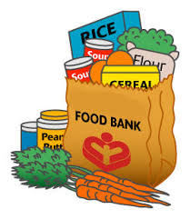





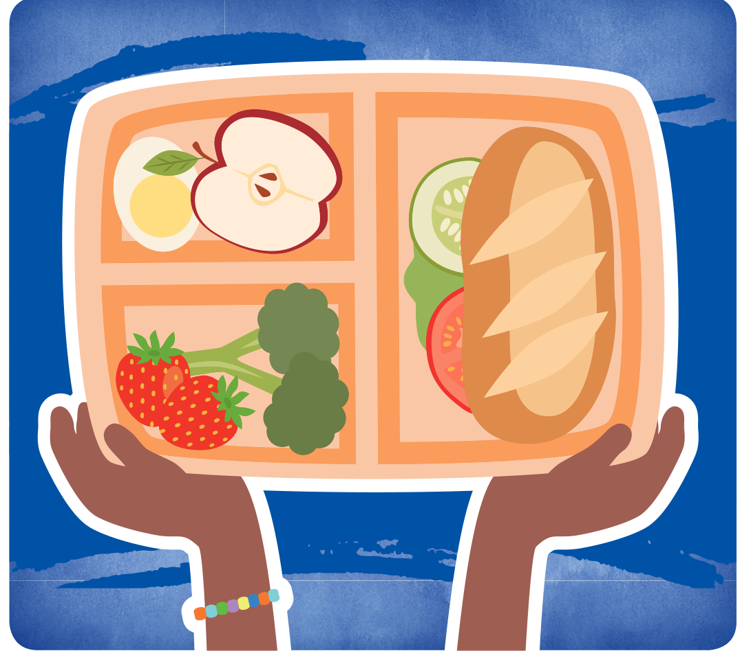
Live Love Learn Framework visuals
Notes:
Kate
Neighborhood food access – how are stores stocked, what are the food prices, do they accept EBT?
Are there nutrition incentive programs in the child’s state/locality?
Did the state accept Medicaid expansion – does that child now have public health insurance?
Does the child’s healthcare provider screen for SDOH?
Maternal and infant home visiting – connection to improved child growth, perhaps via maternal mental health?
SNAP – does the family participate, what are the state-level barriers to participation? Interaction with nutrition incentive programs, ease of running EBT
Food banks – location, policies, stigma
What is the minimum wage in the state? Is it enough to make work worth it when compared to childcare costs in that state?
What is the level of the state earned income tax credit?
Childcare – are there spaces for the child in childcare? Can the family access childcare subsidies – all of this is important before we even consider the nutrition environment of the childcare, CACFP participation
Key points:
Live, love, learn spheres all matter, all build on one another, create capacity for child and family to access resources, and alignment contributes to increased dose and synnergysm
Currently we’re only focused on a small number of these settings, not measuring impacts of diverse policies on young children, not considering interactions between policies.

Slide 14
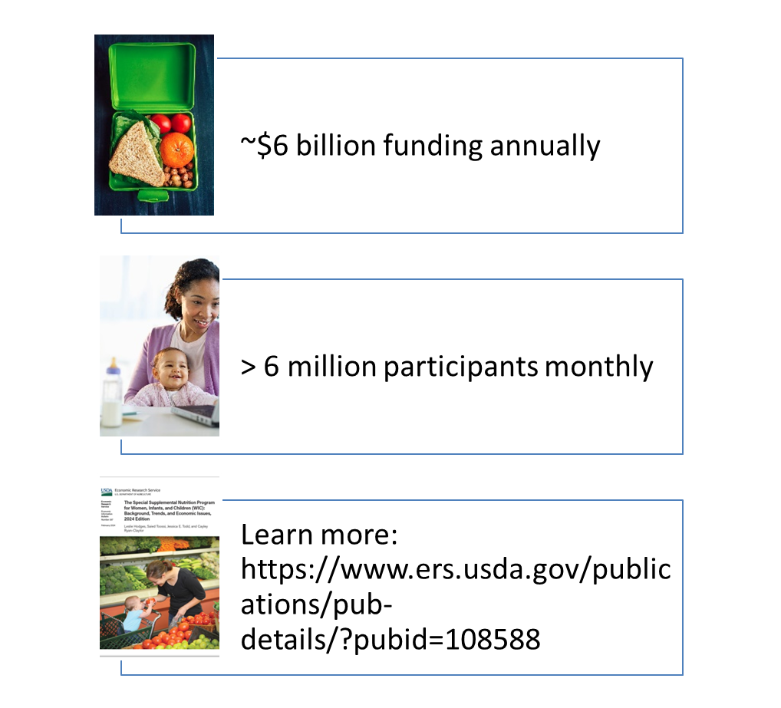
WIC = Special Supplemental Nutrition Program for Women, Infants, and Children
Who is eligible?
Pregnant & postpartum women
Infants & children up to age 5
Must be low-income and nutritionally at-risk
What does the program provide?
Supplemental foods
Nutrition education, including breastfeeding support
Screening and referrals to other social services and programs
Notes:
Goal of WIC is to improve health status of nutritionally at-risk women, infants, and children
Premise: Health and dietary habits established in childhood persist into adulthood
WIC is not an entitlement program, budget determined annual by congress. Number of participants the program can serve depends on funding levels.
In FY 2023, WIC spending was $6.6 billion and WIC reached about 6.6 million participants per month.
The program has a broad reach: ~40% of all infants and about ~20% of all children in the US
You can read more about the WIC program and recent USDA research on WIC in a recent ERS report: The WIC Program: Background, Trends, and Economic Issues linked to here.

Slide 15
How does WIC support nutrition security during early childhood?
Provide foods that are rich in nutrients essential to optimal health and wellbeing
Provide nutrition education, including breastfeeding information and support

Slide 16
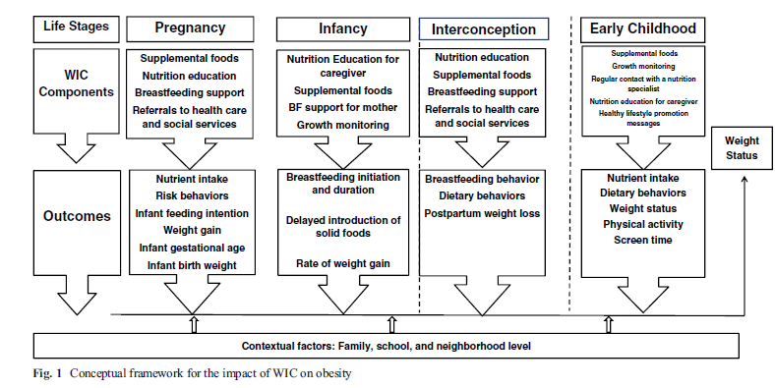
WIC → Nutrition Security → Health
Conceptual Framework for the Impact of WIC on Obesity
From Koleilat, M., Whaley, S..E., Esguerra, K.B., and Sekhobo, J.P. 2017. “The Role of WIC in Obesity Prevention.” Current Pediatrics Reports, 5: 132-141.

Slide 17
Q&A
Notes:
Moderator to lead Q/A

Slide 18
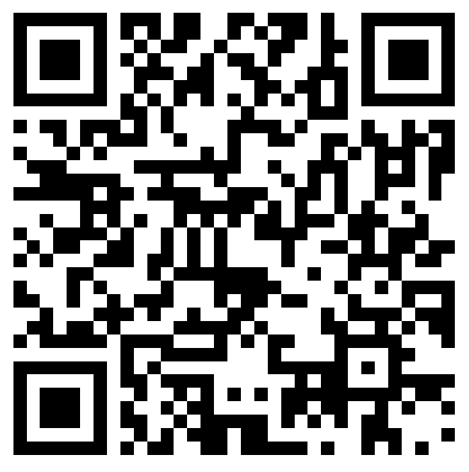
Announcements
Please fill out the session evaluation after today’s session.
You should be directed to fill it out after the call ends OR you may scan the QR code on the right.
Join us for the next session of the speaker series!
Wednesday, August 7 from 4:00 - 5:00 PM ET
Title: Collaborating Successfully across Sectors toward Nutrition Security
To view past recordings, visit https://nopren.ucsf.edu/her-nopren-summer-speaker-series-students-2024
Notes:
Session lead
Reminder: Student presentations - application due Wednesday, July 13 at 5pm EST: https://unc.az1.qualtrics.com/jfe/form/SV_cSJdvAqdmlQXicK
Reminder: please fill out the session evaluation for today: https://duke.qualtrics.com/jfe/form/SV_4SmhYaB4MN4pdn8

