Slide 1

Summer Speaker Series for Students
2025
(The contents and findings of this presentation are those of the speakers and do not represent the official views of the Centers for Disease Control & Prevention or Department of Health and Human Services.)

Slide 2


Getting Started!
Update your name on Zoom, if needed
  Right click on your Zoom box, click “rename”
Type your name and institution into the chat box!
  Question: Which best describes you?
    Ex. Undergraduate Student, Dietetic Intern, Masters Student, Doctoral Student, Post Doc, Public Health Practitioner, Researcher/Professor, Other
Remember to keep yourself on mute.
Type your questions into the chat box.

Slide 3
NOPREN HER Summer Series for Students
Explore various public health topics related to:
  Food and nutrition security
  Federal, state, and local policy
  Strategies to support young children’s health
  And more!
This series is a collaborative effort of Healthy Eating Research (HER) and Nutrition and Obesity Policy Research and Evaluation Network (NOPREN).

Slide 4
NOPREN HER Summer Series for Students Agenda
The series will take place on Wednesdays from
4:00 - 5:00 pm EST
Schedule and Topics
June 11: Policy, Systems, and Environmental (PSE)
Strategies to Support Young Children’s Diet and Health
June 25: Federal, State, and Local Nutrition Policy Updates
July 9: Food Policies in Schools
July 23: Building Resilient Food Systems
August 6: Interventions to Improve Food and Nutrition Security
August 13: Student Presentations
For more information or to register: https://nopren.ucsf.edu/her-nopren-summer%C2%A0speaker-series-students-2025

Slide 5

Student Presentations!
The HER/ NOPREN Summer Speaker Series will end with Student Presentations and Poster Sessions on August 13. Applications are due July 18th. To apply, scan the QR code below:
QR code
Selected students will give a presentation on a nutrition-related project or research they worked on over the summer.
The HER/ NOPREN Summer Speaker Series will end with Student Presentations and Poster Sessions on August 13. Applications are due July 18th. To apply, scan the QR code below:
QR code
Selected students will give a presentation on a nutrition-related project or research they worked on over the summer.

Slide 6

Healthy Eating Research
SENTHIL ANANTHAN, MPH, MBA
RESEARCH ANALYST
HEALTHY EATING RESEARCH

Slide 7
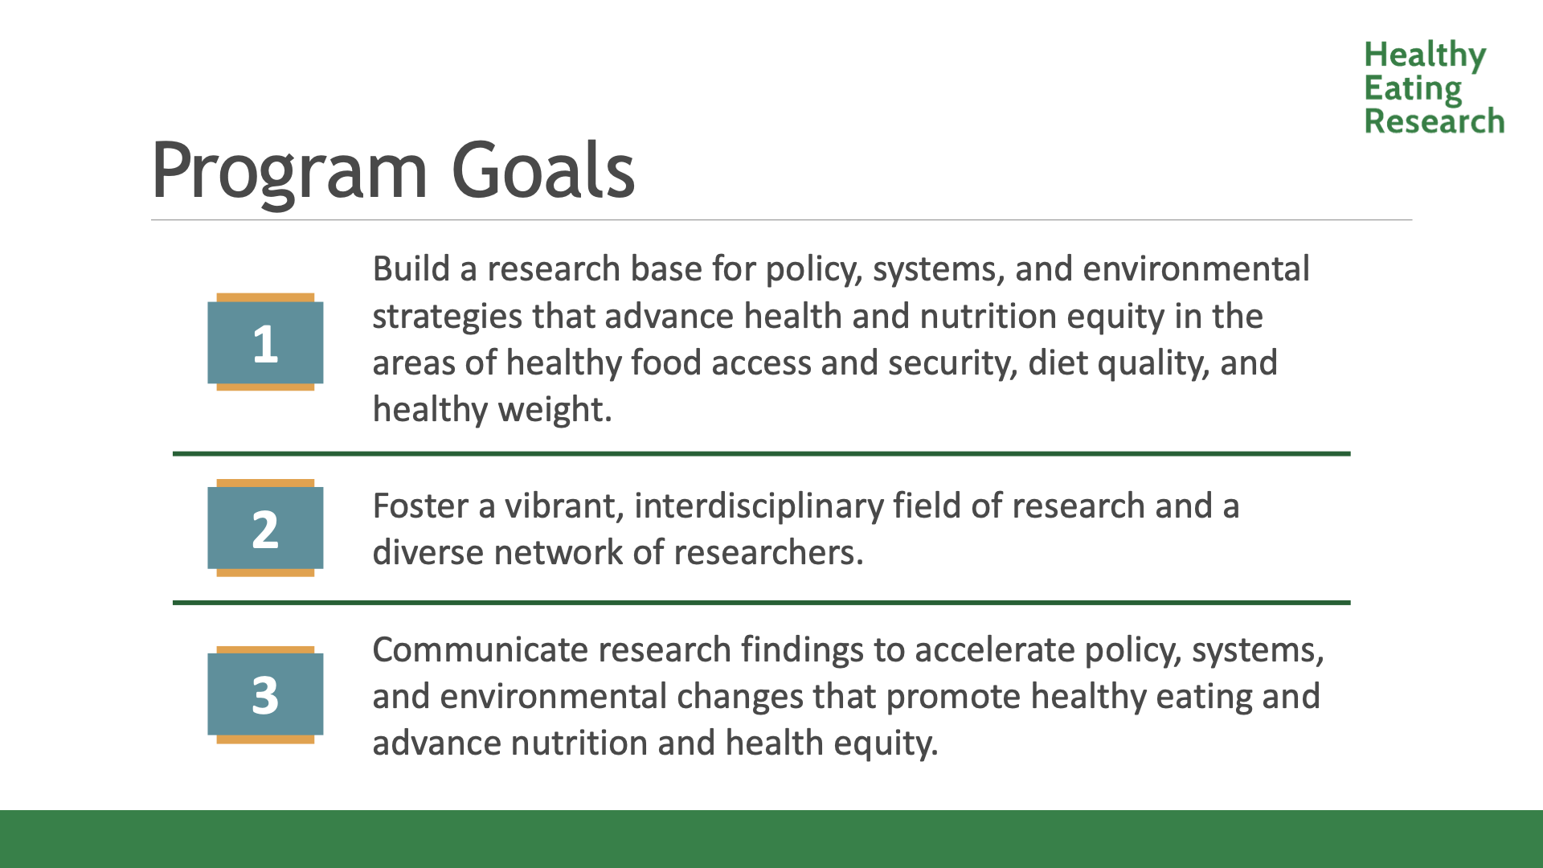
Program goals

Slide 8
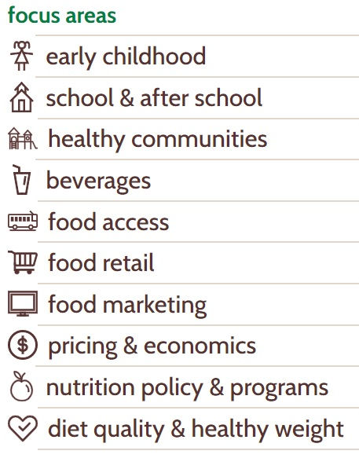
Goal 1: Build a Research Base
Research that focuses on: Children and adolescents from birth to 18 and their families Populations and communities at highest risk for obesity and nutritional disparities.
GOAL 1

Slide 9
Goal 2: Foster a Diverse Network of Researchers
Meetings/Convenings | Active Working Groups | Building the Field
HER Annual Grantee Meeting Topic-based convenings Expert Panels | Early Stage Investigator Food Labeling Strategic Research Collaborative Healthy Food Retail WIC Learning Collaborative Early Childhood Resilient Food Systems | Facilitating connections Training & Technical assistance
GOAL 2

Slide 10

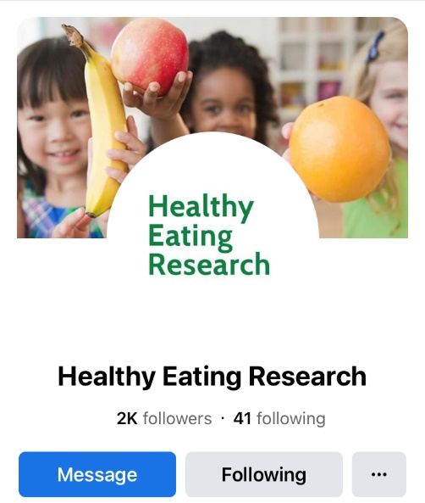
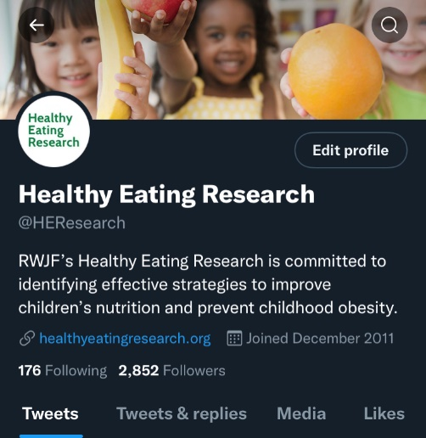
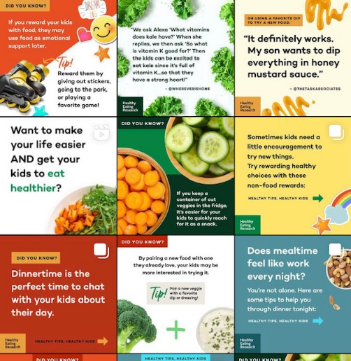
Goal 3: Research Translation & Dissemination
  Assist grantees with communication and translation of research
  HER works in partnership with grantees, RWJF, and Burness Communications
  Dissemination of research products to researchers, advocates, policymakers, parents, caregivers, and other stakeholders
Website
Facebook
Twitter
Instagram
GOAL 3

Slide 11
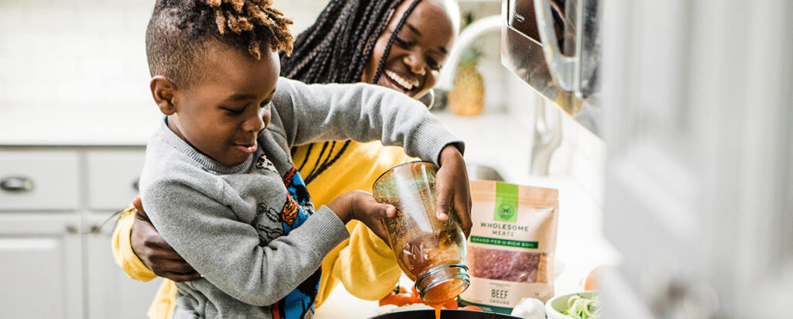
Contact
Website: healthyeatingresearch.org
Instagram: @healthyeatingresearch
Facebook: @HEResearch
Twitter: @HEResearch
  Senthil.Ananthan@duke.edu

Slide 12


NOPREN
Notes:
Melissa

Slide 13
Nutrition and Obesity Policy Research and Evaluation Network (NOPREN): What is it?
Collaborative research network focusing on the effectiveness of policies and practices designed to support the intake of healthy, nutritious foods so that everyone has a fair chance at health.
Funded by the CDC’s Division of Nutrition, Physical Activity, and Obesity (DNPAO) and led by a coordinating center based at the University of California San Francisco (UCSF)
Members (3000+) include policy researchers, evaluators, practitioners, professional organizations, non-profits, and government agencies.
    We encourage early career and junior faculty to join for networking, collaboration, and professional development opportunities.

Slide 14
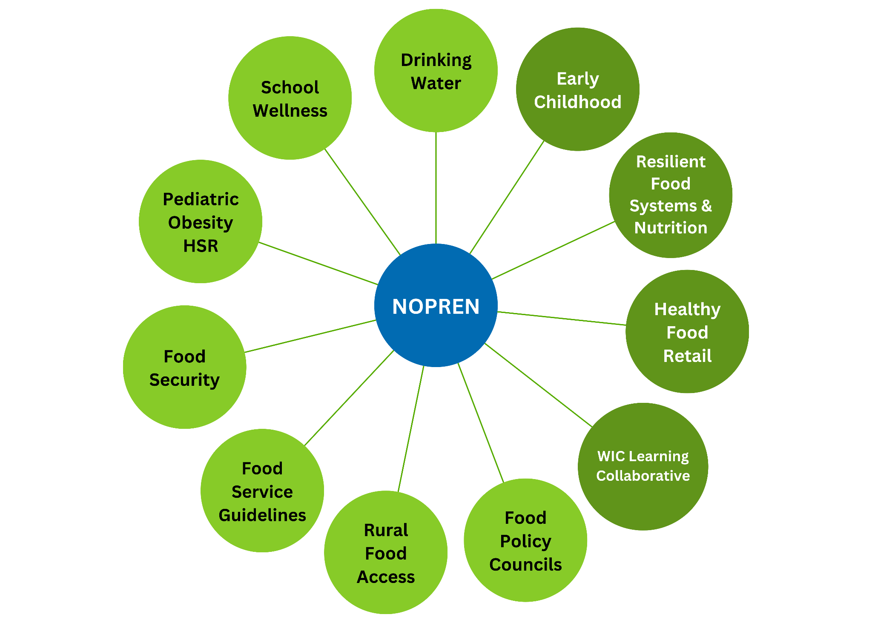


Work Groups
11 Work Groups
4 co-led with HER

Slide 15


Ways to Engage with NOPREN
Sign up for the listserv to receive newsletters and network info
Attend monthly State‐of‐the‐Science webinars
Join a Work Group
Work Group Fellows program

Slide 16
Session 1: Policy Systems and Environmental Strategies to
Support Young Children's Diet and Health
Notes:
Session lead to introduce session topic and moderator

Slide 17
Policy Systems and Environmental Strategies to Support Young Children's Diet and Health
Kate Bauer, PhD
Alison Tovar, PhD
NOPREN Early Childhood Work Group
Notes:
3:45 – 4:00 pm EST: Moderator and presenters join early for tech check
4:00-4:05 pm EST:
HER/NOPREN Staff to open session and introduce session moderator
Kate Bauer to introduce session, presenters, and WG they represent
4:05-4:30pm EST: Presentations
Alison Tovar: Overview of policy, systems, and environmental approaches to improve nutrition security and reduce nutrition inequities among young children.
4:30 – 4:55 pm EST: Questions/Discussion and Networking and Professional Development Breakout Session
Kate Bauer facilitates Q&A
Kate Bauer, Alison Tovar, WG fellow, HER and NOPREN staff to be available for general networking with students
4:55-5:00pm EST: Closing
HER/NOPREN staff to provide closing remarks and invitation to participate in networking and professional development breakout session, reminder of next session date/topic

Slide 18
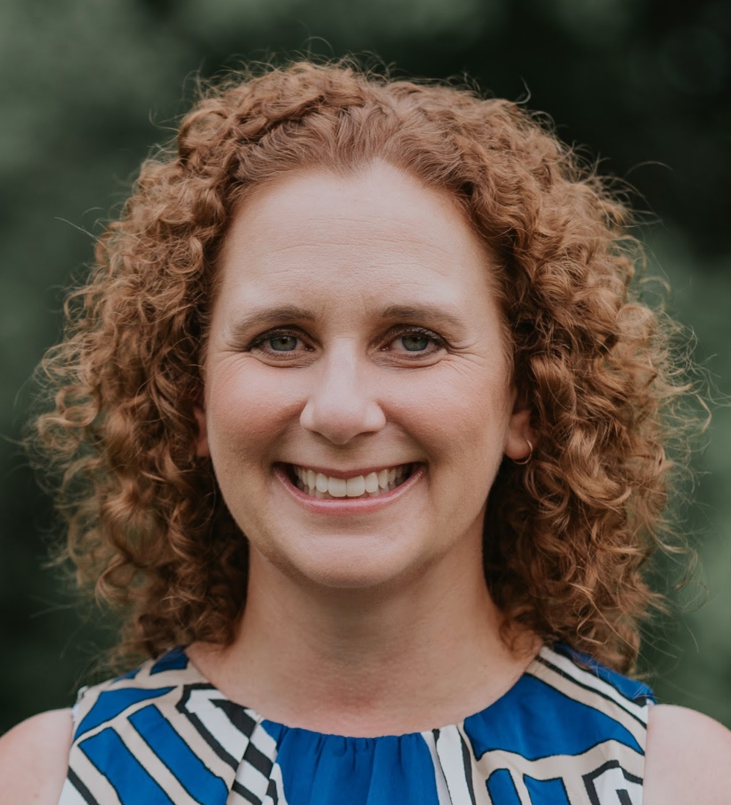
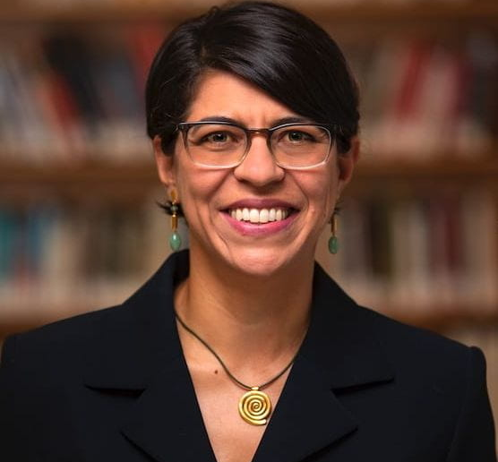
Introductions

Slide 19
NOPREN/HER Early Childhood Work Group
Convenes a multi-disciplinary network focused on policy, systems, and environmental approaches to improve young children’s nutrition and promote healthy growth in the places where children ages 0 through 5 years old live, learn, and play.
A high priority of the Work Group is to advance knowledge on ways to best support nutrition promotion and obesity prevention within early care and education (ECE).
The primary activities of the Work Group is hosting regular webinars to disseminate innovative research and practice, share knowledge of rigorous scientific methods, foster collaborative research, and provide mentorship.
https://nopren.ucsf.edu/early-childhood
Notes:
Kate

Slide 20
Session Objectives
Define policy, system, and environmental strategies to promote healthy eating.
Understand the importance of early childcare and education settings in implementing PSE change to support young children’s healthy eating.
Identify PSE strategies to support young children’s healthy eating.
Notes:
Kate

Slide 21
PSE
P
S
E
Policy
Systems
Environments
Creation or alteration of a formal written statement of a government, business, or nonprofit that results in a new organizational position, decision, action, or mandatory rule or regulation
Information and ongoing change in organizational practices and procedures that results in a new, voluntary way of doing business.
Directly alters the physical, economic, social, or messaging environment that results in a new level of access or opportunity for the target population.
Notes:
Kate

Slide 22
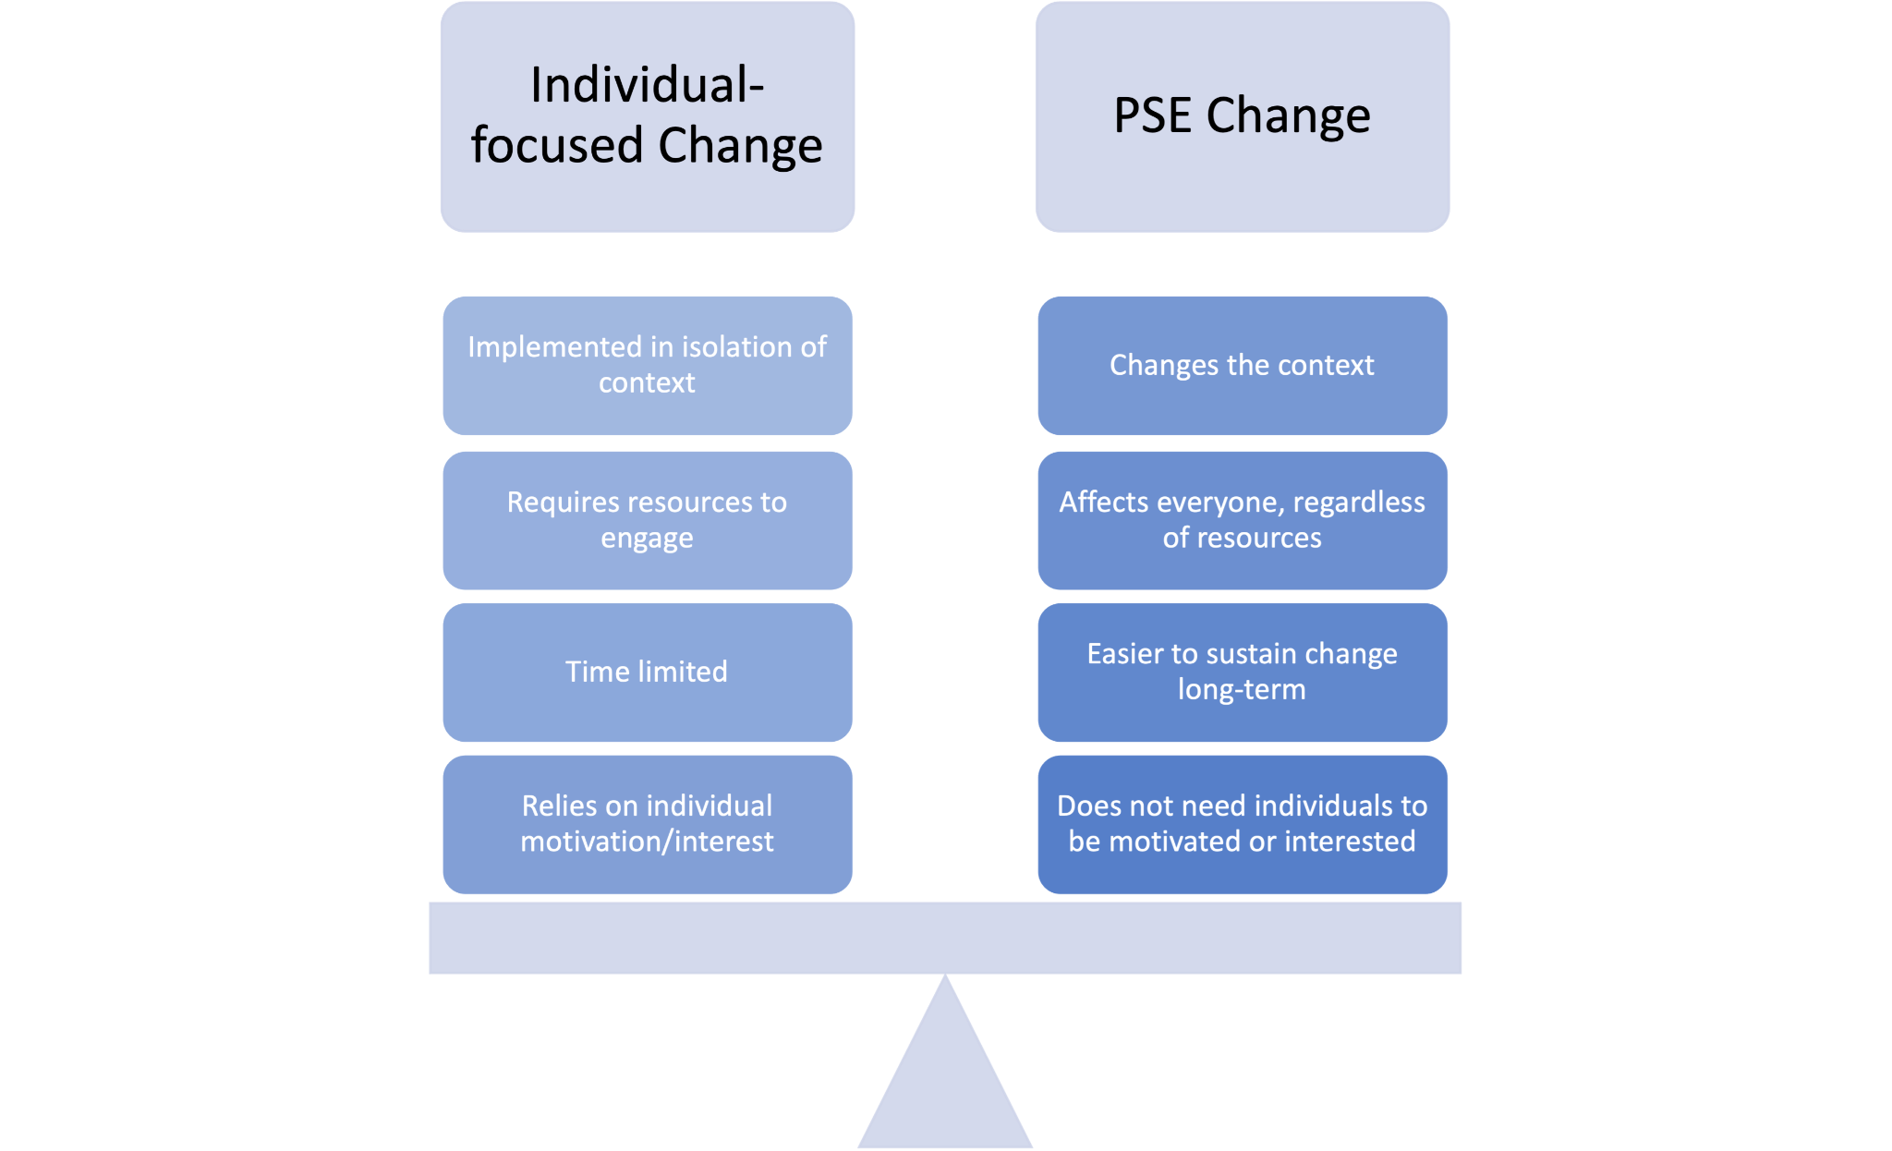
Individual focused change vs. PSE Change

Slide 23

Early Care and Education Settings can Impact Young Children’s Nutrition and Food Security
Notes:
Alison

Slide 24

The ECE Setting Directly Influences Young
Children’s Behaviors and Can Have Ripple Effects
PRE-K
PRESCHOOL
CHILD CARE CENTER
FAMILY CARE HOMES
The ECE setting can directly influence what children eat and drink and how active they are and build a foundation for healthy habits.
59% or 12.5 million children are cared for outside the home at least 1x week
Center based care most common and children spend an average of 31 hours/week
Slide from Carrie Dooyema- CDC
Notes:
Alison

Slide 25
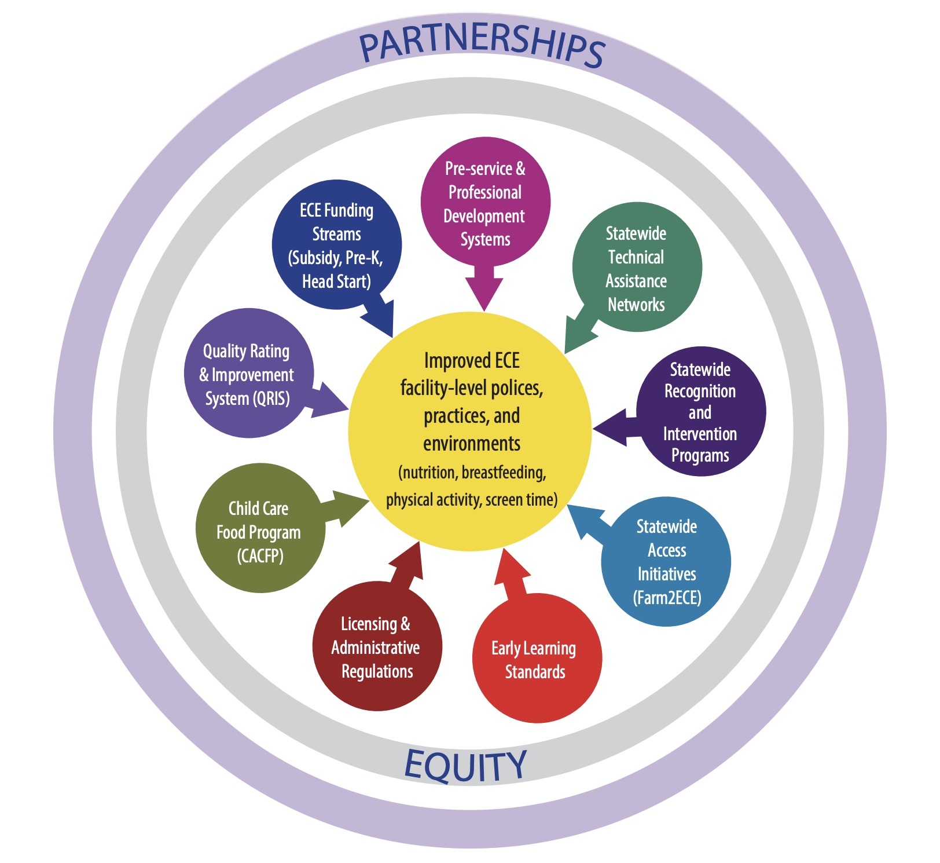
Center for Disease and Control’s Spectrum of Opportunities for Obesity Prevention in the Early Care and Education (ECE) Setting & High Impact Obesity Prevention Standards
https://www.cdc.gov/early-care-education/php/getting-started/spectrum-of-opportunities.html
Notes:
Alison

Slide 26

State Licensing Regulations
States adopt regulations that delineate the requirements licensed ECE providers must follow to legally operate
States can require the licensing to include following CACFP standards

Slide 27
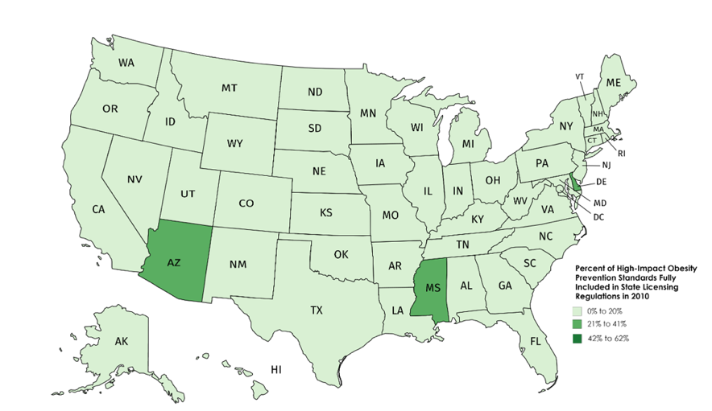
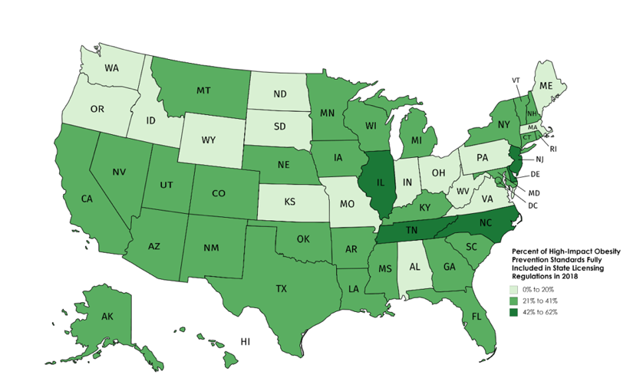
National Trends in Child Care Regulations 2010-2018
From 2010-2018, 39 states updated their licensing standards to include more breastfeeding and infant feeding, nutrition, and physical activity support
2010
2018
The Early Care And Education (ECE) Setting: Helping Our Nation’s Children Grow Up Healthy And Ready To Lean
Warnock A et al. Child Obes. 2021.
Slide from Carrie Dooyema- CDC

Slide 28
What are other policies, systems, and environments that impact young children’s healthy eating?
Please enter responses in the chat
Notes:
Alison

Slide 29
Live, Love, Learn Framework
Love
Immediate and Extended Family, Social Networks
Live
Neighborhood, Physical Community, Geopolitical Location
Child
Learn
Formal and Informal Early Childcare and Education
Notes:
Kate

Slide 30



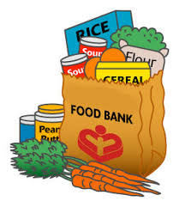







Girl with environmental factors

Slide 31
Q & A

Slide 32
Breakout Rooms
Discuss current policy research opportunities and/or challenges related to today's topic. What are the opportunities/challenges at the local, state, and federal levels?
What are the considerations for practitioners (i.e., healthcare providers, school districts, SNAP or WIC agencies) implementing programs or policies discussed today? What do we still need to know to implement and scale these programs or policies?
Discuss how you've interacted with this topic in your professional career (i.e., current coursework, study, grant).
What are you currently working on that's exciting you?
What advice/questions do you have for people in your breakout?

Slide 33
Announcements
Join us for the next session of the speaker series!
Wednesday, June 25 from 4:00 - 5:00 PM ET
Title: Federal, State, and Local Nutrition Policy Updates

