Slide 1

Summer Speaker Series for Students
2024
Notes:
Welcome everyone to the final session of the 2024 HER NOPREN Summer Speaker Series for Students! We are pleased to have everyone with us today!

Slide 2


Getting Started!
Update your name on Zoom, if needed
  Right click on your Zoom box, click “rename”
Type your name and institution into the chat box!
Remember to keep yourself on mute.
Type your questions into the chat box.
Notes:
Before we get started, we have a few housekeeping items.
If you happen to notice your name appears as something other than it should be, please feel free to update it now using the rename function.
We are again happy to see all those that are here with us today and invite you to introduce yourself by placing your name and institute into the chat box!
We want to remind you all to keep yourself on mute but you are welcome to type questions into the chat box. There will a time of Q&A at the very end. So please wait to unmute yourself until the end of all the presentations.

Slide 3
NOPREN HER Summer Series for Students
Schedule and Topics
June 12: Food Policies in Schools - More than just Lunch!
June 26: Food is Medicine: What does it mean?
Where are we going?
July 10: Leveraging Food Service Contracts at 4-year Public Universities to
Understand Meal Plan Costs and Affordability
July 24: Policy, Systems, and Environmental Strategies to Support Young
Children's Diet and Health
August 7: Collaborating Successfully across Sectors toward Nutrition Security
August 14: Student Presentations
Session recordings available here: https://nopren.ucsf.edu/her-nopren-summer-speaker-series-students-2024
Notes:
The series has taken place bi-weekly on Wednesdays from 4-5pm eastern. You can see our schedule of topics and find all past recordings on the NOPREN website at the URL listed on the slide.

Slide 4
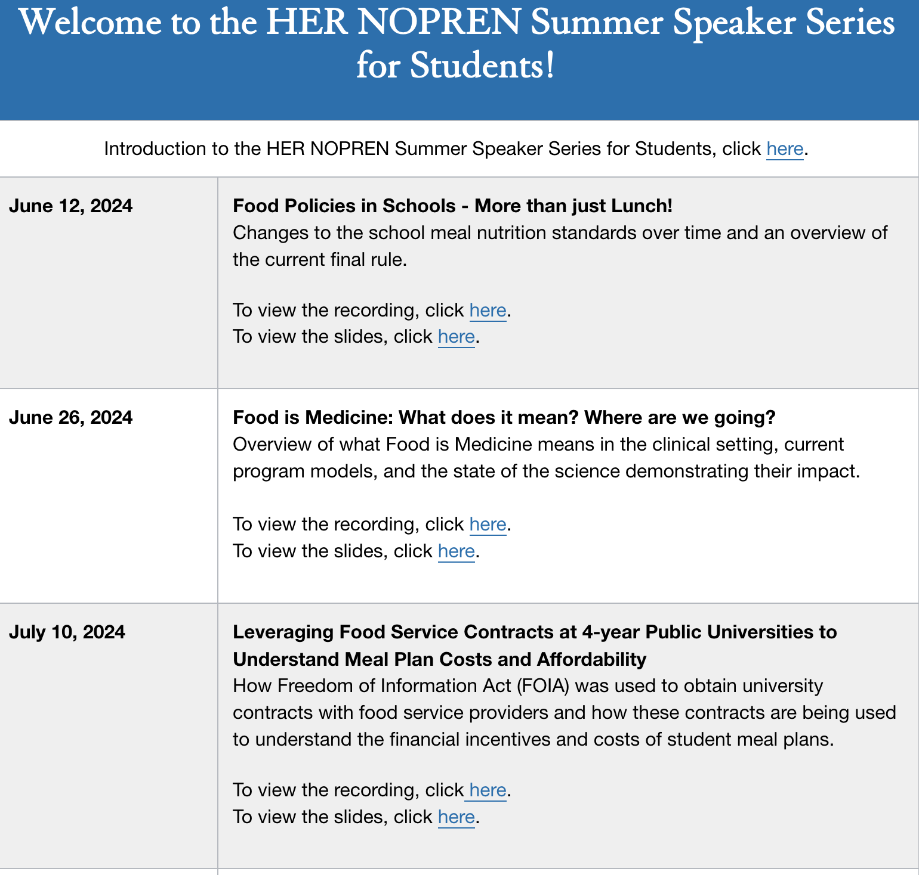
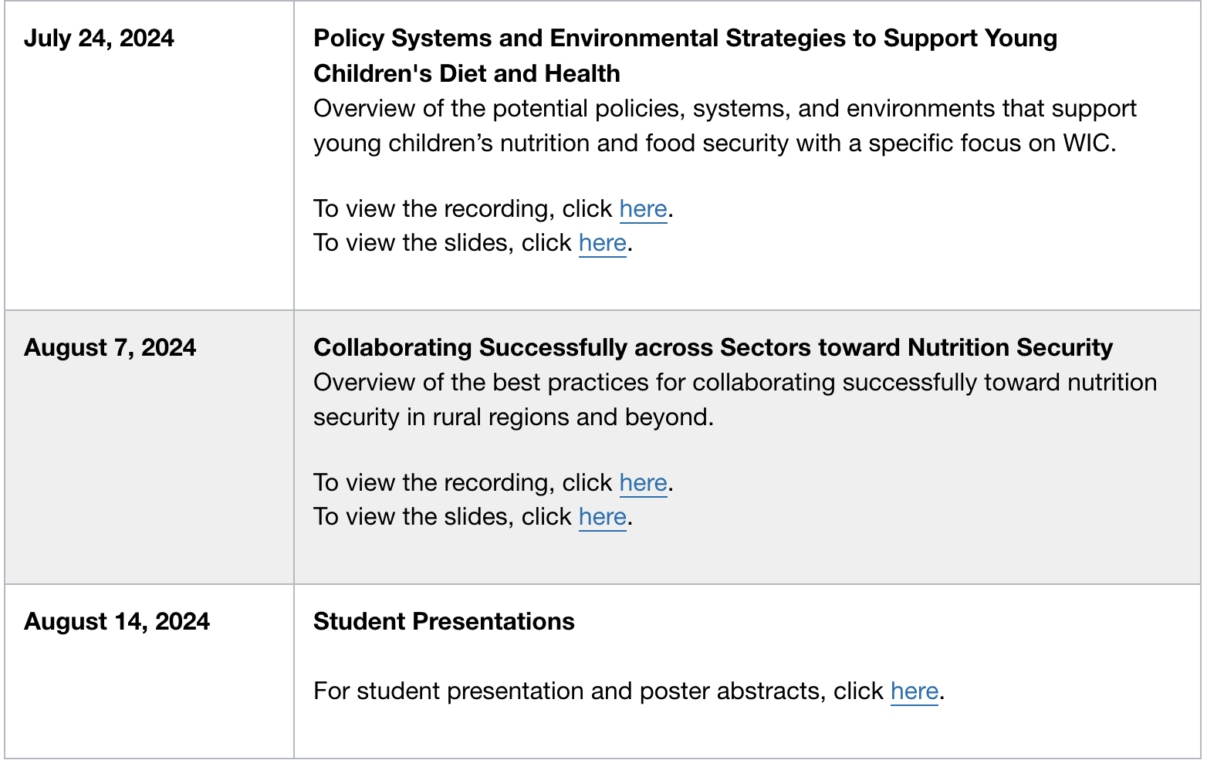
NOPREN HER Summer Series for Students: Recordings
Session recordings available here: https://nopren.ucsf.edu/her-nopren-summer-speaker-series-students-2024

Slide 5
Student Posters
Marian Winters, University of South Carolina: Mediation of the association between sociodemographic characteristics and psychosocial well-being by food insecurity among Mexican and U.S. Mexican American adults in 2021
Elise Sheinberg, Harvard University: New and recurring food insecurity during and after the COVID-19 pandemic in a nationally representative sample
Salma Hakam, The University of North Carolina at Chapel Hill: From Awareness to Access: Enhancing SNAP Participation Among Middle Eastern and North African Immigrants in North Carolina
Man Viet Nguyen, Boston University: Development of a conceptually equivalent Vietnamese-language translation of the US Household Food Security Survey Module for use with Vietnamese people living in the US
Charlotte Kerber, University of California, Davis: Qualitative analysis of fieldnote and interview data for planning a food bank-based breast cancer screening intervention
View them here: https://nopren.ucsf.edu/her-nopren-summer-speaker-series-students-2024
Notes:
Before we get started, I want to put a plug for our student posters. In addition to our presentations today, we have a series of posters from students who conducted work and research over the summer. YOu can find the posters on the NOPREN website as well. Please go ahead and chedk that out.

Slide 6
Session 6: Student Presentations
Notes:
Now, I would like to transition to our student presentations. Today we will be spotlighting presentations from 4 student presenters who will be discussing their research and practicum experiences. Our session today will be moderated by Alex Ross.

Slide 7

Today’s Presenters
Student Presenters:
Hope Craig, Friedman School of Nutrition at Tufts University
Anna Localio, University of Washington
Claire Branley, University of Massachusetts Chan Medical School
Shreya Raval, Arizona State University
Moderator: Alex Ross
Fellow, Healthy Food Retail Work Group
Notes:
Alex Ross is the HER/NOPREN Fellow for the Healthy Food Retail Working Group. She has a Master’s from the Johns Hopkins Bloomberg School of Public Health and recently completed her PhD in Nutrition Epidemiology from the UNC Chapel Hill School of Global Public Health, where she focused her research on food affordability and pricing, as well as policy evaluations in the US and South Africa. Starting in September, she will be a post-doc at Harvard Medical School and the School of Public Health.
Now, I will turn it over to Alex.

Slide 8

Development and Validation of a Nutrition Security Screener
Hope Craig, MSPH
PhD Student, Tufts Friedman School of Nutrition
Presentation to the HER NOPREN Summer Speaker Series
August 14, 2024

Slide 9
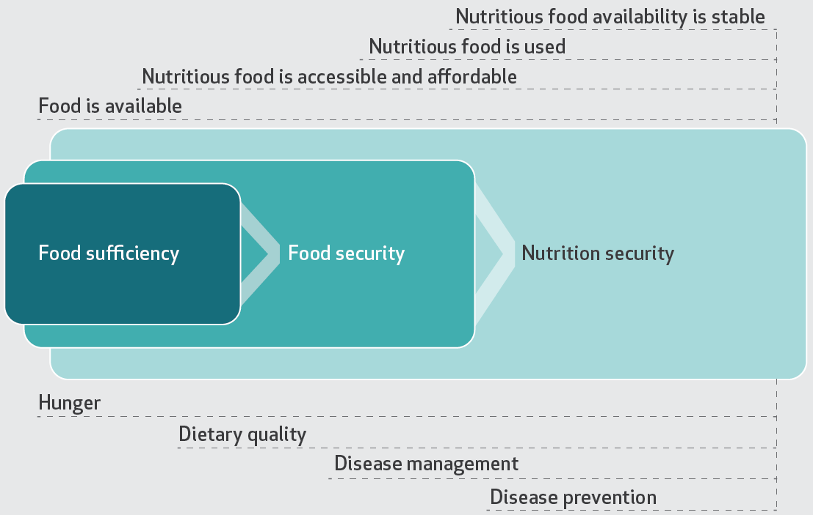
Food security and nutrition security
Mozaffarian (2023) Health Affairs adapted from Thorndike et al. (2022) Circulation.
Notes:
Conceptual framework of nutrition security. Recognizes distinction between access to calories alone vs access to nourishing foods. Food sufficiency and food security beginning to address hunger and food availability, complementary concept of nutrition security builds on this to address disease management and disease prevention.
Food and nutrition insecurity are major public health problems in the U.S.
Current measures of food security have important limitations in the context of FIM interventions, including lack of assessment of food quality.
This nutrition security construct was designed to complement measures of food security. Nutrition security screening tools can enhance efforts to address food insecurity.
Valid measures are needed as an important element in the process of advancing knowledge to improve nutrition and health.
Nutrition security refers to access, availability, and affordability of foods that support well-being and prevent and manage nutrition related diseases.
Healthcare and gov entities are focusing on nutrition insecurity (NI) in light of the distinction between access to calories vs. nourishing foods but validated screening measures are not established.
Source: From Mozaffarian 2023,, Adapted from Thorndike AN, Gardner CD, Kendrick KB, Seligman HK, Yaroch AL, Gomes AV, et al; American Heart Assocaition Advocacy Coordinating Committee. Strengthening US food policies and programs to promote equity in nutrition security: a policy statement from the American Heart Association. Circulation. 2022;145(24):e1077–e1093.

Slide 10
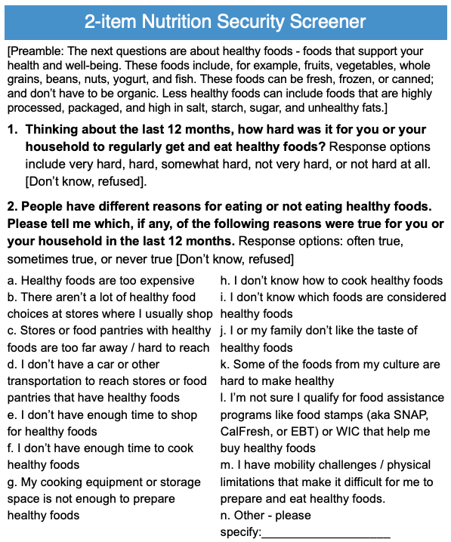
Research Questions
What is the prevalence of nutrition insecurity in diverse U.S. populations?
How does the prevalence of nutrition insecurity compare to the prevalence of food insecurity, as measured by the 2-item HVS and 6-item USDA food security module?
How does nutrition insecurity compare to food insecurity as a predictor of diet-related disease and self-reported health?
Notes:
Valid measure – measuring what we expect. 1) Descriptive analysis – summarize data and identify patterns in accounts. 2) Statistical analysis – to assess validity

Slide 11
Methods
2-item NSS was refined in pilot studies and assessed against measures of food insecurity (2-item HVS or 6-item USDA module), socio-demographics, and health in 5 diverse populations.
Descriptive analyses examine prevalence of food and nutrition security.
Multivariate logistic modelling examines food and nutrition insecurity as predictors of health, adjusting for age, sex, income, race/ethnicity, and education.
Data were analyzed using STATA.

Slide 12
Methods
Summary of included surveys
# | Survey | Sample population | n | Description
1 | Food is Medicine (FIM) National Poll | National | 3009 | Investigates knowledge/experience with diet-related medical conditions, FIM programs within health care settings, and experience with food and nutrition insecurity.
2 | Food is Medicine (FIM) California Poll | State | 650 | Investigates of knowledge/experience with diet-related medical conditions, FIM programs within health care settings, and experience with food and nutrition insecurity.
3 | Kaiser Permanente Social Needs Survey | National | 6317 | Describes prevalence of social risk and need across representative sample of KP members nationally.
4 | Los Angeles County Department of Public Health Survey | LA County | 9372 | Assesses of health needs/behaviors of County residents, evaluates current programs and initiatives, and informs public health policy planning.
5 | USC Understanding America | LA County | 1152 | UAS is a probability-based nationally representative internet panel of U.S. adults, oversampled in LA County. Offers in-depth portrayal of the people in the U.S., their daily lives and opinions
Notes:
Cross-sectional
Asian American, Native Hawaiian and Pacific Islanders (AANHPI)

Slide 13
Results
Income | FIM National Poll (N=3009)
<$25,000 | 27%
$25,000-$49,999 | 25%
$50,000-$99,999 | 16%
$100,000-$150,000 | 16%
>$150,000 | 15%
Education
< High school or High school / GED | 39%
Some college / vocational (trade school) | <8%
College graduate or higher | 53%
Race
White (non-Hispanic) | 63%
Hispanic/Latinx | 16%
Black (non-Hispanic) | 14%
Asian/Pacific Island/Other (non-Hispanic) | <5%
Native American, indigenous (non-Hispanic) | <2%
Demographics
Age | FIM National Poll (N=3009)
18-34 years | 31%
35-49 years | 35%
50-64 years | 15%
65+ years | 19%
Sex
Female | 51%
Male | 49%
Non-binary | <1%
Notes:
Weighted to represent population of interest; KP for its membership and LA County Dep’t PH and USC surveys weighted for LA county.
Initially over-sampled lower income in FIM samples. May relate to higher level of low education

Slide 14
Food and nutrition insecurity prevalence and correlation
Survey | n | Food security measure | Food insecurity | Nutrition insecurity | Spearman correlation (r) | P-value
FIM National Poll | 3009 | 2-item HVS | 42% | 44% | 0.618 | <0.001
FIM CA Poll | 650 | 2-item HVS | 37% | 41% | 0.610 | <0.001
KP National Social Needs | 6317 | 2-item HVS | 13% | 18% | 0.551 | <0.001
Los Angeles County Public Health Survey | 9372 | 6-item USDA module | 25% | 33% | 0.400 | <0.001
USC Understanding America Study, L.A. County | 1152 | 6-item USDA module | 24% | 25% | 0.458 | <0.001
FIM = Food is Medicine. HVS = Hunger Vital Signs. KP = Kaiser Permanente. USC = University of Southern California.
Notes:
Over 20K respondents total, from five diverse populations (Table 1).
Note HVS is known to overestimate FS
Only moderate positive correlation exists between the presence of food insecurity and nutrition insecurity (Table 1).
Prevalence of food insecurity in the five surveys ranged from 13-42% while prevalence of nutrition insecurity ranged from 18-44% (Table 1).
Does nutrition security measure give us more information?
Spearman correlation coefficient shows moderate positive correlation between NSS (nutrition insecurity) and HVS (food insecurity).
For both the FIM national poll (r(3007) = 0.62; p < 0.001) and FIM CA poll (r(3007) = 0.61; p < 0.001)
R = 0.85 is considered high (positive correlation; convergent validity)
R <0.30 is considered low (low correlation; discriminant validity)
Should be Spearman coefficient because categorical variable
Spearman’s rho = 0.6179, p<0.001 (national poll)
=0.6098, p<0.001 (CA poll)

Slide 15
Overlap of food and nutrition insecurity
*USC survey does not distinguish between low and very low NS
Notes:
FS green, FI red. Shading / level of saturation indicates degree of nutrition security. Does nutrition security measure give us more information?

Slide 16
Overlap of food and nutrition insecurity cont
*USC survey does not distinguish between low and very low NS
Notes:
Food insecurity and nutrition insecurity only partly overlapped, with discordance in about 20% of all respondents (Figure 1).
See blue borders. FS green, FI red. Shading / level of saturation indicates degree of nutrition security.

Slide 17
Barriers to Nutrition Security (Often/Sometimes True)
Notes:
Common barriers to nutrition security were cost, cooking knowledge, and uncertainty around food assistance qualifications (Figure 2).

Slide 18
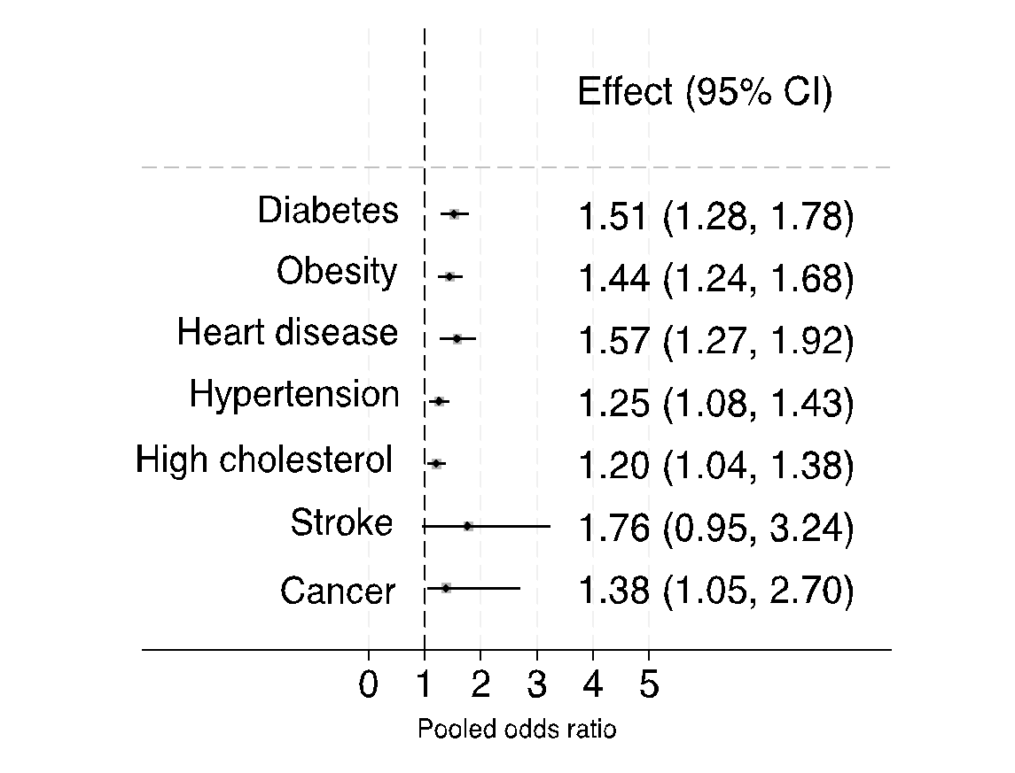
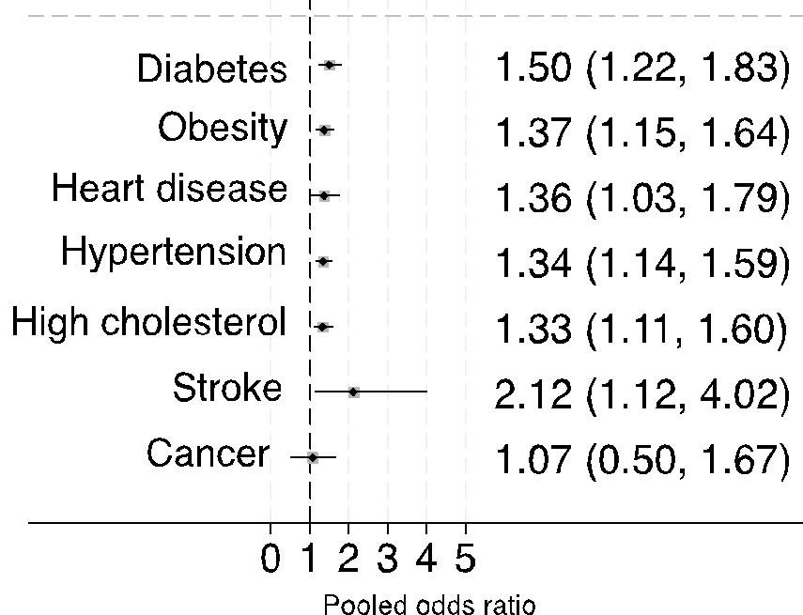
Multivariable adjusted associations of food and nutrition insecurity with prevalent health conditions
Food insecurity ⁺
Nutrition insecurity ⁺
Odds ratio (95% CI)
Odds ratio (95% CI)
⁺ Multivariable model adjusted for age, sex, income, race/ethnicity, education and jointly adjusted for food and nutrition insecurity. Pooled results from FIM National, FIM CA, and LACPH Surveys.
Notes:
Across the 3 studies, presence of nutrition insecurity and food insecurity each independently predicted significantly higher risk of diabetes, obesity, heart disease, hypertension, and high cholesterol

Slide 19
Multivariable adjusted associations of food and nutrition insecurity with prevalent health conditions (cont)
Food insecurity ⁺
Nutrition insecurity ⁺
Odds ratio (95% CI)
Odds ratio (95% CI)
⁺ Multivariable model adjusted for age, sex, income, race/ethnicity, education and jointly adjusted for food and nutrition insecurity. Pooled results from FIM National, FIM CA, and LACPH Surveys.
Notes:
Across the 3 studies, presence of nutrition insecurity and food insecurity each independently predicted significantly higher risk of diabetes, obesity, heart disease, hypertension, and high cholesterol

Slide 20
Association of food and nutrition insecurity and self-reported physical and mental health
KP Social Needs Survey (N=6317) | Food insecurity⁺ |  | Nutrition insecurity⁺
Self-reported physical health | OR | 95% CI | OR | 95% CI
Very Good/Excellent (n=2877) | 1.00 (Ref) | --- | 1.00 (Ref) | ---
Good (n=2358) | 1.37 | (0.92, 2.04) | 1.75* | (1.25, 2.45)
Poor / Fair (n=1017) | 1.67* | (1.03, 2.72) | 3.14** | (2.07, 4.75)
Self-reported mental health
Very Good/Excellent (n=3524) | 1.00 (Ref) | --- | 1.00 (Ref) | ---
Good (n=1796) | 1.23 | (0.83, 1.81) | 2.04** | (1.47, 2.85)
Poor/Fair (n=943) | 2.54** | (1.66, 3.91) | 2.30** | (1.58, 3.33)
⁺ Multivariable model adjusted for age, sex, income, race/ethnicity, education and jointly adjusted for food and nutrition insecurity.
Notes:
Compared to those who reported very good/excellent physical health, those with reporting poor or fair physical health had 3x greater odds of nutrition insecurity and 2.3x greater odds among those reporting poor/fair mental health (Table 2).

Slide 21
Association of food and nutrition insecurity and self-reported physical and mental health (cont)
KP Social Needs Survey (N=6317) | Food insecurity⁺ |  | Nutrition insecurity⁺
Self-reported physical health | OR | 95% CI | OR | 95% CI
Very Good/Excellent (n=2877) | 1.00 (Ref) | --- | 1.00 (Ref) | ---
Good (n=2358) | 1.37 | (0.92, 2.04) | 1.75* | (1.25, 2.45)
Poor / Fair (n=1017) | 1.67* | (1.03, 2.72) | 3.14** | (2.07, 4.75)
Self-reported mental health
Very Good/Excellent (n=3524) | 1.00 (Ref) | --- | 1.00 (Ref) | ---
Good (n=1796) | 1.23 | (0.83, 1.81) | 2.04** | (1.47, 2.85)
Poor/Fair (n=943) | 2.54** | (1.66, 3.91) | 2.30** | (1.58, 3.33)
⁺ Multivariable model adjusted for age, sex, income, race/ethnicity, education and jointly adjusted for food and nutrition insecurity.
Notes:
Compared to those who reported very good/excellent physical health, those with reporting poor or fair physical health had 3x greater odds of nutrition insecurity and 2.3x greater odds among those reporting poor/fair mental health (Table 2).

Slide 22
Many thanks to our collaborators:
UMass Medical School, Population & Quantitative Health Sciences
Kurt Hager
Matthew Alcusky
Shiwei (Echo) Liang
USC, Center for Economic & Social Research
Kayla de la Haye
Rockefeller Foundation
Vivian Peng
Tasnuva Orchi
L.A. County Department of Public Health
Julia Caldwell
Dipa Shah-Patel
Kelly Warner
Kaiser Permanente
Meagan Brown
Ceping Chao
Claudia Nau
Pamela Schwartz
Mina Habib
Food is Medicine Institute, Friedman School of Nutrition, Tufts
Julia Reedy Sharib
Ronit Ridberg
Dariush Mozaffarian

Slide 23
Thank you!
hope.craig@tufts.edu
Hope Craig, MSPH
Tufts Friedman School of Nutrition

Slide 24
Extra Slides

Slide 25
Nutrition Security Screener
[Preamble] The next questions are about healthy foods - foods that support your health and well-being. These foods include, for example, fruits, vegetables, whole grains, beans, nuts, yogurt, and fish. These foods can be fresh, frozen, or canned; and don’t have to be organic. Less healthy foods can include foods that are highly processed, packaged, and high in salt, starch, sugar, and unhealthy fats.
1. Thinking about the last 12 months, how hard was it for you or your household to regularly get and eat healthy foods?
  Very hard
  Hard
  Somewhat hard
  Not very hard
  Not hard at all
2. People have different reasons for eating or not eating healthy foods. Please tell me which, if any, were true for you / your household in the last 12mo. Often true, sometimes true, or never true.
  Healthy foods are too expensive
  There aren’t a lot of healthy food choices at the stores where I usually shop
  Stores or food pantries with healthy foods are too far away or hard to reach
  I don’t have a car or other transportation to reach stores or food pantries that have healthy foods
  I don’t have enough time to shop for healthy foods
  I don’t have enough time to cook healthy foods
  My cooking equipment or storage space is not enough to prepare healthy foods
  I don’t know how to cook healthy foods
  I don’t know which foods are considered healthy foods
  I or my family don’t like the taste of healthy foods
  Some of the foods from my culture are hard to make healthy
  I’m not sure I qualify for food assistance programs like food stamp that help me buy healthy foods
  I have mobility challenges or physical limitations making it difficult to prepare/eat healthy foods.
  Other - please specify:___________________
Notes:
Team at Tufts University, Kaiser Permanente, and Los Angeles County Department of Public Health designed a 2-item Nutrition Security Screener (NSS), refined it in pilot studies, and validated it against measures of food insecurity (FI), sociodemographics, and health
[Bea – how important is healthfulness in what people are purchasing

Slide 26
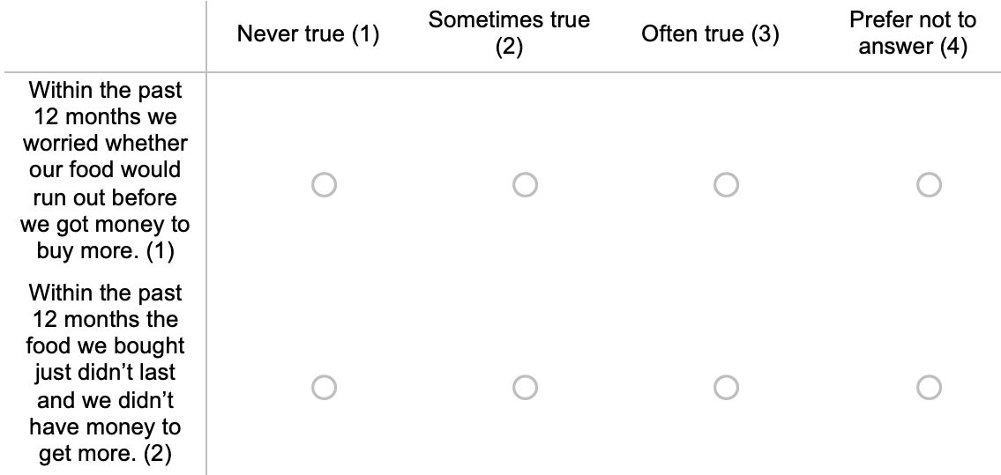
Food Security Screener
2-item Hunger Vital Sign (HVS) tool
Notes:
**Be clear this is distinct from USDA common measure and 8-item international measure
Developed in 2010; Erin Hager and Anna Quigg. 2-question food insecurity screening tool based on US Household Food Security Survey Module. Identifies household at risk of food insecurity. More sensitive vs specific approaches.
We are using most specific measure: affirmative response to both questions 1 and 2 (sensitivity of 78%; specificity of 96%). This is compared to more sensitive approach (affirmative response to either; sensitivity of 97%; specificity of 83%).

Slide 27
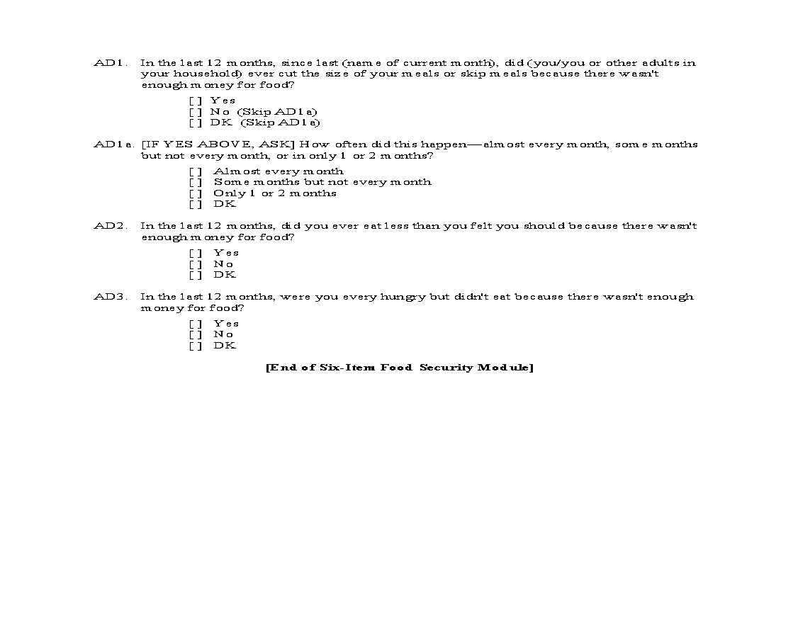
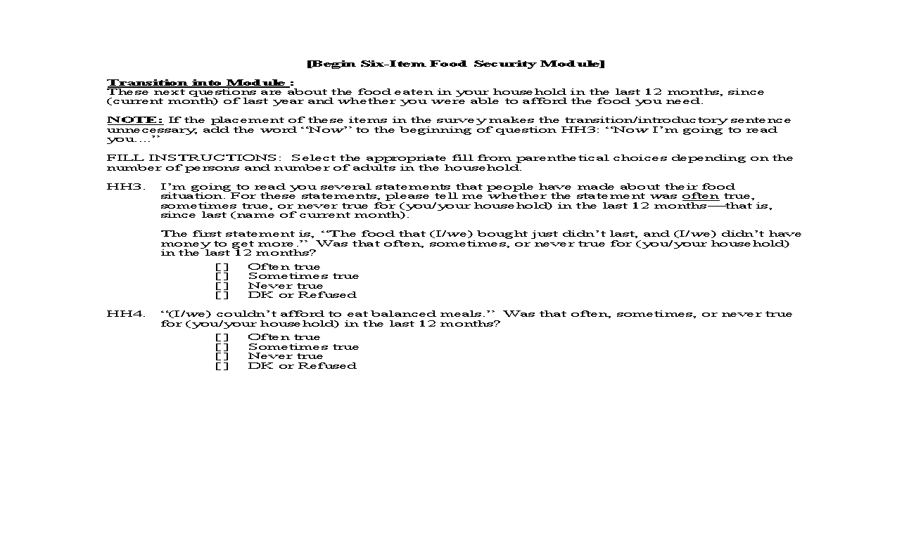
Food Security Survey Module
6-item USDA Food Security Scale
These next questions are about the food eaten in your household in the last 12 months, since (current month) of last year and whether you were able to afford the food you need.

Slide 28
Background / Rationale
Food and nutrition insecurity are major public health problems in the U.S.
Current measures of food security have important limitations in the context of FIM interventions, including lack of assessment of food quality.
This nutrition security construct was designed to complement measures of food security. Nutrition security screening tools can enhance efforts to address food insecurity.
Valid measures are needed as an important element in the process of advancing knowledge to improve nutrition and health.
Notes:
Nutrition security refers to access, availability, and affordability of foods that support well-being and prevent and manage nutrition related diseases.
Healthcare and gov entities are focusing on nutrition insecurity (NI) in light of the distinction between access to calories vs. nourishing foods but validated screening measures are not established.

Slide 29

Evaluating the Impact of a Universal Free School Meals Policy on High Blood Pressure in Children
Anna Localio, MPH
University of Washington

Slide 30
Public Health Problem:
Pediatric High Blood Pressure
Systolic or diastolic blood pressure ≥ 90th percentile for age, sex, and height
  Threshold for deleterious health outcomes
Tracks into adulthood; causes cardiovascular disease and stroke
Major Causes:
  High BMI
  Low diet quality
  Insufficient physical activity
Flynn et al. 2017, 2022
Azegami et al. 2021

Slide 31

Potential Policy Solution:
Community Eligibility Provision (CEP)
Authorized by the 2010 Healthy, Hunger-Free Kids Act
Became available to eligible schools nationwide in school year 2014-15
Allows schools in low-income areas to provide free breakfast and lunch to all students
Increases participation in school meals which are healthier than alternatives
Linked to improvements in food security and academic, behavioral, and health outcomes
Reaches over 40,000 schools, 20 million children
Cohen et al. 2021
Au et al. 2018
Localio et al. 2024
FRAC 2023

Slide 32
Research Question
What is the association of school CEP participation with prevalence of high blood pressure in children?

Slide 33
Methodology:
Study Sample
Open cohort of children and adolescents ages 4-18 who received care from community health organizations nationwide within the OCHIN network
Patient medical records matched to neighborhood schools based on address
School CEP participation data obtained directly from state departments of education and National Center for Education Statistics
Followed patient-matched schools longitudinally from 2013 through 2019

Slide 34
Methodology:
Variables
Exposure:
  School CEP participation
Outcome:
  School-level prevalence of a high blood pressure measurement
Covariates:
  Time-varying:
    Mean patient age
    Percent of patients with public health insurance
    Percent Hispanic, White, and Black patients
    State Medicaid Expansion status
  Time invariant:
    Model controlled for all time-invariant school-level confounders

Slide 35
Methodology:
Statistical Analysis
Callaway & Sant’Anna Difference-in-Differences Estimator
Estimates a separate treatment effect for each cohort and year
Estimates can be aggregated by cohort or years relative to policy adoption
Control group: both never and not yet participating schools
Parallel trends assumption conditional on covariates
Doubly robust estimator: IPTW and outcome regression
Weighted by mean number of patients per school

Slide 36
Results …
67% Elementary Schools
16% Middle Schools
15% High Schools
1,052 schools
matched to > 5 patients per year between school years 2013-14 through 2018-19
78% Students Eligible for Free or Reduced Price Meals at Baseline
Sample Characteristics
Mean Patients per School: 47
155,778 distinct patients with ≥ 1 blood pressure measurement during school year, 2013-14 through 2018-19
48% Hispanic
22% Non-Hispanic White
16% Non-Hispanic Black

Slide 37
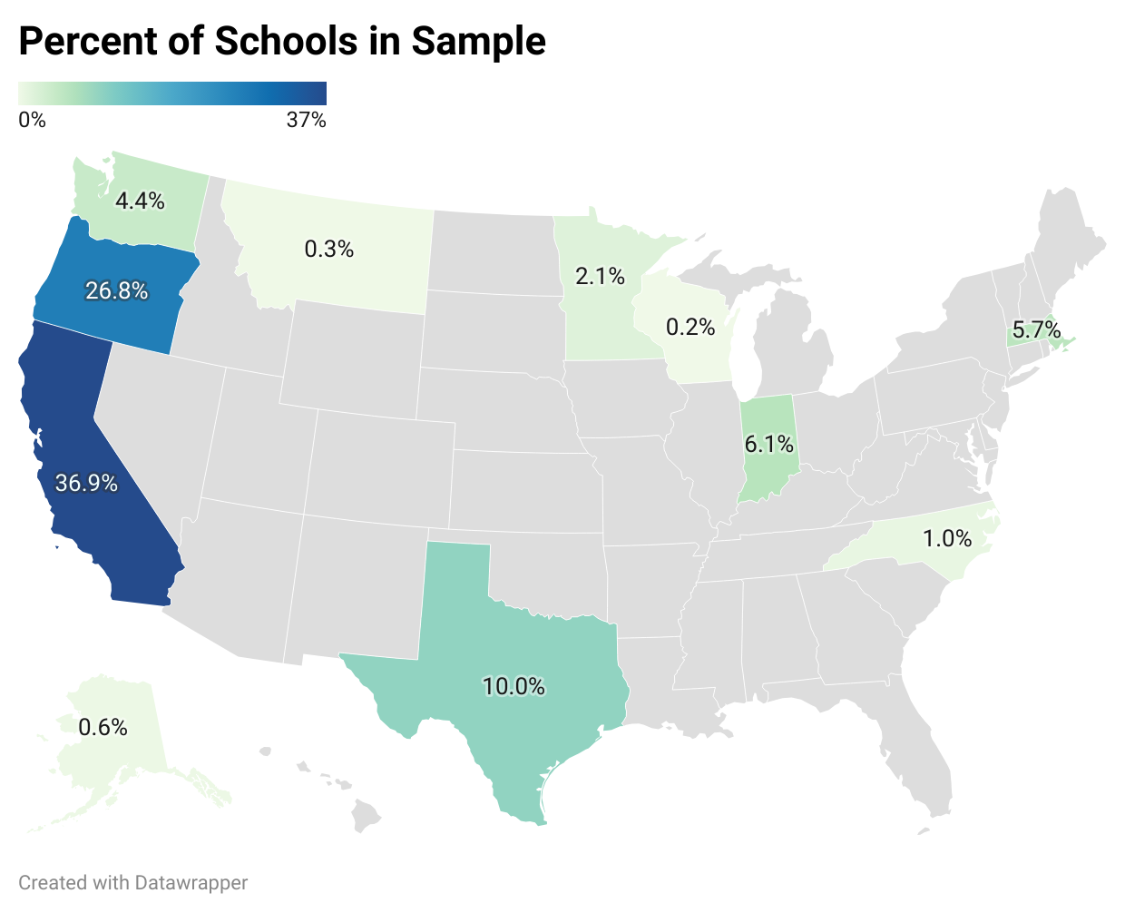
Results….
Sample Characteristics

Slide 38
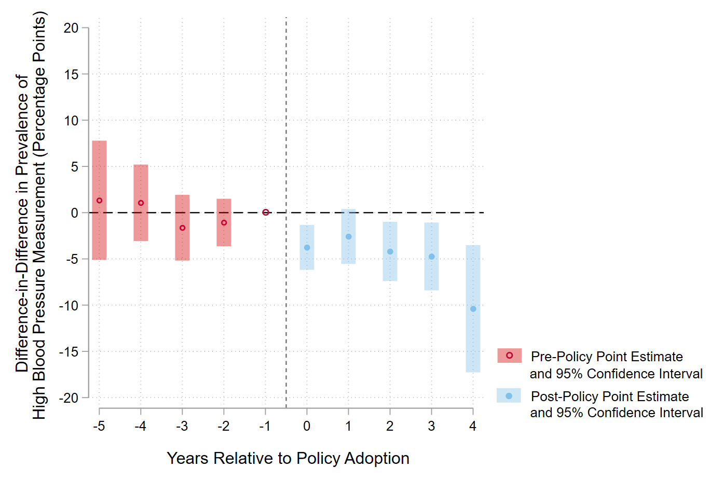
Results…..
Overall Post-Policy Estimate:
-2.73 percentage points
(95% CI: -4.76, -0.70, p<.01)
Corresponds to an 11% net decrease from baseline
Adjusted Difference-in-Differences in High Blood Pressure Prevalence

Slide 39
Limitations
Sample is not nationally representative; schools concentrated predominantly in California and Oregon
Limited analysis to a balanced sample of schools
  Decreased generalizability, increased internal validity
Outcome “prevalence of a high blood pressure measurement” overestimates true prevalence of persistent, elevated blood pressure
Potential for measurement error in matching patients to closest neighborhood based on address

Slide 40

Significance
Adds to mounting evidence that CEP is linked to positive health outcomes
Findings can be used to guide policy and funding decisions and inform future research
Represents paradigm shift in investigating interventions to address high blood pressure

Slide 41
Acknowledgements
Coauthors on this research:
UW Collaborators:
  Jessica Jones-Smith, PhD, MPH (PI)
  Paul Hebert, PhD
  Melissa Knox, PhD
  Jennifer Sonney, PhD
OCHIN Collaborators:
  Wyatt Bensken, PhD
  Aileen Ochoa, MPH

Slide 42
THANK YOU
Questions?
Contact:
Anna Localio
alocalio@uw.edu

Slide 43
References
Flynn JT, Kaelber DC, Baker-Smith CM, et al. Clinical Practice Guideline for Screening and Management of High Blood Pressure in Children and Adolescents. Pediatrics. 2017;140(3):e20171904. doi:10.1542/peds.2017-1904
Flynn JT. What Level of Blood Pressure Is Concerning in Childhood? Circ Res. 2022;130(5):800-808. doi:10.1161/CIRCRESAHA.121.319819
Azegami T, Uchida K, Tokumara M, Mori M. Blood Pressure Tracking from Childhood to Adulthood. Frontiers in Pediatrics. 2021;9:785356. doi: 10.3389/fped.2021.785356
Au LE, Gurzo K, Gosliner W, Webb KL, Crawford PB, Ritchie LD. Eating School Meals Daily Is Associated with Healthier Dietary Intakes: The Healthy Communities Study. J Acad Nutr Diet. 2018;118(8):1474-1481.e1. doi:10.1016/j.jand.2018.01.010
Cohen JFW, Hecht AA, McLoughlin GM, Turner L, Schwartz MB. Universal School Meals and Associations with Student Participation, Attendance, Academic Performance, Diet Quality, Food Security, and Body Mass Index: A Systematic Review. Nutrients. 2021;13(3):911. doi:10.3390/nu13030911
Localio AM, Knox MA, Basu A, Lindman T, Walkinshaw LP, Jones-Smith JC. Universal Free School Meals Policy and Childhood Obesity. Pediatrics. Published online March 18, 2024. doi:https://doi.org/10.1542/peds.2023-063749
Food Research and Action Center (FRAC). Community Eligibility: The Key to Hunger-Free Schools, School Year 2022-2023. Published online May 2023. Accessed December 8, 2023. https://frac.org/wp-content/uploads/cep-report-2023.pdf

Slide 44
Implementation of a Social Needs Screener and Uptake Patterns of a Produce Prescription Program in a Pediatric Clinic
Claire Branley
MD/PhD Student, UMass Chan Medical School
August 14th, 2024
HER NOPREN Summer Speaker Series for Students

Slide 45
Outline
Background
  WECARE Social Needs Screener
  Fresh Connect program
Study Objective
Methods
Results
Discussion

Slide 46
Social Risk/Social Need Screening
American Academy of Pediatrics (AAP): early identification of social needs, and referrals to resources, among families with children is an effective strategy to ameliorate child poverty¹
Variety of screening options are available²
  Social risk: adverse conditions associated with poor health; ie food insecurity
  Social need: a social risk an individual seeks assistance with
Screener | SDOH Domains Assessed
Accountable Health Communities Tool | Disabilities, education employment, financial strain, food insecurity, housing insecurity, housing quality, interpersonal violence, social support, stress, transportation, utilities
Health Leads | Childcare access, food insecurity, healthcare/medicine access, housing insecurity, literacy, social support, transportation, utilities
Hunger Vital Sign | Food insecurity
Safe Environment for Every Kid (SEEK) | Food insecurity interpersonal violence, social support, stress
Well Child Care, Evaluation, Community Resources, Advocacy, Referral, Education (WE CARE) | Childcare access, education, employment, food insecurity, housing insecurity, utilities
Table modified from Brochier et al

Slide 47
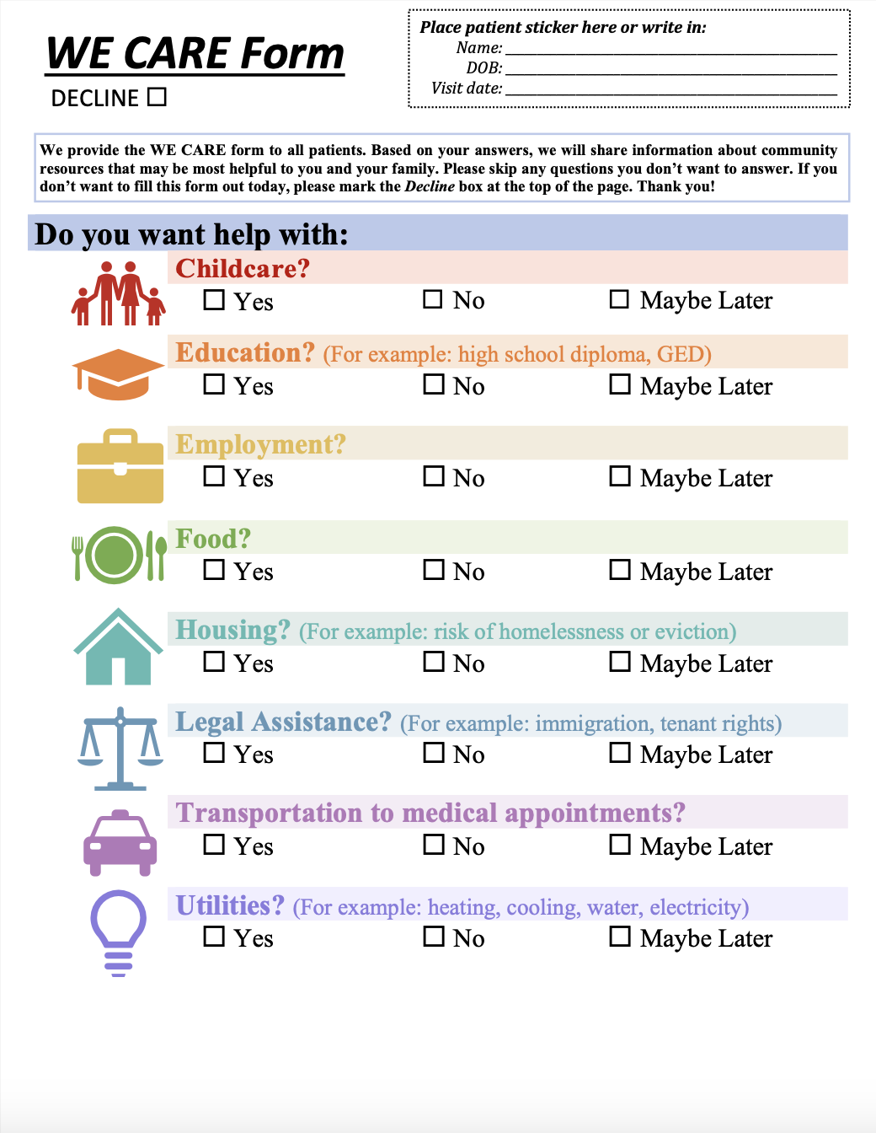
WE CARE Social Needs Screener
WE CARE=Well Child Care, Evaluation, Community Resources, Advocacy, Referral, Education
  Created by Dr. Arvin Garg³
  Originally implemented in Boston, MA and expanded to clinics nationally
Integrated into EHR at a new urban pediatric primary care clinic in October 2021

Slide 48
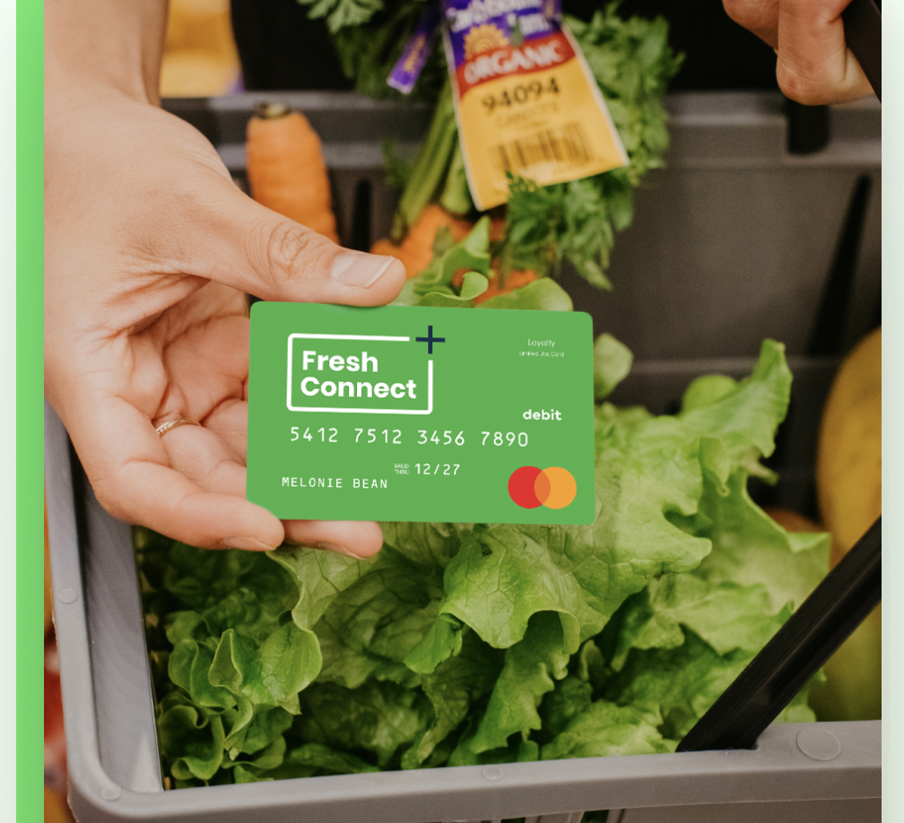
Produce Prescription: FreshConnect
About Fresh, a Boston-based company, created FreshConnect to digitalize produce prescriptions and referrals
Benefit amounts and and length vary depending on hospital system
  Families at the clinic were offered $80 per month for 6 months
  The debit card purchases fresh fruits and vegetables at specific retailers only
Oct. 2021
Aug 2022-Aug 2023
July 2024
https://www.freshconnect.org/
  WE CARE screening implemented
  Parent responses recorded in EHR
  Staggered enrollment in Fresh Connect begins
  All parents/caregivers with completed WCS offered FC regardless of response (n=1,049)
    Must speak English, Spanish, or Portuguese
  Analysis
  Child race/ethnicity, age, parent preferred language, and insurance status extracted from medical record
  Those with missing information removed from analysis (n=24)

Slide 49
Study Objectives and Analysis
Objective
Determine the association between social needs screener responses and odds of enrollment into FC
Analysis
Descriptive statistics of sample population were calculated
A multivariable adjusted logistic regression was used to determine the association between WCS response and FC enrollment

Slide 50
Sample Demographics
 | Sample Characteristics (n=1,025)
WE CARE Screening Response | No (Ref) | Yes | Maybe Later | Left Blank
Sample, n | 802 | 62 | 19 | 142
Child Race/ethnicity
White, non-Hispanic | 39.5 | 24.2 | 15.8 | 40.9
Hispanic | 30.9 | 30.7 | 42.1 | 17.6
Black, non-Hispanic | 14.7 | 40.3 | 32.6 | 26.1
NH Asian/Multiracial/Other | 14.8 | 4.8 | 10.5 | 15.5
Child age (mean, SD) | 8.9 (6.5) | 10.2 (7.1) | 8.1 (5.7) | 10.6 (6.5)
Parent Preferred Language
English | 98.1 | 96.8 | 94.7 | 94.4
Not English | 1.9 | 3.2 | 5.3 | 5.6
Child Insurance
Private | 46.1 | 22.6 | 15.8 | 34.5
Public | 49.0 | 69.4 | 79.0 | 59.2
Uninsured | 4.9 | 8.1 | 5.3 | 6.3
Enrolled in Fresh Connect | 19.2 | 27.4 | 52.6 | 18.31

Slide 51
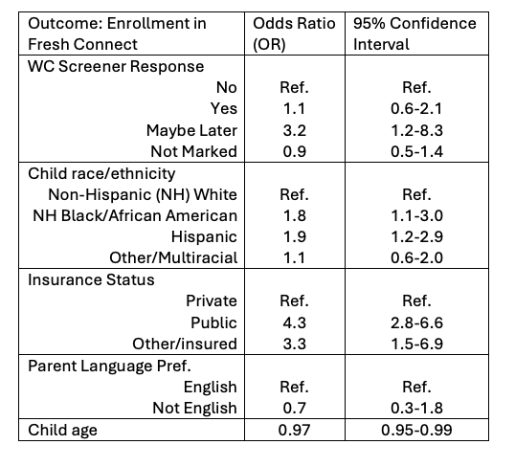
Results (contin)
After adjusting for sociodemographic characteristics, indicating “yes” for wanting help with food on a social needs screener did not increase the odds of enrollment into produce prescription program
🡪 There was a statistically significant association between parents choosing “maybe later” on the screener and enrollment in FC

Slide 52
Discussion
Parents accepted the pediatric produce prescription regardless of screening response
  The majority (73%) of parents who requested help with food never enrolled in FC
    Reflection of the program
    Few other programs have described concordance between screening and response and program enrollment⁴
  Indicating “maybe later” on the screener was significantly associated with enrollment
    Small sample size
    Look into time between screener and phone call for enrollment
When possible, offer food resources to all families regardless of screening response

Slide 53
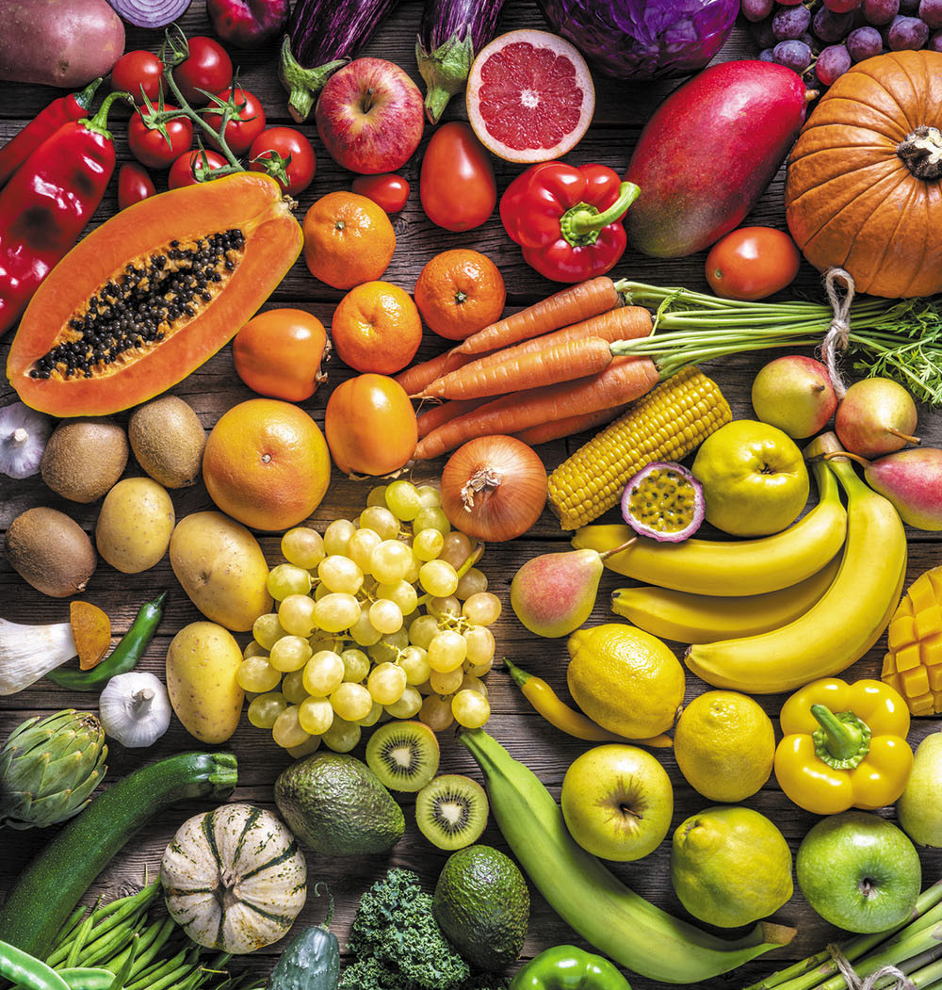
Acknowledgements (cont)
Dr. Arvin Garg, MD, MPH
  Founding Director of Child Health Equity Center, UMass Chan Medical School/UMass Memorial Health Children’s Medical Center
Alison LeBlanc, MS, PMP
  Executive Director of Child Health Equity Center
Katherine Barahona Paz
  Clinical Research Assistant, Child Health Equity Center
Leela Garg and Maya O’Connor
  Child Health Equity Center interns
Dr. Stephenie Lemon, PhD
  Professor and Chief of the Division of Preventative and Behavioral Medicine in the Dept. of Population and Quantitative Health Sciences, UMass Chan Medical School

Slide 54
References (cont)
COUNCIL ON COMMUNITY PEDIATRICS, Gitterman BA, Flanagan PJ, et al. Poverty and Child Health in the United States. Pediatrics. 2016;137(4):e20160339. doi:10.1542/peds.2016-0339
Brochier A, Garg A, Peltz A. Clinical and public policy interventions to address food insecurity among children. Current Opinion in Pediatrics. 2022;34(1):2. doi:10.1097/MOP.0000000000001096
Garg A, Brochier A, Tripodis Y, Messmer E, Drainoni ML. A Social Care System Implemented in Pediatric Primary Care: A Cluster RCT. Pediatrics. 2023;152(2):e2023061513. doi:10.1542/peds.2023-061513
Bottino CJ, Rhodes ET, Kreatsoulas C, Cox JE, Fleegler EW. Food Insecurity Screening in Pediatric Primary Care: Can Offering Referrals Help Identify Families in Need? Acad Pediatr. 2017 July;17(5):497-503. doi: 10.1016/j.acap.2016.10. 006. Epub 2017 Mar 13. PMID: 28302365.

Slide 55


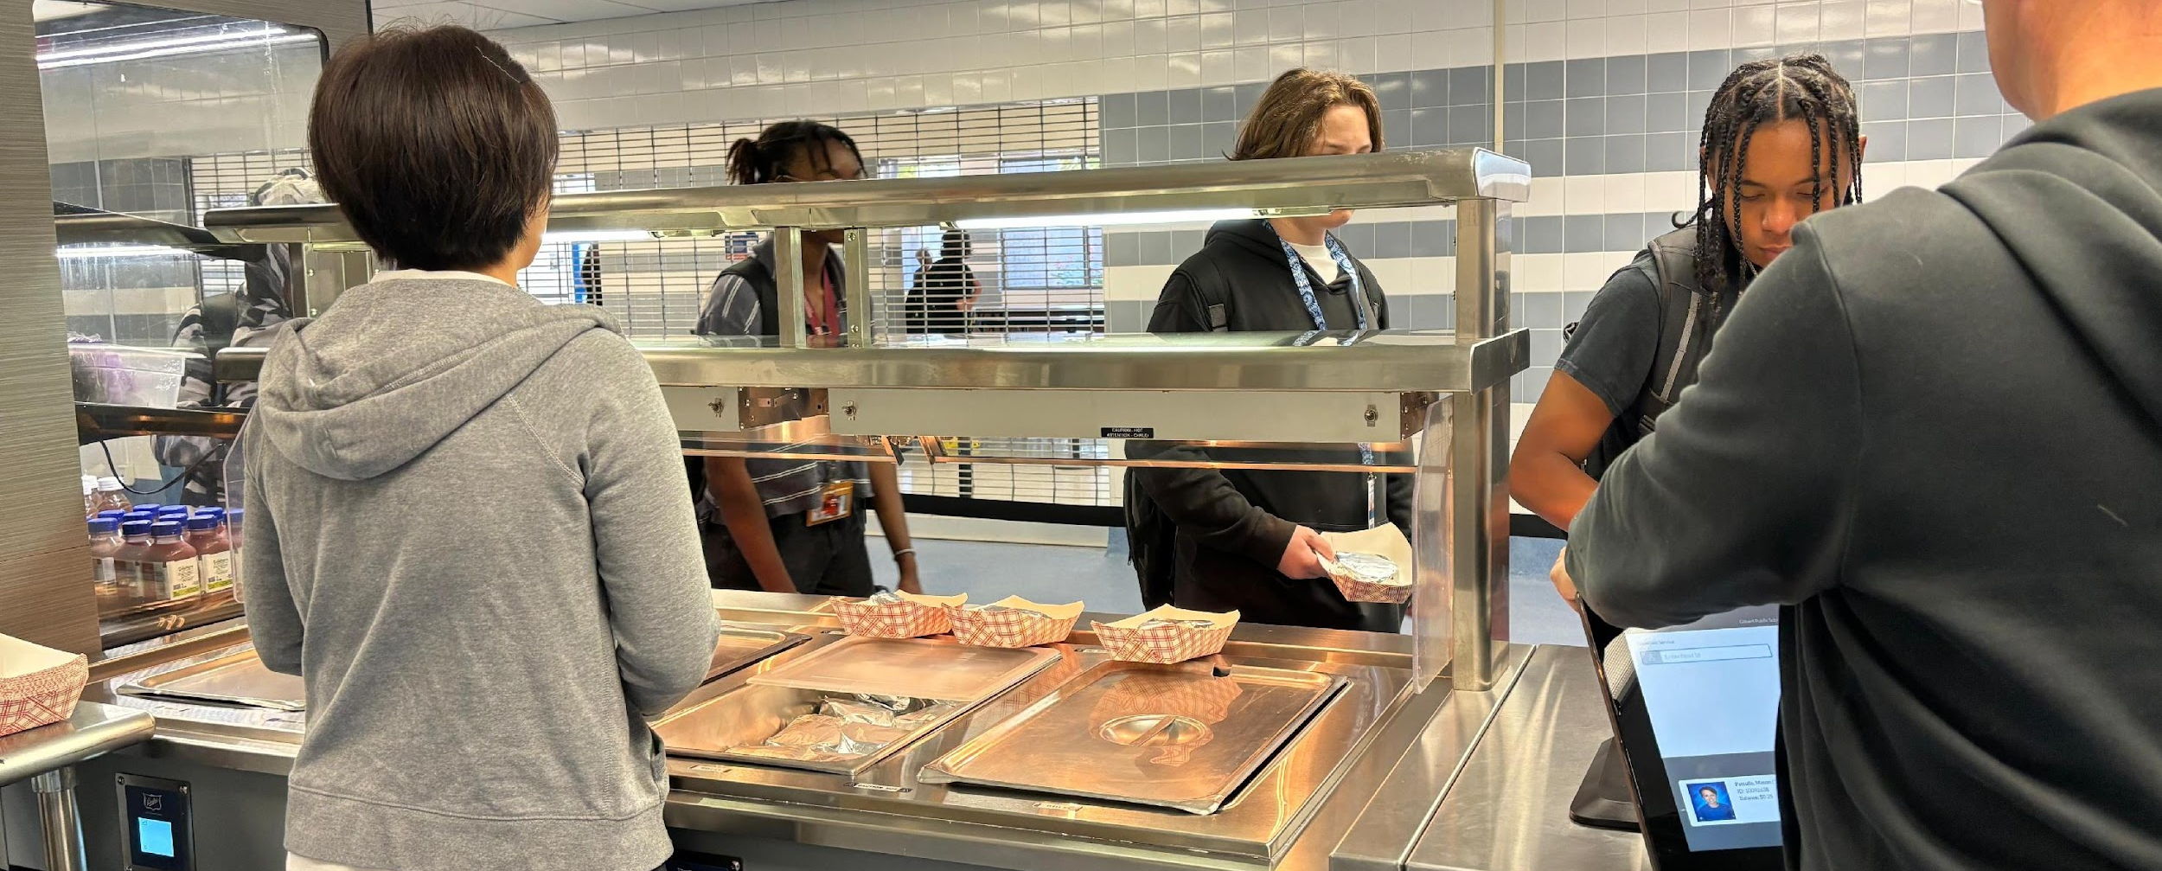
Evaluating School Meal Participation Post-Policy Change in Arizona.
Shreya Raval (PhD student in Exercise and Nutritional Sciences), Sarah Martinelli, Punam Ohri-Vachaspati
College of Health Solutions, Arizona State University

Slide 56


Background
3 Tiered System
Free Meals
Reduced Price Meals
Paid Meals
Eligibility
<130% of the federal poverty line
are eligible for free meals
130-185 % of the federal poverty line
are eligible for reduced-price meals
Above 185% of the federal poverty line
pay full price
USDA, (The National School Lunch Program, n.d.; The School Breakfast Program, n.d.)

Slide 57
Background cont.
Improves Weight Outcomes
Improve attendance, academic
performances and academic
achievements
Helps Alleviate Food Insecurity
and Poverty
Supports Good Nutrition
WHY SCHOOL MEALS ARE IMPORTANT?
(Cohen et al., 2021; Fletcher & Frisvold, 2017; Huang & Barnidge, 2016)

Slide 58

Background (cont..)
USDA authorized free school meals in response to the COVID-19 pandemic
  Free school meals ended in September 2022 and most states returned to the 3-tiered system
The Arizona Department of Education implemented a policy to provide free meals to children eligible for reduce-price meals from January 2023 – June 2024.
(Child Nutrition Programs: COVID-19 Waivers by State | Food and Nutrition Service, n.d.), (Director,N 2022)

Slide 59
Research Question (pt1)
The objective of this study is to examine the impact of a state-level policy that eliminated the reduced-price co-pay for families in Arizona as of January 2023 on school meal participation.

Slide 60
Methodology
Data Sources
  Meals served, student eligibility, and CEP participation data: Arizona Department of Education
  School demographic data: National Center for Education Statistics
Study Periods:
Analysis: Compare the overall average daily participation (ADP) rate for each time period and for each of the following categories
  Free meals
  Reduced-price meals
  Full-price meals
Time Period 1 | July 22-Dec 22 (3 tiered system in place)
Time Period 2 | July 23- Dec 23 (Arizona policy in place)

Slide 61

Learnings
Requesting Data from state agency (ADE)
Analytical variable construction from secondary data sources (NCES)
Data management and data cleaning
Merging and appending multiple datasets to create analytical datasets

Slide 62
Policy Implications
To ensure continued state funding to cover co-pays for reduced price category, and for future expansion of school meals, rigorous evaluations are needed.
Results from our study will provide useful and timely information for policy makers and advocates to improve access to healthy school meals in Arizona.

Slide 63

“With the temporary funding ending after the 2023–24 school year, the food bank worked with the state Legislature to get the $3.8 million added to the state budget”
AzFoodBanks.org, KJZZ.org, ASU News

Slide 64
Acknowledgment:
The Arizona Food Bank Network (AzFBN) funded this research

Slide 65
References (pt1)
The School Breakfast Program, USDA https://www.fns.usda.gov/sbp/school-breakfast-program
The National School Lunch Program, USDA https://www.fns.usda.gov/nslp
Cohen, J. F. W., Hecht, A. A., McLoughlin, G. M., Turner, L., & Schwartz, M. B. (2021). Universal School Meals and Associations with Student Participation, Attendance, Academic Performance, Diet Quality, Food Security, and Body Mass Index: A Systematic Review. Nutrients, 13(3), 911. https://doi.org/10.3390/nu13030911
Fletcher, J. M., & Frisvold, D. E. (2017). The Relationship between the School Breakfast Program and Food Insecurity. Journal of Consumer Affairs, 51(3), 481–500. https://doi.org/10.1111/joca.12163
Huang, J., & Barnidge, E. (2016). Low-income Children’s participation in the National School Lunch Program and household food insufficiency. Social Science & Medicine (1982), 150, 8–14. https://doi.org/10.1016/j.socscimed.2015.12.020
Child Nutrition Programs: COVID-19 Waivers by State | Food and Nutrition Service. (n.d.). Retrieved August 10, 2024, from https://www.fns.usda.gov/disaster/pandemic/covid-19/cn-waivers-flexibilities

Slide 66
References (pt2)
Director, N. (2022, December 14). Superintendent Hoffman announces $6.75 million investment for school meals. The Gila Herald. https://gilaherald.com/superintendent-hoffman-announces-6-75-million-investment-for-school-meals/
Network, A. F. B. (2024, June 18). State Budget Includes First-Time Investment in School Meals. Arizona Food Bank Network. https://azfoodbanks.org/state-budget-includes-first-time-investment-in-school-meals/
ASU helps secure $3.8 million in free school meals for tens of thousands of Arizona kids. (2024, July 12). KJZZ. https://www.kjzz.org/news/2024-07-12/asu-helps-secure-3-8-million-in-free-school-meals-for-tens-of-thousands-of-arizona-kids
ASU research helps result in free school meals for low-income students | ASU News. (n.d.). Retrieved August 11, 2024, from https://news.asu.edu/20240709-health-and-medicine-asu-research-helps-result-free-school-meals-lowincome-students

Slide 67
Thank You! (cont)

Slide 68
Q&A
Notes:
Moderator to lead Q/A

Slide 69
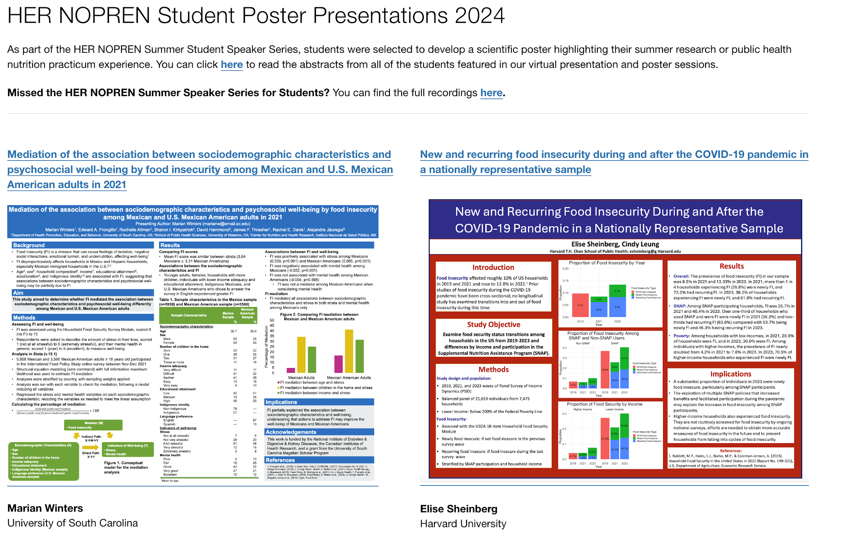
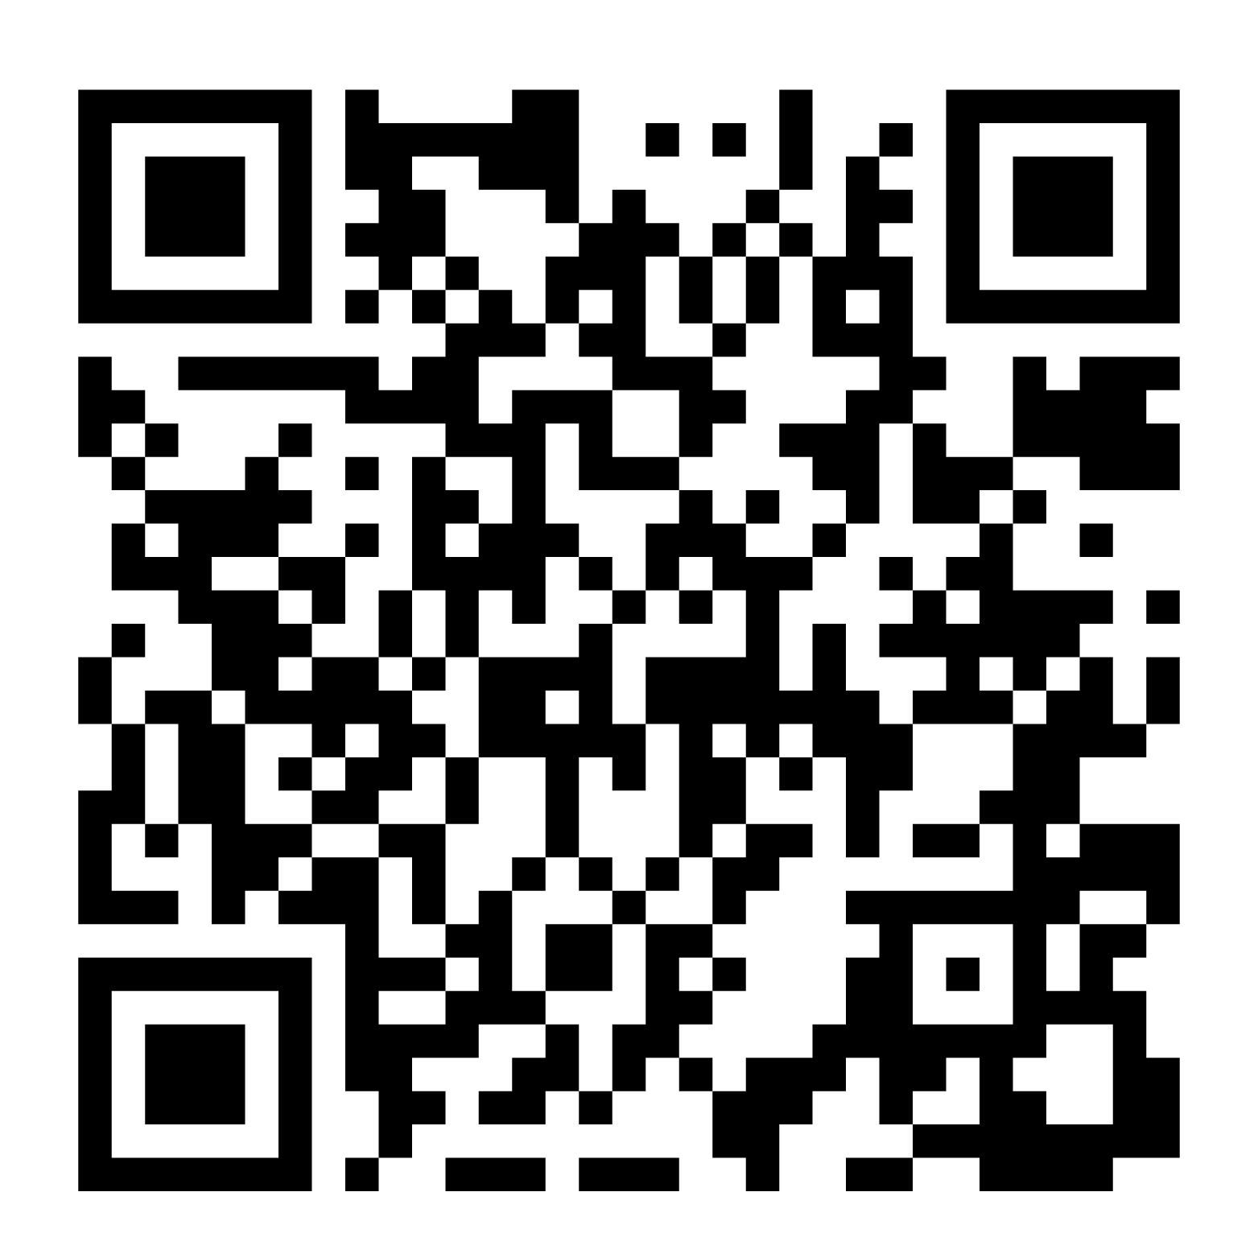
Thank you for joining the 2024 Summer Speaker Series!
Visit the NOPREN website to view the poster presentations!
Please fill out the series evaluation after today’s session:
https://duke.qualtrics.com/jfe/form/SV_3aglRCDqWhVaMoS
Thank you for attending the series! To join the NOPREN listserv, visit us at NOPREN.ucsf.edu
Notes:
Thank you so much Alex! And a huge thank you to today’s presenters. We are impressed by the research and work being done and the potential for large impact in the field.
I want to close out by putting another plug for the posters that are now live on the NOPREN website. Similar to the presentations you just heard, the posters also showcase additional great work and research conducted by students this summer.
We do ask that you fill out our series evaluation. This is the last session of the series. We do want to emphasize that your feedback is important and helps inform and refine future sessions. Please take a few minutes to fill this evaluation out. You can visit the url on the slide or scan the QR code.
Lastly, I wanted to close out and thank you all for attending the series. While the series is now complete, we do encourage students to stay engaged with NOPREN and HER and take advantage of the professional development and networking opportunities that are ongoing. You can join the NOPREN listserv by emailing us at nopren@ucsf.edu or visiting our website nopren.ucsf.edu. Thank you so much again!

