Slide 1

Summer Speaker Series for Students
2024
Notes:
Session Lead: HER

Slide 2


Getting Started!
Update your name on Zoom, if needed
  Right click on your Zoom box, click “rename”
Type your name and institution into the chat box!
  Question: Which best describes you?
    Ex. Undergraduate Student, Dietetic Intern, Masters Student, Doctoral Student, Post Doc, Public Health Practitioner, Researcher/Professor, Other
Remember to keep yourself on mute.
Type your questions into the chat box.
Notes:
HER staff
Each session there will be a different question of the day:
What are you looking forward to this summer?
What is the weather like today where you are?
What is your go-to morning beverage?
What’s the best book you’ve ever read?
If you were a fruit or vegetable, what would you be?
What would be the title of your autobiography?
What’s your dream vacation destination?
Who performed at the last concert you went to?

Slide 3
NOPREN HER Summer Series for Students
Explore various public health topics related to:
  Food and nutrition security
  Federal nutrition assistance programs
  Nutrition equity
This series is a collaborative effort of Healthy Eating Research (HER) and Nutrition and Obesity Policy Research and Evaluation Network (NOPREN).
Notes:
HER staff
Weekly speaker series that explores various public health topics related to food and nutrition security, federal nutrition assistance programs, COVID-19 implications, and nutrition equity through research, policy, and practice.
Students will hear from experts and leaders in the field who will present on the fundamentals of each topic, along with relevant professional opportunities in research, policy, and practice.
This series is a collaborative effort of Healthy Eating Research, a national program of the Robert Wood Johnson Foundation, and the Centers for Disease Control and Prevention’s (CDC) Nutrition and Obesity Policy Research and Evaluation Network (NOPREN).

Slide 4
NOPREN HER Summer Series for Students Agenda
The series will take place on Wednesdays from
4:00 - 5:00 pm EST
Schedule and Topics
June 12: Food Policies in Schools - More than just Lunch!
June 26: Food is Medicine: What does it mean?
Where are we going?
July 10: Leveraging Food Service Contracts at 4-year Public Universities to
Understand Meal Plan Costs and Affordability
July 24: Policy Systems and Environmental Strategies to Support Young Children's
Diet and Health
August 7: Collaborating Successfully across Sectors toward Nutrition Security
August 14: Student Presentations
For more information or to register: https://nopren.ucsf.edu/student-resources
Notes:
HER staff
Put registration link in chat box: https://nopren.ucsf.edu/student-resources

Slide 5
Student Presentations!
The HER/ NOPREN Summer Speaker Series will end with Student Presentations and Poster Sessions on August 14. Stay tuned for more details!
Selected students will give a presentation on a nutrition-related project or research they worked on over the summer.
Notes:
HER staff
Put application link in chat:
Reminder: Student presentations - application due Wednesday, July 13 at 5pm EST: https://unc.az1.qualtrics.com/jfe/form/SV_cSJdvAqdmlQXicK

Slide 6

Healthy
Eating
Research
LINDSEY REED, MPH
SENIOR RESEARCH ANALYST
HEALTHY EATING RESEARCH
Notes:
HER

Slide 7
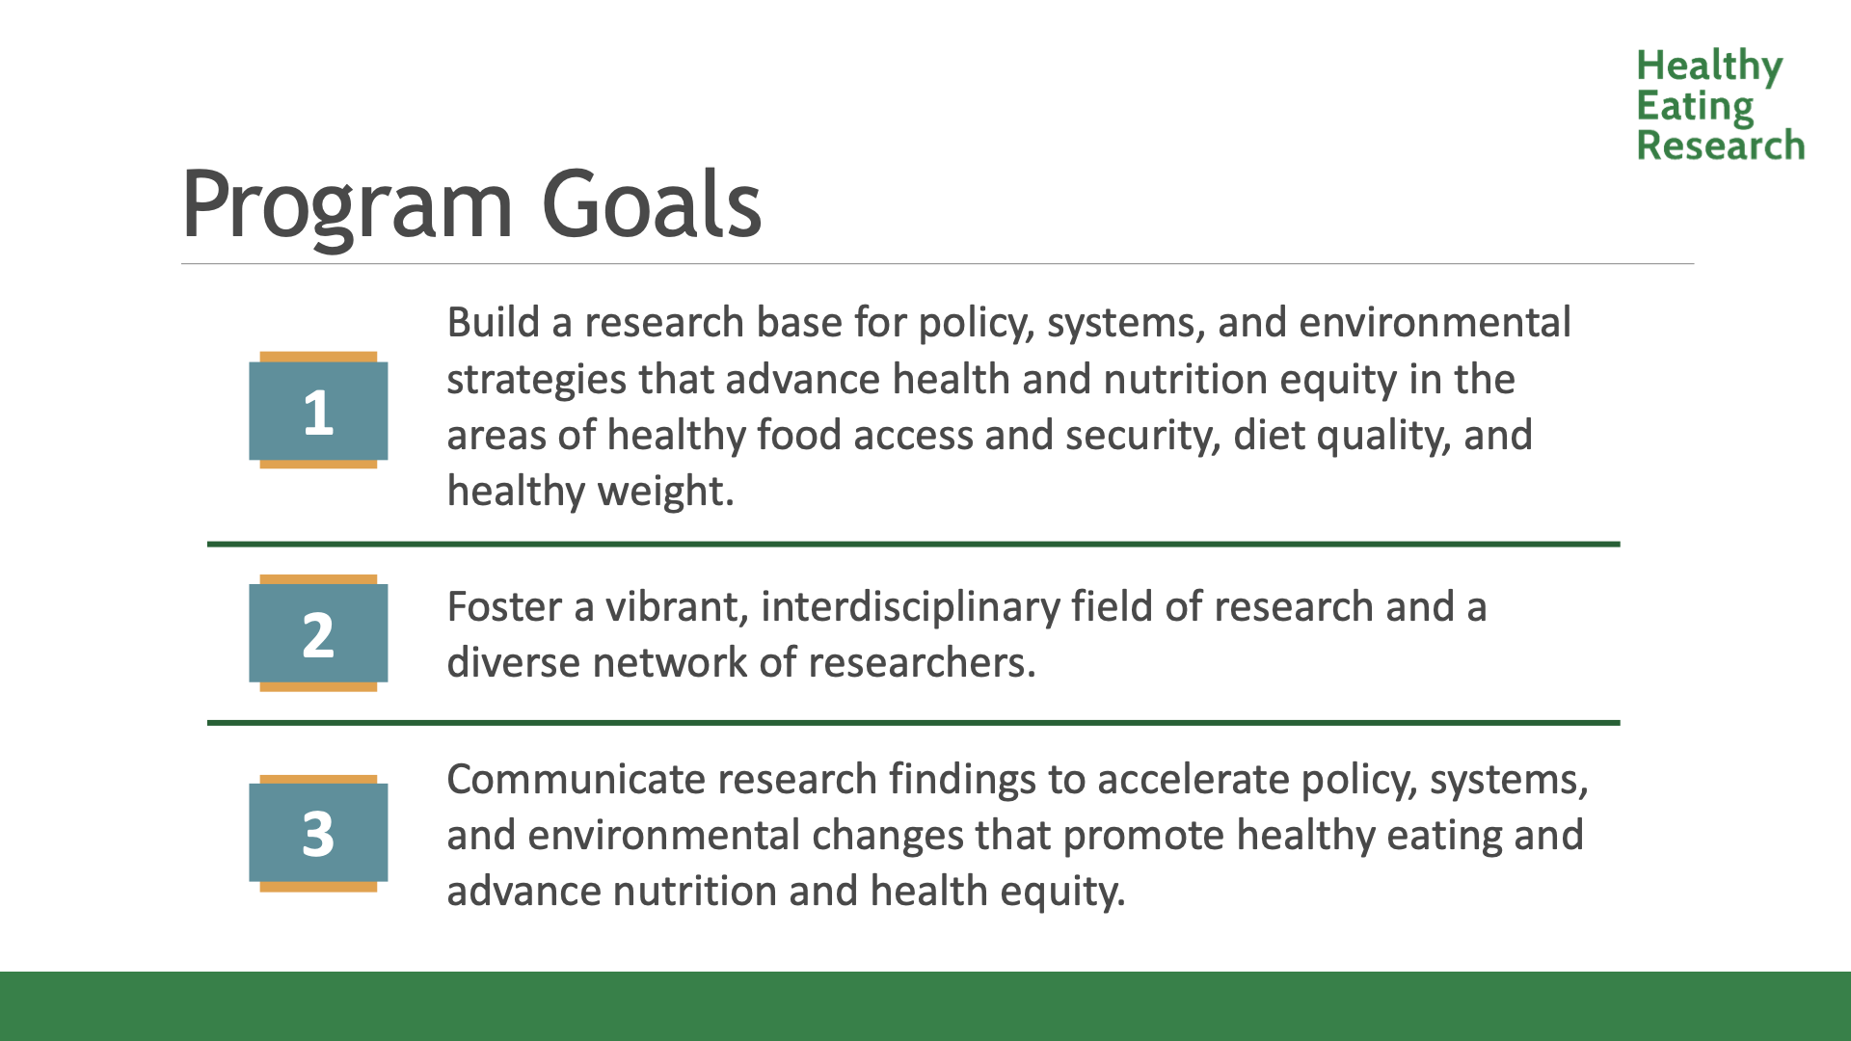
Program Goals
Notes:
HER

Slide 8
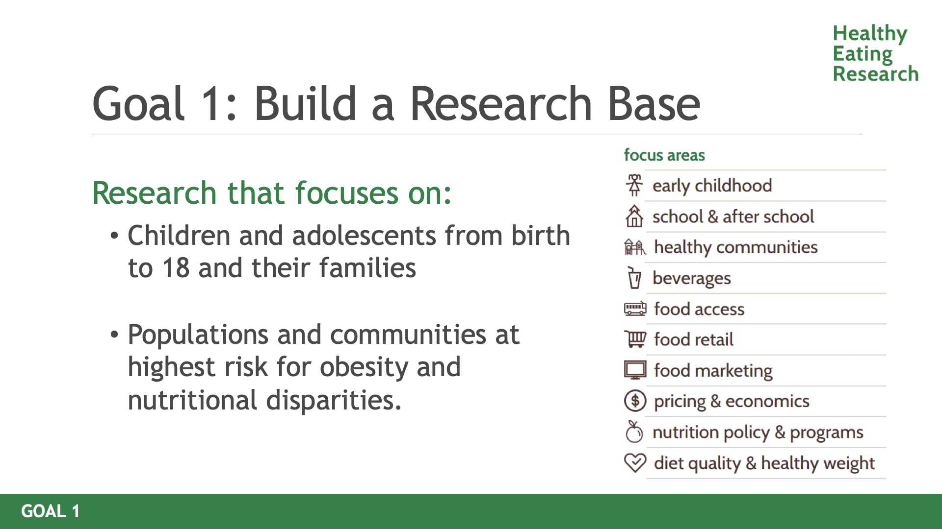
Goal !
Notes:
HER

Slide 9

Goal 2: Foster diverse network of researchers
HER NOPREN Work Groups
Healthy Food Retail
Early Childhood
Resilient Food Systems
WIC Learning Collaborative
HER Work Groups
Early Stage Investigator
Food Labeling
Visit the NOPREN website to learn more about the HER NOPREN Work Groups! https://nopren.ucsf.edu/
Visit the HER website to learn more about the HER Work Groups! https://healthyeatingresearch.org/what-we-fund/grantee-resources/
Notes:
HER

Slide 10
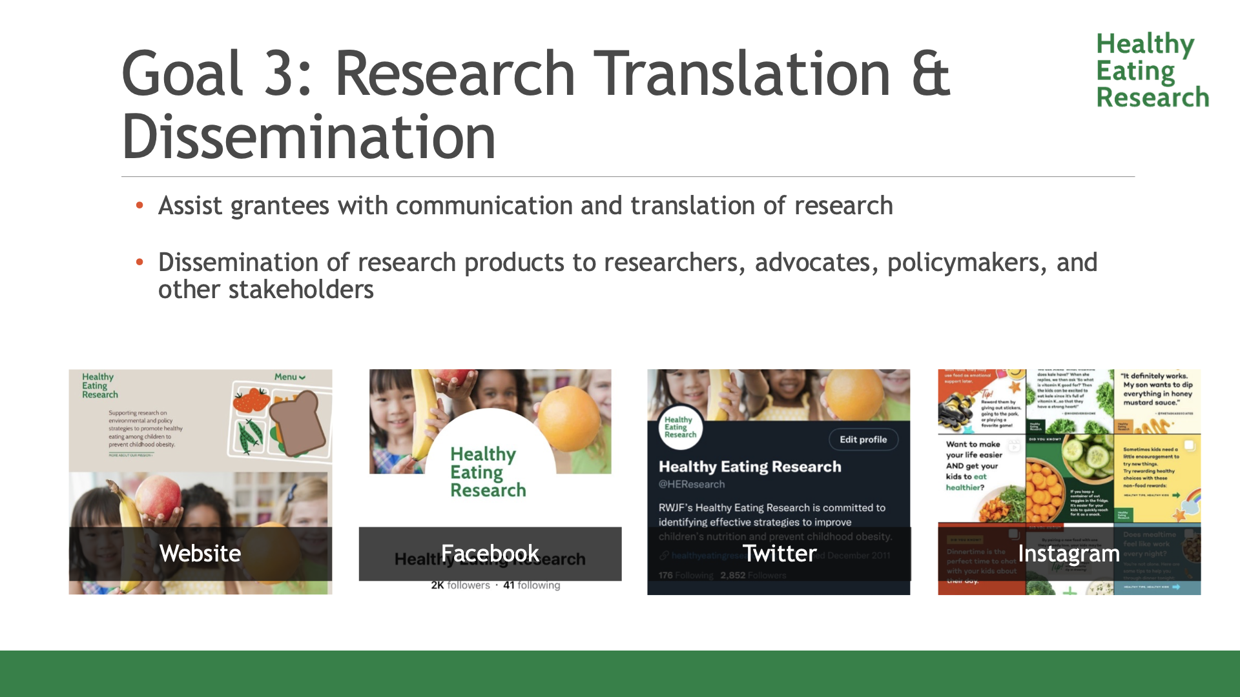
Goal 3
Notes:
HER

Slide 11

Contact
Instagram: @Healthyeatingresearch
Facebook: @HEResearch
Twitter: @HEResearch
Lindsey.Miller102@Duke.edu
Notes:
HER

Slide 12


NOPREN
Notes:
Jennifer

Slide 13
Nutrition and Obesity Policy Research and Evaluation Network (NOPREN): What is it?
Collaborative, equity-focused applied research and practitioner network that informs policies and practices designed to support the equitable intake of healthy, nutritious foods so that everyone has a fair chance at health
Led by a coordinating center based at the University of California San Francisco (UCSF) in partnership with CDC DNPAO leadership
    Hosts monthly state‐of‐the‐science webinars
    Facilitates collaboration among members
    Send bi-weekly NOPREN News
    Serves as a platform for sharing and disseminating research
    Provides professional development opportunities for members
    Support the network’s Work Groups
Members (3000+) include policy researchers, evaluators, practitioners, professional organizations, non-profits, and government agencies.
    We encourage early career and junior faculty to join for networking, collaboration, and professional development opportunities.
Notes:
Jennifer

Slide 14
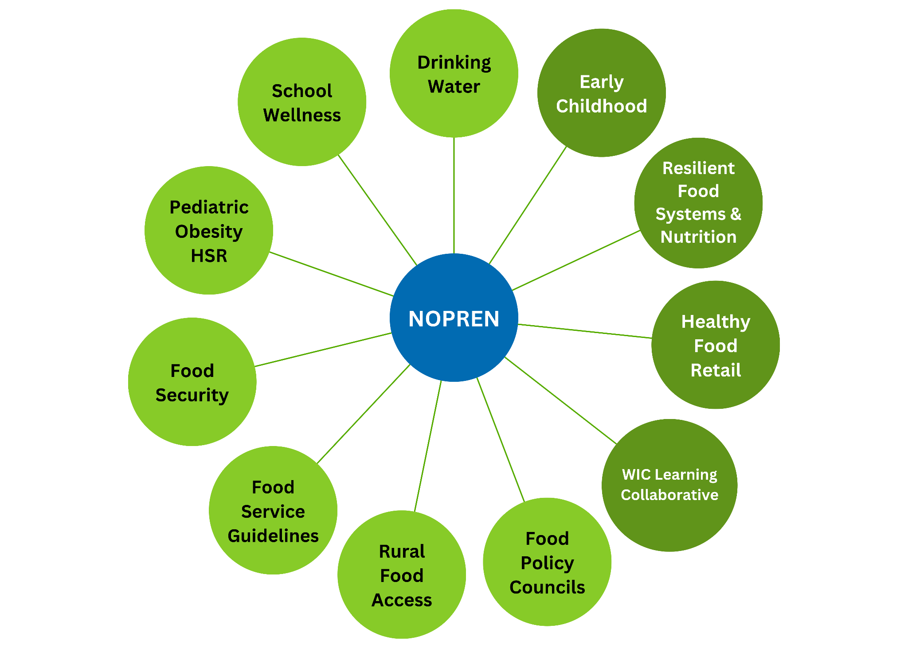


Work Groups
11 Work Groups
4 co-led with HER
Notes:
Jennifer

Slide 15


Ways to Engage with NOPREN
Sign up for the listserv to receive newsletters and network info
Attend monthly State‐of‐the‐Science webinars
Join a Work Group
Work Group Fellows program
Notes:
Jennifer

Slide 16

CDC
Notes:
HER introduce Heidi

Slide 17
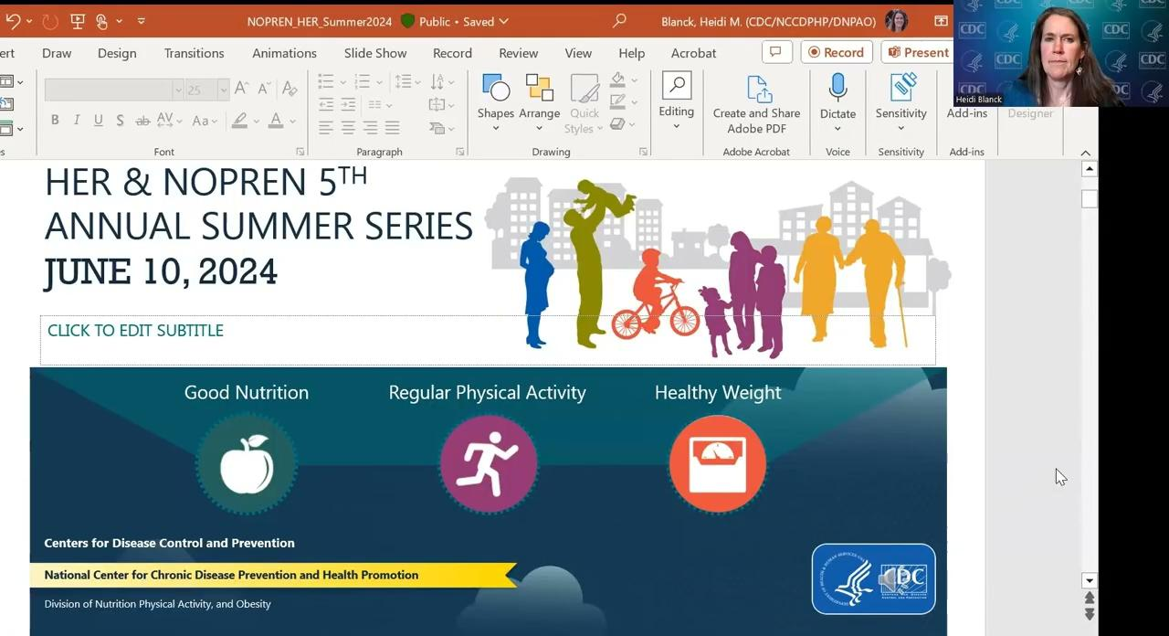
HER and NOPREN Annual Summer Speaker Series
Notes:
HER introduce Heidi

Slide 18
Session 1: Food Policies in Schools - More than just Lunch!
Notes:
Session lead to introduce session topic and moderator

Slide 19
School Wellness Workgroup Introduction
The mission of the School Wellness Workgroup is to identify and address research and practice gaps on the implementation and evaluation of school district policies, state laws, and federal policies, and their impact on wellness practices in K-12 school settings.
Meetings are the second Tuesday of each month
2 pm ET/11 am PT
Next meeting: August 13th, 2024
Workgroup co-chair: Dr. Juliana Cohen, cohenj@merrimack.edu
Workgroup co-chair: Dr. Erin Hager, ehager1@jhmi.edu
Workgroup fellow: Dr. Leah Chapman, chapmanle@Merrimack.edu
Workgroup fellow: Dr. Nan Dou, ndou1@jhu.edu
Notes:
Moderator to give very brief background on WG they are representing

Slide 20
An Overview of School Meals in the United States

Slide 21
History of School Breakfast & Lunch Program
Background for School Meals
Children’s Aid Society of NY serves meals to vocational students (1853)
Congress approves law that begins the commodity program (1935)
DOD Fresh Fruit and Vegetable Program starts (1996)
Updated School Meal Standards (2024)!!
The book Poverty is published (1904)
Pilot breakfast program starts (1966)
1850
1900
1950
2000
Penny lunches in 1 school in Philadelphia (1894)
Women’s Educational & Industrial Union serves hot lunches in Boston (1908)
National School Lunch Act approved (1946)
School Breakfast Program becomes a permanent entitlement program (1975)
HHFKA (2010)

Slide 22
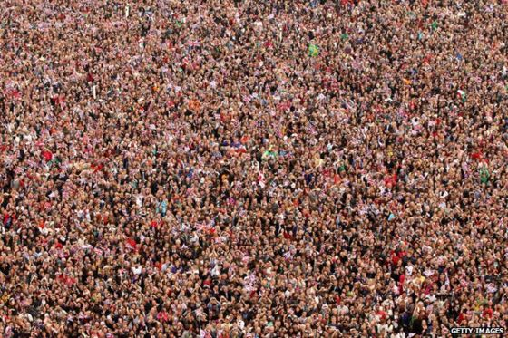
30.3 million children
Background for School Meals

Slide 23
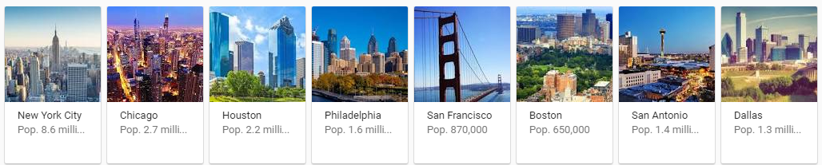
2/3 receive a free or reduced-price meal
Background for School Meals

Slide 24
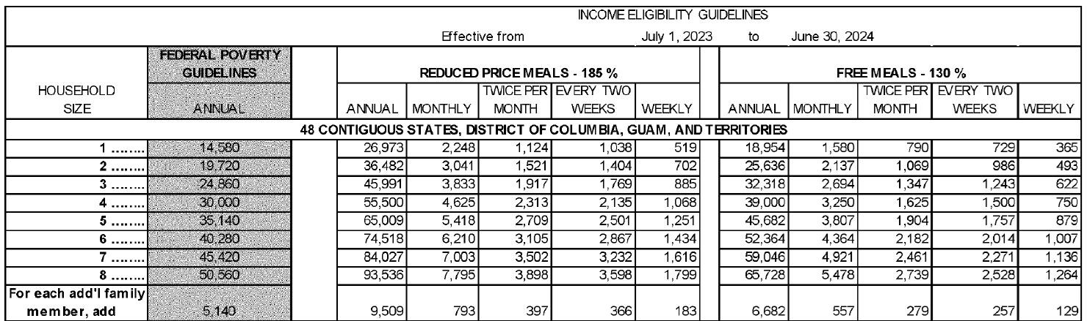
Eligibility for free or Reduced-Price Meals
Background for School Meals
Children from families with incomes at or below 130 percent of the poverty level are eligible for free meals.
Those with incomes between 130 percent and 185 percent of the poverty level are eligible for reduced‐price meals

Slide 25
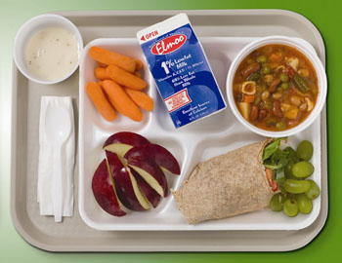
School Meal Requirements
Must Offer:
  Fruit
  Vegetable (variety)
  (Whole) Grains
  Milk
  Meat/meat alternative

Slide 26
School Meal Requirements - Serve
Must Serve:
  3 meal components (one of which MUST be a fruit or vegetable)

Slide 27
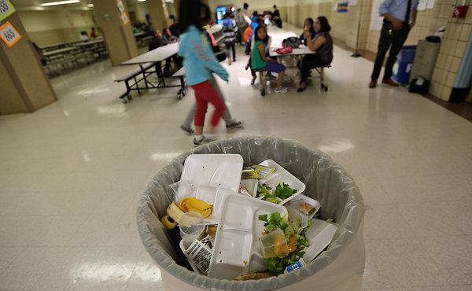
Lessons Learned from the HHFKA

Slide 28
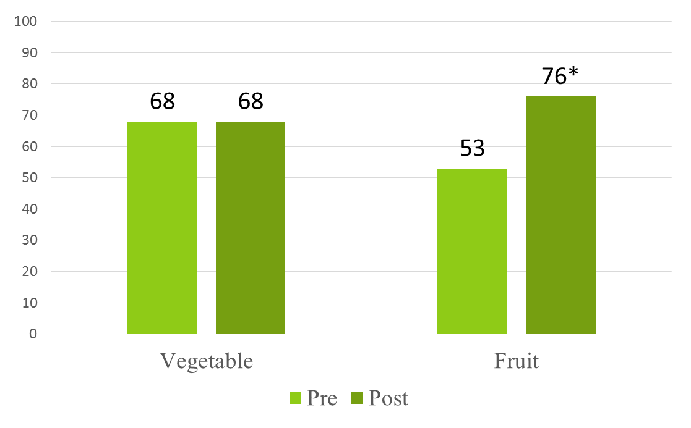
Lessons Learned from the HHFKA cont.
The updated USDA school meal standards have overall led to positive changes
  Improvements in fruit selection
Source: Cohen, Juliana FW, et al. “Impact of the new US Department of Agriculture school meal standards on food selection, consumption, and waste.” American journal of preventive medicine 46.4 (2014): 388-394.

Slide 29
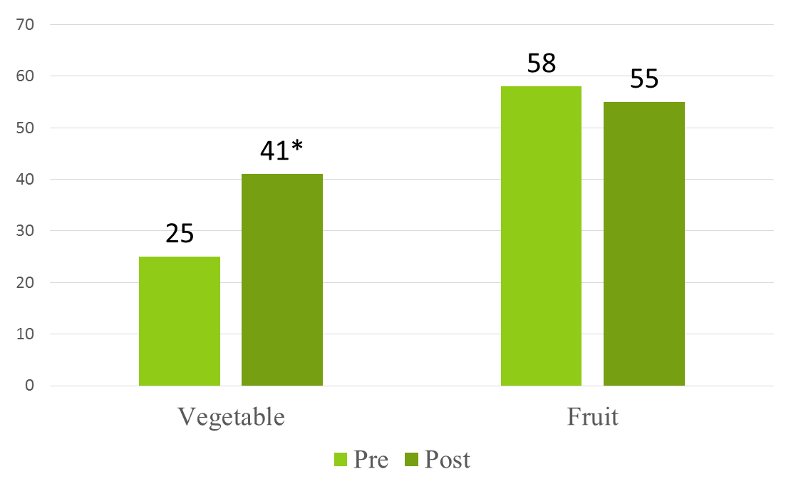
Lessons Learned from the HHFKA cont..
The updated USDA school meal standards have overall led to positive changes
  Improvements in vegetable consumption (no statistically significant difference in fruit consumption)
Source: Cohen, Juliana FW, et al. “Impact of the new US Department of Agriculture school meal standards on food selection, consumption, and waste.” American journal of preventive medicine 46.4 (2014): 388-394.

Slide 30
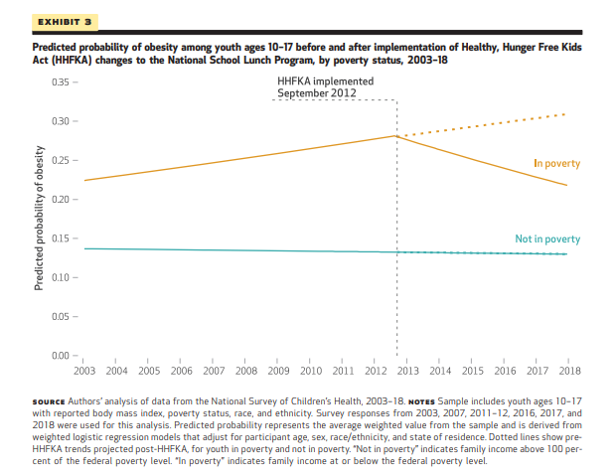
Lessons Learned from the HHFKA cont…

Slide 31
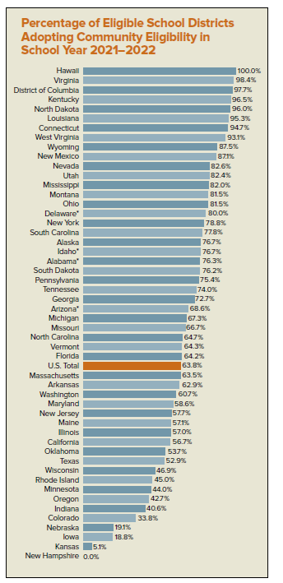
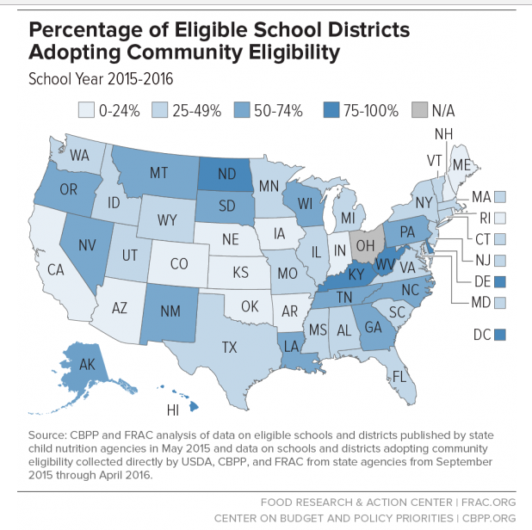
Universal Free School Meal Policies
Community Eligibility Provision

Slide 32
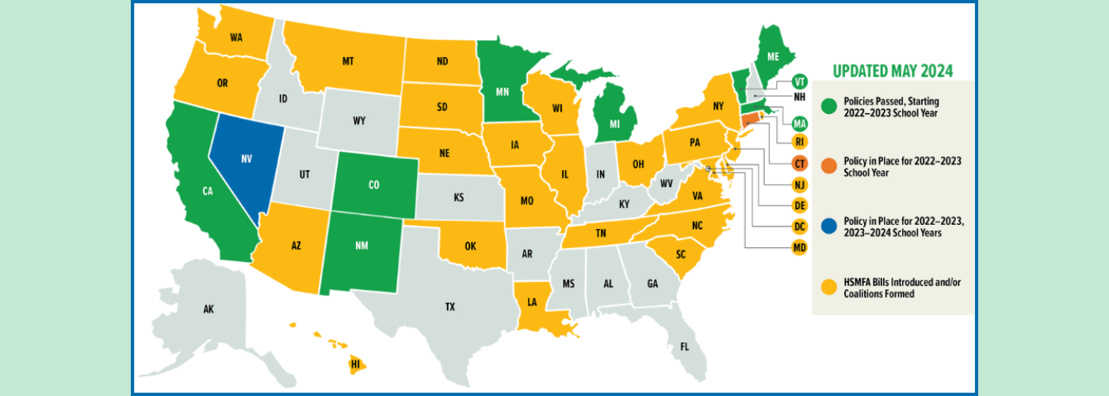
Universal Free School Meal Policies: State-Level Universal School Meals
State-Level Universal School Meals
Source: FRAC https://frac.org/healthy-school-meals-for-all

Slide 33
Changes to School Meal Nutritional Requirements Over Time

Slide 34
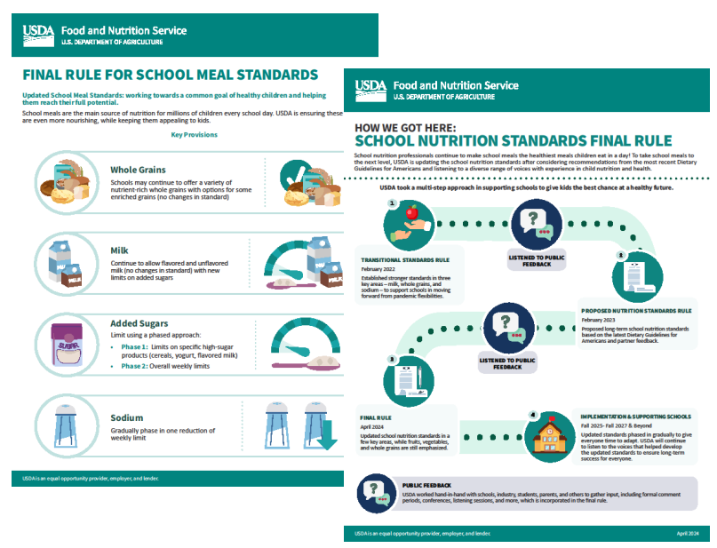
Updated school meal standards on April 25, 2024
Nutrition Standards Final Rule
Child Nutrition Programs: Meal Patterns Consistent With the 2020-2025 Dietary Guidelines for Americans

Slide 35
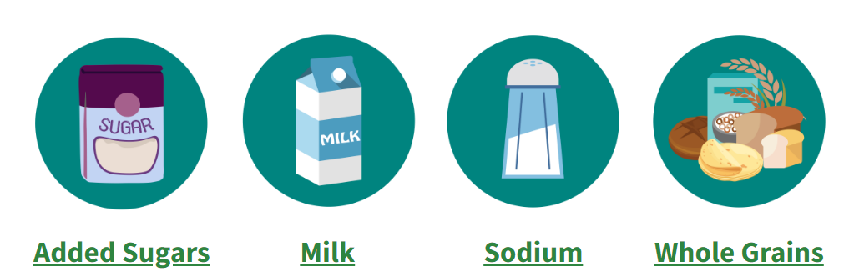

Nutrition Standards Final Rule
Available at:

Slide 36
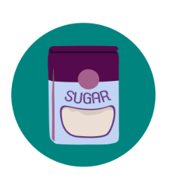
Added Sugars – School Meal Programs (SBP & NSLP)
Current standards
  No limits on added sugar in school meals
July 2025 updated standards
  Product-based limits:
    Breakfast cereals: ≤6 g/oz
    Yogurt: ≤12 g/6 oz
    Flavored milk:10 g/8 oz
July 2027 updated standards
  Average weekly limits for added sugars in overall meals (<10% of weekly calories)

Slide 37

Milk
Current standards
  Allow both flavored and unflavored 1% and fat-free milks in the school meals programs to K-12 students
  Schools continue to offer at least two varieties of milk, and unflavored milk must be offered at each meal service
Updated standards
  Maintain the current standards

Slide 38

Whole Grains
Current standards
  At least 80% of the grains offered weekly must be whole grain-rich
  “Whole grain-rich” is defined by the FNS as products containing 50% to 100% whole grain
Updated standards
  Maintain the current standards

Slide 39
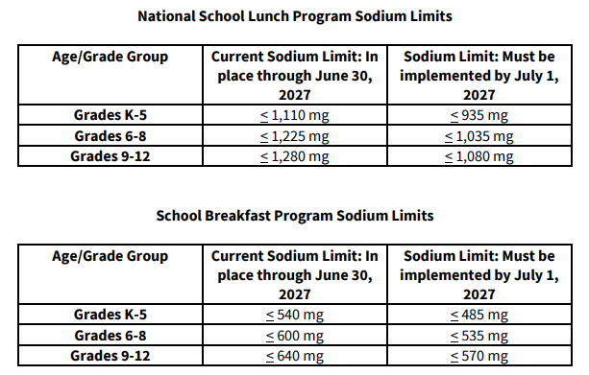

Sodium
Updated standards
  Schools will maintain current sodium limits through SY 2026-2027
  By July 1, 2027, schools must implement a 15% reduction for lunch and a 10% reduction for breakfast from current sodium limits

Slide 40
Competitive Foods in Schools

Slide 41
Overview
What are “competitive foods?”
  Snacks and beverages that “compete” with school meals
Sold in:
  School vending machines
  School stores
  Snack bars
  Cafeterias
  Fundraisers

Slide 42
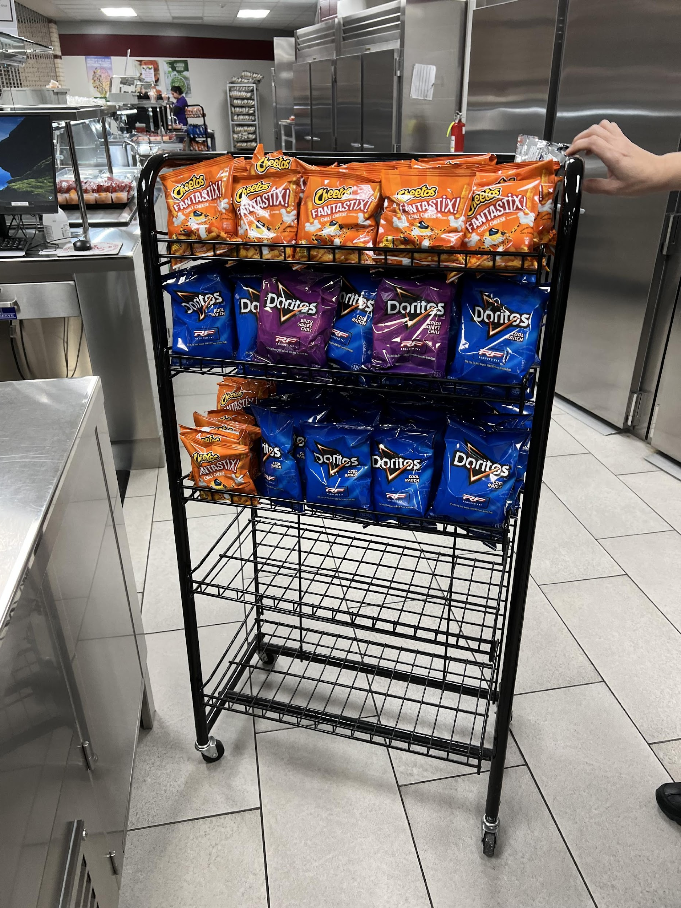
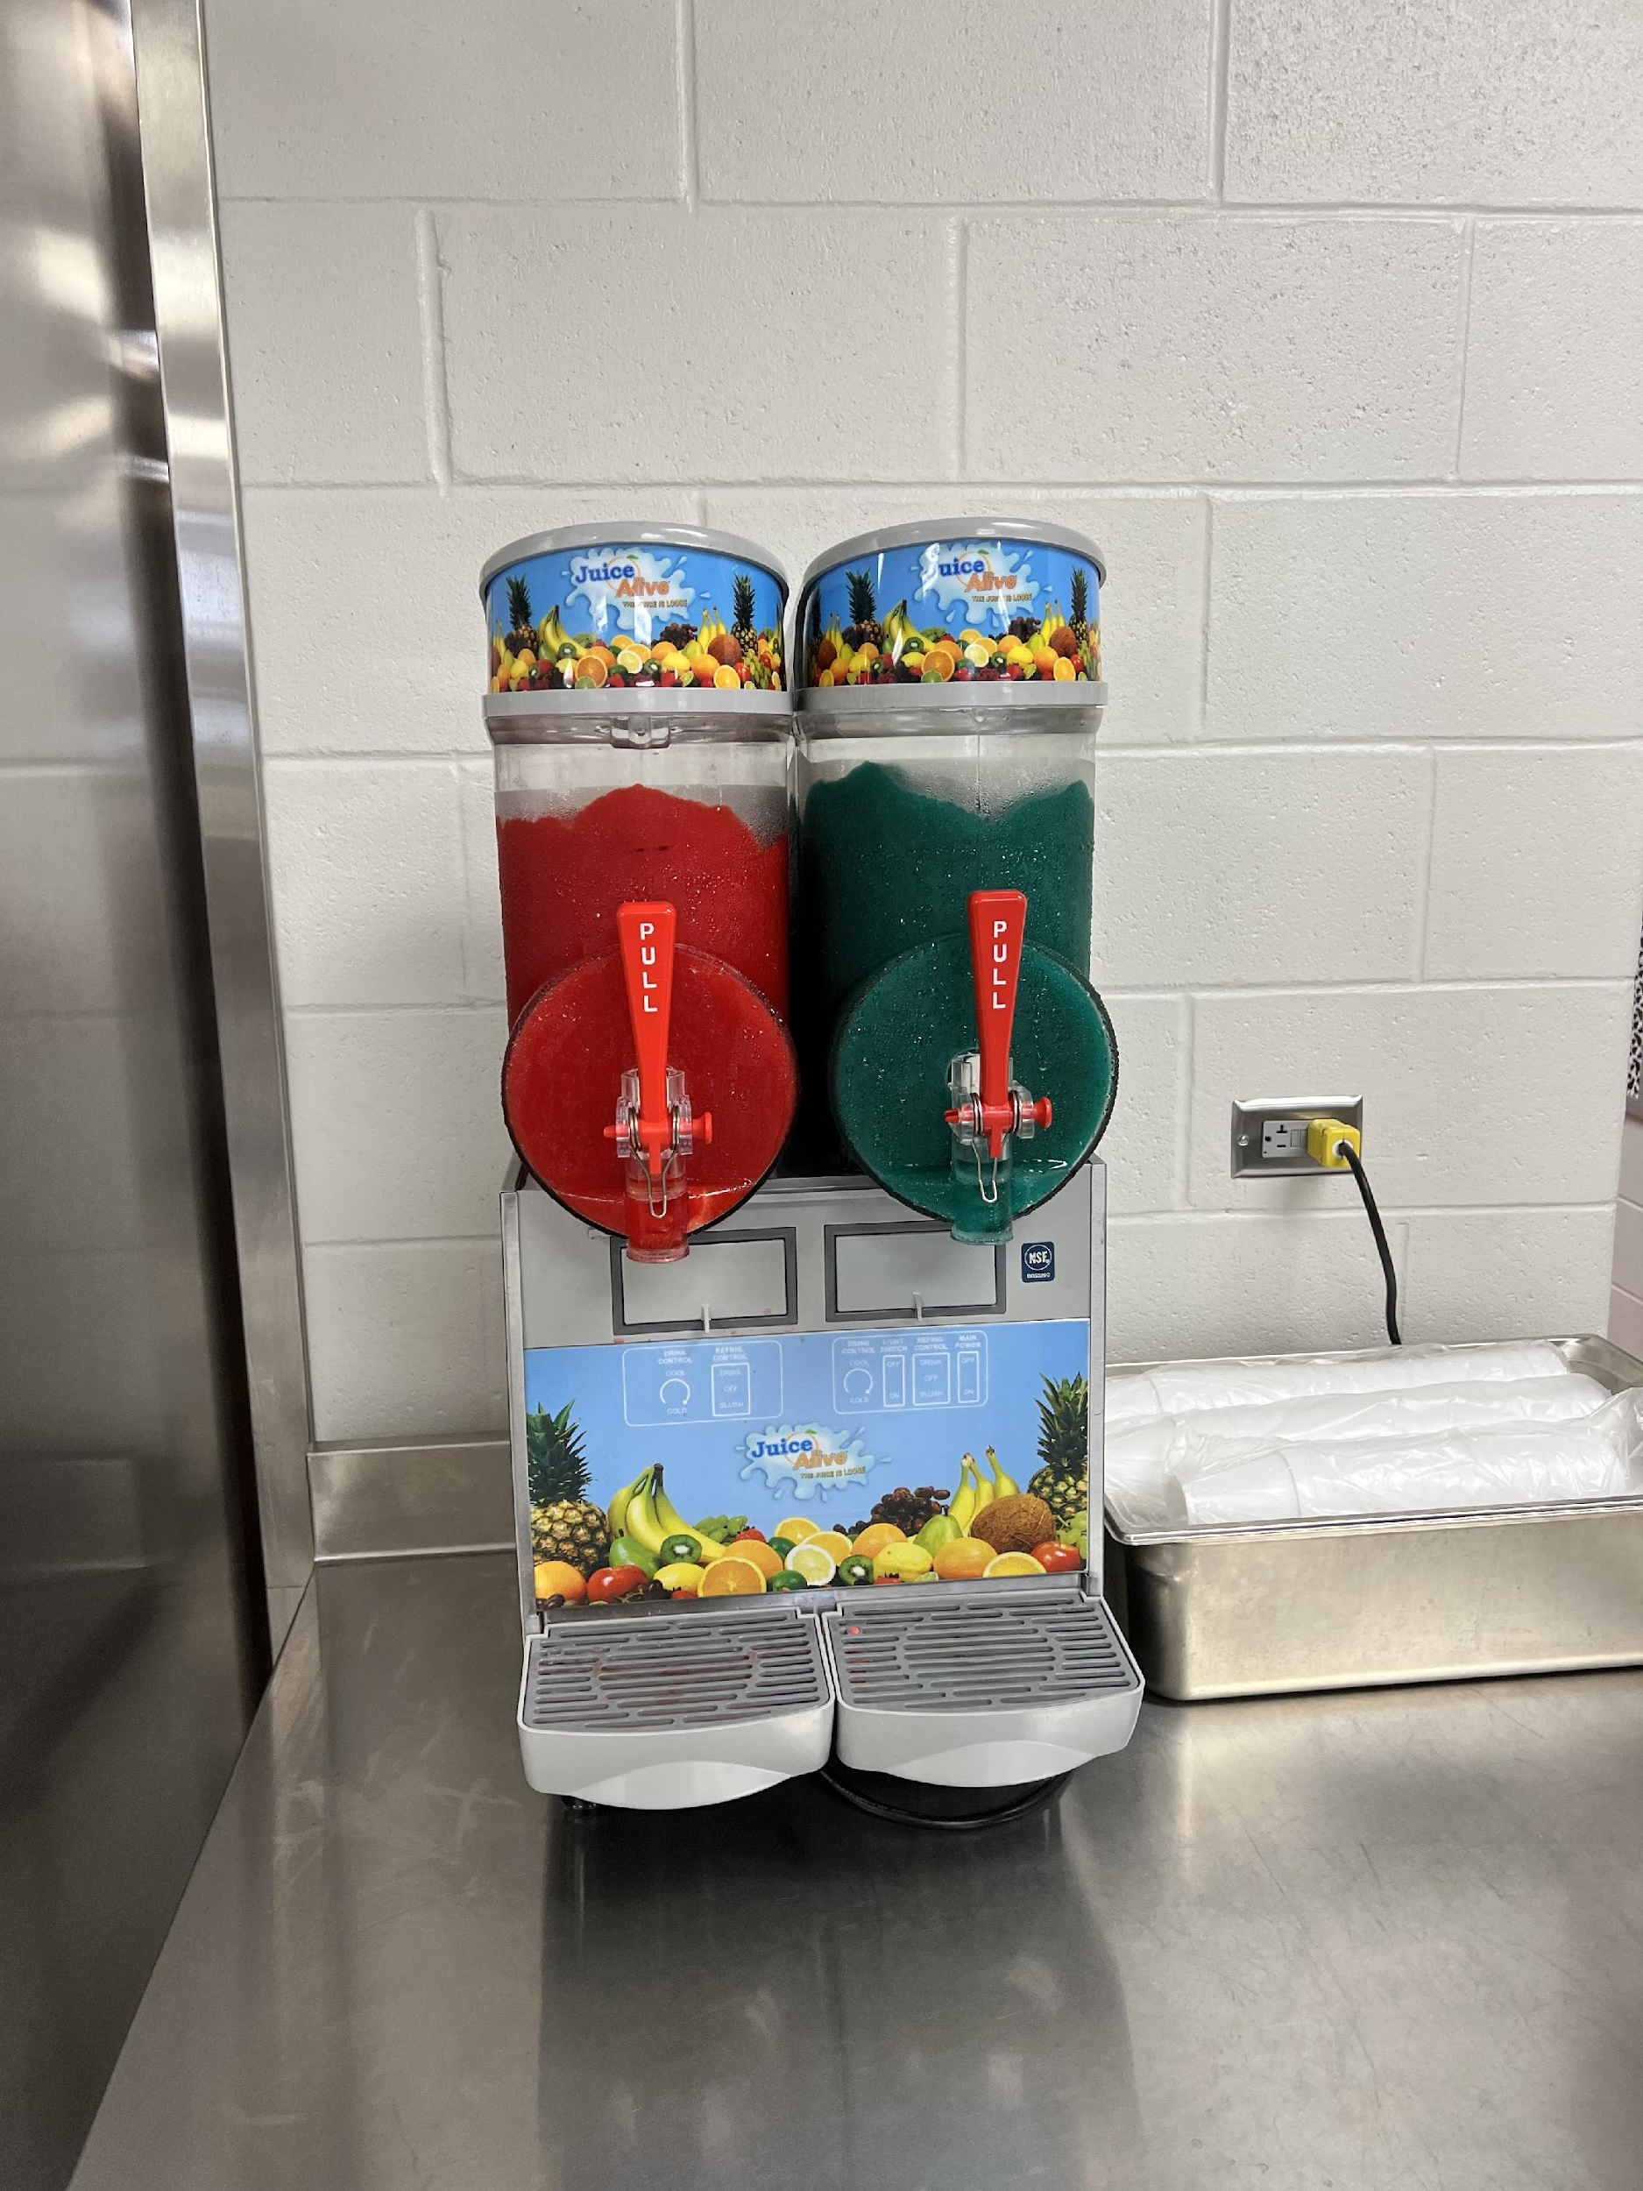
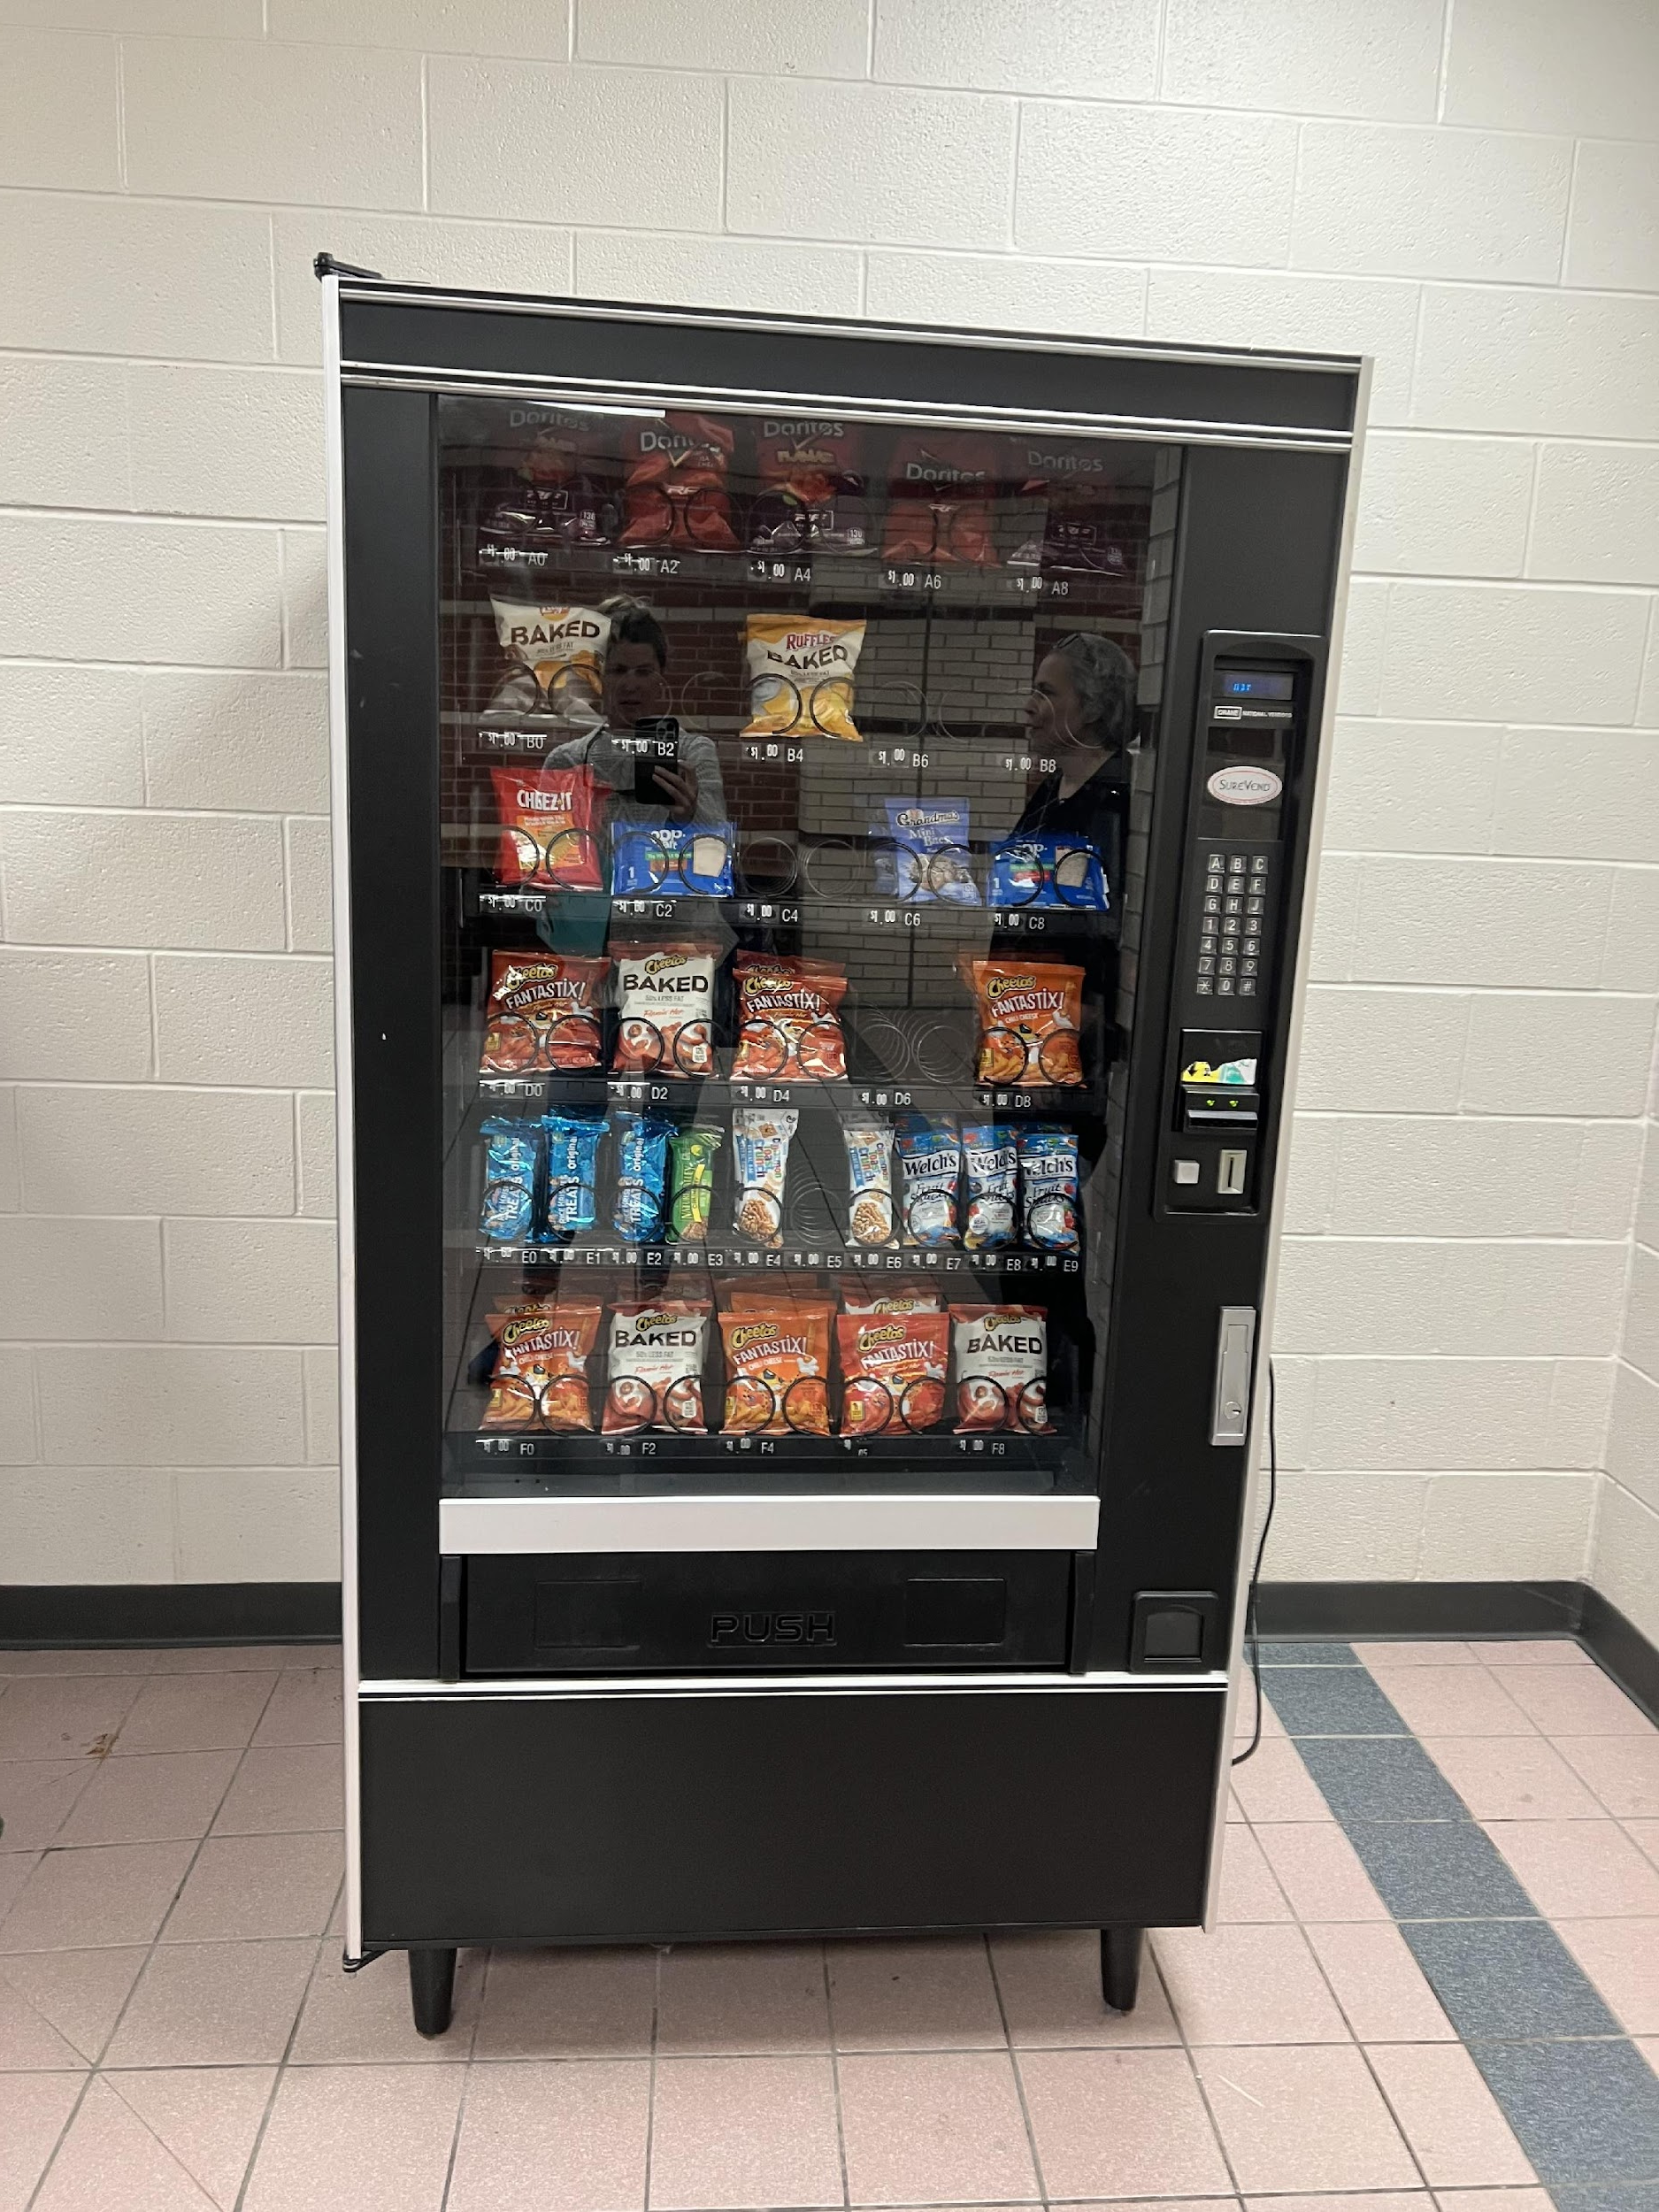
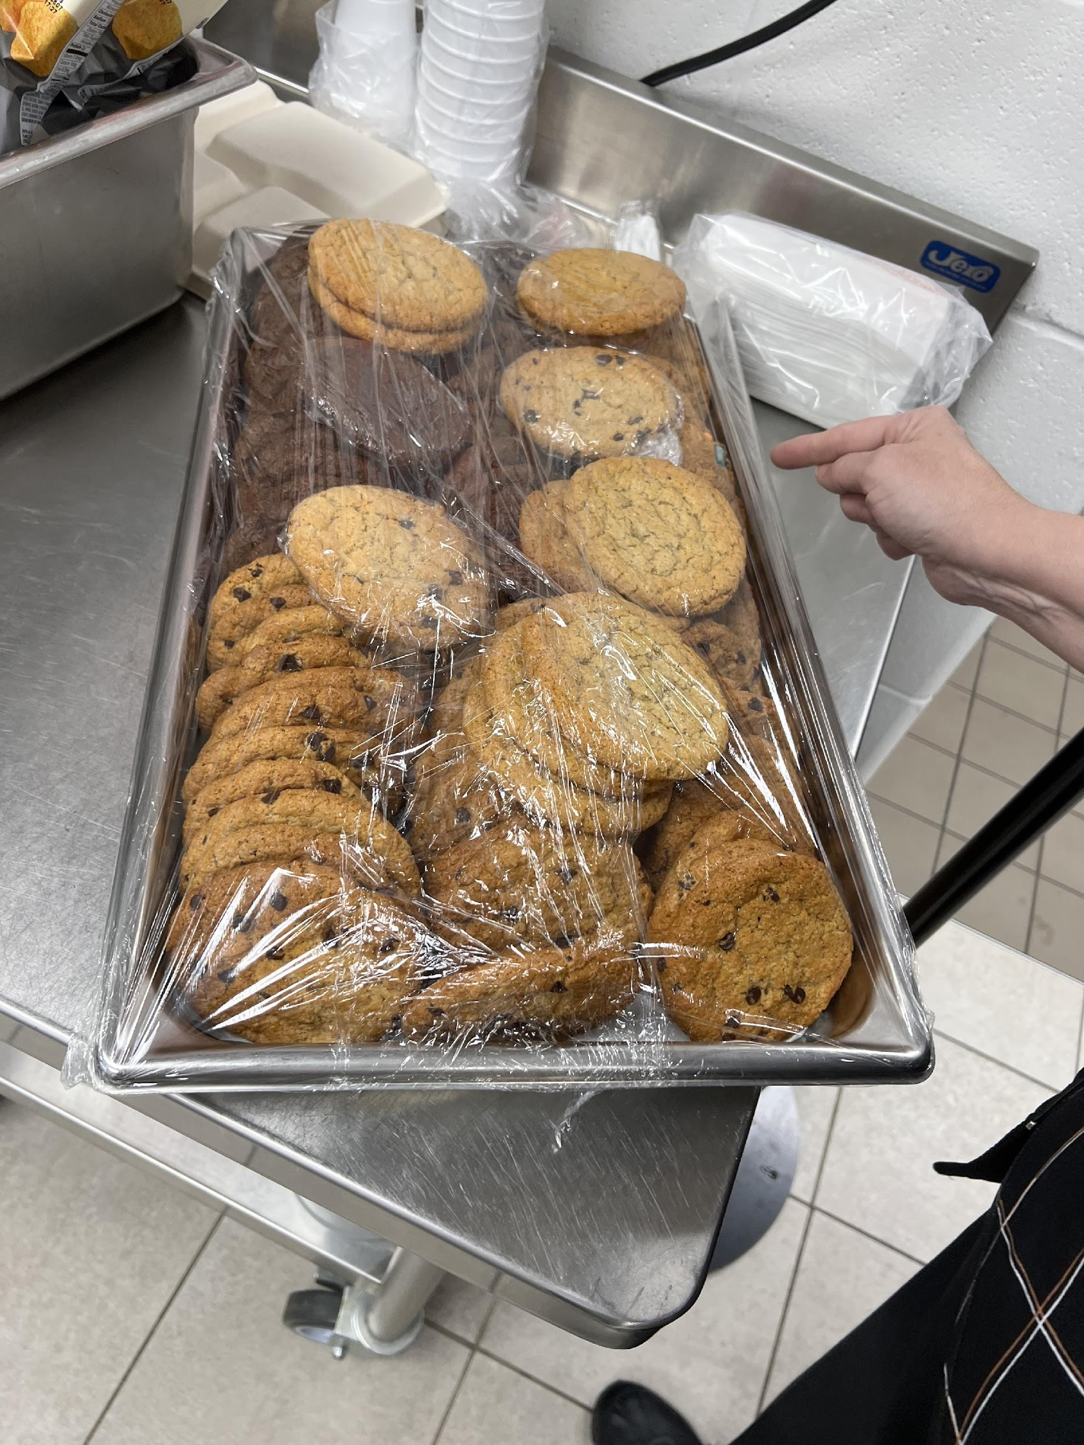
Overview of Competitive Foods

Slide 43
Regulation of Competitive Foods
How are competitive foods regulated?
  USDA Smart Snack nutritional standards
  2010 Healthy, Hunger-Free Kids Act required standards for competitive foods
  National standards passed in 2014

Slide 44
Regulation of Competitive Foods
Overview of Smart Snack Standards
  Whole grain-rich product (first ingredient is whole grain) OR
  First ingredient is a fruit, a vegetable, a dairy food, or a protein food OR
  Be a combination food that contains at least ¼ cup of fruit and/or vegetable (e.g., ¼ cup of raisins with enriched pretzels) AND
  Meet the nutrient standards for calories, sodium, fats, and total sugars

Slide 45
Regulation of Competitive Foods: Smart Snacks
Overview of Smart Snack Standards
  Exact regulations vary by school type
  USDA Smart Snacks Guide: https://fns-prod.azureedge.us/sites/default/files/resource-files/smartsnacks.pdf
  Compliance check: https://foodplanner.healthiergeneration.org/calculator/

Slide 46
Regulation of Competitive Foods: Elementary & Middle
Beverage Smart Snack Standards- Elementary and Middle
  Plain water or plain carbonated water
  Plain or flavored low-fat or non-fat milk
    Elementary: 8 fl oz
    Middle: 12 fl oz
  100% fruit or vegetable juice (regular or diluted with water with no added sweeteners, with or without carbonation- e.g., Izze Sparkling Juice Beverage)
    Elementary: 8 fl oz
    Middle: 12 fl oz

Slide 47
Regulation of Competitive Foods: High Schools
Beverage Smart Snack Standards- High Schools
  Same as middle schools, plus:
  Low-calorie beverages with or without caffeine
    40 calories/8 fl oz
    60 calories/12 fl oz
  No-calorie beverages with or without caffeine
    10 calories/20 fl oz

Slide 48
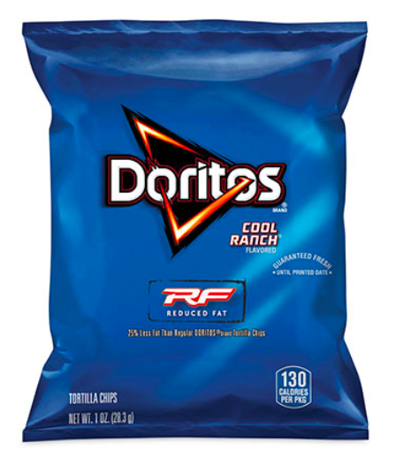
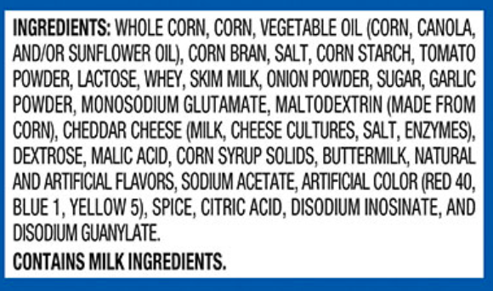
“Copycat” Competitive Foods
Unintended Consequences of Smart Snack Standards
  Product reformulation
  Doritos 🡪 Reduced-fat whole grain Doritos
  Reduced their fat and calories
  First ingredient is “whole corn”

Slide 49
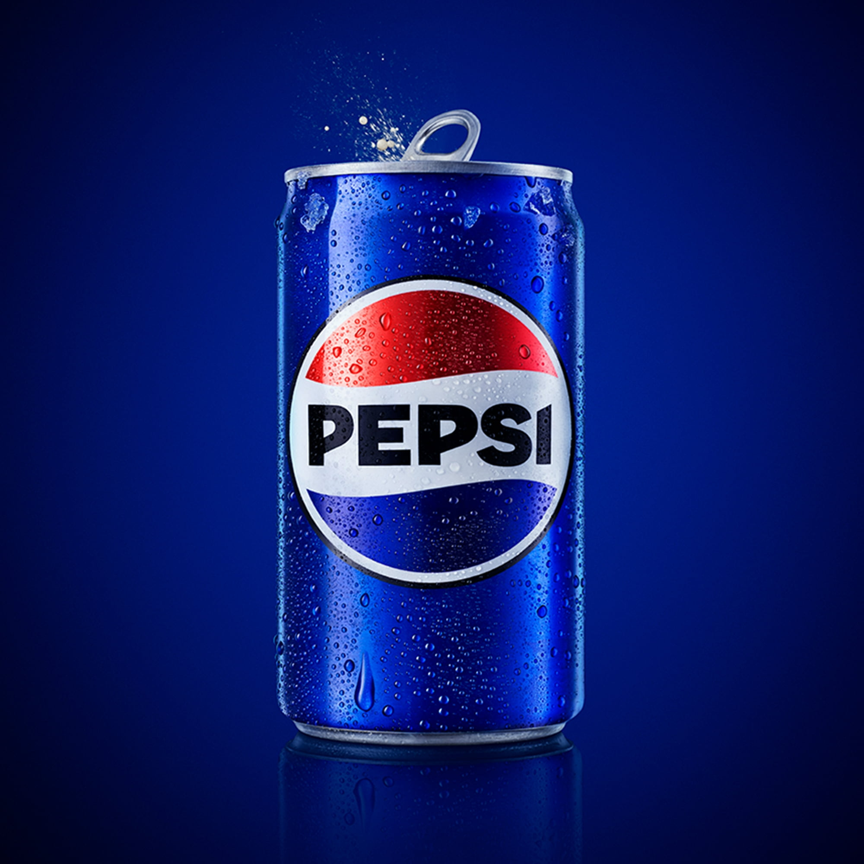
Regulation of Competitive Foods: Pepsi
12 fl oz Pepsi
Compliant or Not?
See pgs. 9-12 for help!

Slide 50

Regulation of Competitive Foods: Starburst
Starburst
Compliant or Not?
See pgs. 9-12 for help!

Slide 51
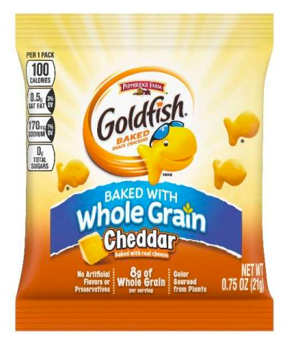
Regulation of Competitive Foods: Goldfish
Whole Grain Goldfish
Compliant or Not?
See pgs. 9-12 for help!
Ingredients: Whole Wheat Flour, Enriched Wheat Flour (flour, Niacin, Reduced Iron, Thiamine Mononitrate, Riboflavin, Folic Acid), Cheddar Cheese ([cultured Milk, Salt, Enzymes], Annatto), Vegetable Oils (canola, Sunflower And/or Soybean), Salt, Contains 2% Or Less Of: Yeast, Autolyzed Yeast Extract, Paprika, Spices, Celery, Baking Soda, Monocalcium Phosphate, Onion Powder. Contains: Wheat, Milk.

Slide 52
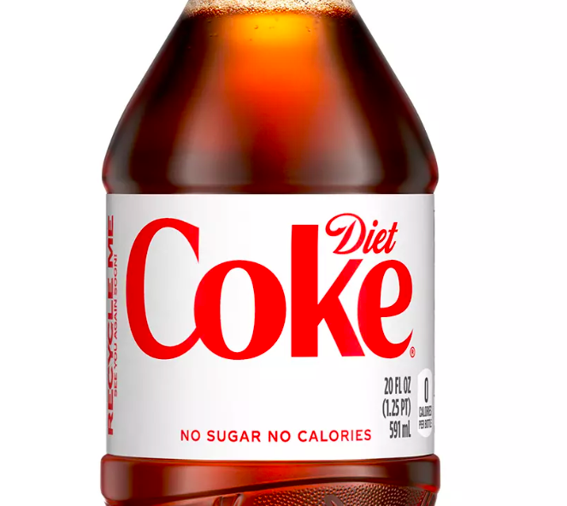
Regulation of Competitive Foods: Diet Coke
20 fl oz Diet Coke
Compliant or Not?
See pgs. 9-12 for help!

Slide 53
Prevalence of Competitive Foods
How many schools sell competitive foods?
  Cohen et al., 2024
    National sample of 90 schools
    70% of middle schools sold competitive foods
    90% of high schools sold competitive foods
    Most commonly sold competitive foods:
      Beverages (47% of all foods documented)
      Sweet snacks (25%)
      Salty snacks (18%)
      Ice cream/frozen treats (12%)

Slide 54
Compliance with Smart Snack Standards
Do schools follow the Smart Snack standards?
  Gorski et al., 2016
    MA sample of 72 schools
    Food compliance: 60%
    Beverage compliance: 79%
  Cohen et al., 2024
    National sample of 90 schools
    Food compliance: 75%
    Beverage compliance: 80%

Slide 55
Nutritional Quality of Competitive Foods
What is the nutrient profile of competitive foods?
  Cohen et al., 2024
    Average calories: 118 kcal
    Average total fat: 3 g
    Average saturated fat: 1 g
    Average total sugar: 13 g
    Average added sugar: 9 g
    Average sodium: 108 mg
    Average fiber: 1 g

Slide 56
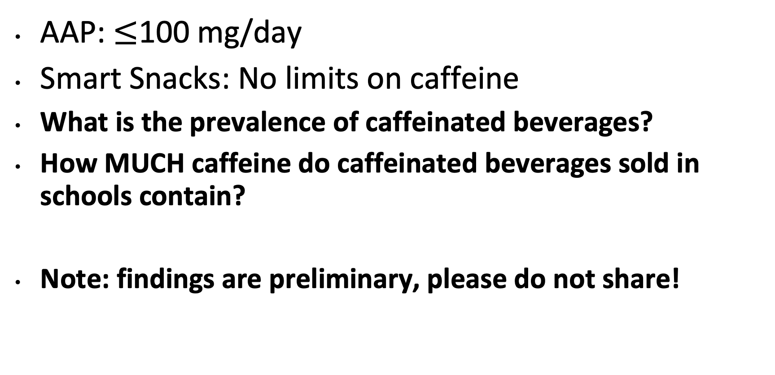
Future Research on Competitive Foods

Slide 57
Future Research on Competitive Foods cont.
1,040 beverages documented
24% contained caffeine (n=249/1,040)
Average amount of caffeine: 65 mg
The most commonly available caffeinated beverages:
  Sodas (n=123/249 [49.4%]; 71 mg)
  Teas (n=66/249 [26.5%]; 34 mg)
  Sweetened waters (n=38/249 [15.3%]; 67 mg)
  Energy drinks (n=13/249 [5.2%]; 95 mg)
  Coffee drinks (n=7/249 [2.8%]; 103 mg)
  Milk/milk substitutes (n=1/249 [0.4%]; 1 mg)

Slide 58
Breakout Rooms
Notes:
Moderator to lead breakout session

Slide 59

Announcements
Please fill out the session evaluation after today’s session.
You should be directed to fill it out after the call ends OR you may scan the QR code on the right.
Join us for the next session of the speaker series!
Wednesday, June 26 from 4:00 - 5:00 PM ET
Title: Food is Medicine: What does it mean?
Where are we going?
Notes:
Session lead: HER
Reminder: Student presentations - application due Wednesday, July 13 at 5pm EST: https://unc.az1.qualtrics.com/jfe/form/SV_cSJdvAqdmlQXicK
Reminder: please fill out the session evaluation for today: https://duke.qualtrics.com/jfe/form/SV_4SmhYaB4MN4pdn8

