Slide 1

Summer Speaker Series for Students
2024
Notes:
Session lead

Slide 2


Getting Started!
Update your name on Zoom, if needed
  Right click on your Zoom box, click “rename”
Type your name and institution into the chat box!
  Question: Which best describes you?
    Ex. Undergraduate Student, Dietetic Intern, Masters Student, Doctoral Student, Post Doc, Public Health Practitioner, Researcher/Professor, Other
Remember to keep yourself on mute.
Type your questions into the chat box.
Notes:
HER/NOPREN staff
Each session there will be a different question of the day:
What are you looking forward to this summer?
What is the weather like today where you are?
What is your go-to morning beverage?
What’s the best book you’ve ever read?
If you were a fruit or vegetable, what would you be?
What would be the title of your autobiography?
What’s your dream vacation destination?
Who performed at the last concert you went to?

Slide 3
NOPREN HER Summer Series for Students
Schedule and Topics
June 12: Food Policies in Schools - More than just Lunch!
June 26: Food is Medicine: What does it mean?
Where are we going?
July 10: Leveraging Food Service Contracts at 4-year Public Universities to
Understand Meal Plan Costs and Affordability
July 24: Policy Systems and Environmental Strategies to Support Young Children's
Diet and Health
August 7: Collaborating Successfully across Sectors toward Nutrition Security
August 14: Student Presentations
For more information, to register, or to watch past recordings: https://nopren.ucsf.edu/her-nopren-summer-speaker-series-students-2024
The series sessions take place on Wednesdays from
4:00 - 5:00 pm EST
Notes:
HER/NOPREN staff
Put registration link in chat box: https://nopren.ucsf.edu/student-resources

Slide 4
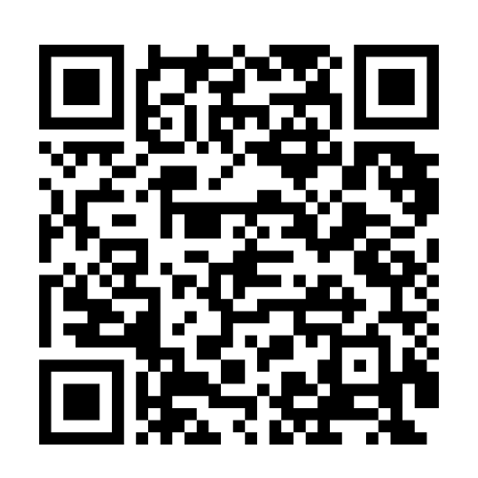
Student Presentations!
The HER/ NOPREN Summer Speaker Series will end with Student Presentations and Poster Sessions on August 14!
Selected students will give a presentation on a public health nutrition-related project or research they worked on over the summer. Applications are due July 17th. To apply, scan the QR code below:
Notes:
HER/NOPREN staff
Put application link in chat:
Reminder: Student presentations - application due Wednesday, July 13 at 5pm EST: https://unc.az1.qualtrics.com/jfe/form/SV_cSJdvAqdmlQXicK

Slide 5
Session 2:
Food is Medicine –
What does it mean? Where are we going?
Notes:
Session lead to introduce session topic and moderator

Slide 6
Food Security Work Group
The mission of the Work Group is to examine, implement, and disseminate work to support food security through evidence-informed policies, programs, and practices.
In our work, we aim to include and uplift the voices of communities who face historic and ongoing oppression, as these groups are more likely to experience food insecurity.
To join the listserv, please contact our work group fellow:
Ximena Perez-Velazco (ximenapv@live.unc.edu)
Notes:
Moderator to give very brief background on WG they are representing

Slide 7
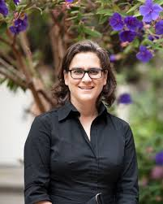



Today’s Presenters
Hilary Seligman, MD MAS
University of California San Francisco
Melissa Akers, MPH CPH
University of California San Francisco
Lisa Goldman Rosas, PhD MPH
Stanford University
Ronli Levi, MPH RDN
University of California San Francisco
Notes:
Moderator to introduce session speakers
Replace with speaker pictures

Slide 8
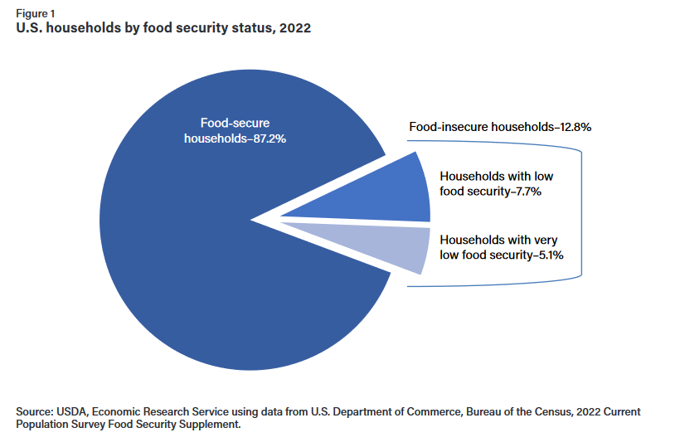
1 in 8 US Households Food Insecure in 2022

Slide 9
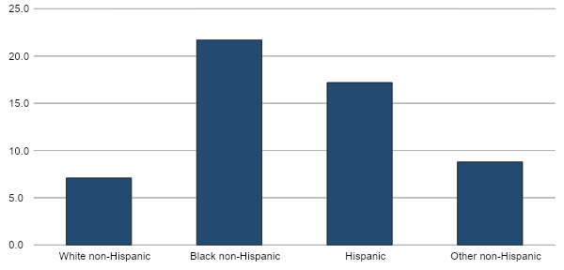
These disparities mimic disparities in chronic disease risk.
Disparities in food insecurity rates by race, 2020
Source: USDA, Economic Research Service, using data from the December 2020 Current Population Survey Food Security Supplement, U.S. Census Bureau

Slide 10
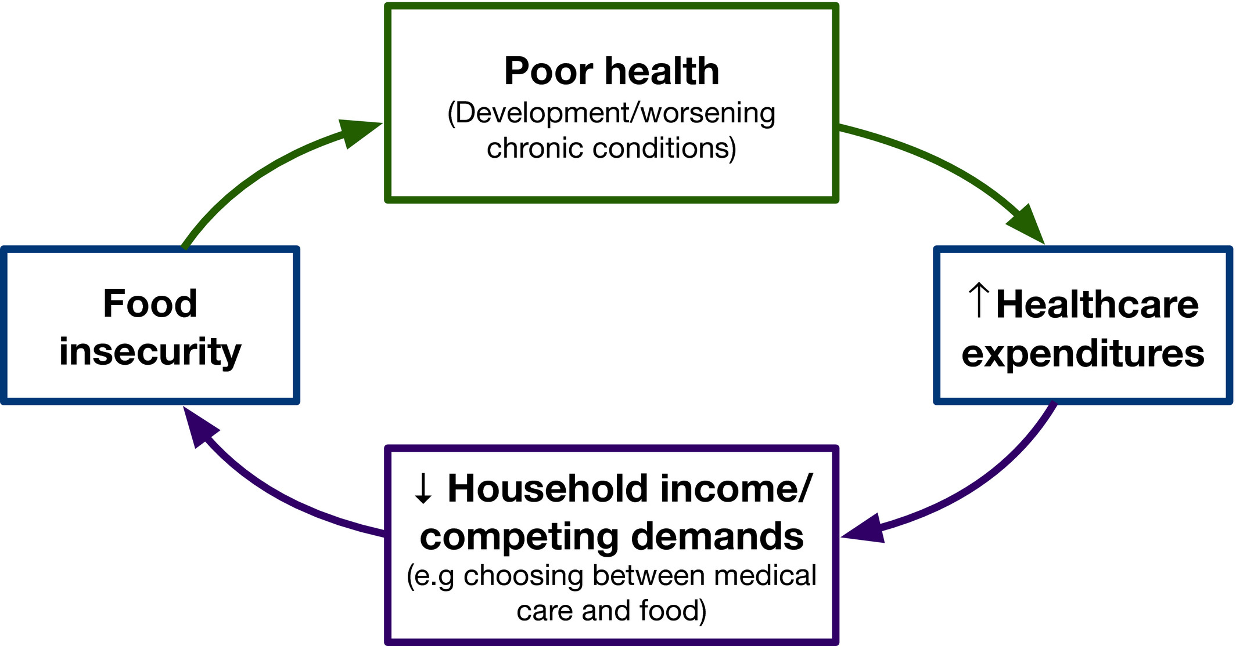
Bidirectional relationship between food insecurity and poor health
Johnson, Palakshappa, Seligman. Health Services Research, 2021.

Slide 11
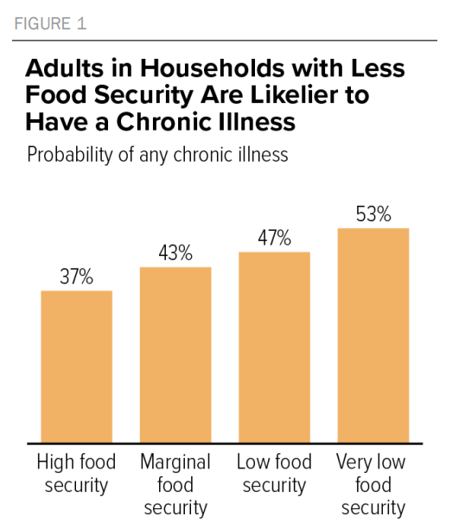
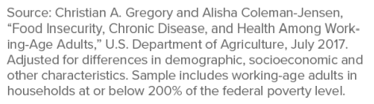
Adults in households with less food security are likelier to have chronic illness

Slide 12
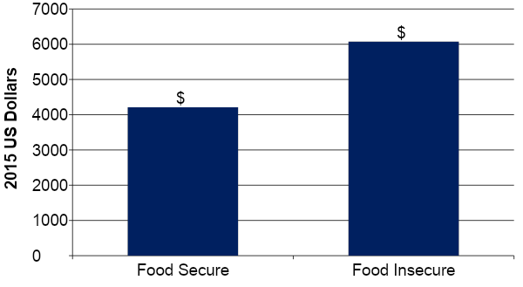
Food Insecurity &
Subsequent Annual Health Care Expenditures
$ 1863
NHIS-MEPS data adjusted for: age, age squared, gender, race/ethnicity, education, income, rural residence, and insurance.
Berkowitz, Basu, and Seligman. Health Services Research: 2017.

Slide 13
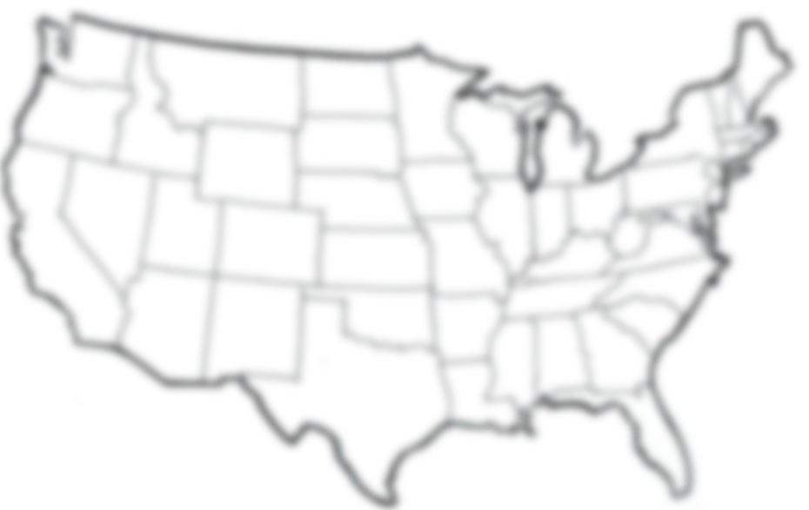
$77.5 billion additional health care expenditures annually
Berkowitz, Basu, and Seligman. Health Services Research: 2017.

Slide 14
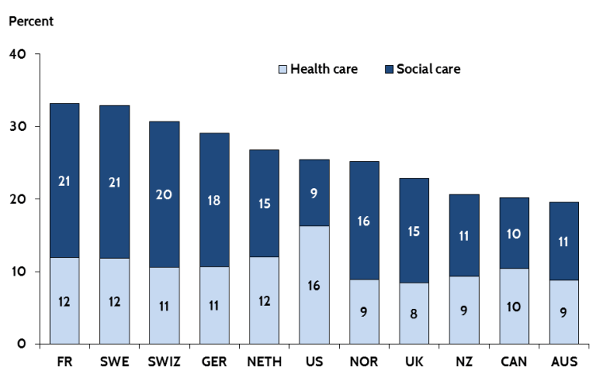
Mis-Alignment Between Health Care & “Social Care” in the US
These is the downstream impact of policies we have put into place.
Figure 1. Health and Social Care Spending as a Percentage of GDP
Rebalancing Social & Medical Spending to Promote Health. Butler et al. Brookings Institution. 2017
Notes:
HC sector becoming engaged in SDH and recognizing that this mismatch betwn health care and social care in the US, but it hasn’t been immediately obvious how the HC sector should engage in this challenge

Slide 15
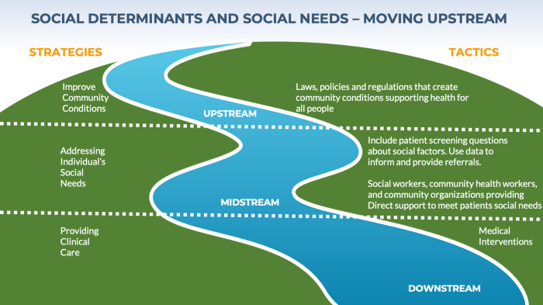
Social determinants and social needs
Social Determinants of Health
Social Needs
“Meeting Individual Social Needs Falls Short Of Addressing Social Determinants Of Health,” Health Affairs Blog, January 16, 2019. DOI: 10.1377/hblog20190115.234942

Slide 16
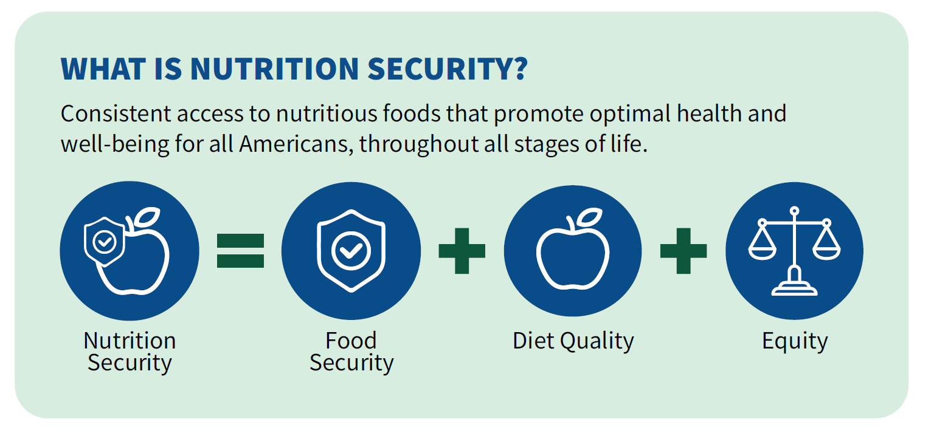
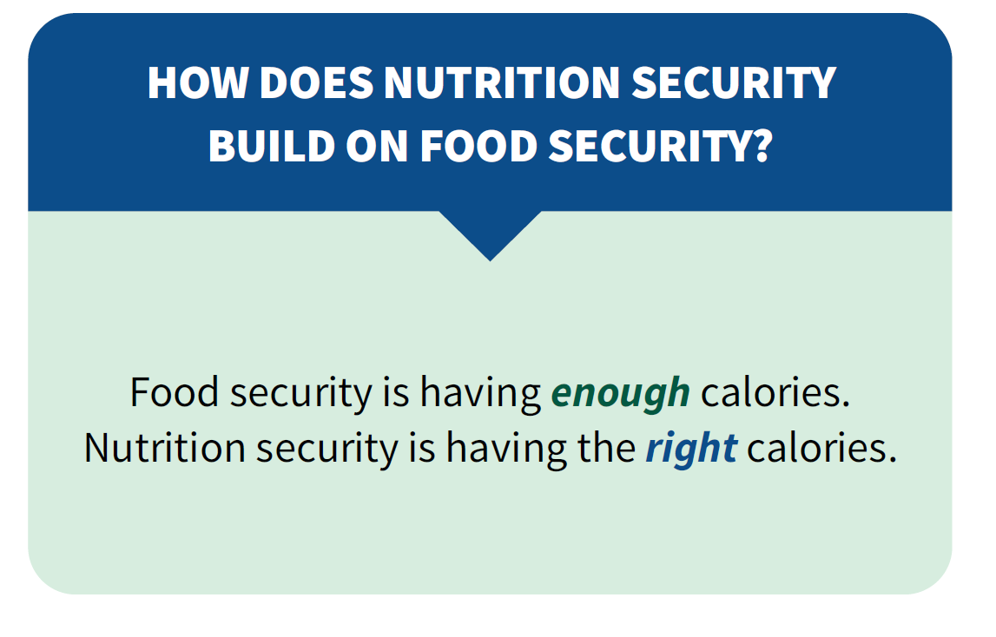
Nutrition security vs food security simplified
Nutrition Security vs Food Security (simplified)
https://www.fns.usda.gov/resource/usda-actions-nutrition-security

Slide 17


Food Is Medicine
Food is Medicine
Integration of specific food and nutrition interventions in, or in close collaboration with, the health care system
Target population
  People with or at high risk for certain health conditions (often diet-related)
  People with or at high risk of food insecurity

Slide 18

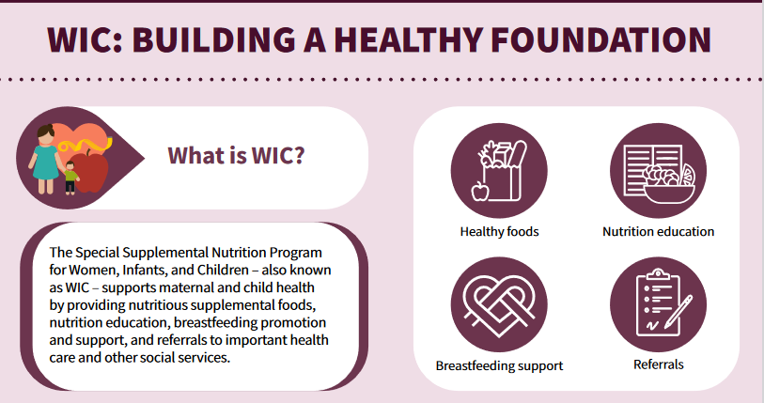
Largest FIM Program
Largest FIM Program
Can FIM programs be scaled?
PROVEN
Can FIM programs impact short and long term health outcomes?
PROVEN

Slide 19






Theory of Change
Data transfer between sectors (health care, CBO, & food vendor)
Data tracking within the electronic health record
CBO capacity to provide food how, when, where and at the price that healthcare desires
Fragmentation of the ecosystem outside of healthcare
Identification of food insecurity by positive clinical screen
Referral to FIM program
Enrollment in FIM program
Improved diet quality, food security, and satisfaction
Improvement of health and utilization outcomes

Slide 20
Spectrum of FIM programs
Spectrum of FIM Programs
From the perspective of health care
Clinical Screen for Food Insecurity
MTM=Medically Tailored Meals
MTG=Medically Tailored Groceries
SNAP=Supplemental Nutrition Assistance Program
“On-Site” Programs
Community Programs
Federal Nutrition Programs
Food pantry in clinic
MTM’s/MTG’s
SNAP
Food Is Medicine
Mobile food distribution in clinic
Food Pantry
WIC
Clinical Referral
SNAP enrollment assistance
Produce Prescriptions
Numerous Others
= “food is medicine”

Slide 21
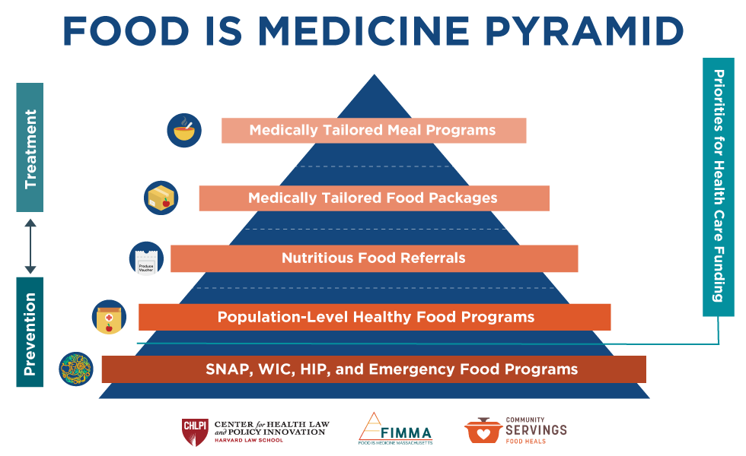
System Fragmentation
Supermarket
Big Box Store
Corner Store
Convenience Store
CSA boxes
Farmers Market
Food Pantry
Food Bank
Home-Delivered Meal Provider
Mobile Market
“CSA boxes” refers to delivery of foods directly from the farm to a household.

Slide 22
What do we know about the impact of FIM programs?

Slide 23
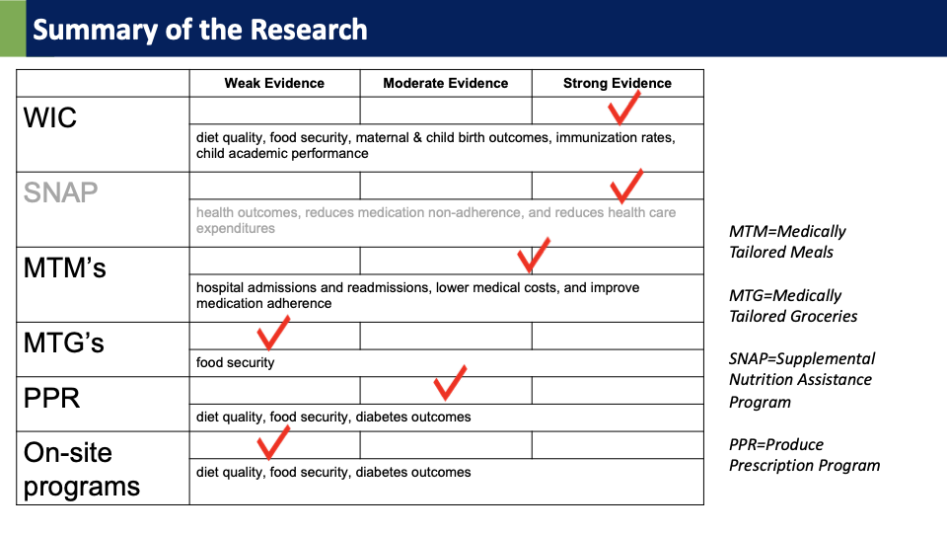

Summary of Research
Summary of the Research
 | Weak Evidence | Moderate Evidence | Strong Evidence
WIC
 | diet quality, food security, maternal & child birth outcomes, immunization rates, child academic performance
SNAP
 | health outcomes, reduces medication non-adherence, and reduces health care expenditures
MTM’s
 | hospital admissions and readmissions, lower medical costs, and improve medication adherence
MTG’s
 | food security
PPR
 | diet quality, food security, diabetes outcomes
On-site programs
 | diet quality, food security, diabetes outcomes
MTM=Medically Tailored Meals
MTG=Medically Tailored Groceries
SNAP=Supplemental Nutrition Assistance Program
PPR=Produce Prescription Program
Notes:
Take text away!

Slide 24
Summary of Research cont
Aspen Institute updates: https://aspenfood.org/wp-content/uploads/2024/04/Food-is-Medicine-Action-Plan-2024-Final.pdf
 | Weak Evidence | Moderate Evidence | Strong Evidence
WIC
 | diet quality, food security, maternal & child birth outcomes, immunization rates, child academic performance
SNAP
 | health outcomes, reduces medication non-adherence, and reduces health care expenditures
MTM’s
 | hospital admissions and readmissions, lower medical costs, and improve medication adherence
MTG’s
 | food security
PPP
 | diet quality, food security, diabetes outcomes
On-site programs
 | diet quality, food security, diabetes outcomes
Aspen Inst FIM Research Action Plan
MTM’s: 10 studies, 2 RCT’s, 5 with a ctl group, & 5 with >100 ppts
MTG’s: 12 studies, 3 with a ctl group, & 5 with >100 ppts
PPP: 27 studies, 5 with a ctl group, & 8 with >100 ppts
Notes:
Take text away!

Slide 25
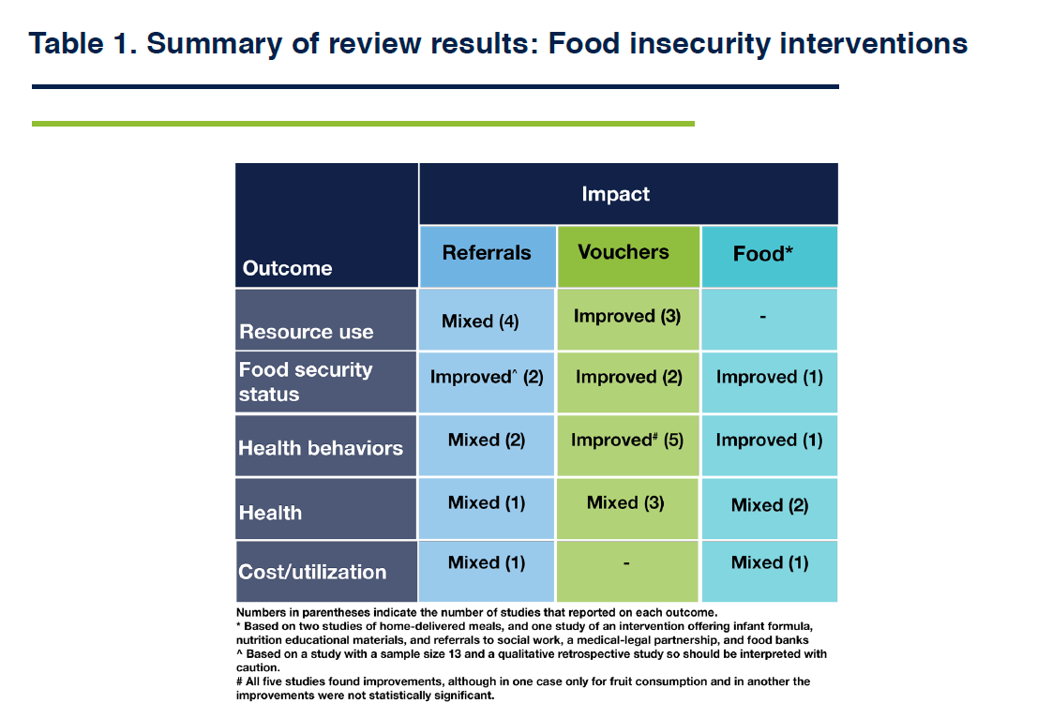
Table 1

Slide 26
Why is the data so limited?

Slide 27

Evaluation Challenges
Evaluation Challenges
Almost all programs reach a small number of people
  Not suitable* for examining health outcomes, utilization, & cost
Almost all programs offer a relatively small dose & duration
  Not suitable* for examining health outcomes, utilization & cost
Many programs are single-site
  Limited applicability to the field as a whole
Bottom line: You need a LOT of data to show an impact
  Most programs have limited funds available for evaluation
This is really hard!
* I would argue it is also not ethical
Notes:
Take text away

Slide 28

Health outcomes, utilization and cost
Why is so much data needed to prove impact on health outcomes, utilization, & cost?
Food security and nutrition programs are generally
  Better at prevention than at treatment
  Expected to have an impact over a long length of time
  Proven by their SMALL effect on a LARGE number of people, rather than their LARGE effect on a SMALL number of people
If you anticipate a SMALL effect, to show an impact you need
  A lot of people
  A long duration of “treatment”
  A high “dose”
  A long duration of observation
POPULATION HEALTH
Notes:
Take text away

Slide 29
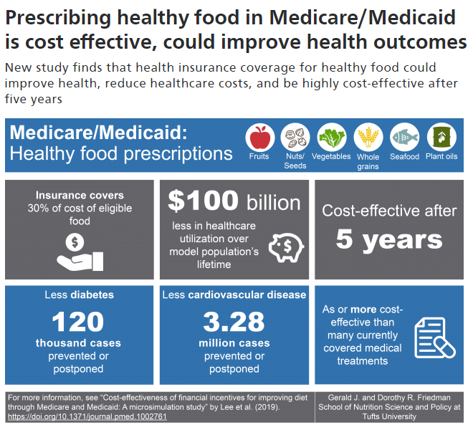
Modelling Studies Have Limitations but Can Fill in Some Gaps

Slide 30
Where are the opportunities?

Slide 31
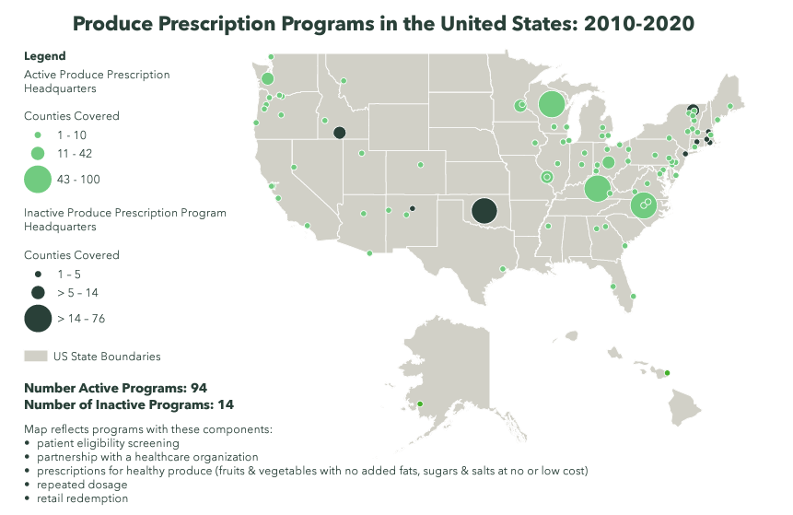
Opportunities for the Field
Access to Large Amounts of Data
Shared metrics across numerous programs
  eg GusNIP Produce Prescription Programs
Large health systems with a single electronic health record
  VA, Indian Health Service, other integrated health systems
Health insurers
  Claims data
Notes:
Take text away

Slide 32
Opportunities for Individual Programs
Controversy Alert!
Nutritious Diet
Better Health
FIM Program
Increased FV Intake
Better Health
Increased FV Intake
Better Health
FIM Program
Food Security
Better Health
Food Security
Better Health
This will happen if:
Implemented at scale
Dose and duration are sufficient
THIS IS PROVEN ALREADY
Notes:
Transition to next slide: So how do we measure increased FV intake and food security?

Slide 33
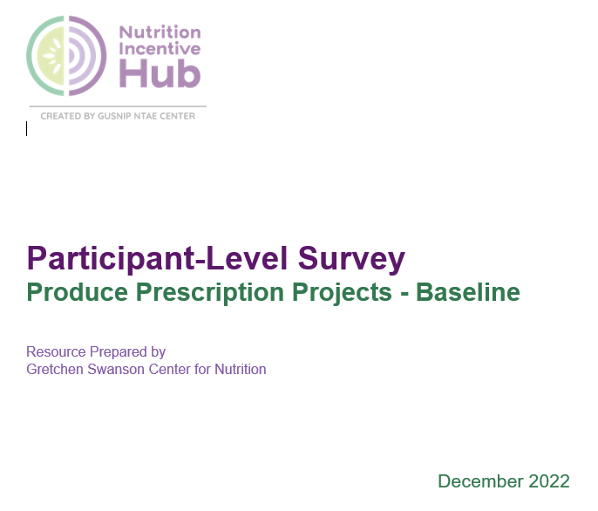
Opportunities for Individual Programs: Shared Metrics
Shared metrics → pooled data →
  More participants
  More sites
Food security
FV intake
SNAP participation
Program satisfaction
Health status
Basic demographics
Budd Nugent N, Byker Shanks C, Seligman HK, Fricke H, Parks CA, Stotz S, Yaroch AL. Accelerating Evaluation of Financial Incentives for Fruits and Vegetables: A Case for Shared Measures. Int J Environ Res Public Health. 2021 Nov 19;18(22):12140.
https://www.nutritionincentivehub.org/resources/resources/reporting-evaluation/core-metrics-produce-prescription/participant-level-metrics
Notes:
This is especially true if all the FIM programs participating are targeted toward people with diabetes!

Slide 34
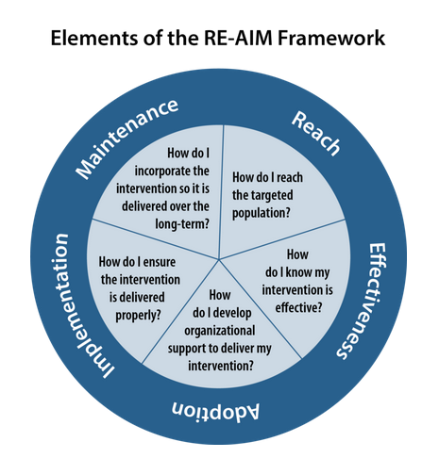
Opportunities for Individual Programs:
Implementation Science
Glasgow RE, Vogt TM, Boles SM. Evaluating the public health impact of health promotion interventions: the RE-AIM framework. Am J Publ Health 1999;89(9):1322–7.
Notes:
Take text away

Slide 35

wave

Slide 36

National Strategy

Slide 37

Pillar 2

Slide 38
Key Plans to Support Pillar 2
Expands “food is medicine” programs in Medicare, Medicaid, the VA, and the IHS, including medically tailored meals and produce prescriptions
Universal screening for food insecurity in federal healthcare systems and incentivizes payors to screen for food insecurity and other SDOH
Supports data infrastructure for food insecurity and other SDOH screenings
Increases nutrition training for clinicians

Slide 39
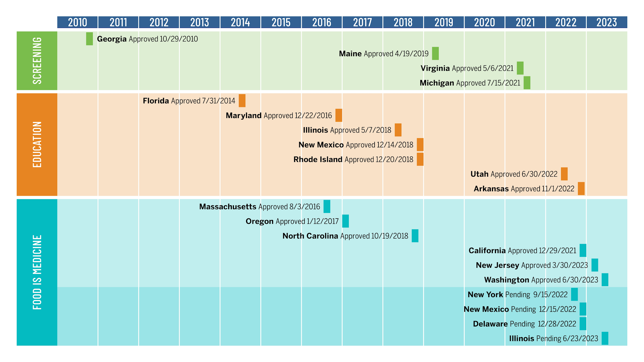
graph
PREPUBLICATION: Hanson E. et al. The Evolution and Scope of Medicaid Section 1115 Demonstrations to Address Nutrition: A U.S. Survey. 2023

Slide 40
Q&A
Notes:
Moderator to lead Q/A

Slide 41
Breakout Rooms
Notes:
Moderator to lead breakout session

Slide 42
experts
Purpose: To connect with experts aligned with your potential career trajectory
Hilary Seligman, MD MAS
University of California San Francisco
Lisa Goldman Rosas, PhD MPH
Stanford University
Melissa Akers, MPH CPH
University of California San Francisco
Ronli Levi, MPH RDN
University of California San Francisco
Notes:
Speaker Two (if applicable) to input slides

Slide 43
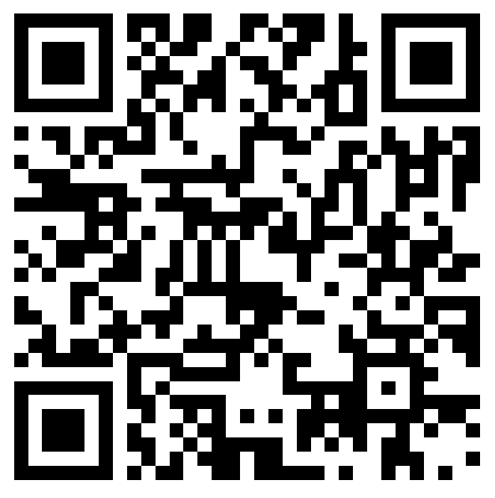
Announcements
Please fill out the session evaluation after today’s session.
You should be directed to fill it out after the call ends OR you may scan the QR code on the right.
Join us for the next session of the speaker series!
Wednesday, July 10 from 4:00 - 5:00 PM ET
Title: Leveraging Food Service Contracts at 4-year Public Universities to Understand Meal Plan Costs and Affordability
To view the recording or learn more about the series: https://nopren.ucsf.edu/her-nopren-summer-speaker-series-students-2024
Notes:
Session lead
Reminder: Student presentations - application due Wednesday, July 13 at 5pm EST: https://unc.az1.qualtrics.com/jfe/form/SV_cSJdvAqdmlQXicK
Reminder: please fill out the session evaluation for today: https://duke.qualtrics.com/jfe/form/SV_4SmhYaB4MN4pdn8

