Slide 1

Summer Speaker Series for Students
2025
(The contents and findings of this presentation are those of the speakers and do not represent the official views of the Centers for Disease Control & Prevention or Department of Health and Human Services.)
Notes:
Hello Everyone! We want to welcome you back for the third session of the HER NOPREN Summer Speaker Series for Students. My name is Jennifer Tong and I am with the Nutrition and Obesity Policy Research and Evaluation Network Coordinating Center at the University of California San Francisco.
Please note: The contents of these sessions are those of the speakers and do not represent the official views of the Centers for Disease Control & Prevention or Department of Health and Human Services.
My name is Jennifer Tong. I am a part of the Coordinating Center for NOPREN or the Nutrition and Obesity Policy Research and Evaluation network, which is based at the University of California at San Francisco. NOPREN and our partners at Healthy Eating Research (HER) want to welcome you to the third session of the HER NOPREN Summer Speaker Series for Students.

Slide 2


Getting Started!
Update your name on Zoom, if needed
  Right click on your Zoom box, click “rename”
Type your name and institution into the chat box!
  Question: Which best describes you?
    Ex. Undergraduate Student, Dietetic Intern, Masters Student, Doctoral Student, Post Doc, Public Health Practitioner, Researcher/Professor, Other
Remember to keep yourself on mute.
Type your questions into the chat box.
Notes:
We would like to start with some housekeeping items!
To get a sense of who is joining us today, we ask that you introduce yourselves in the chatbox and include your name, institution or affiliation, and how best you describe.
At this point, we are all familiar with Zoom etiquette but just a reminder to keep yourself on mute during the duration of the presentation. You may come off mute toward the end when we have Q&A.
That being said, we do encourage an active chat box. Please use the chat box to input questions and comments for the speakers.

Slide 3
NOPREN HER Summer Series for Students
Explore various public health topics related to:
  Food and nutrition security
  Federal, state, and local policy
  Strategies to support young children’s health
  And more!
This series is a collaborative effort of Healthy Eating Research (HER) and Nutrition and Obesity Policy Research and Evaluation Network (NOPREN).
Notes:
As a reminder, the HER NOPREN Summer Speaker Series, which started 6 years ago, is a place for HER and NOPREN to utilize our platforms and networks to reach students and early career professionals who are interested in food and nutrition and provide a series that gives a comprehensive overview over several topics essential to policy, systems, and environments that are impacting public health nutrition related policy research.
This series is put on jointly and is a collaborative effort of Healthy Eating Research (HER) and the Nutrition and Obesity Policy Research and Evaluation Network (NOPREN).

Slide 4
NOPREN HER Summer Series for Students Agenda
The series will take place on Wednesdays from
4:00 - 5:00 pm EST
Schedule and Topics
June 11: Policy, Systems, and Environmental (PSE)
Strategies to Support Young Children’s Diet and Health
June 25: Federal, State, and Local Nutrition Policy Updates
July 9: Food Policies in Schools
July 23: Building Resilient Food Systems
August 6: Interventions to Improve Food and Nutrition Security
August 13: Student Presentations
For more information or to watch past recordings, visit: https://nopren.ucsf.edu/her-nopren-summer%C2%A0speaker-series-students-2025
Notes:
This biweekly series will be on Wednesdays at 4-5pm Eastern. Today, we will take a look at Food Policies in Schools.
Subsequently, we will hear about Building Resilient Food Systems, interventions to improve food and nutrition security. We will end with a student presentation session!
For more information about the series or watch past recordings, please visit the link on the slide. We will drop the link in the chat for easy access.

Slide 5

Student Presentations!
The HER/ NOPREN Summer Speaker Series will end with Student Presentations and Poster Sessions on August 13. Applications are due July 18th. To apply, scan the QR code below:
QR code
Selected students will give a presentation on a nutrition-related project or research they worked on over the summer.
The HER/ NOPREN Summer Speaker Series will end with Student Presentations and Poster Sessions on August 13. Applications are due July 18th. To apply, scan the QR code below:
QR code
Selected students will give a presentation on a nutrition-related project or research they worked on over the summer.
Notes:
As mentioned, our series will culminate in our student presentations. We invite students at varying stages to submit abstracts on exciting projects or research that they are involved in this summer and have the opportunity to present or have a poster featured on the NOPREN website. Applications are due July 18th, so you still have time!. You can scan the QR code on the slide to access the application.
Again, we want to emphasize this amazing opportunity for you to showcase your public health nutrition related project or research to a broad, national audience!

Slide 6
Session 3: Food Policies in Schools
Notes:
Today we are excited to be joined by Drs Juliana Cohen, Mary Curnutte, and Erin Hager to present on Food Policies in Schools.
Dr. Mary Curnutte holds a PhD in Public Health, with an emphasis in health policy, from the University of Louisville and an MS in Nutrition & Dietetics from Saint Louis University. Mary is a practicing Registered Dietitian. Mary's research interest is broadly focused on food environment and public health outcomes and specifically has researched competitive foods in schools. Mary is the Fellow for the NOPREN School Wellness Working Group.
Dr. Juliana Cohen is a Professor of Nutrition and Public Health at Merrimack College and an Adjunct Professor of Nutrition at the Harvard T.H. Chan School of Public Health. Dr. Cohen has broad research interests in pediatric nutrition, including school-based interventions, child and adolescent health and development, health disparities, and nutrition policies. Her research centers on the identification, evaluation, and dissemination of effective nutrition policies and initiatives to promote nutrition equity and reduce the risk of obesity among children. Dr. Cohen has multiple grants to examine school-based policies and interventions to improve children’s school meal participation and consumption both in the United States and internationally, including Universal Free School Meal policies, stronger school nutrition standards, and competitive food standards for snacks and beverages sold in schools. Dr. Cohen is also Director of the NOURISH Lab.
Dr. Hager is a Professor at the Johns Hopkins Bloomberg School of Public Health in the Department of Population, Family and Reproductive Health. She is a nutritional epidemiologist with additional training in physical activity assessment and promotion. She has funding from the USDA, NIH, and other local and federal agencies to evaluate the impact of policies and programs to promote healthy eating, physical activity, and food security for children and families, with a focus on schools. In addition to her research, she serves as the co-chair of the NOPREN School Wellness Working Group and the chair of the Maryland State School Health Council.

Slide 7
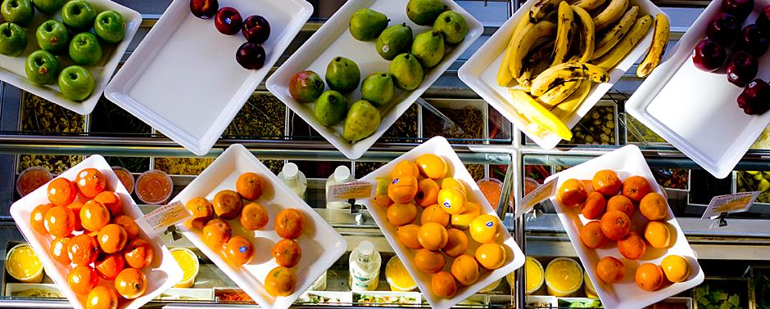
ERIN HAGER, PhD
ASSOCIATE PROFESSOR, DEPARTMENT OF POPULATION, FAMILY AND REPRODUCTIVE HEALTH, JOHNS HOPKINS BLOOMBERG SCHOOL OF PUBLIC HEALTH
MARY CURNUTTE, PhD, RD
NOPREN SCHOOL WELLNESS FELLOW
Impact of School Meal Policies:
Past, Present, & Future
JULIANA COHEN, ScD, ScM, RD
PROFESSOR & DIRECTOR OF THE CENTER FOR HEALTH INNOVATION, RESEARCH AND POLICY (CHIRP), MERRIMACK COLLEGE
ADJUNCT PROFESSOR, DEPARTMENT OF NUTRITION, HARVARD TH CHAN SCHOOL OF PUBLIC HEALTH
\\
Notes:
I will turn it over now to our presenters!

Slide 8
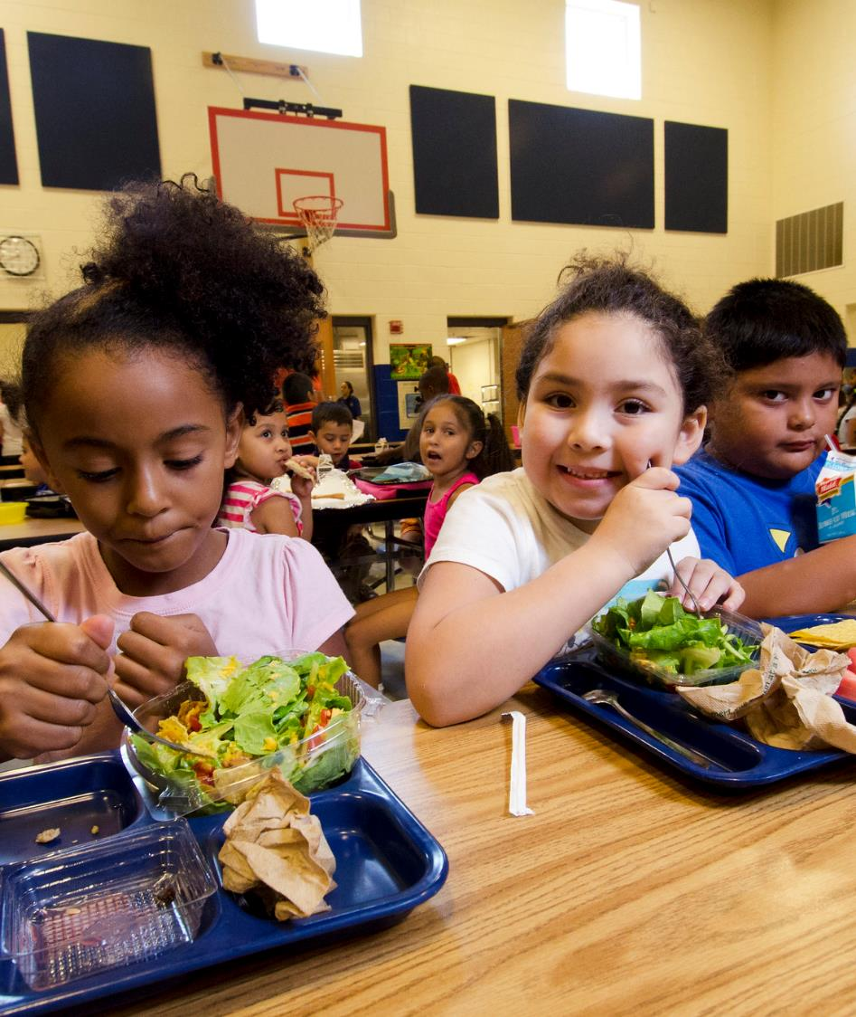
In what ways is food sold or provided to children at school?
(please respond in the chat)
Image: USDA FNS, Lance Cheung

Slide 9
In what ways is food sold or provided to children at school?
National School Lunch and Breakfast Programs
Snack foods sold in schools: cafeteria, school stores, vending machines, etc.
Federal Fresh Fruit and Vegetable Program
Celebrations
Rewards
After School: At-risk Snack and Supper Programs

Slide 10
Outline for Today
Background of School Meals
School Meal Policies
  HHFKA
  Universal Free School Meals
  Updated standards
Competitive Food Policies
Wellness Policies

Slide 11
Background: School Meal Milestones
1960s
School Breakfast Program
Summer Food Service Program
1990-2000s
Dietary Guidelines for Americans identifies inadequate intakes
Afterschool Snack and Supper Programs
Fresh Fruit and Vegetable Program
2020s
COVID-19 highlights school role in food security
Universal meals
Updated standards
1930s
Great Depression
Farm sustainability
Local meal programs
1946
Surplus commodities
National School Lunch Program
1970-1980s
Calls for privatization to fund
Private companies provide fast food
Program funding cut
2010s
Focus on child obesity and nutrition
Healthy, Hunger-Free Kids Act Nutrition standards for meals & competitive foods
Community Eligibility Provision

Slide 12
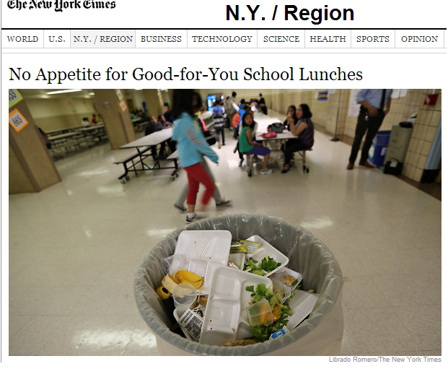
HHFKA: Updated Standards
Must Offer:
  Fruit (↑ portion size)
  Vegetable (variety / ↑ portion size)
  (Whole) Grains
  Milk (skim or 1% / limited chocolate milk to skim)
  Meat/meat alternative
  Limits on sodium, saturated fat, calories (minimum and maximum values)
Must Serve:
  3 meal components (including a fruit or vegetable)

Slide 13
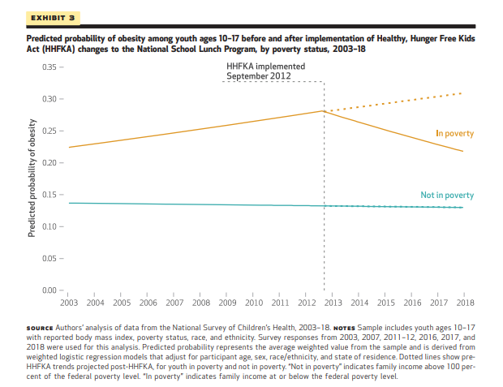
Impact of the HHKFA on child obesity
Impact of the HHKFA on child obesity

Slide 14
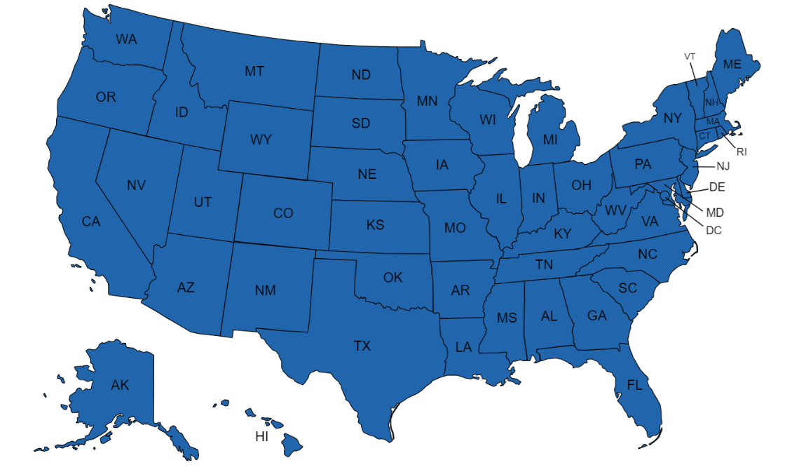
Universal Free School Meals (UFSM)
During COVID (2021-22SY): National UFSM

Slide 15
Universal Free School Meals (UFSM) Question
During COVID (2021-22SY): National UFSM
Question (Chat Box): What states CURRENTLY have UFSM?

Slide 16
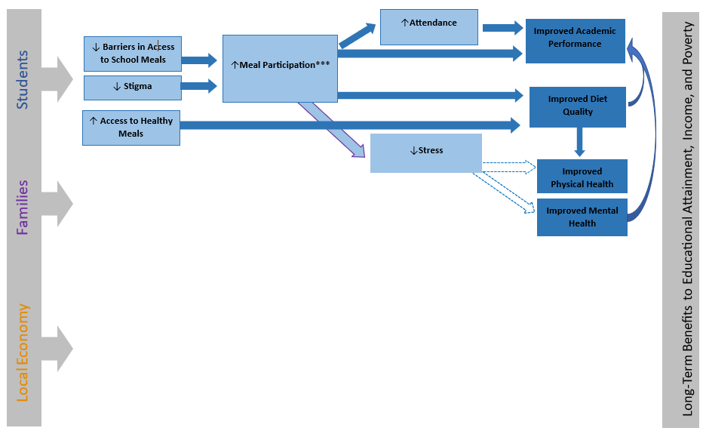
Benefits of UFSM

Slide 17
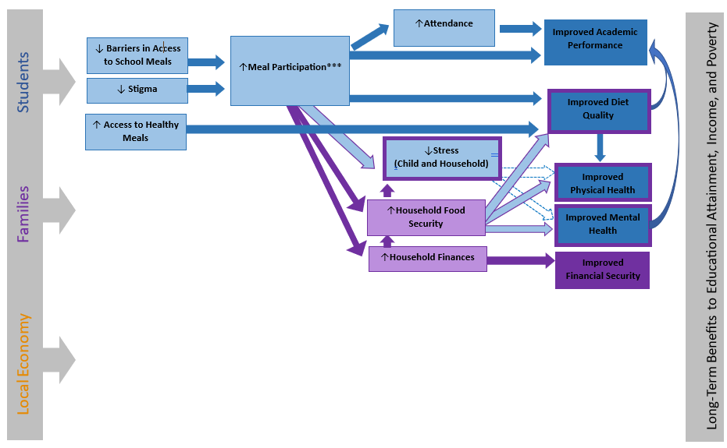
Benefits of UFSM cont.

Slide 18
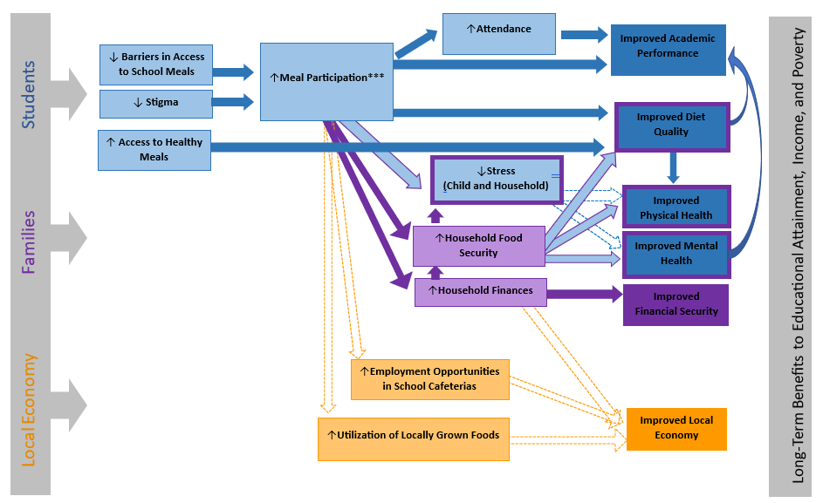
Benefits of UFSM cont..

Slide 19
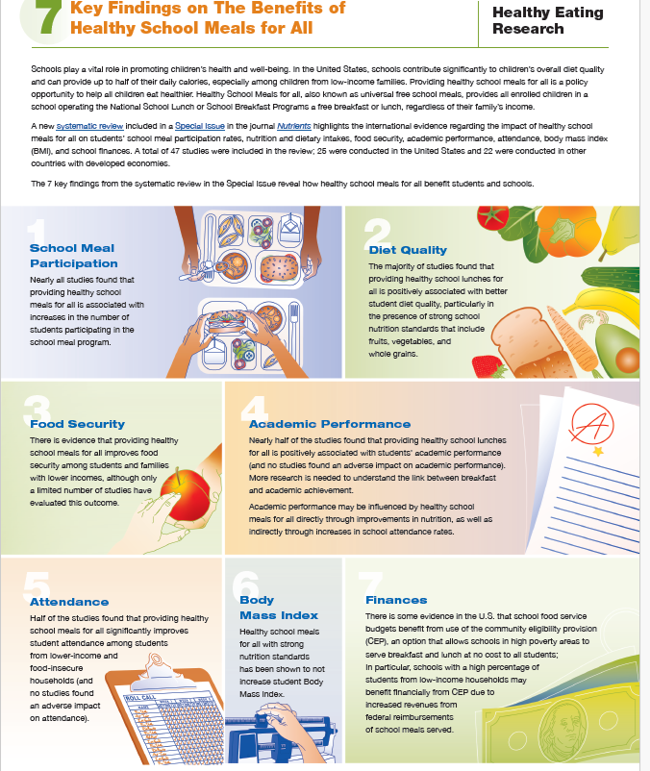
Benefits of UFSM: Evidence from an International Systematic Review
Source: Cohen JF, Hecht AA, McLoughlin GM, Turner L, Schwartz MB. Universal school meals and associations with student participation, attendance, academic performance, diet quality, food security, and body mass index: A systematic review. Nutrients. 2021 Mar 11;13(3):911.

Slide 20
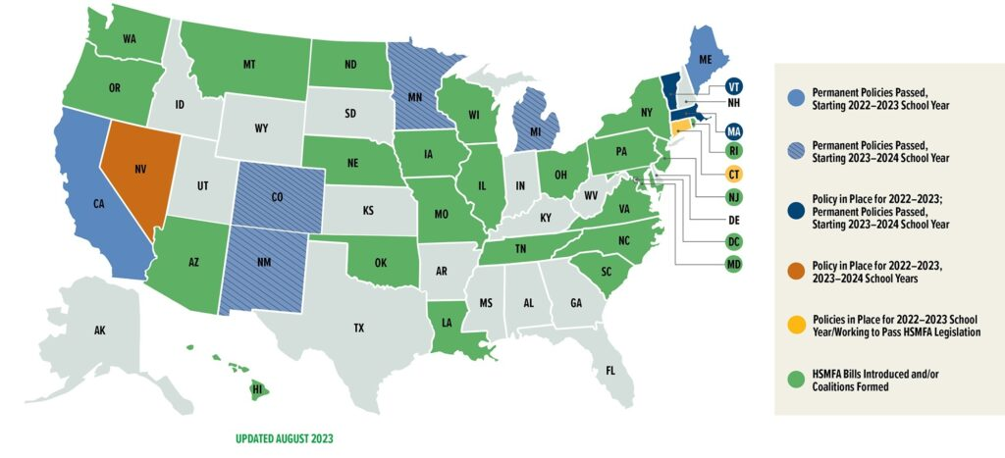
Universal Free School Meals (UFSM) Map
State-level UFSM: Current

Slide 21
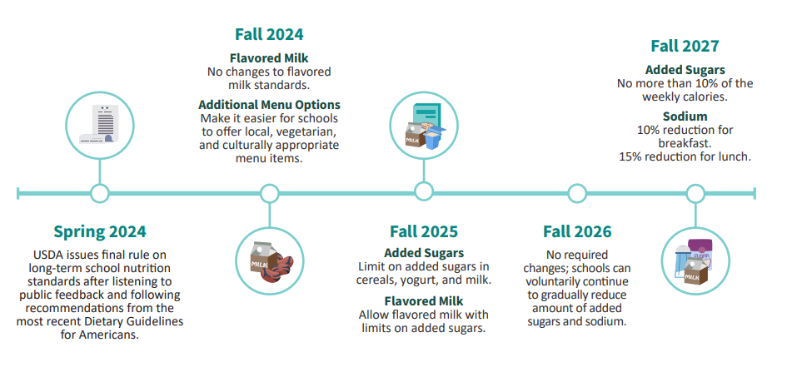
Updated School Meal Standards

Slide 22
What do you think are the biggest contributors of added sugar and sodium?
Biggest Contributors of Added Sugar in School Meals
Biggest Contributors of Sodium in School Meals

Slide 23
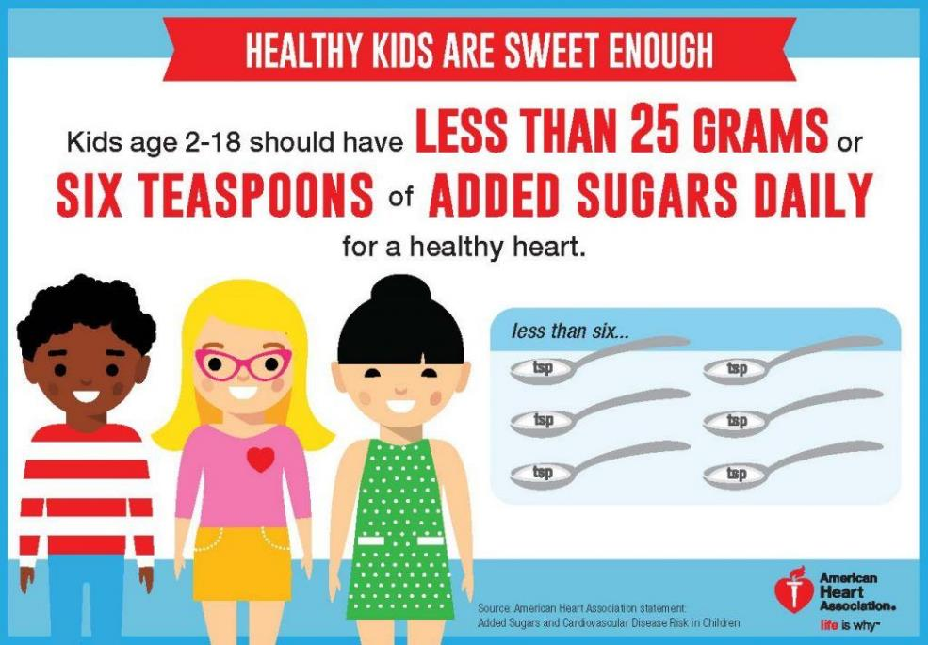
Why the focus on added sugars?

Slide 24

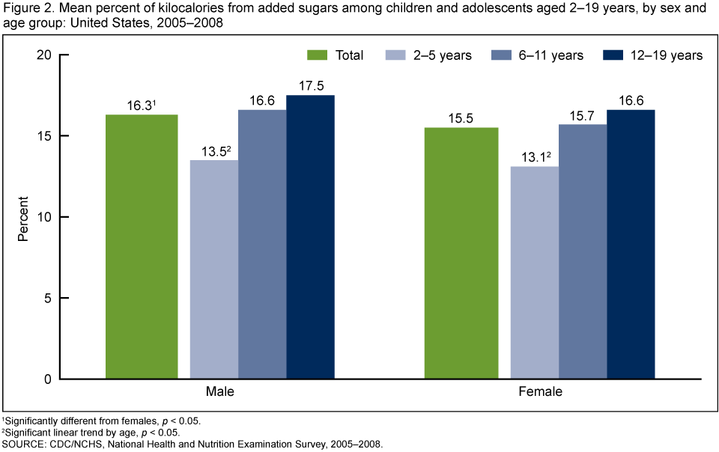
Why the focus on added sugars? (cont)
Two-thirds of school-aged children currently exceed the Dietary Guidelines for Americans (DGA) recommended daily limits for added sugars (<10% of total energy per day).

Slide 25
Why the focus on sodium?
What is recommended for sodium?

Slide 26
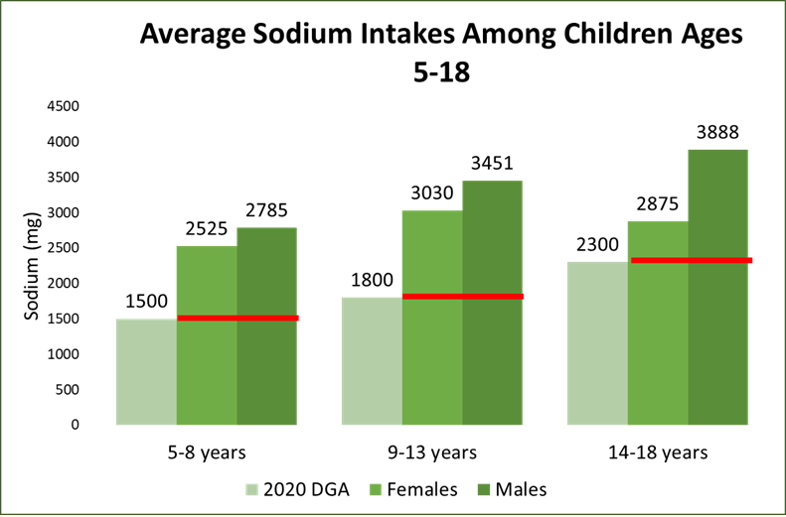
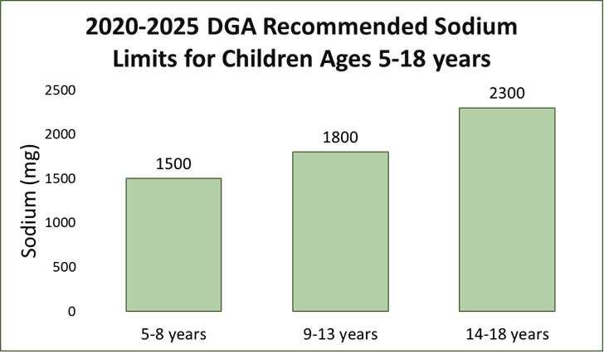
Why the focus on sodium? (cont)
What is actually consumed by children for sodium?

Slide 27

Why the focus on sodium? (cont.)
15% of US children have high blood pressure, which can be lowered in part by a healthy diet, including less sodium

Slide 28

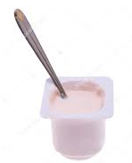
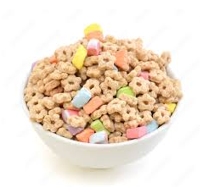
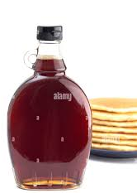
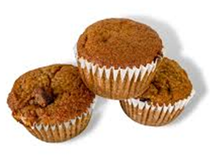
Biggest contributors of added sugar and sodium
Biggest Contributors of Added Sugar in School Meals
Biggest Contributors of Sodium in School Meals
Source: Centers for Disease Control and Prevention: Sodium and Children

Slide 29
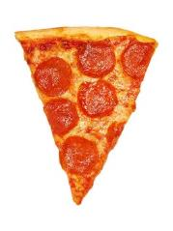
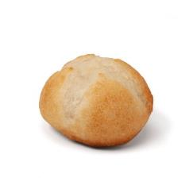

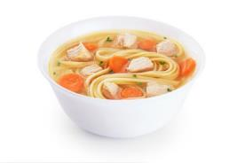

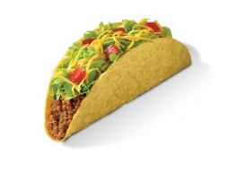
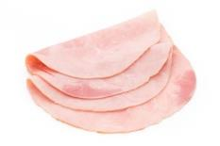
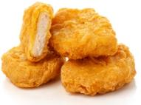
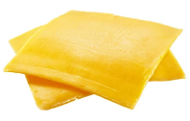
Biggest contributors of added sugar and sodium (cont)
Biggest Contributors of Added Sugar in School Meals
Biggest Contributors of Sodium in School Meals
Source: Centers for Disease Control and Prevention: Sodium and Children

Slide 30
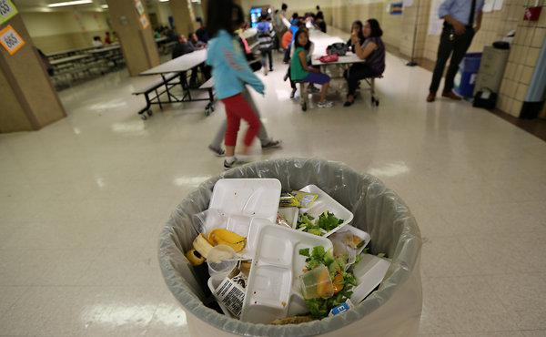
Will Kids Eat Healthier Meals?
Food is only “healthy” if kids actually eat it!

Slide 31
Will Kids Eat Healthier Meals? (cont)
Some good news…
The majority of school meals are already in compliance with the updated standards!
And our research has found that kids are eating them!
Chapman LE, Richardson S, Harb AA, Fear E, Daly TP, Olarte DA, Hawley M, Zukowski E, Schwartz C, Maroney M, Cohen JF. Nutrient content and compliance with sodium standards in elementary school meals in the United States pre-and post-COVID-19. Nutrients. 2022 Dec 19;14(24):5386.
Cohen JF, Richardson S, Roberto CA, Rimm EB. Availability of Lower-Sodium School Lunches and the association with selection and consumption among Elementary and Middle School Students. Journal of the Academy of Nutrition and Dietetics. 2021 Jan 1;121(1):105-11.

Slide 32
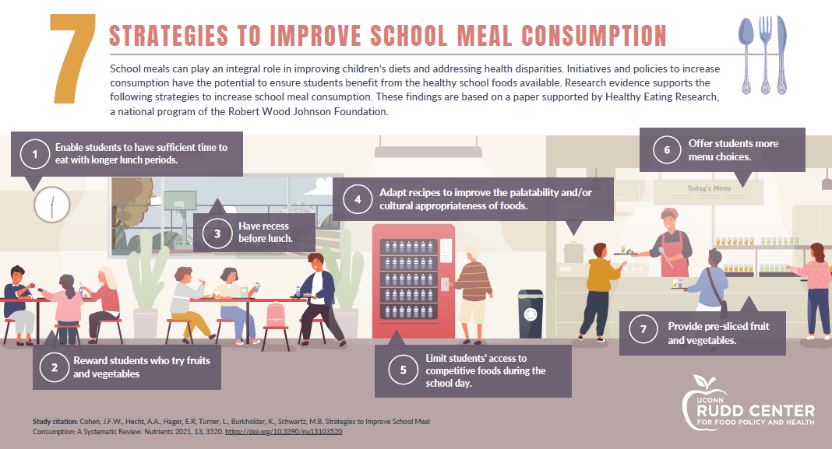
Policies to Reduce Food Waste

Slide 33

HHFKA: Smart Snacks in School
What happened when Smart Snacks went into effect in 2014?

Slide 34
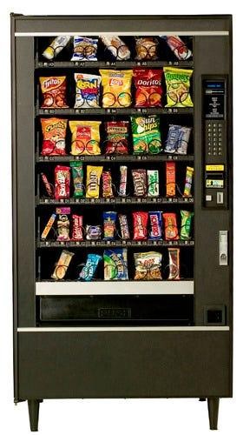
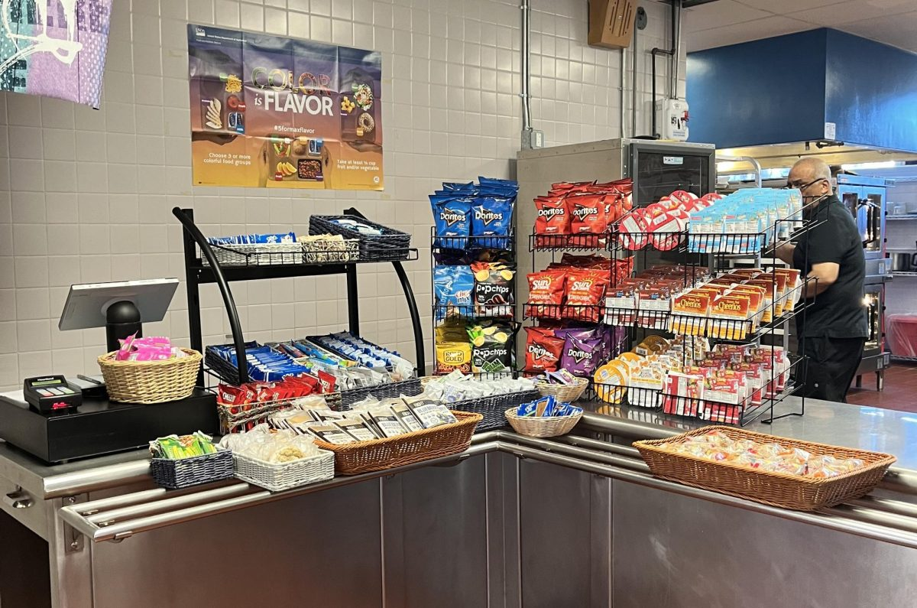
Competitive Foods “Compete” with School Lunch

Slide 35

HHFKA: Competitive Foods impact on diet
Our research has found:
  Students select AND eat more of their healthier school meals when there is limited access to competitive foods
  Student eat less of the unhealthy food outside of school when they eat a healthy school lunch
% Selection
* P<0.001
Cohen JF, Findling MTG, Rosenfeld L, Smith L, Rimm EB, and Hoffman JA, 2018. The impact of 1 year of healthier school food policies on students’ diets during and outside of the school day. JAND, 118(12), pp.2296-2301.

Slide 36
HHFKA: Smart Snack Standards impact on Competitive Food Availability
Our research has found:
  School offered fewer competitive foods after Smart Snacks Standards Implementation
Curnutte, Mary E., "Analyzing the association of competitive food policy on competitive food content in U.S. schools." (2025). Electronic Theses and Dissertations. Paper 4527. Retrieved from https://ir.library.louisville.edu/etd/4527

Slide 37
HHFKA: Smart Snack Standards impact on Competitive Food Availability (cont)
Our research has found:
  Competitive food offerings in schools decreased, especially items high in added sugar, fat, salt, and calories—aligning with the goals of Smart Snack Standards
Curnutte, Mary E., "Analyzing the association of competitive food policy on competitive food content in U.S. schools." (2025). Electronic Theses and Dissertations. Paper 4527. Retrieved from https://ir.library.louisville.edu/etd/4527

Slide 38
HHFKA: Smart Snack Standards impact on Competitive Food Availability (cont.)
Our research has found:
  Smaller decreases were seen in fruits and vegetables
  Schools with existing state-level competitive food policies also saw decreases in unhealthy food availability.
    Smart Snack Standards enhanced the effects of existing policies rather than replacing them
Curnutte, Mary E., "Analyzing the association of competitive food policy on competitive food content in U.S. schools." (2025). Electronic Theses and Dissertations. Paper 4527. Retrieved from https://ir.library.louisville.edu/etd/4527

Slide 39
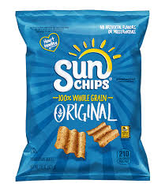
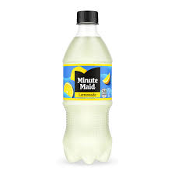
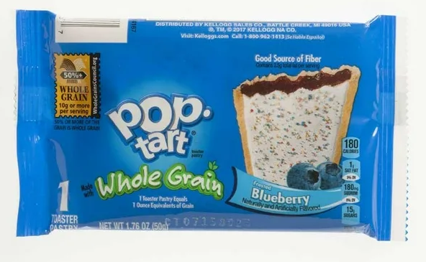
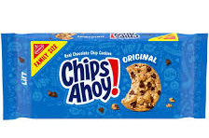
Impact of HHFKA on nutrients in competitive foods
Question (Chat Box): Which competitive food is Smart Snacks Standards complaint?

Slide 40
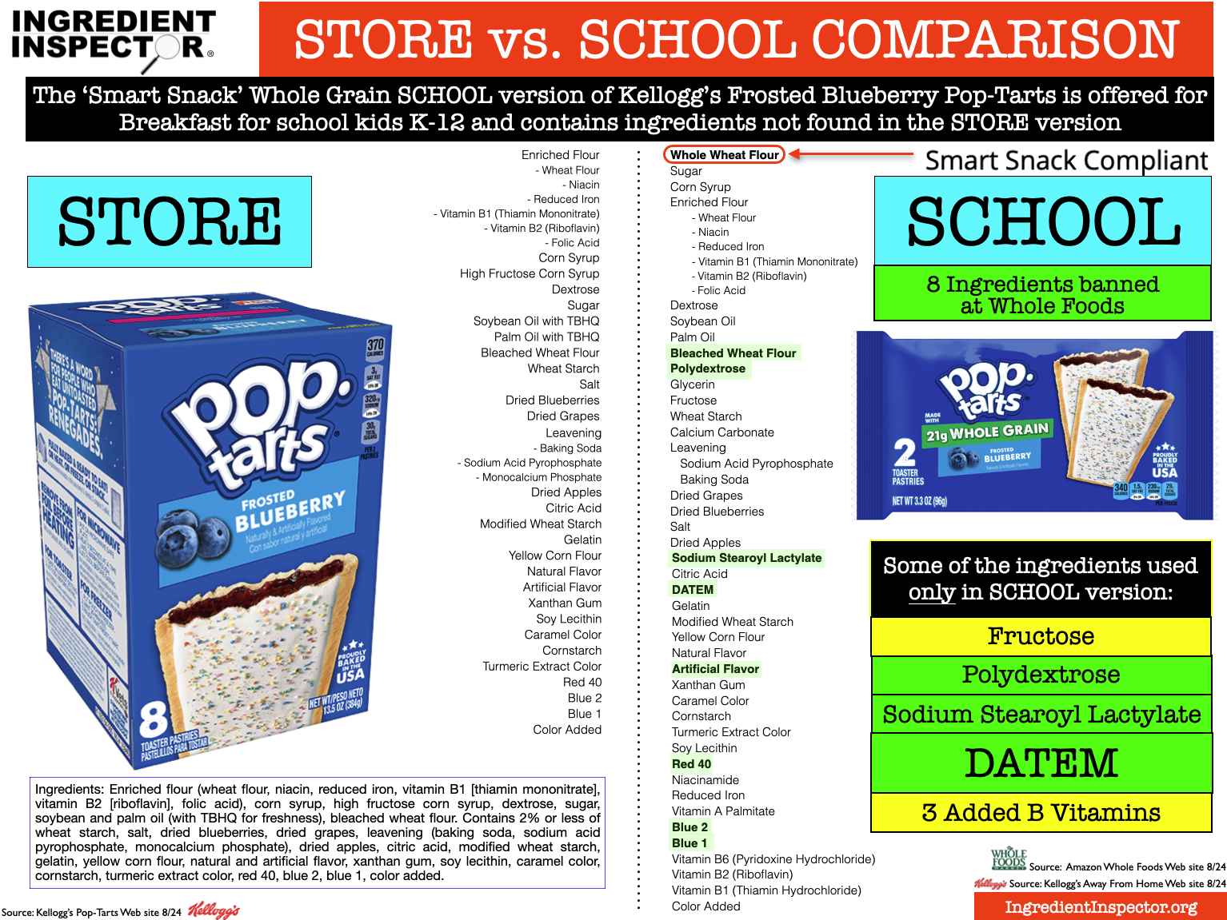
Impact of HHFKA on nutrients in competitive foods (cont)
https://www.ingredientinspector.org/home/smart-snacks-school-pop-tarts

Slide 41
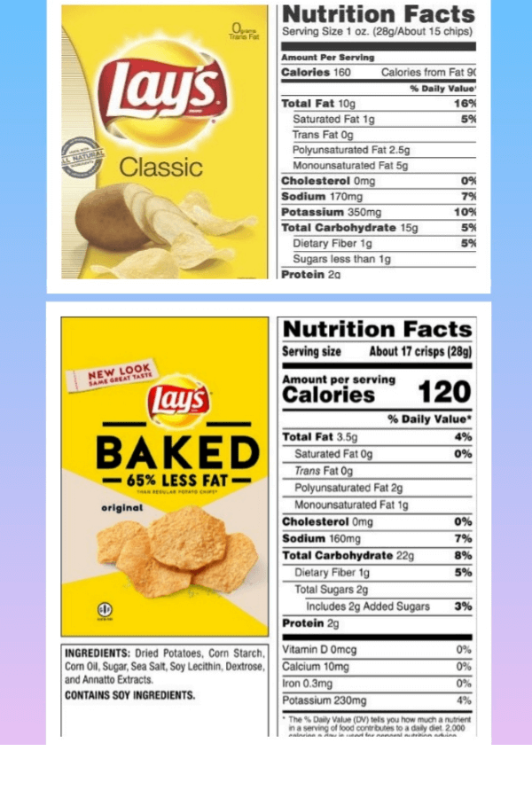
Impact of HHFKA on nutrients in competitive foods (cont.)

Slide 42

Impact of HHFKA on nutrients in competitive foods (cont..)
↓ calories, saturated fat, sodium, and sugar
↑ Fiber
17% of products were reformulated before the standards went into effect in 2014!
Jahn JL, Cohen JF, Gorski-Findling MT, Hoffman JA, Rosenfeld L, Chaffee R, Smith L, Rimm EB. Product reformulation and nutritional improvements after new competitive food standards in schools. Public health nutrition. 2018 Apr;21(5):1011-8.

Slide 43
HHFKA: Competitive Foods impact on diet (cont).
Our research has found:
  Students select AND eat more of their healthier school meals when there is limited access to competitive foods
  Student eat less of the unhealthy food outside of school when they eat a healthy school lunch
Average # Snacks
* P<0.001
Cohen JF, Findling MTG, Rosenfeld L, Smith L, Rimm EB, and Hoffman JA, 2018. The impact of 1 year of healthier school food policies on students’ diets during and outside of the school day. JAND, 118(12), pp.2296-2301.

Slide 44
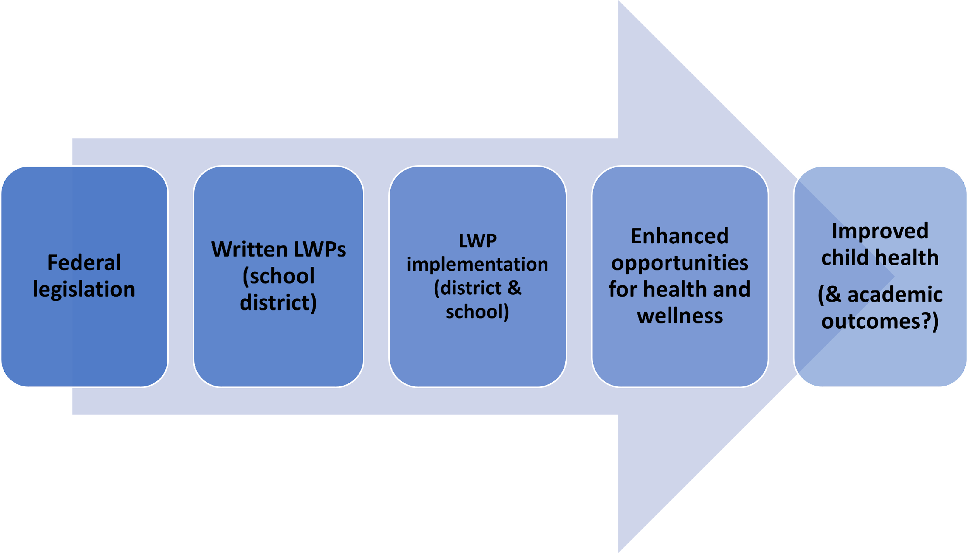
Local Wellness Policies (LWPs)
District policies established via Child Nutrition Reauthorization Act of 2004 (PL 108-265, Section 204)
Required to be in place by start of 2006-07 school year

Slide 45
Local Wellness Policies (LWPs) (cont)
Healthy Hunger-Free Kids Act Local Wellness Policy Implementation Final Rule (July 2017):
Content of Wellness Policy
Wellness Leadership
Enhanced Documentation
Public Updates
Monitoring/Oversight
Triennial Assessments***
District policies established via Child Nutrition Reauthorization Act of 2004 (PL 108-265, Section 204); required to be in place by start of 2006-07 school year

Slide 46
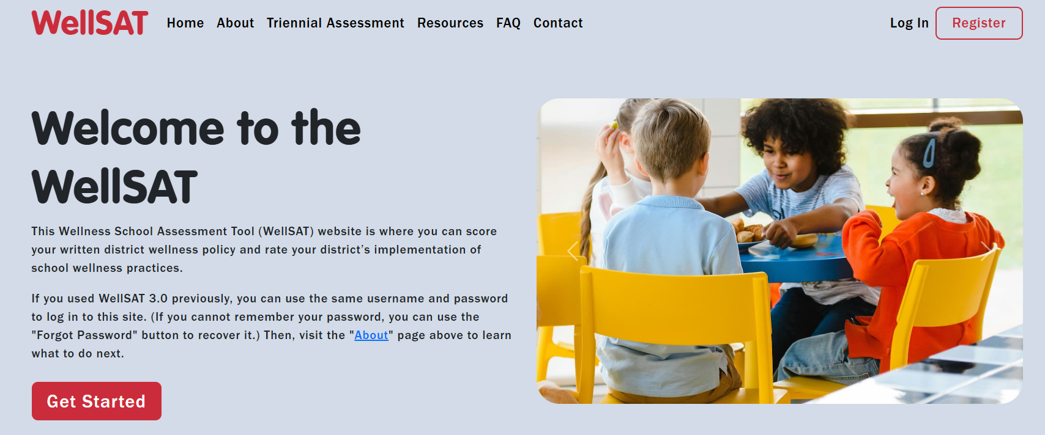
Triennial Assessment
Great resource: Wellness School Assessment Tool (WellSAT)
Due in 2020/2021, 2024, 2027…. And so on
Three components:
  Comparison with a model policy
  LWP compliance (among 100% of district schools)
  LWP goals; progress in meeting past LWP goals
Triennial assessment results MUST be made available to the public!
https://www.wellsat.org/home
Notes:
Not everyone is on the same schedule

Slide 47
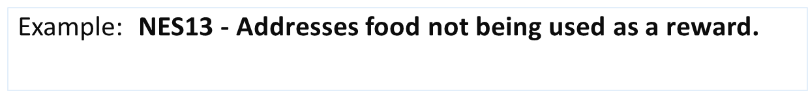
Comparison with a Model Policy: WellSAT Policy Assessment
0 | Not mentioned OR only allows healthy food to be used as a reward.
1 | Discourages food as a reward. | Examples: "…strongly discourage the use of food/beverages as a reward or punishment.” “ …will encourage non-food alternatives as rewards.” “Food should not be used as a reward.”
2 | Prohibits teachers or staff from using food as a reward. | Examples: "Food rewards or incentives shall not be used in classrooms to encourage student achievement or desirable behavior.” “The use of food or candy as a classroom reward in any school is prohibited.” “Schools will not use food or beverages as rewards for academic, classroom, or sports performances.”
Section 1: Federal Requirements
Section 2: Nutrition Environment and Services
Section 3: Nutrition Education
Section 4: Physical Education and Physical Activity
Section 5: Employee Wellness
Section 6: Integration and Coordination
https://www.wellsat.org/home
Notes:
Prohibition of food as a reward with the exception of Individualized Academic Plans (IAP) or Individualized Education Plans (IEP) should be rated “2.”

Slide 48
LWP Compliance
No standardized tool
WellSAT Practice Assessment
State or District-specific Assessments
  Example: Maryland

Slide 49
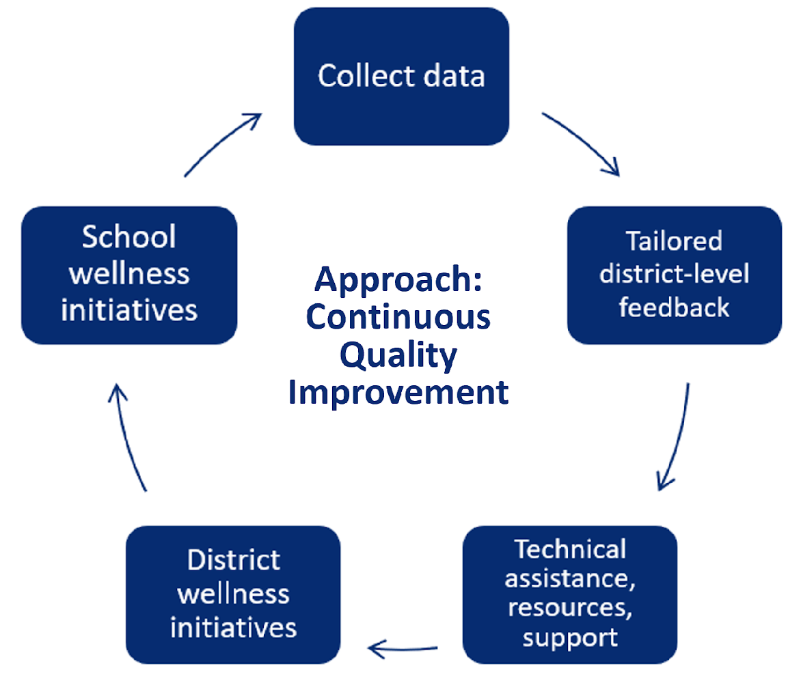
Maryland Wellness Policies and Practices Project (MWPPP)
Overall goal: to enhance opportunities for healthy eating and physical activity for Maryland students by helping schools and school districts create and implement strong and comprehensive written LWPs
Focus: Quality, Implementation, and Impact of LWPs
State-Wide Initiative: 2012-2020
Partnerships: Maryland Departments of Education & Health, 24 School Districts
Supported the first triennial assessment

Slide 50


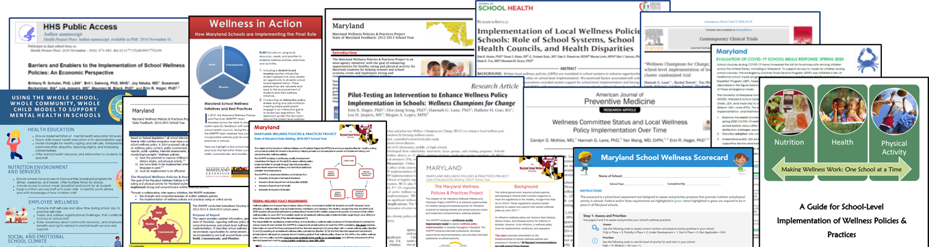
Key Lessons Learned from the MWPPP
Importance of school-based wellness teams in supporting LWP implementation
Intervening to support the development of school-based wellness teams can improve LWP implementation (Wellness Champions for Change)

Slide 51
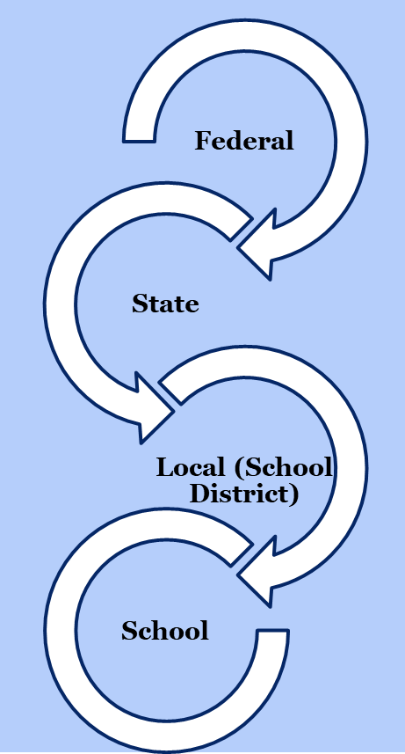
LWP Research & Practice Next Steps
Practitioners, Parents, Community Members:
  Read your School District’s LWP & Triennial Assessment Report
  Find out about your State or School District School Health Council & consider joining
  Find out if your school has a wellness team. If so, ask to join. If not, consider starting one!
Consider joining the CDC NOPREN/PAPREN School Wellness Working Group
Triennial Assessment: research & practice opportunities!
Visit our website for measures and resources: www.marylandschoolwellness.org
  Data analysis and paper writing opportunities!

Slide 52
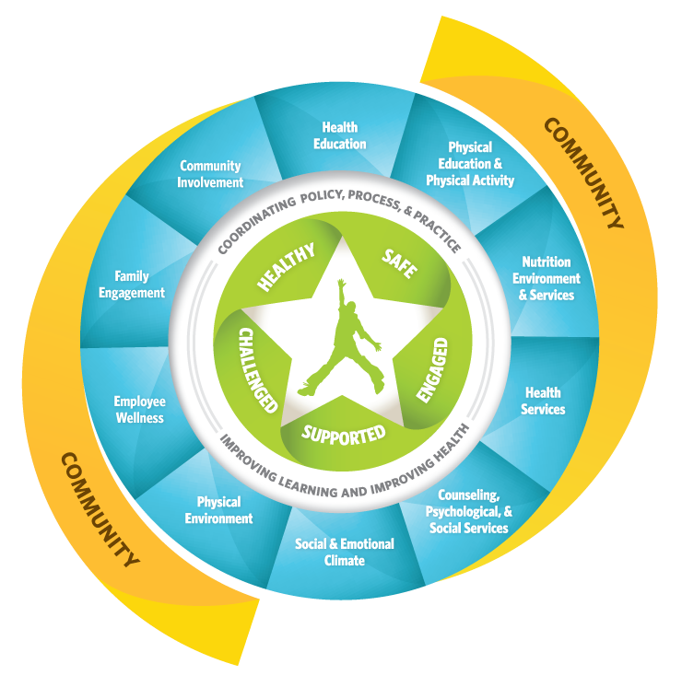
What is missing?
Policies for the
“Whole Child”:
Whole School Whole Child, Whole Community Model (WSCC)

Slide 53
CONCLUSIONS
  Strong evidence that:
    Strong meal standards has led to improvements in school meal quality and positive outcomes for students
    UFSM promotes school meal participation, which can have important implications for children, families, and schools.
    Smart Snack Standards are correlated with a healthier school food environment and healthier student food choice
    Local Wellness Policies contribute to healthier school environments

Slide 54

Thank you
https://www.childnourishlab.org/healthy-school-meals-for-all

Slide 55
Q&A

Slide 56
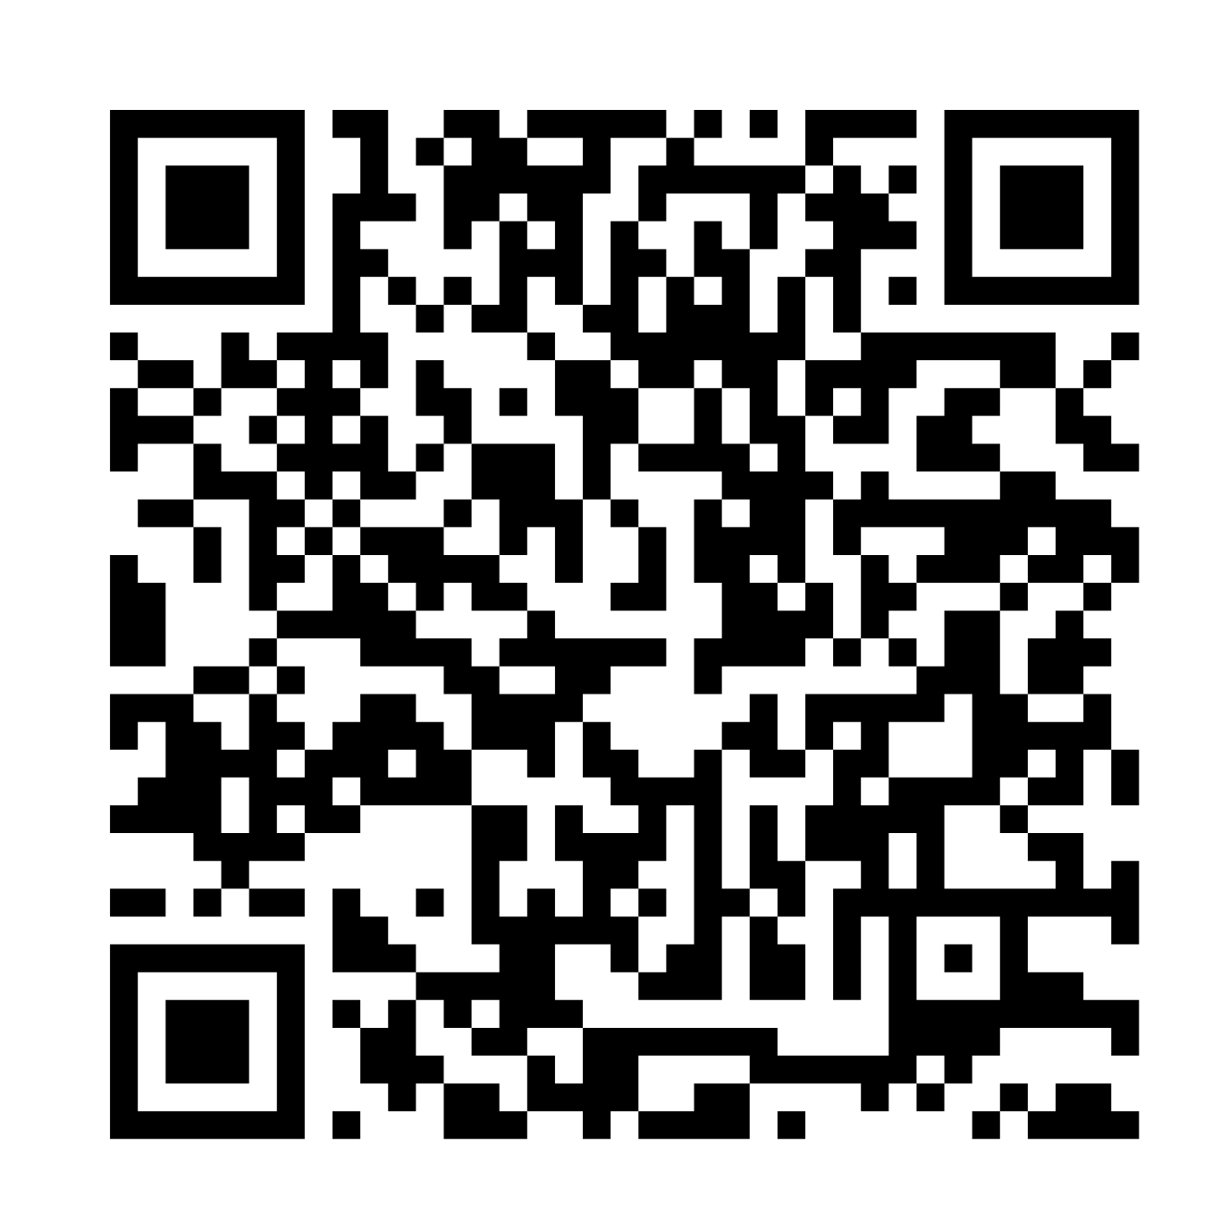
Announcements
Join us for the next session of the speaker series!
Wednesday, July 23rd at 4pm-5pm ET
  “Building Resilient Food Systems”
Reminder: Student Presentation and Poster
Applications due July 18th!
To view past recordings, scan QR code below
Notes:
Thank you all so much for attending the first session of the Summer Speaker Series! Our next session will be in two weeks on July 23rd and we will be hearing building resilient food systems.
We also wanted to put another final plug in for the student presentation and poster sessions. Please consider applying by July 18th for this amazing opportunity!
You can scan the QR code on the right to view past recordings and slides.
______________________

Slide 57
Optional Breakout Rooms
Discuss current policy research opportunities and/or challenges related to today's topic. What are the opportunities/challenges at the local, state, and federal levels?
What are the considerations for practitioners (i.e., healthcare providers, school districts, SNAP or WIC agencies) implementing programs or policies discussed today? What do we still need to know to implement and scale these programs or policies?
Discuss how you've interacted with this topic in your professional career (i.e., current coursework, study, grant).
What are you currently working on that's exciting you?
What advice/questions do you have for people in your breakout?
Notes:
Now, we wanted to offer the optional opportunity for those that may be interested in some more in depth conversation about today’s topic to stay on for the remainder of our time to participate in our breakout rooms. We may either stay together as one large group or split into smaller groups depending on attendance. We have some questions here to guide the conversation or you can ask your own!

