Slide 1

Summer Speaker Series for Students
2025
(The contents and findings of this presentation are those of the speakers and do not represent the official views of the Centers for Disease Control & Prevention or Department of Health and Human Services.)
Notes:
Hello Everyone! We want to welcome you back for the fifth session of the HER NOPREN Summer Speaker Series for Students. It is hard to believe it is flying by so quickly! My name is Jennifer Tong and I am with the Nutrition and Obesity Policy Research and Evaluation Network Coordinating Center at the University of California San Francisco.
Please note: The contents of these sessions are those of the speakers and do not represent the official views of the Centers for Disease Control & Prevention or Department of Health and Human Services.

Slide 2


Getting Started!
Update your name on Zoom, if needed
  Right click on your Zoom box, click “rename”
Type your name and institution into the chat box!
  Question: Which best describes you?
    Ex. Undergraduate Student, Dietetic Intern, Masters Student, Doctoral Student, Post Doc, Public Health Practitioner, Researcher/Professor, Other
Remember to keep yourself on mute.
Type your questions into the chat box.
Notes:
Per usual, we would like to start with some housekeeping items!
To get a sense of who is joining us today, we ask that you introduce yourselves in the chatbox and include your name, institution or affiliation, and how best you describe.
Just a reminder to keep yourself on mute during the duration of the presentation. You may come off mute toward the end when we have Q&A.
That being said, we do encourage an active chat box. Please use the chat box to input questions and comments for the speakers.

Slide 3
NOPREN HER Summer Series for Students
Explore various public health topics related to:
  Food and nutrition security
  Federal, state, and local policy
  Strategies to support young children’s health
  And more!
This series is a collaborative effort of Healthy Eating Research (HER) and Nutrition and Obesity Policy Research and Evaluation Network (NOPREN).
Notes:
As a reminder, the HER NOPREN Summer Speaker Series, which started 6 years ago, is a place for HER and NOPREN to utilize our platforms and networks to reach students and early career professionals who are interested in food and nutrition and provide a series that gives a comprehensive overview over several topics essential to policy, systems, and environments that are impacting public health nutrition related policy research.
This series is put on jointly and is a collaborative effort of Healthy Eating Research (HER) and the Nutrition and Obesity Policy Research and Evaluation Network (NOPREN).

Slide 4
NOPREN HER Summer Series for Students Schedule
The series will take place on Wednesdays from
4:00 - 5:00 pm EST
Schedule and Topics
June 11: Policy, Systems, and Environmental (PSE)
Strategies to Support Young Children’s Diet and Health
June 25: Federal, State, and Local Nutrition Policy Updates
July 9: Food Policies in Schools
July 23: Building Resilient Food Systems
August 6: Interventions to Improve Food and Nutrition Security
August 13: Student Presentations
For more information or to watch past recordings, visit: https://nopren.ucsf.edu/her-nopren-summer%C2%A0speaker-series-students-2025
Notes:
This biweekly series has been held on Wednesdays at 4-5pm Eastern. Today, we will take a look at Interventions to Improve Food and Nutrition Security.
Our last session is next week and will be our student presentations! Please note that this is next week. We will not be taking our week break. Selected students will present on research or a project that they have worked on over the summer.
For more information about the series or watch past recordings, please visit the link on the slide. We will drop the link in the chat for easy access.

Slide 5
Session 5: Interventions to Improve Food and Nutrition Security
Notes:
Today we are excited to be joined by Dr. Hilary Seligman, Dr. Jennifer Garner, and Ida Doutt and to present on Interventions to Improve Food and Nutrition Security
Hilary Seligman, MD, MAS: Dr. Hilary Seligman is Professor at the University of California San Francisco with appointments in the Departments of Medicine and of Epidemiology and Biostatistics. She is an expert in food insecurity and its health implications across the life course. Her research focuses on the intersection between food insecurity in the US and health, particularly the prevention and management of chronic disease. She has led the NOPREN Coordinating Center since 2014, co-directs UCSF's IMPACT Program, founded Vouchers 4 Veggies, a healthy food voucher program headquartered in San Francisco, and directs the National Clinician Scholars Program at UCSF.
Jennifer Garner, PhD, RD: Dr. Jennifer Garner is a registered dietitian and community-engaged nutrition interventionist. She is focused on co-creating and evaluating programs designed to support biological, social, and community health with a particular focus on food and nutrition security. Dr. Garner’s team, The Garner Research Group, leverages a diverse set of methods to conduct such research, integrating quantitative and qualitative data toward unique insights. The ultimate aim of this research is to inform clinical and community practice and policies related to nutrition, food systems, and community development.
Ida Doutt lives in Athens, Ohio, and is the healthcare liaison for the SE Ohio Produce Prescription working group, a collaborative initiative in association with Rural Action, Hopewell Health Centers, the Southeast Ohio Foodbank, The Garner Research Group, and other regional and state partner organizations and institutions. Ida has a BS in Human Nutrition (DPD) from Ohio State and has worked in various capacities in health insurance, foodservice, and community-based social and mental health services.

Slide 6

Food is medicine
Food is Medicine:
What Do We Know?
Where Are We Going?
Hilary Seligman MD MAS
Professor of Medicine and of Epidemiology & Biostatistics, UCSF
UCSF Center for Vulnerable Populations

Slide 7
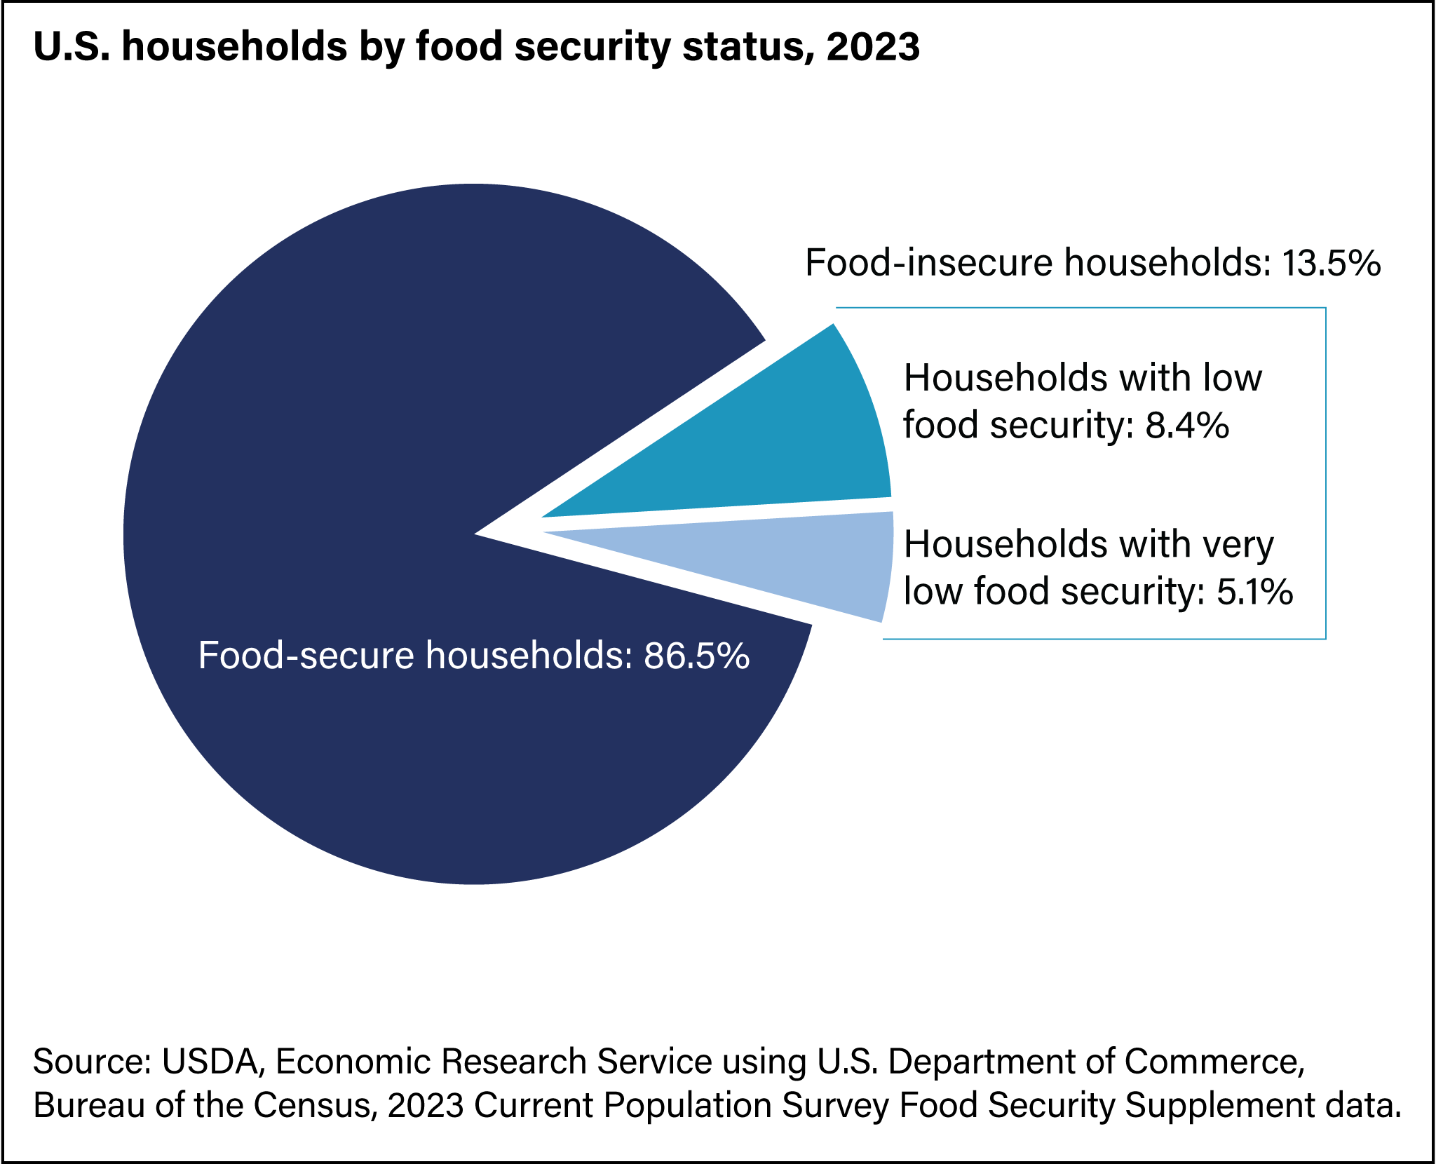
1 in 7 US Households Food Insecure in 2023

Slide 8
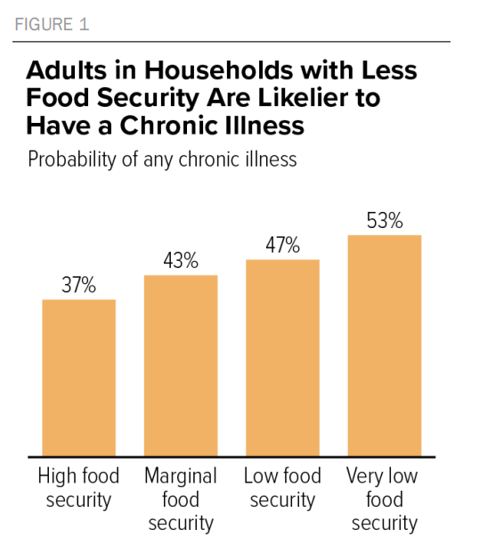
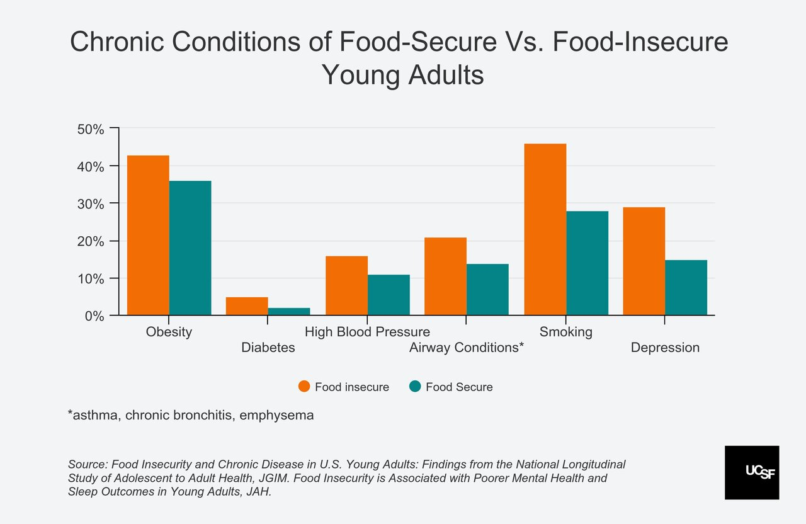
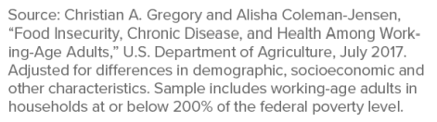
graphs

Slide 9
Food insecurity and poor health
Food Insecurity
Poor Health
Johnson, Palakshappa, Seligman. Health Services Research, 2021.

Slide 10
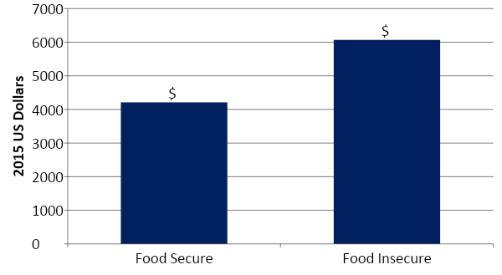
Food Insecurity &
Subsequent Annual Health Care Expenditures
$ 1863
NHIS-MEPS data adjusted for: age, age squared, gender, race/ethnicity, education, income, rural residence, and insurance.
Berkowitz, Basu, and Seligman. Health Services Research: 2017.

Slide 11
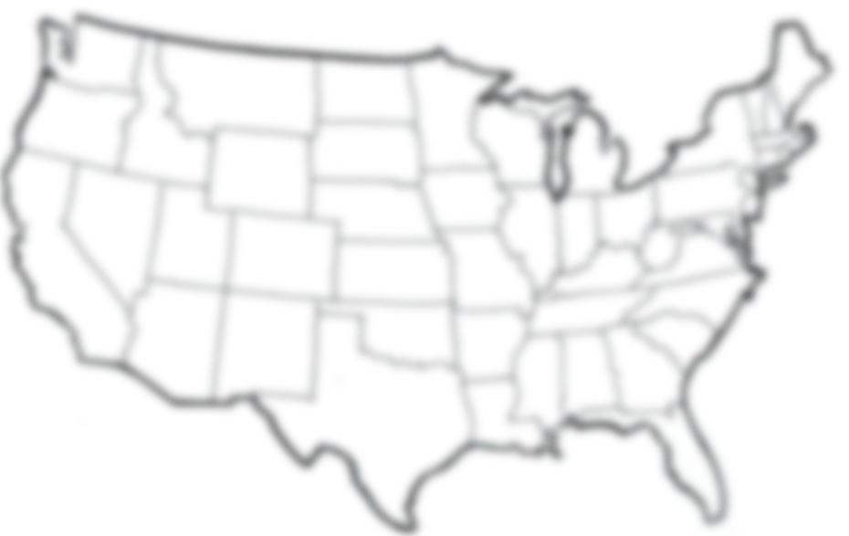
$77.5 billion additional health care expenditures annually
Berkowitz, Basu, and Seligman. Health Services Research: 2017.

Slide 12
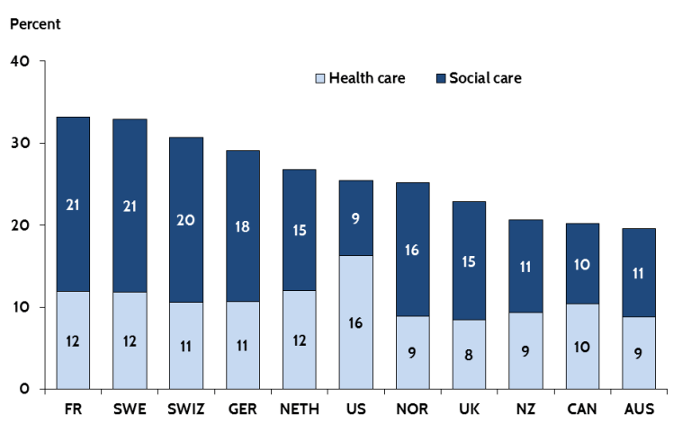
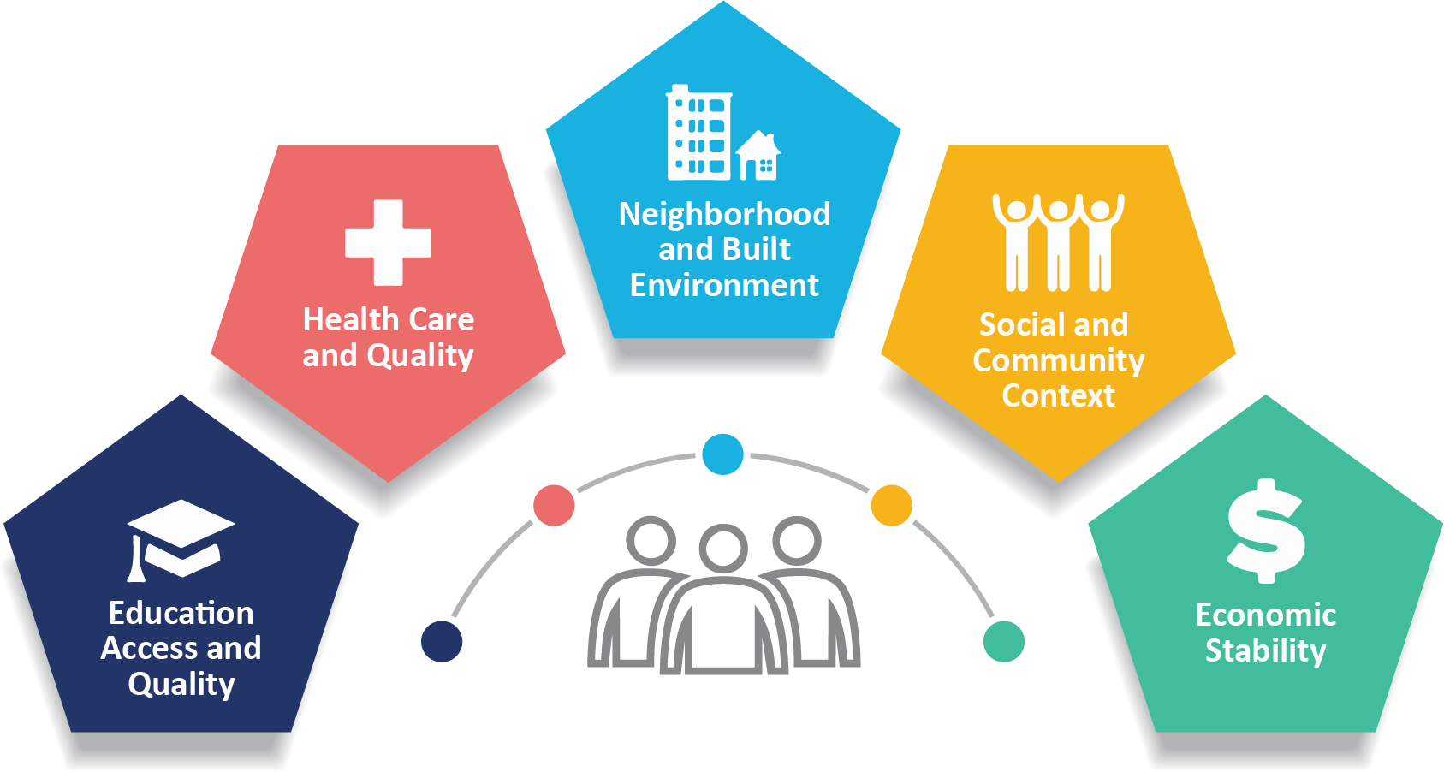
Mis-Alignment Between Health Care & “Social Care” in the US
These is the downstream impact of policies we have put into place.
Figure 1. Health and Social Care Spending as a Percentage of GDP
https://www.cdc.gov/public-health-gateway/php/about/social-determinants-of-health.html Accessed 8/1/2025.
Rebalancing Social & Medical Spending to Promote Health. Butler et al. Brookings Institution. 2017
Notes:
HC sector becoming engaged in SDH and recognizing that this mismatch betwn health care and social care in the US, but it hasn’t been immediately obvious how the HC sector should engage in this challenge

Slide 13
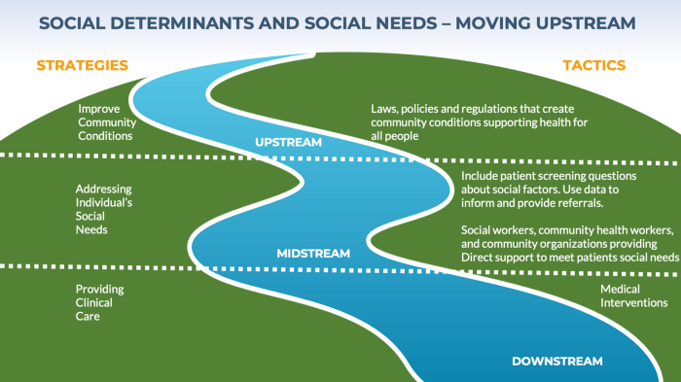
Social determinants
Social Drivers of Health
Social Needs
“Meeting Individual Social Needs Falls Short Of Addressing Social Determinants Of Health,” Health Affairs Blog, January 16, 2019. DOI: 10.1377/hblog20190115.234942

Slide 14
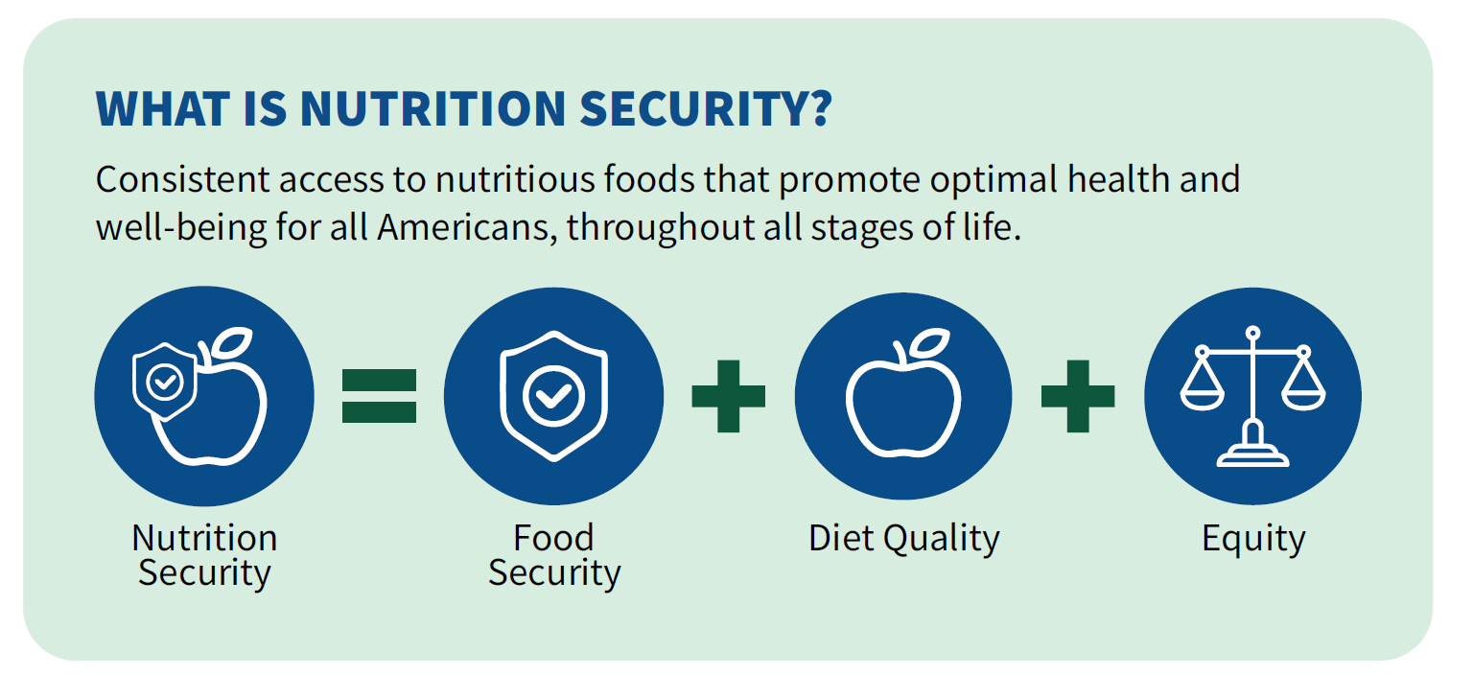
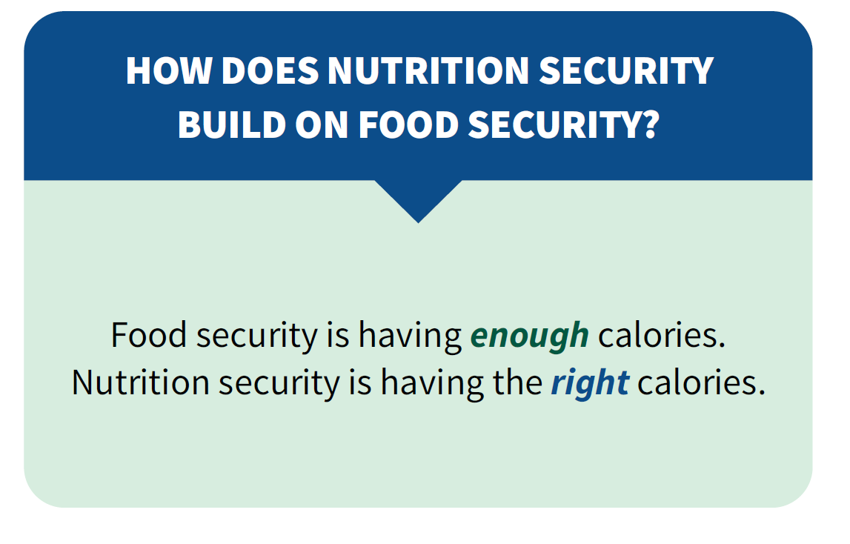
Nutrition security vs food security
Nutrition Security vs Food Security (simplified)
https://www.fns.usda.gov/resource/usda-actions-nutrition-security
Note that this citation is provided for historical reference and is no longer active. This graphic does not represent the official position of USDA.

Slide 15


Food is medicine def
Food is Medicine Definition
Integration of specific food and nutrition interventions in, or in close collaboration with, the health care system
Target population
  People with or at high risk for certain health conditions (often diet-related)
  People with or at high risk of food insecurity

Slide 16

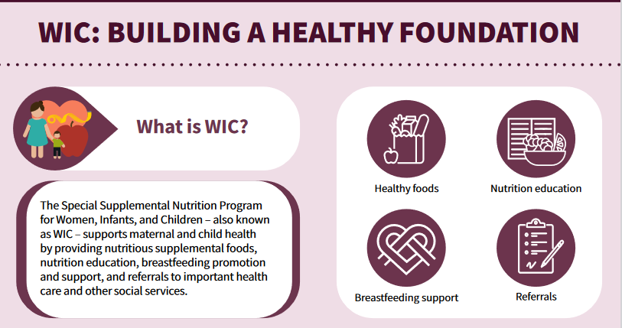
Largest FIM Program
Largest FIM Program
Can FIM programs be scaled?
PROVEN
Can FIM programs impact short and long term health outcomes?
PROVEN

Slide 17






Theory of Change
Data transfer between sectors (health care, CBO, & food vendor)
Data tracking within the electronic health record
CBO capacity to provide food how, when, where and at the price that healthcare desires
Fragmentation of the ecosystem outside of healthcare
Identification of food insecurity by positive clinical screen
Referral to FIM program
Enrollment in FIM program
Improved diet quality, food security, and satisfaction
Improvement of health and utilization outcomes

Slide 18
Spectrum of fim programs
Spectrum of FIM Programs
From the perspective of health care
Clinical Screen for Food Insecurity
MTM=Medically Tailored Meals
MTG=Medically Tailored Groceries
SNAP=Supplemental Nutrition Assistance Program
“On-Site” Programs
Community Programs
Federal Nutrition Programs
Food pantry in clinic
MTM’s/MTG’s
SNAP
Food Is Medicine
Mobile food distribution in clinic
Food Pantry
WIC
Clinical Referral
SNAP enrollment assistance
Produce Prescriptions
Numerous Others
= “food is medicine”

Slide 19
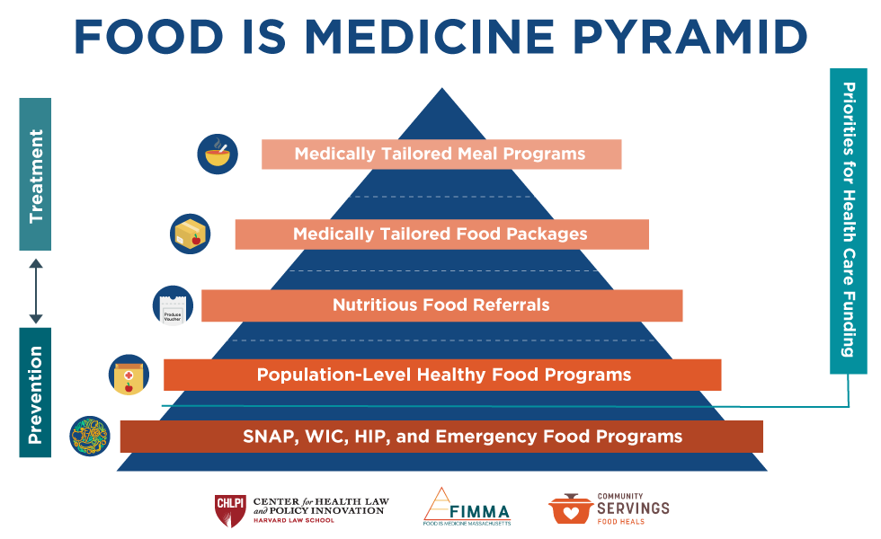
System Fragmentation
Supermarket
Big Box Store
Corner Store
Convenience Store
CSA boxes
Farmers Market
Food Pantry
Food Bank
Home-Delivered Meal Provider
Mobile Market
“CSA boxes” refers to delivery of foods directly from the farm to a household.

Slide 20
What do we know about the impact of FIM programs?

Slide 21
Studies of FIM Programs Show
Improvements in Some, but Not All, Outcomes
Resource Use
Food Security
Health behaviors (inc Diet Quality)
Clinical outcomes
Cost & utilization

Slide 22
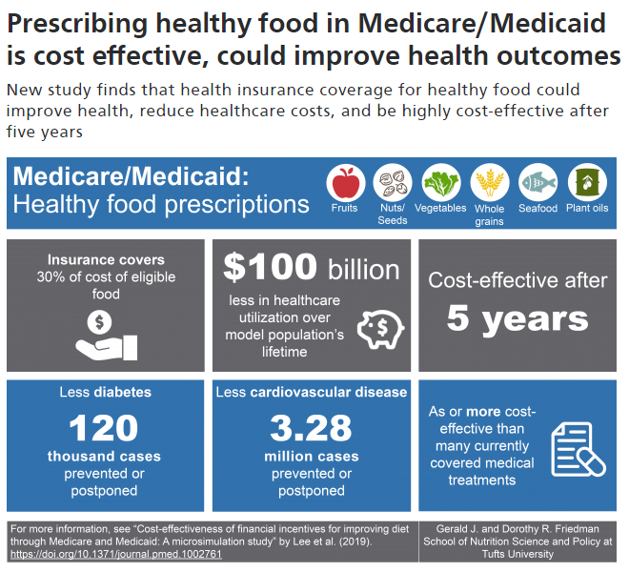
Modelling Studies Have Limitations but Can Fill in Some Gaps

Slide 23
Why is the data so limited?

Slide 24
Evaluation Challenges
Evaluation Challenges
Almost all programs reach a small number of people
  Not suitable* for examining health outcomes, utilization, & cost
Almost all programs offer a relatively small dose & duration
  Not suitable* for examining health outcomes, utilization & cost
Many programs are single-site
  Limited applicability to the field as a whole
Bottom line: You need a LOT of data to show an impact
  Most programs have limited funds available for evaluation
“This is really hard!”
* I would argue it is also not ethical
Notes:
Take text away

Slide 25

Why is data needed
Why is so much data needed to prove impact on health outcomes, utilization, & cost?
POPULATION HEALTH
Food security and nutrition programs are generally
  Better at prevention than at treatment
  Expected to have an impact over a long length of time
  Proven by their SMALL effect on a LARGE number of people, rather than their LARGE effect on a SMALL number of people
If you anticipate a SMALL effect, to show an impact you need
  A lot of people
  A long duration of “treatment”
  A high “dose”
  A long duration of observation
Notes:
Take text away

Slide 26
Current Considerations in Implementation

Slide 27

Local orgs vs national companies
LOCAL ORGANIZATIONS
Embedded in communities
Cultural competency
Personalized service
Decades of experience
Non-profit mission
NATIONAL COMPANIES
Shovel-ready
Enormous scale
Access to rural areas
Efficiency
Capacity to bill healthcare for services
Notes:
One of the tensions that is arising frequently is in who is going to PROVIDE the food: small, local organizations or large, national companies.
Local organizations often offer the advantages of being….
On the other hand, national companies are READY for this moment! They can function at enormous scale, they may be better able to access rural communities, they may be more efficient, and they may already have the capacity to bill for HC services.

Slide 28
High burden vs prevention
FOCUS ON PEOPLE WITH
HIGH DISEASE BURDEN
Momentum
Can “prove ROI” in a short-time frame
Aligns with an annual HC budget
FOCUS ON PREVENTION
Many more people are eligible
May prevent onset of disease completely
Population as well as individual impacts
ROI is greater in the end
Notes:
Tension #2: are we focusing on people with a high disease burden, or are we focusing on prevention?
There has been momentum toward focusing on people with a high disease burden (like CHF) because we can prove an ROI in a short time frame. This aligns with the needs of people beholden to an annual HC budget—if the money goes out this year it better pay off this year too.
On the other hand, if we move further upstream—like before people develop obesity or cardiovascular disease, or maybe even all the way to the pediatric setting—MANY more people would be eligible for services, we may prevent the onset of diet-related diseases completely (wasn’t this the point of FIM to begin with?), and we may have population-level improvements in health outcomes. Obviously in the long term this offers a much greater potential for ROI—but we would have to wait for it.

Slide 29
High dose vs low dose
HIGH DOSE – LOW REACH
Smaller number of people benefit
More likely to have a demonstrable impact on health outcomes
Habit formation allows for maintenance of effect
LOW DOSE – HIGH REACH
Reach more people & leave out fewer people
Households, rather than individuals (multi-generational impacts)
Population level impact likely even with a small effect size
Notes:
Tension #3: are we prioritizing High dose/low reach programs, or low dose/high reach programs?
By High dose, I mean a larger benefit amt or a longer duration. By low reach, I mean a smaller number of people benefit.
So for approximately the same amount of money, you can think of your options are to reach fewer people with more services, or more people with fewer services.
Advantages of the high dose-low reach system: although a smaller number of people benefit, you are more likely to have a demonstrable impact on health outcomes, and a high dose intervention may be required in order to change habits, so that after the program is withdrawn some of the effect is maintained.
Advantages of the low dose-high reach system: we reach more people and fewer are left out! You may be able to provide services to entire households, rather than just individuals, which increases the impact and may allow the impact to spread across generations. And even if you are supporting just a small change in people’s dietary habits, magnified over an enormous number of people receiving the services means that you may be able to support the health of entire populations.

Slide 30
Choice vs pre-selected foods
CHOICE
Dignity
Support of local retail
May be higher value for the individual participant
PRE-SELECTED FOOD ITEMS
Efficient
Local sourcing
Exposure to new foods
Notes:
Tension #5: do we prioritize systems that offer patients the choice of foods (for example, any fruits or vegetables), or do we pre-choose a box of healthy items for peopel?
Programs that offer choice, like a PPR, may offer participants more dignity, they may better support local retailers, and may be of higher value for the individual ppt.
On the other hand, when we pre-select healthy food items, the system may be more efficient, we may be able to more easily prioritize locally sourced items, and it may expose ppts to new food items.

Slide 31
Food insecure vs. chronic disease
TARGET POPULATION:
FOOD INSECURITY
Roots of FIM movement
Focuses resources on a less advantaged group
Pushes healthcare to develop systems to address SDH
TARGET POPULATION:
CHRONIC DISEASE
May be more politically feasible
Does not require screening for food insecurity
Allows wider access to healthy food benefits
Notes:
Tension #5: do we prioritize systems that offer patients the choice of foods (for example, any fruits or vegetables), or do we pre-choose a box of healthy items for peopel?
Programs that offer choice, like a PPR, may offer participants more dignity, they may better support local retailers, and may be of higher value for the individual ppt.
On the other hand, when we pre-select healthy food items, the system may be more efficient, we may be able to more easily prioritize locally sourced items, and it may expose ppts to new food items.

Slide 32
Disparities
People with reduced access to health care
  Uninsured and underinsured
  States that did not expand (or will be rolling back) Medicaid
Communities that had poorer access to healthy food to begin with
  Rural vs urban
  Neighborhoods with full-service grocery stores vs neighborhoods without
Reinforcing existing disparities in the agricultural sector
What does equity mean in the context of scale?
Notes:
And finally, tension #6, which I can’t frame as a trade off : are we creating a system that narrows or widens disparities?
I think all of us have come to these tables seeking to address disparities in access to healthy food and disparities in health outcomes. Let’s think about the ways in which the system we put into place might actually WIDEN the very disparities we are seeking to narrow.
If people are only able to access these systems through health care, how will we avoid leaving out people who don’t have good access to health care? That would include the uninsured and underinsured, or the states that did not expand Medicaid, for example.
We may also be leaving behind the communities that had poorer access to healthy food to begin with, and therefore have a more difficult time making use of programs that pre-suppose access. This may be rural communities or low-income urban communities, they may be neighborhoods without access to a full service grocery store.

Slide 33
Where are the opportunities?

Slide 34
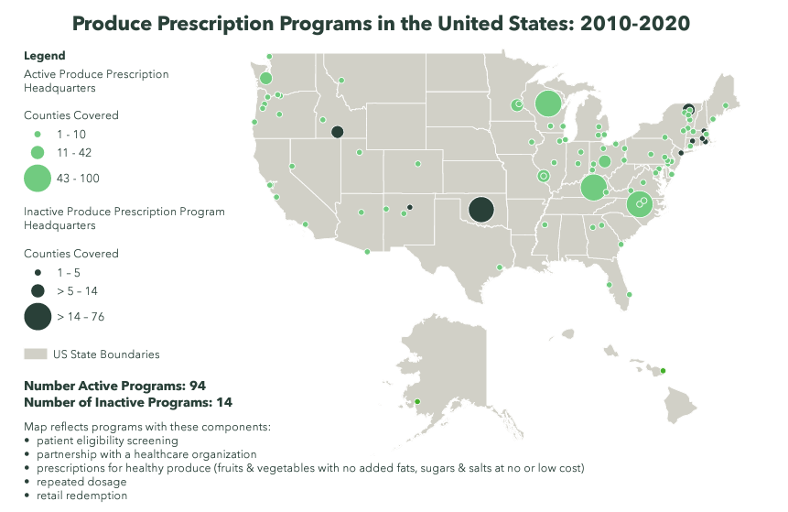
Opportunities for the Field
Access to Large Amounts of Data
Shared metrics across numerous programs
  eg GusNIP Produce Prescription Programs
Large health systems with a single electronic health record
  VA, Indian Health Service, other integrated health systems
Health insurers
  Claims data
Notes:
Take text away

Slide 35
Opportunities for Individual Programs
Controversy Alert!
Nutritious Diet
Better Health
FIM Program
Increased FV Intake
Better Health
Increased FV Intake
Better Health
FIM Program
Food Security
Better Health
Food Security
Better Health
This will happen if:
Implemented at scale
Dose and duration are sufficient
THIS IS PROVEN ALREADY
Notes:
Transition to next slide: So how do we measure increased FV intake and food security?

Slide 36
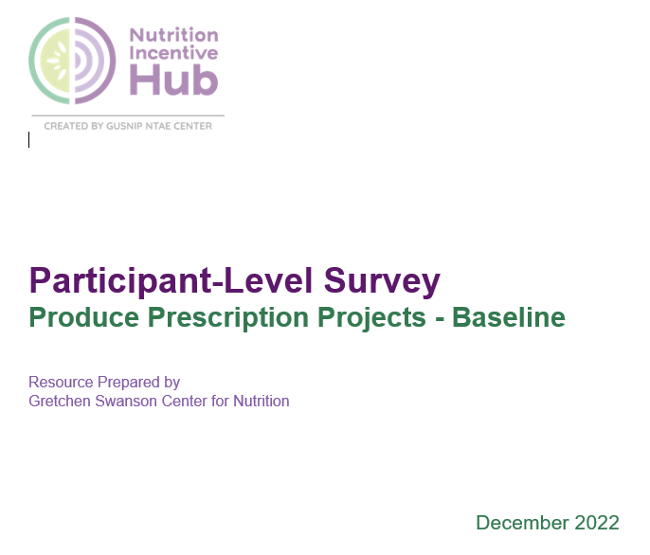
Opportunities for Individual Programs: Shared Metrics
Shared metrics 🡪 pooled data 🡪
  More participants
  More sites
Food security
FV intake
SNAP participation
Program satisfaction
Health status
Basic demographics
Budd Nugent N, Byker Shanks C, Seligman HK, Fricke H, Parks CA, Stotz S, Yaroch AL. Accelerating Evaluation of Financial Incentives for Fruits and Vegetables: A Case for Shared Measures. Int J Environ Res Public Health. 2021 Nov 19;18(22):12140.
https://www.nutritionincentivehub.org/resources/resources/reporting-evaluation/core-metrics-produce-prescription/participant-level-metrics
Notes:
This is especially true if all the FIM programs participating are targeted toward people with diabetes!

Slide 37
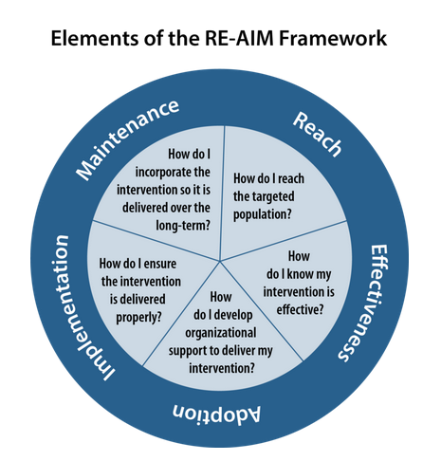
Opportunities for Individual Programs:
Implementation Science
Glasgow RE, Vogt TM, Boles SM. Evaluating the public health impact of health promotion interventions: the RE-AIM framework. Am J Publ Health 1999;89(9):1322–7.
Notes:
Take text away

Slide 38
Food is Medicine Overview
FIM programs support food security and healthy diets
Tremendous momentum toward implementing & evaluating FIM programs across the US
Evaluation of FIM programs is hard
  Resist the temptation to re-prove that nutritious food and food security are good for your health
  Right-size your evaluation for the size of your program
  Implementation science studies are critical
  Use the same metrics others are using, when possible
  We need (and are awaiting) the large, rigorously conducted trials
Notes:
Take text away

Slide 39
Food is Medicine: An Opportunity to Support
Local Ag in Rural Regions and Beyond
Jennifer A. Garner, PhD, RD
Ida Doutt
John G. Searle Assistant Professor of Nutritional Sciences
School of Public Health,
University of Michigan
Project Lead
Community Health & Nutrition Programming, Community Health Improvement Associates
NOPREN Summer Series | August 6th, 2025

Slide 40
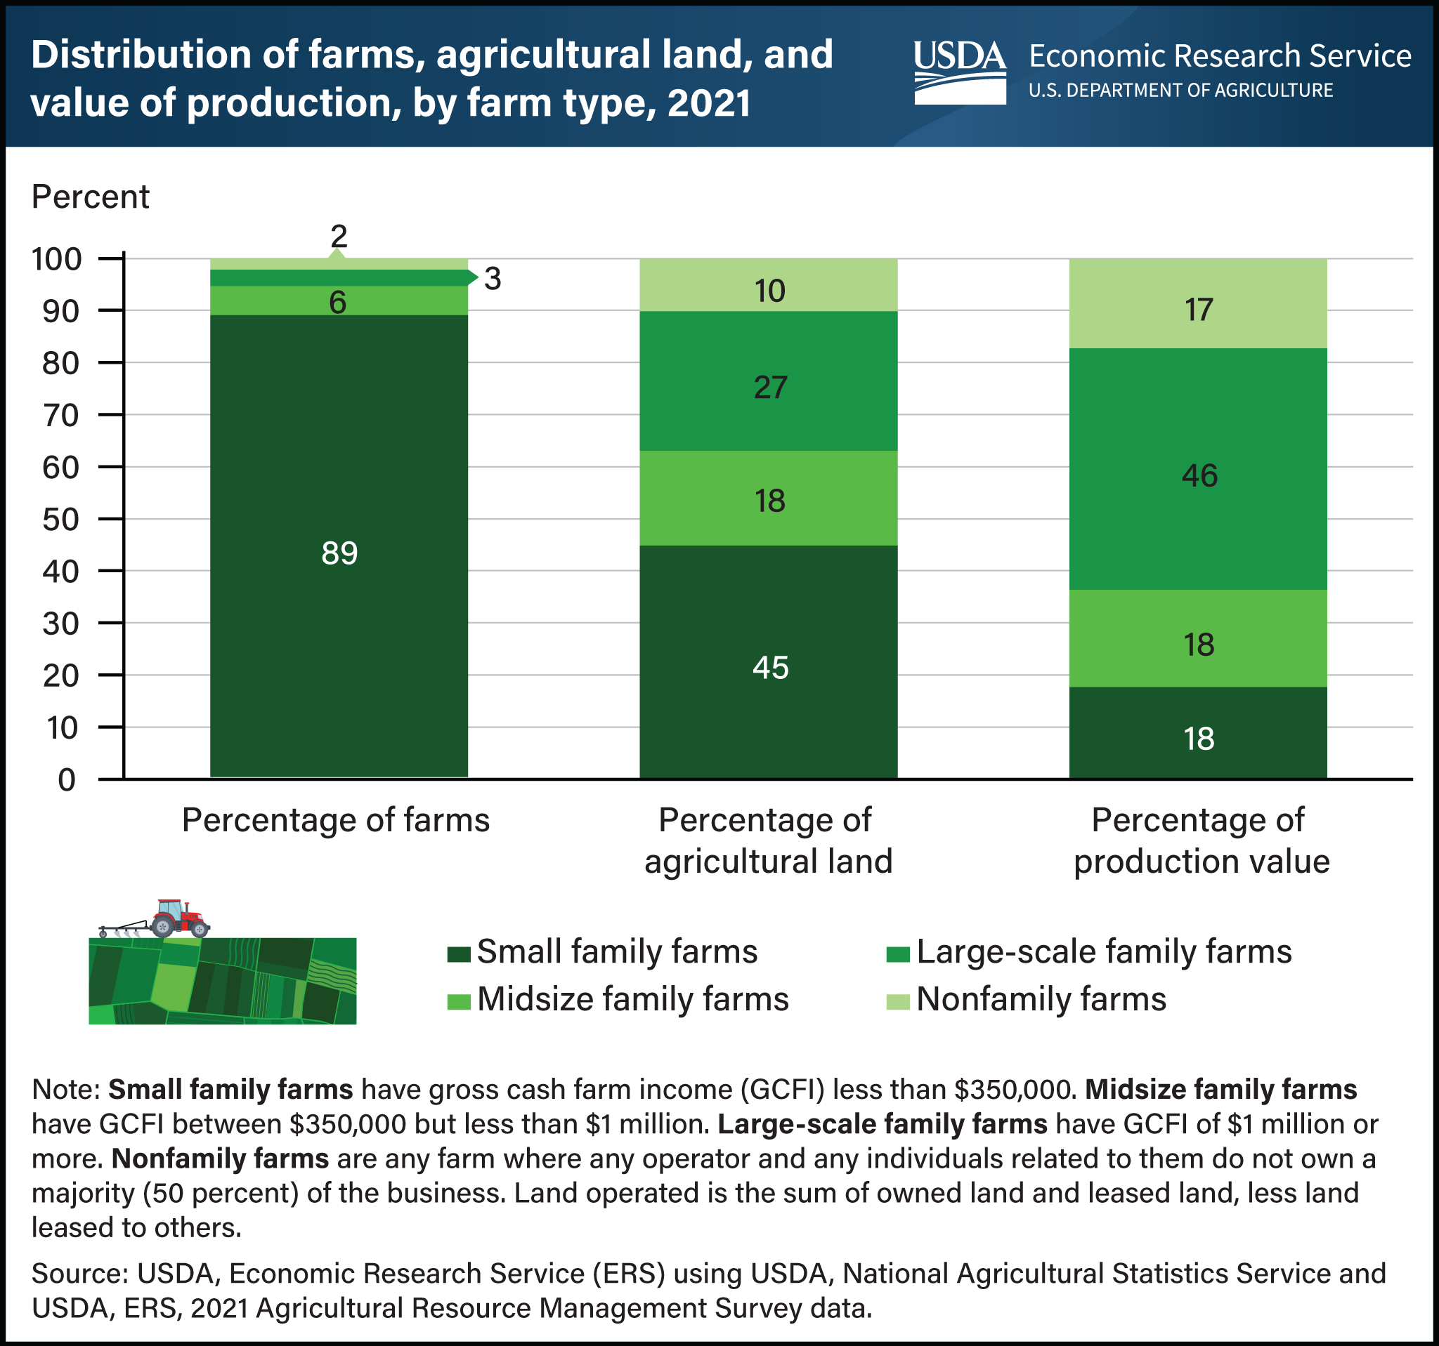
A ‘Triple Win’ for a Trio of Concerns?
Household Food Security
Individual Health
(Rural) Community Resilience
Notes:
There is growing focus on rural economic development, generally, and on enhancing supports for small and midsize farm operations, specifically - particularly those who grow primarily specialty crops like FV.

Slide 41


A ‘Triple Win’ for a Trio of Concerns? (cont)
Household Food Security
Community (Local) Food Systems
Individual Health
(Rural) Community Resilience
Notes:
Consequently, we are seeing increased investment in local food systems. One key example of this is the now permanent funding in the farm bill for the conduct and evaluation of projects that incentive the purchase of FV among LI consumers. A dot that has not been connected *as much*, though, is that between heightened interest in rural economic development and agricultural supports in tandem with the explosion of interest in FIM. This is a key opportunity.

Slide 42
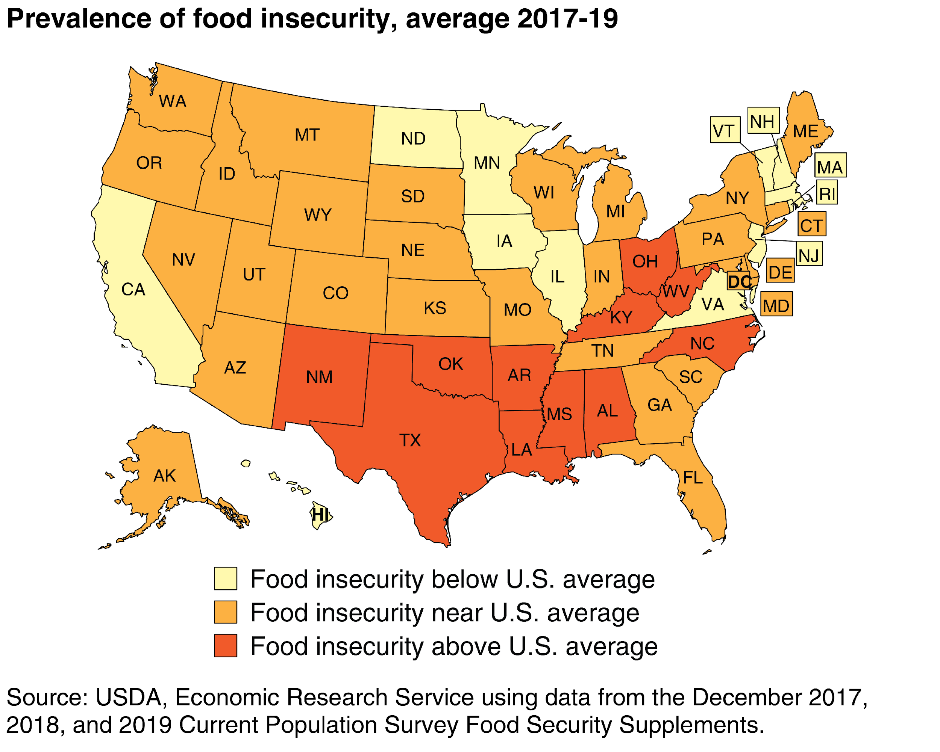
Regional Context
4
(Feeding America 2018; USDA ERS 2019; USDA ERS 2020)
Notes:
[Share context at the time when I was first introduced to the SE OH partners and their local food system efforts.]
Certain regions, such as the Appalachian and more Southern portions of the U.S., consistently experience greater rates of food insecurity than others.

Slide 43
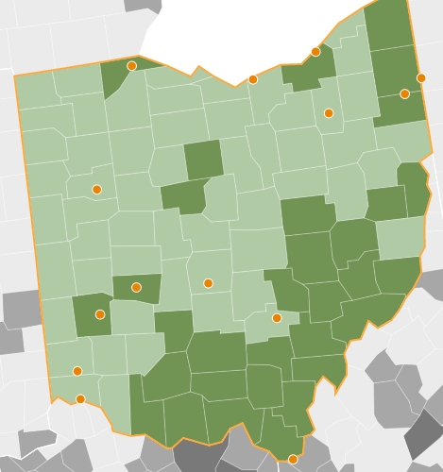
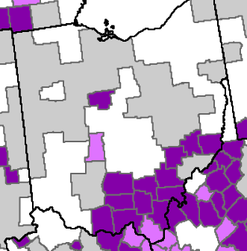
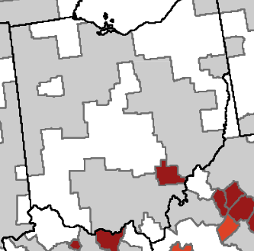
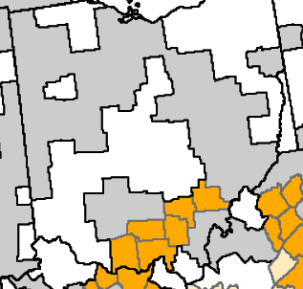
Regional Context cont
Food Insecure
Low Employment
18.2%
Persistent Poverty
Persistent Child Poverty
(Feeding America 2018; USDA ERS 2019; USDA ERS 2020)
Notes:
…and the Athens area has fared worst among OH regions with a food insecurity rate of nearly one in five households. Athens County is also the only county in OH where low employment overlaps with not only persistent poverty, but also persistent child poverty. These statistics, though, really belie the region’s rich assets and robust local food system.
In a context where we’re talking less about disparities and equity, we can and should still focus on a region’s unique assets as we can continue our important health promotion work.

Slide 44
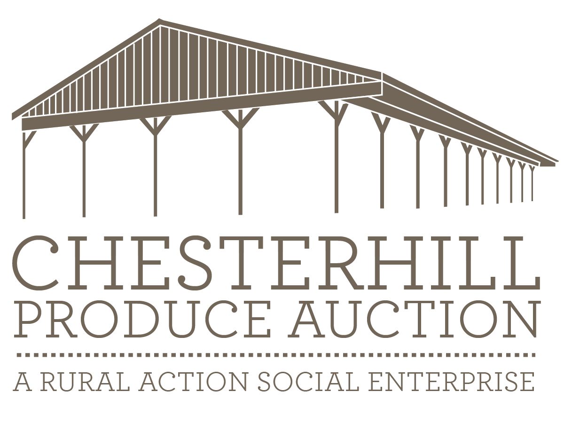

Food is Medicine in the Rural Context:
The Southeastern Ohio PRx Partnership
Regional Farmers
FQHC clinics

Slide 45
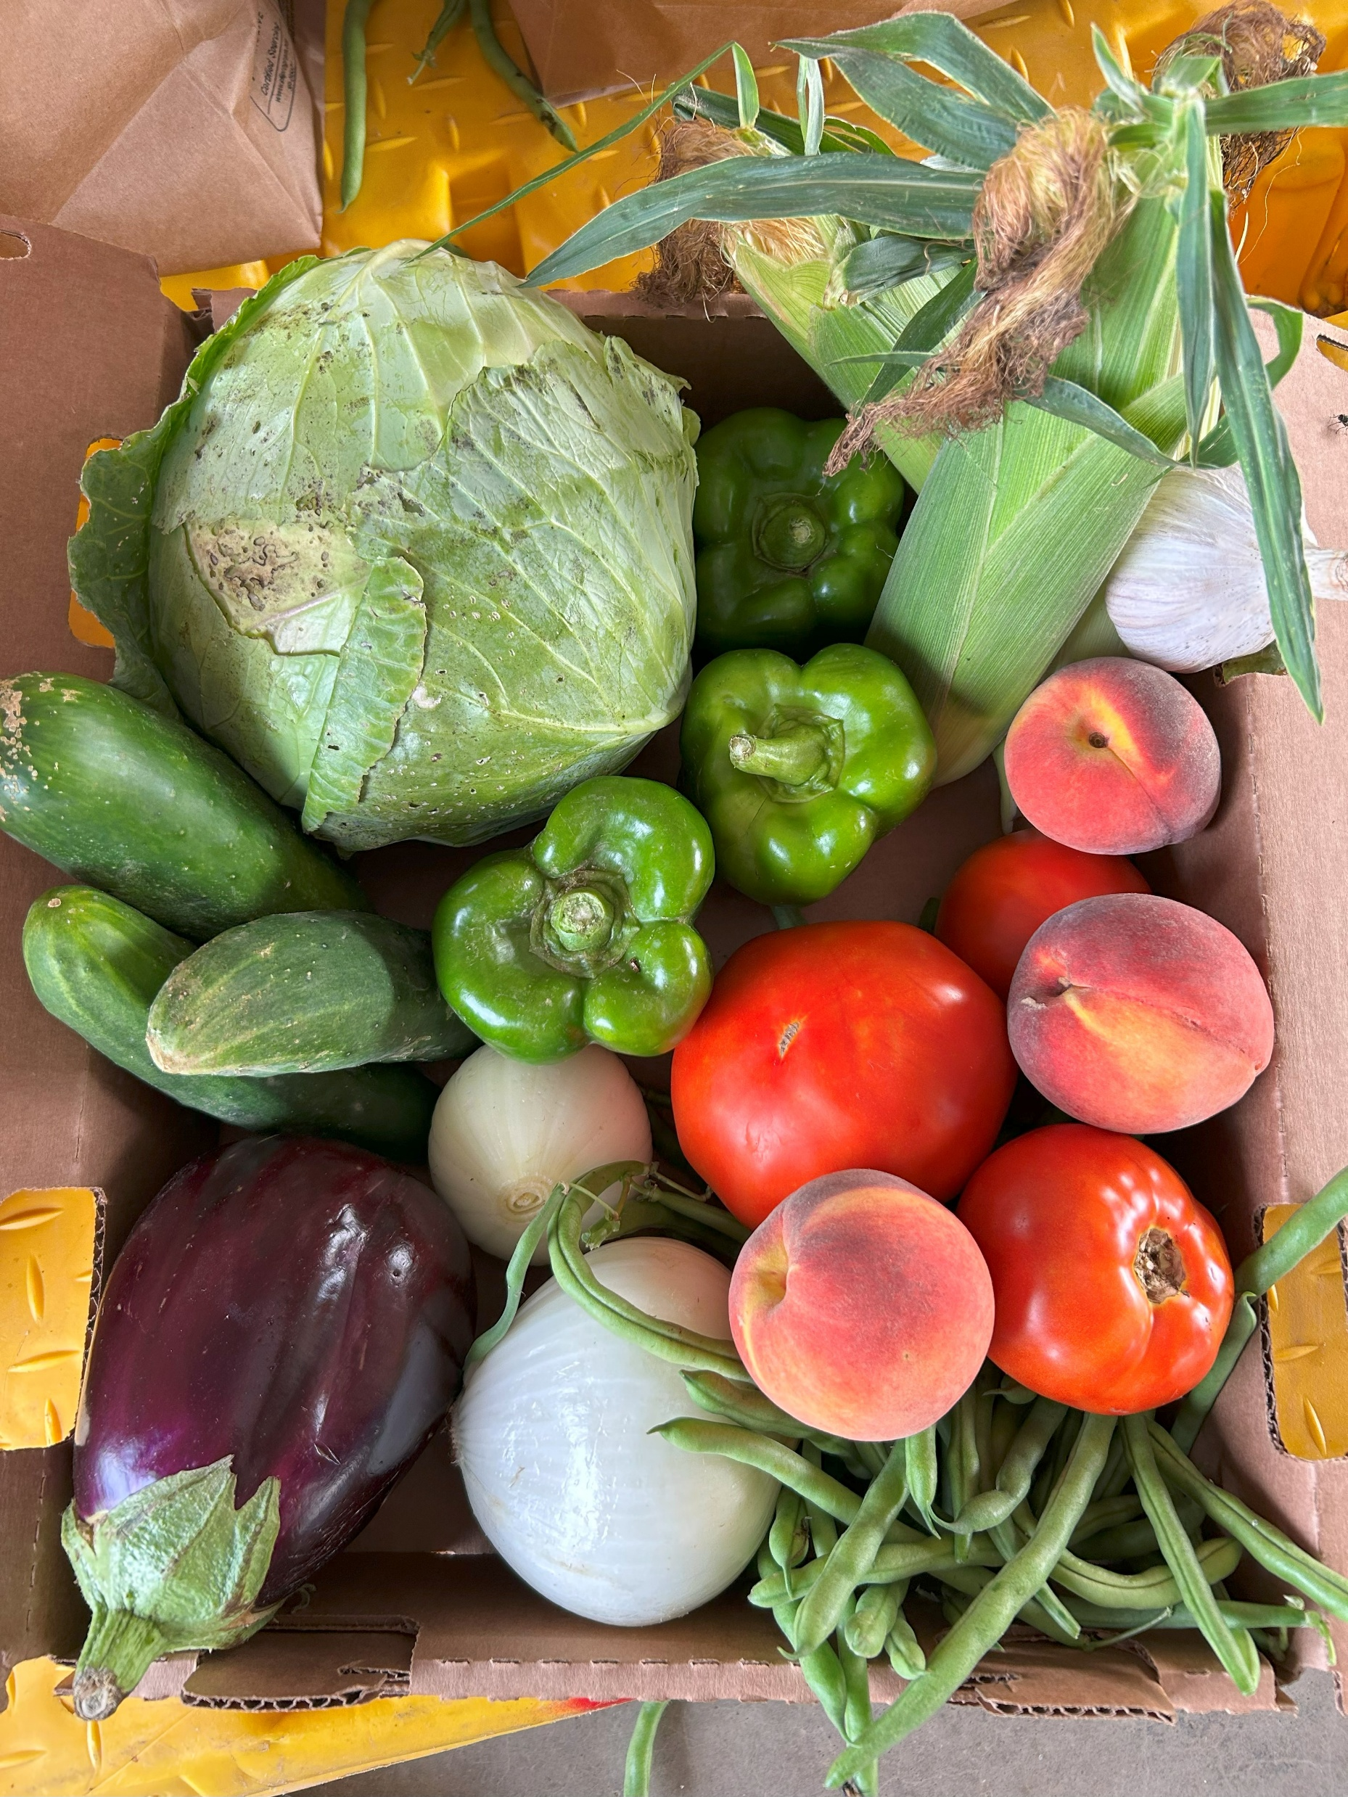
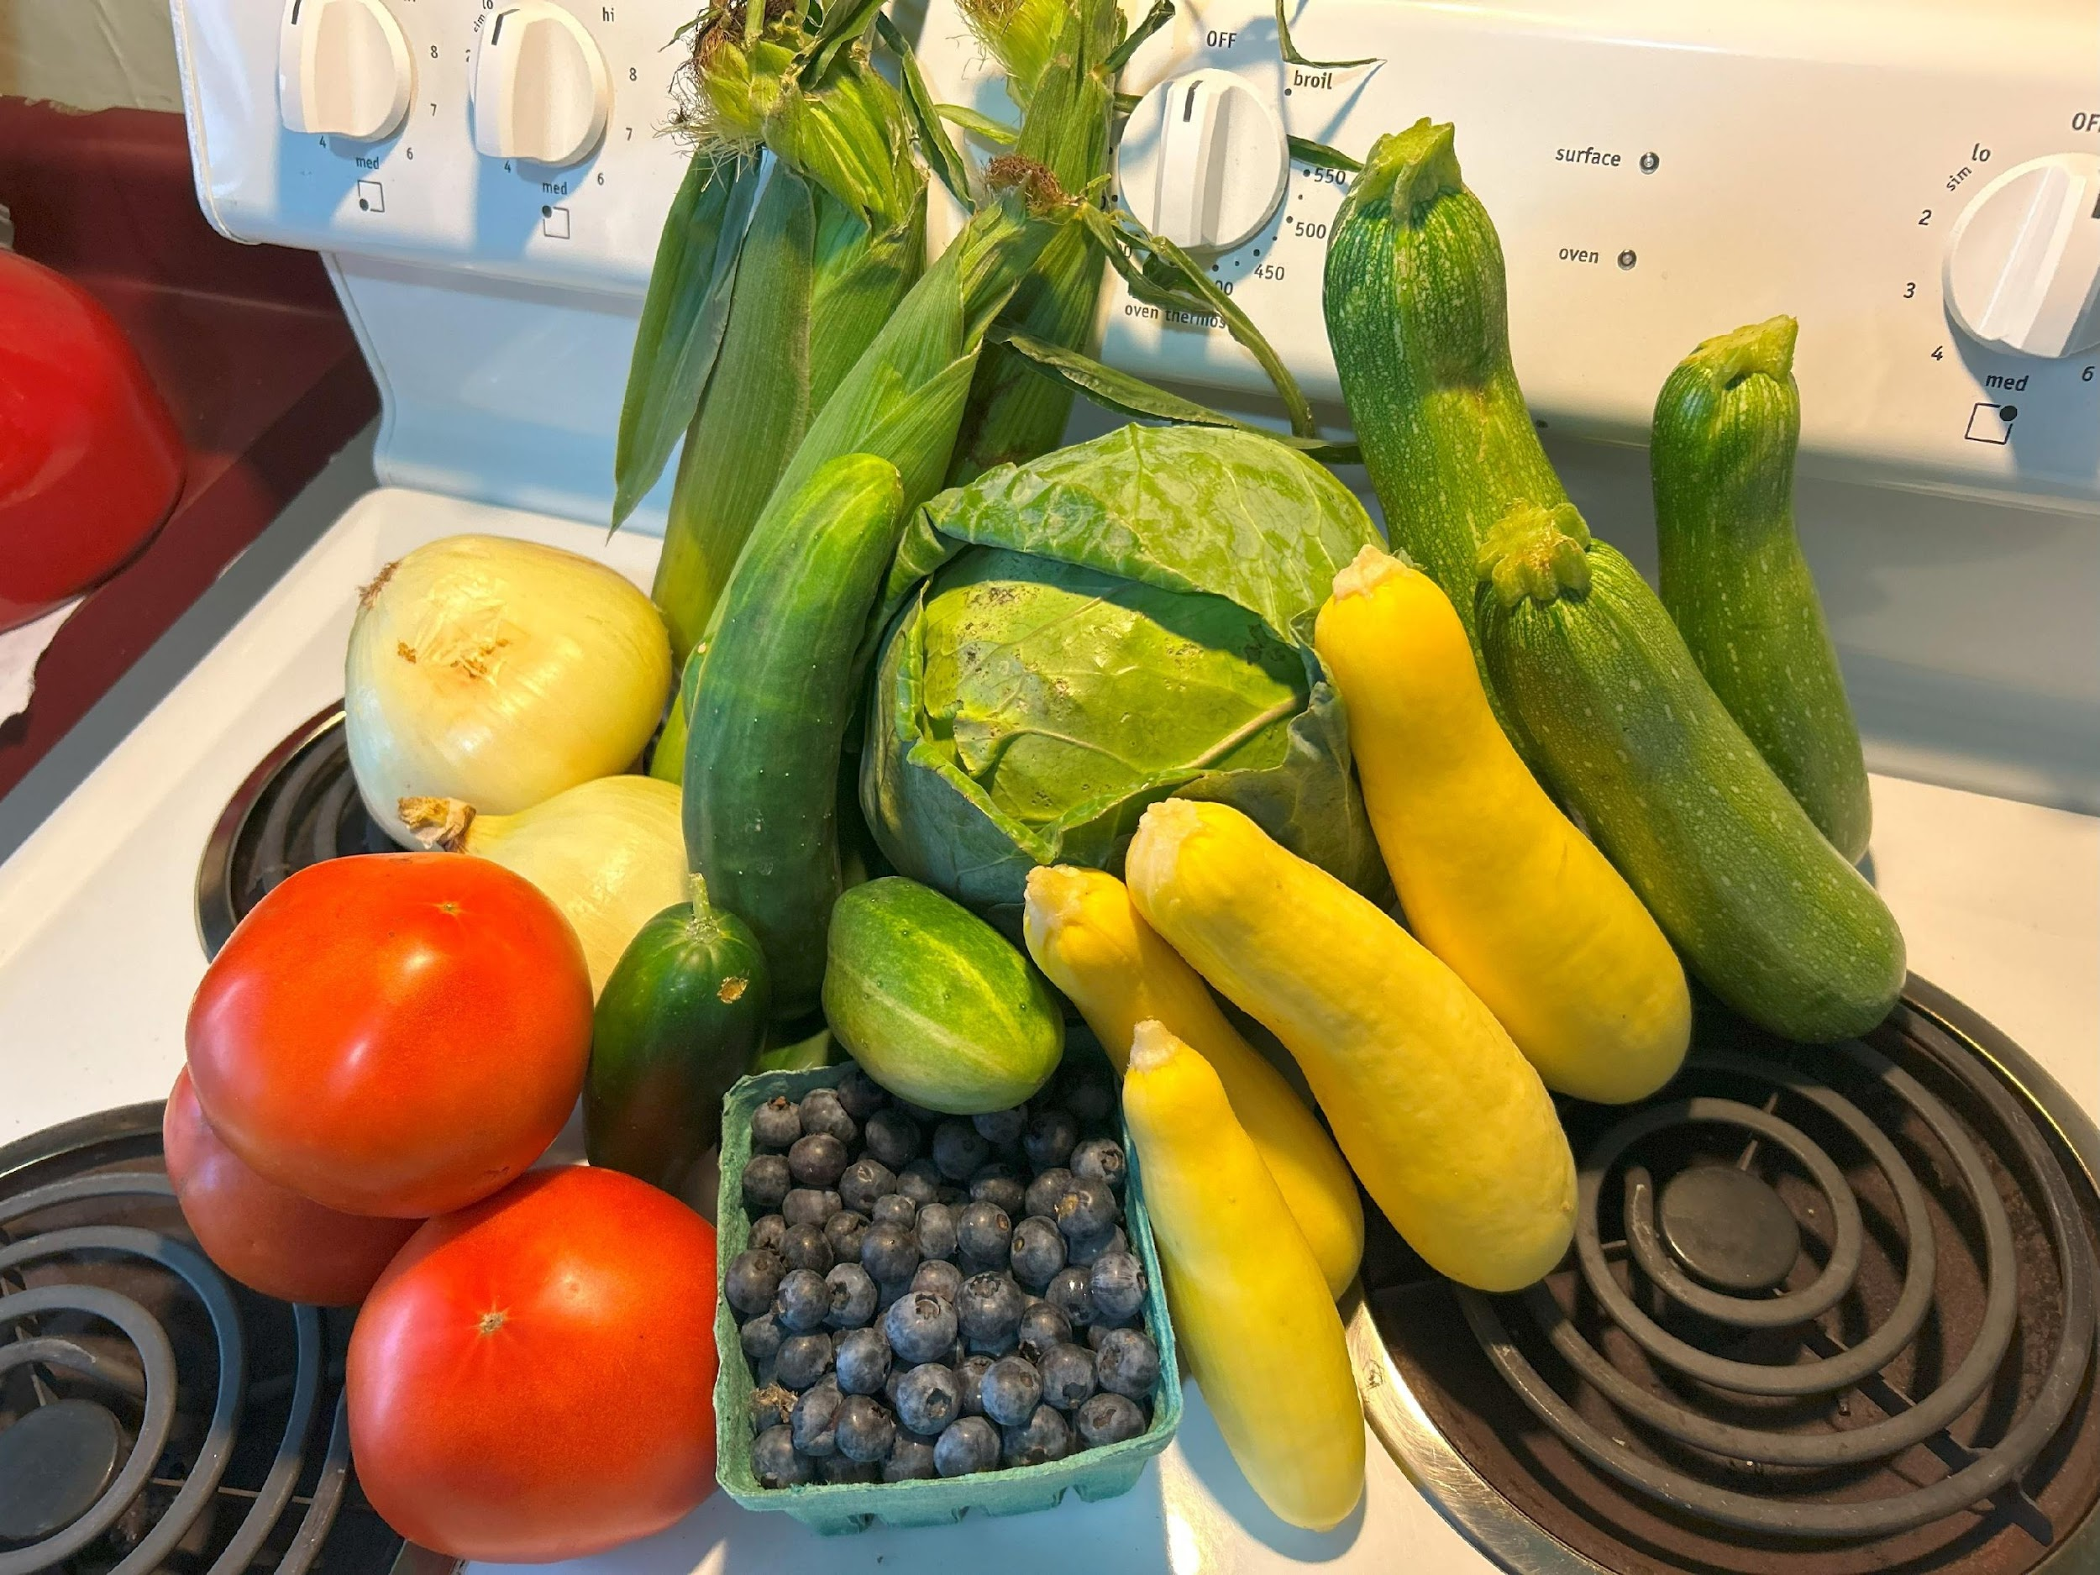
Food is Medicine in the Rural Context:
The Southeastern Ohio PRx Partnership cont

Slide 46

Local Agricultural Calendar
“Patients said that they didn’t have many fruit options. And I would always respond with, "It’s seasonal. It’s hard. We’re getting this stuff locally." “Sometimes we would get a whole bunch of green peppers and onions, and then there wouldn’t be a lot of variety. So it would be kind of whatever fruit, whatever produce was in season, which I think is common. But I think patients were somewhat frustrated, that they were like, "Well if I go to Krogers and purchase this, then I can get a lot more variety, so I’m not going to shop here.“
- Country Fresh Stop site representative
Krzyzanowski Guerra K, … Garner JA. Nutrients. 2021 Nov 19;13(11):4145. doi: 10.3390/nu13114145. PMCID: PMC8624271.
Notes:
We aren’t completely naïve to the challenges of implementing such a model.

Slide 47
Seasonal Ebb & Flow
“Wintertime is tough because we’re not getting as much produce. Then, especially as people start relying on that or are more accustomed to getting that produce… when that dies off, they’re like, ‘Oh where are my veggies?’.”
-Donation State site representative
Krzyzanowski Guerra K, … Garner JA. Nutrients. 2021 Nov 19;13(11):4145. doi: 10.3390/nu13114145. PMCID: PMC8624271.

Slide 48
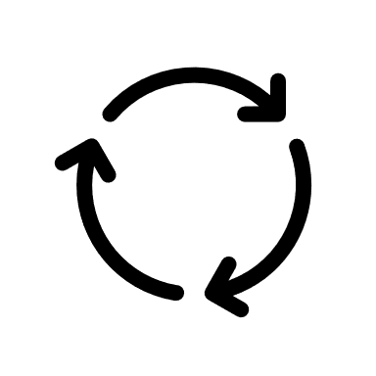

Our Revised (Pilot) PRx Model
Regional Farmers
FQHC clinics
U.S. Farmers
Notes:
It doesn’t have to be one or the other. It can be a both/and.

Slide 49
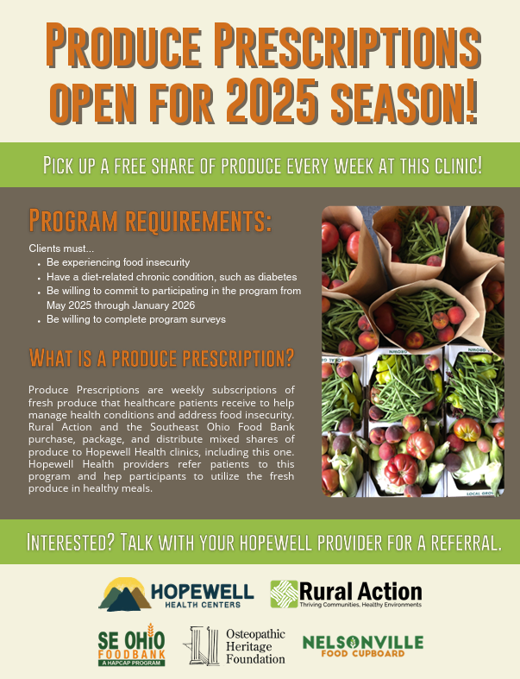
Key Changes
Streamlined data collection 🡪 aligned with GusNIP measures
Maximized utility of Electronic Health Record via exclusive focus on patients with diabetes
Extended program duration to 9 months via integration of local and non-local produce sources

Slide 50


Some Lessons Learned
For Implementation
  Integrating local produce with non-local produce can help balance organizational missions will patron demand.
  Leverage each sector’s strength… breaking down silos doesn’t have to mean overhauling workflows.
For Research
  EHR-centric data capture assumes a certain (higher) level of engagement with the healthcare system.
  Aggregate measures of health (e.g., AHA’s Life’s Essential 8) may afford more inclusive program inclusion criteria.
Notes:
e.g., as would be expected for patients with diabetes 🡪 harder to leverage this resource for primary / secondary prevention, behavioral health patients, etc.

Slide 51
Q&A

Slide 52
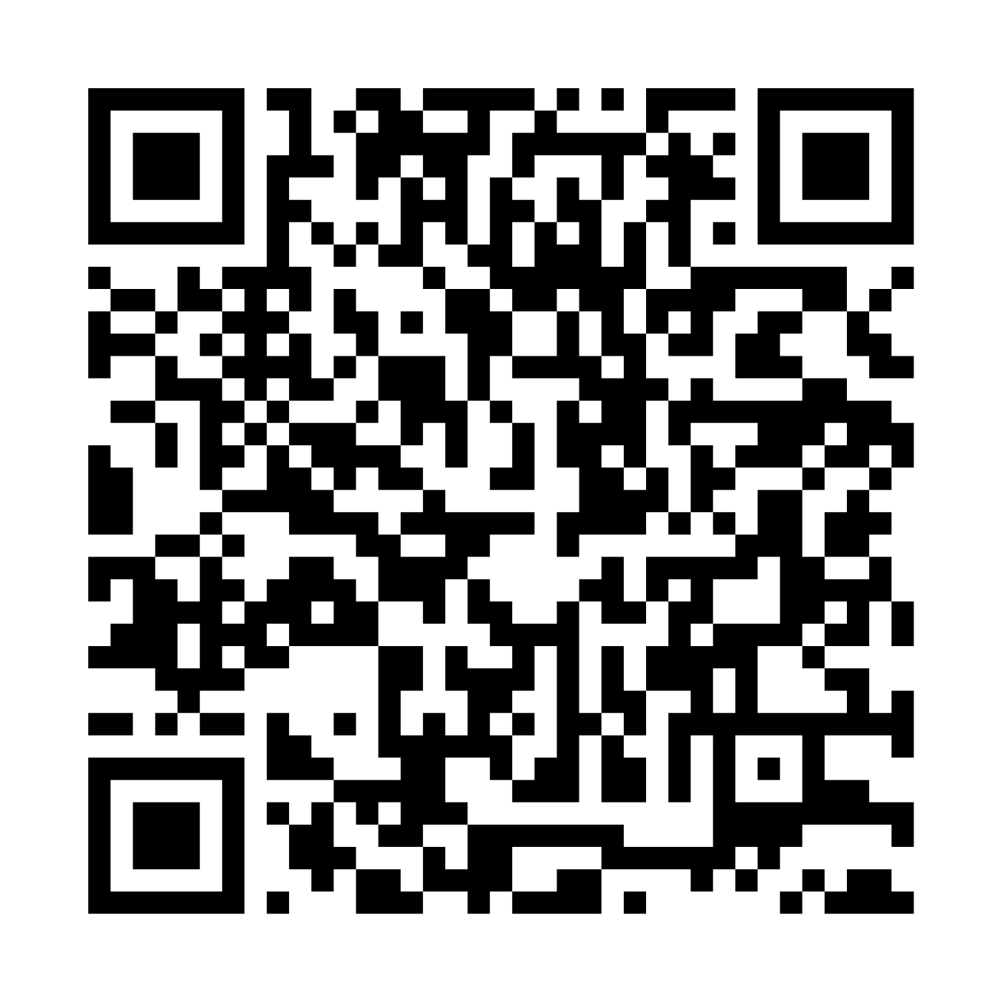
Announcements
Join us for the last session of the series!
Wednesday, August 13th at 4pm-5pm ET
  Student Presentations!
To view past recordings, scan QR code below
Notes:
Thank you to our amazing speakers and another thank you to you all for attending the fifth session of the Summer Speaker Series! Our final session will be our student presentations next week on August 13th. We will hear from selected students who will present on their research or projects this summer. You won’t want to miss this!
To listen to past recordings, you can scan the QR code on the right
Thank you so much! See you next week! Bye.
______________________

