Slide 1
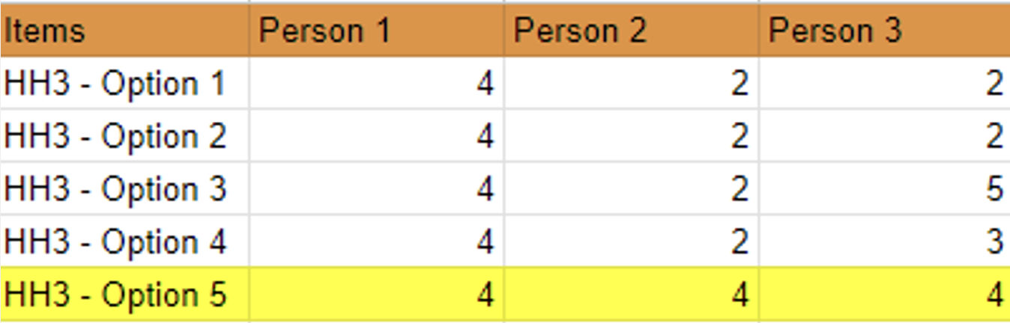

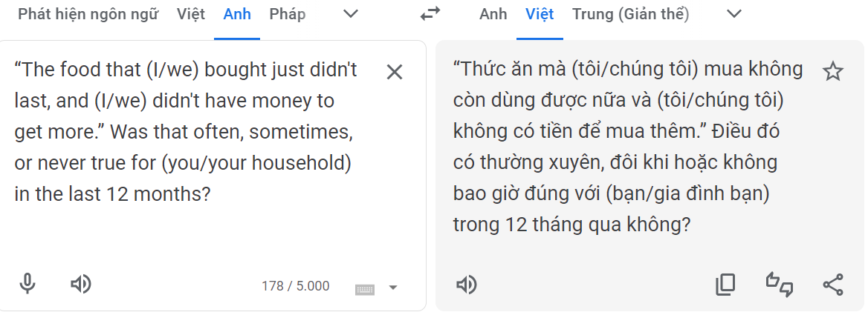
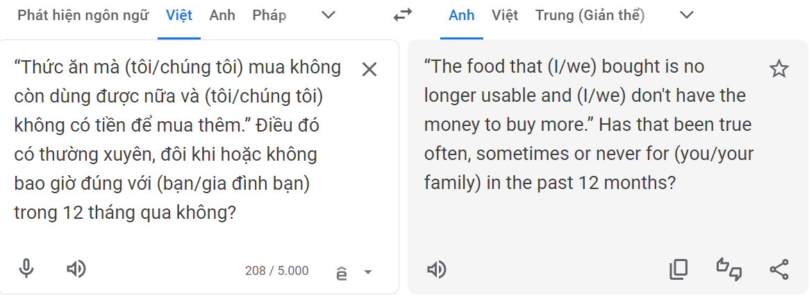


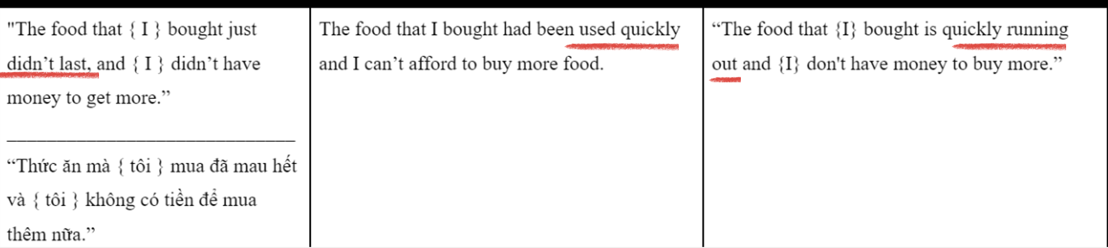

Development of a conceptually equivalent Vietnamese-language translation of the US Household Food Security Survey Module
for use with Vietnamese and Vietnamese Americans living in the US.
Man Nguyen,¹ Ana Poblacion, PhD, MSc,^{2,3} Trang Tran,⁴ Andy Nguyen,⁵ Tran Mai,⁵ Noah Rieber,⁶ Avy Osalvo,³ Isabella Villafuerte,⁵ Rena Nurhussein,⁶ Xiaoqi Wang, MS,⁷ Taylor Le,⁵ Mark Tran,⁸ Khang Le,⁵ Isabelle Nguyen,⁹ Noor Al-Zahraa Safar, MPH³
,
¹Boston University School of Public Health, ²Department of Pediatrics, Boston Medical Center; ³Department of Pediatrics, Boston University Chobanian and Avedisian School of Medicine; ⁴Brown University; ⁵Boston University College of Arts and Sciences, ⁶ Boston University Sargent College of health and Rehabilitation, ⁷ Tufts University, ⁸The Fredrick S Pardee School of Global Studies, Boston University , ⁹ College of Engineering, Boston University
Background
Results
Food insecurity refers to the limited or uncertain access to nutritionally adequate and safe foods obtained in socially acceptable ways,¹ which affects both the quality and longevity of life.²
Surveillance plays an important role in addressing food insecurity. The USDA Household Food Security Survey Module (HFSSM) is the gold standard measure of food insecurity in the US.
The HFSSM has been validated in English, Spanish, and Chinese for use in the US.³ However, it has not been validated in Vietnamese - a language with the largest percentage of Non-English Language Preference speakers (58.9% between 2015).⁴
Among Vietnamese, prevalence of food insecurity reached 7.1% between 2016-2021.⁵ However, data may misrepresent Vietnamese American subgroups as there is no validated and culturally adapted Vietnamese version of the HFSSM.
Objective: To translate and culturally adapt the USDA Household Food Security Survey Module (HFSSM) into Vietnamese for the Vietnamese population in the US.
1. Results from the Literature Review:
To date, the HFSSM has not been fully translated and culturally adapted into Vietnamese in its integral format for use in the US.
A survey that used the HFSSM as gold standard in its validation process and has been used internationally called “Food Insecurity Experience Scale – FIES” contained similar questions. These helped with some of the syntax translations, but not all.
WHERE THERE IS A GAP THERE IS AN OPPORTUNITY
4. Results from the Committee Review:
Observing results from the back-translation options, the Committee opted to fix the initial Vietnamese forward translation, using a choice of word that would better capture the original meaning of the HH3 English version.
Vietnamese Forward Translation | Correction on the Forward Translation | Back Translation to English | Original English Version
Thức ăn mà chúng tôi mua đã mau hết và chúng tôi đã không có tiền để mua thêm. | Thức ăn mà chúng tôi mua đã không còn nữa và chúng tôi đã không có tiền để mua thêm. | The food we bought was no longer available and we had no money to buy more. | The food that {I} bought just didn’t last, {I} didn’t have money to get more.
2. Results from the Forward Translation:
To illustrate the result of the forward translation, question HH3 of the HFSSM will be used as an example, which reads:
“The food that (I/we) bought just didn’t last, and (I/we) didn’t have money to get more.” Was that often, sometimes, or never true for (you/your household) in the last 12 months
The image above shows how the rectified back translation resulted in similar meaning to the original HH3 English version.
The image below illustrates the scores resulting from rating of the forward translation options of the HH3 in the second Delphi round. The first two options were the researchers’ translations and the three other options were the additional translation suggestions from language professionals.
5. Results from the Qualitative Interviews:
Design/Methods
When Vietnamese participants were asked to interpret the meaning of the HH3 sentence, they consistently referred to the original meaning of the question in English:
To attain a Vietnamese translation of the HFSSM, four steps were used in this research:
1. Literature Review: A thorough worldwide literature search on previous translations of the HFSSM into Vietnamese was completed using PubMed and ResearchGate, as well as by exchanging information with food insecurity research experts.
2. Forward Translations: After receiving training from food security content experts and researchers in the field, two bicultural and bilingual (Vietnamese and English) researchers independently translated 18 food insecurity questions (HFSSM) and 1 pre-screen question (food sufficiency) into Vietnamese, resulting in two forward translation versions.
To achieve unity, three independent Vietnamese language professionals participated in three rounds of survey reconciliation using a Delphi methodology.⁶ Language professionals were selected via online reach and selected if older than 18 years old; bicultural and bilingual (Vietnamese and English); Vietnamese language professional (work in healthcare/public health/social work/discuss nutrition and diet with Vietnamese-speaking clients OR specialize in the Vietnamese language OR work on the HFSSM. Vietnamese language professionals were excluded if living with a cognitive disability.
A document with the two initial forward translations were sent to professionals who rated the translations in a Likert scale from 1 to 5 (one being strongly disagree and five being strongly agree), and offered additional versions, if needed.
A Steering Committee consisting of the two forward-translators, one HFSSM expert, and one Vietnamese language expert participated in several meetings to reach consensus on the professionals’ feedbacks to create a single Vietnamese version of the HFSSM.
The translation option with higher scores (4 or 5) and without any significant critiques in each individual question was chosen to compose the final Vietnamese translation of the HFSSM.
3. Back-translations: Two bilingual and bicultural translators who were unaware of the HFSSM independently back-translated the Vietnamese HFSSM into English, and offered additional versions, if needed. Back-translators were also encouraged to highlight challenges and share a rationale for their translations.
4. Expert Committee Final Conciliation: The Steering Committee engaged in several meetings to compare back-translation options with the original English version of the HFSSM.
5. Qualitative Interviews: Yet to be concluded, a set of qualitative interviews have been conducted with Vietnamese people to determine the accuracy and clarity of the translations. This phase will be concluded when translations reach data saturation.
“No more food in the house...due to a lack of money”
As HH3 reaches saturation, the Vietnamese version will feature it as the final HH3 question.
,³
,³
Example of Translation using Google translate:
As seen, question HH3 had five translation options rated extremely different in the Likert scale, except for option 5 which received a score of 4 across all professionals. Thus, this question was selected as the translation of the HH3.
Given that the HFFSM contains 18 questions, and a pre-screen question, a total of 19 questions went through this process, with some of the questions having up to eight different translations.
Validation and cultural adaptation are processes that ensure a word/sentence is close in meaning to its original version. Image 4 shows how Google translate should not be used as a validation tool.
3. Results from the Back Translation:
The image below illustrates results from the back translation options of the HH3 question by two independent bilingual and bicultural translators.
English & Vietnamese
Forward Translations
Back-translation A
Back-translation B
Implications
A Vietnamese HFFSM is on the midst of being successfully validated and culturally adapted for use in the US.
Despite laborious, a combination of several methods showed to be efficient in reaching a Vietnamese HFFSM.
Cultural adaptation of English words into Vietnamese proved to be challenging, as certain words are not readily available in Vietnamese such as “meals”, “household”, “adults” “children”, “didn’t last”, etc.
While an inaccurate translation affects all groups, it can particularly affect groups with high percentage of people with Non-English Language Preference.
Despite similar, both forward translations differ from the original version in English.
The original English version conveys the idea of a household having no more food in the house due to financial constraints. However, the first forward translation to Vietnamese, despite careful adoption of three rounds of Delphi methodology and conciliation by experts, did not convey its original meaning. Thus, both forward translators A and B put forth an item that used "food...had been used quickly" or "food bought is quickly running out."
Thus, another round of forward translations were carried out to rectify possible mistakes.
Acknowledgements
We would like to thank all involved in this project, from Professors to students, and the Vietnamese community members.
We would also like to thank BU Kilachand Honors College and BU Innovate for funding this research.
Further information, please contact Dr. Ana Poblacion: ana.poblacion@bmc.org
References
1. Anderson SA. Core Indicators of Nutritional State for Difficult-to-Sample Populations. The Journal of Nutrition. 1990; 120:1555-1598.
4. Batalova J and Zong J. Language Diversity and English Proficiency in the United States. Migration Information Source. 2016.
5. Vu M, Trinh D, Kandula NR, Pham NHT, Makelarski J, Seligman HK. Low-Income Asian Americans: High Levels Of Food Insecurity And Low Participation In The CalFresh Nutrition Program. Health Affairs. 2023;42(10):1420-1430.
2. Drennen CR, Coleman SM, Ettinger De Cuba S, et al. Food Insecurity, Health, and Development in Children Under Age Four Years. Pediatrics. 2019;144(4): e20190824.
6. Teig CJP, Bond MJ, Grotle M, et al. A novel method for the translation and cross-cultural adaptation of health-related quality of life patient-reported outcome measurements. Health Qual Life Outcomes. 2023;21(1):13.
3. U.S. Department of Agriculture Economic Research Service. Food Security in the U.S. Survey Tools. ​

