Slide 1

Summer Speaker Series for Students
2024
Notes:
Hello everyone, welcome to today’s session of the HER NOPREN Summer Speaker Series for Students. My name is Senthil and I’m a research analyst at HER.

Slide 2


Getting Started!
Update your name on Zoom, if needed
  Right click on your Zoom box, click “rename”
Type your name and institution into the chat box!
  Question: Which best describes you?
    Ex. Undergraduate Student, Dietetic Intern, Masters Student, Doctoral Student, Post Doc, Public Health Practitioner, Researcher/Professor, Other
Remember to keep yourself on mute.
Type your questions into the chat box.
Notes:
Feel free to update your name on Zoom if needed. You can type your name, institution, and what best describes you in the chat box. Please keep yourself on mute and type any questions in the chat which we will get to during the Q&A portion.

Slide 3
NOPREN HER Summer Series for Students
The series will take place on Wednesdays from
4:00 - 5:00 pm EST
Schedule and Topics
June 12: Food Policies in Schools - More than just Lunch!
June 26: Food is Medicine: What does it mean?
Where are we going?
July 10: Leveraging Food Service Contracts at 4-year Public Universities to
Understand Meal Plan Costs and Affordability
July 24: Policy Systems and Environmental Strategies to Support Young
Children's Diet and Health
August 7: Collaborating Successfully across Sectors toward Nutrition Security
August 14: Student Presentations
For more information or to register: https://nopren.ucsf.edu/her-nopren-summer-speaker-series-students-2024
Notes:
This is the 5th session of the series and we’ll have our last session next Wednesday, August 14th which will be our student presentation and poster session.
Put registration link in chat box: https://nopren.ucsf.edu/student-resources

Slide 4
Session 5: Collaborating Successfully across Sectors toward Nutrition Security
Notes:
So I’ll introduce the moderators for today’s session. Jennifer Garner and Lindsey Haynes Maslow are co-Chairs of the Rural Food Access Working Group with Alice Ammerman. Jennifer is the John G. Searle Assistant Professor of Nutritional Sciences in University of Michigan's School of Public Health and Lindsey is an Associate Professor of Health Policy and Management in the UNC Gillings School of Global Public Health. And I’ll turn it over to Lindsey

Slide 5
Rural Food Access Work Group
Work Group mission:
To advance the conduct of collaborative research that addresses the environmental, policy, and economic issues related to rural food access.
Activities:
We (1) convene researchers and practitioners via monthly webinars focused on emerging findings and relevant methods, and (2) facilitate the engagement of interested members in WG-related research projects.
Meetings are the 3rd Thursday of the month from noon-1 pm EST.
Please contact Kate Garrity (kategarr@umich.edu)
to be added to our listserv.
Notes:
Moderator to give very brief background on WG they are representing

Slide 6
Our premise
Our Premise:
Working across sectors is not only advantageous, but essential, to improving food and nutrition security, especially in communities that have been marginalized, underserved, or disinvested from over prior generations (e.g., rural communities).

Slide 7
Today’s learning objectives
But how? → Today’s Learning Objectives:
Characterize the unique challenges of and opportunities for nutrition security cross-sector collaborations in marginalized, underserved, or disinvested communities.
Discuss at least 3 concrete strategies for facilitating successful cross-sector nutrition security collaborations.
Notes:
Speaker Two (if applicable) to input slides

Slide 8
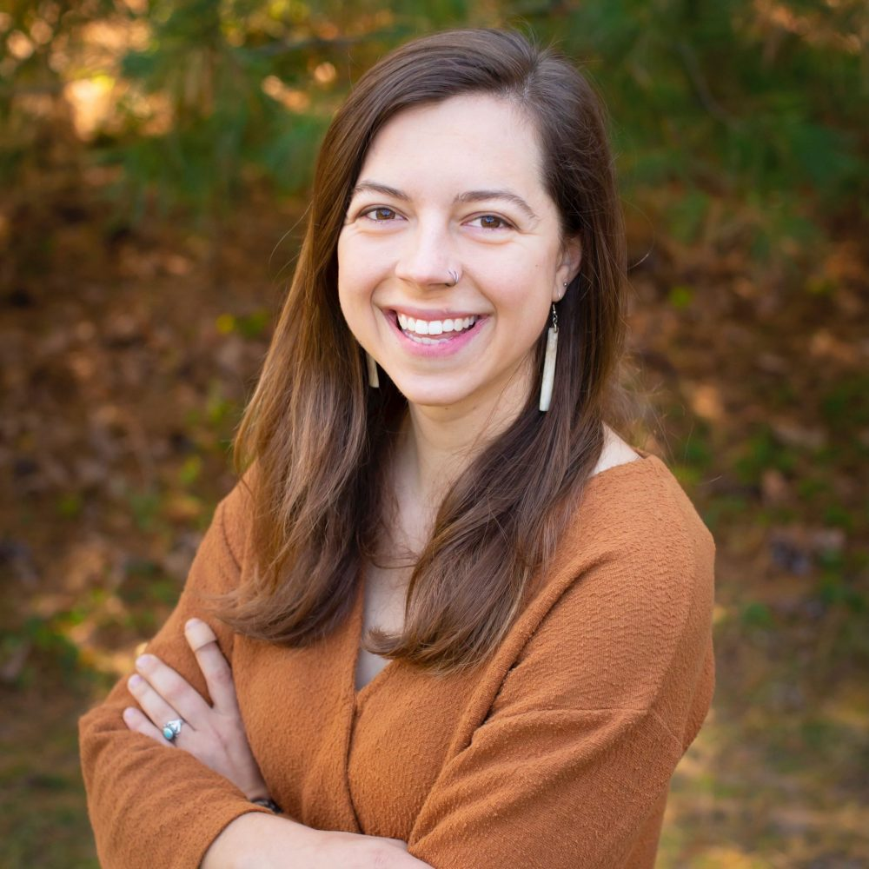

Today’s Presenters
Molly Sowash
Sustainable Agriculture Director, Rural Action
Owner and Operator, MoSo Farms
Kate Garrity
Registered Dietitian
PhD Candidate, University of Michigan
Notes:
Moderator to introduce session speakers
Replace with speaker pictures

Slide 9
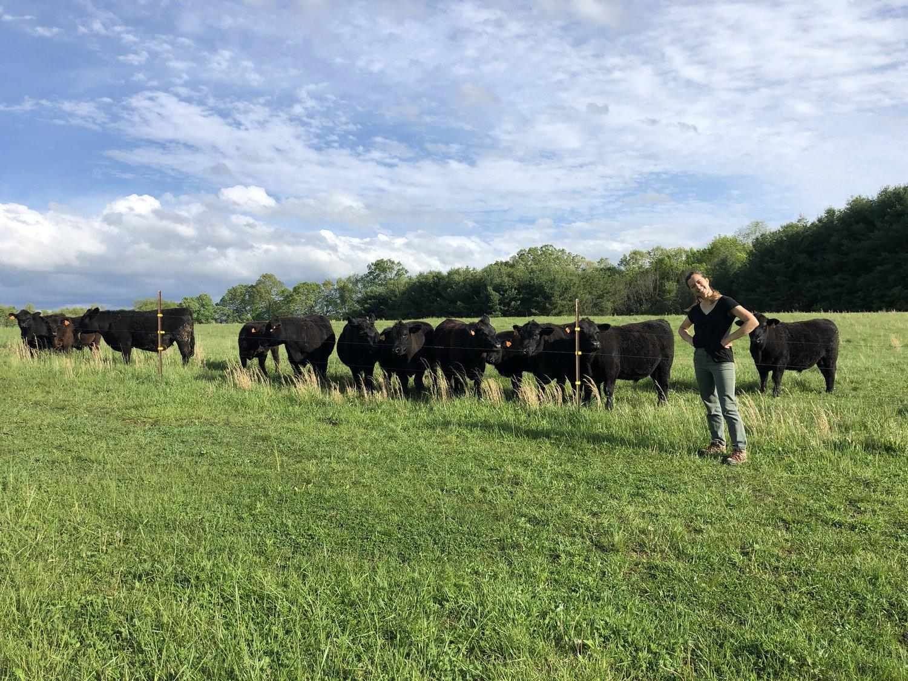


Speaker
Molly Sowash
Sustainable Agriculture Director
molly@ruralaction.org
MoSo Farm Owner Operator
@mosofarmin

Slide 10

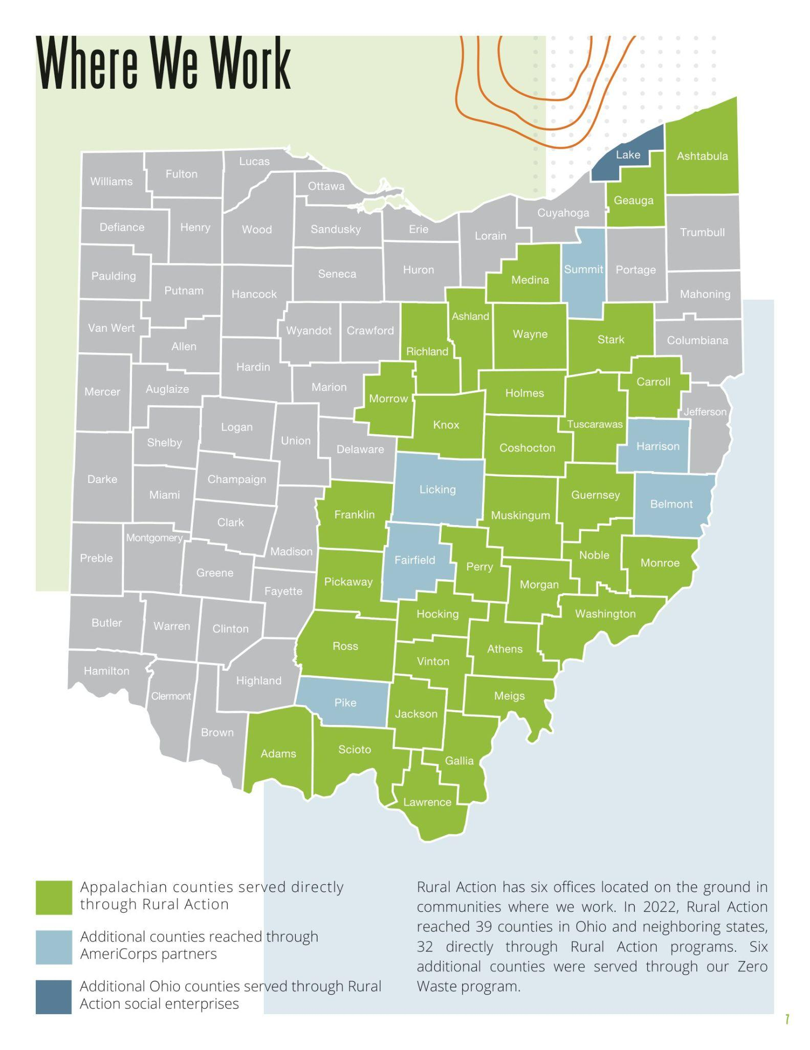
Rural Action
Serving Appalachian Ohio since 1994.
Our Mission is to build a more just economy by developing the region’s assets in environmentally, socially, and economically sustainable ways.

Slide 11
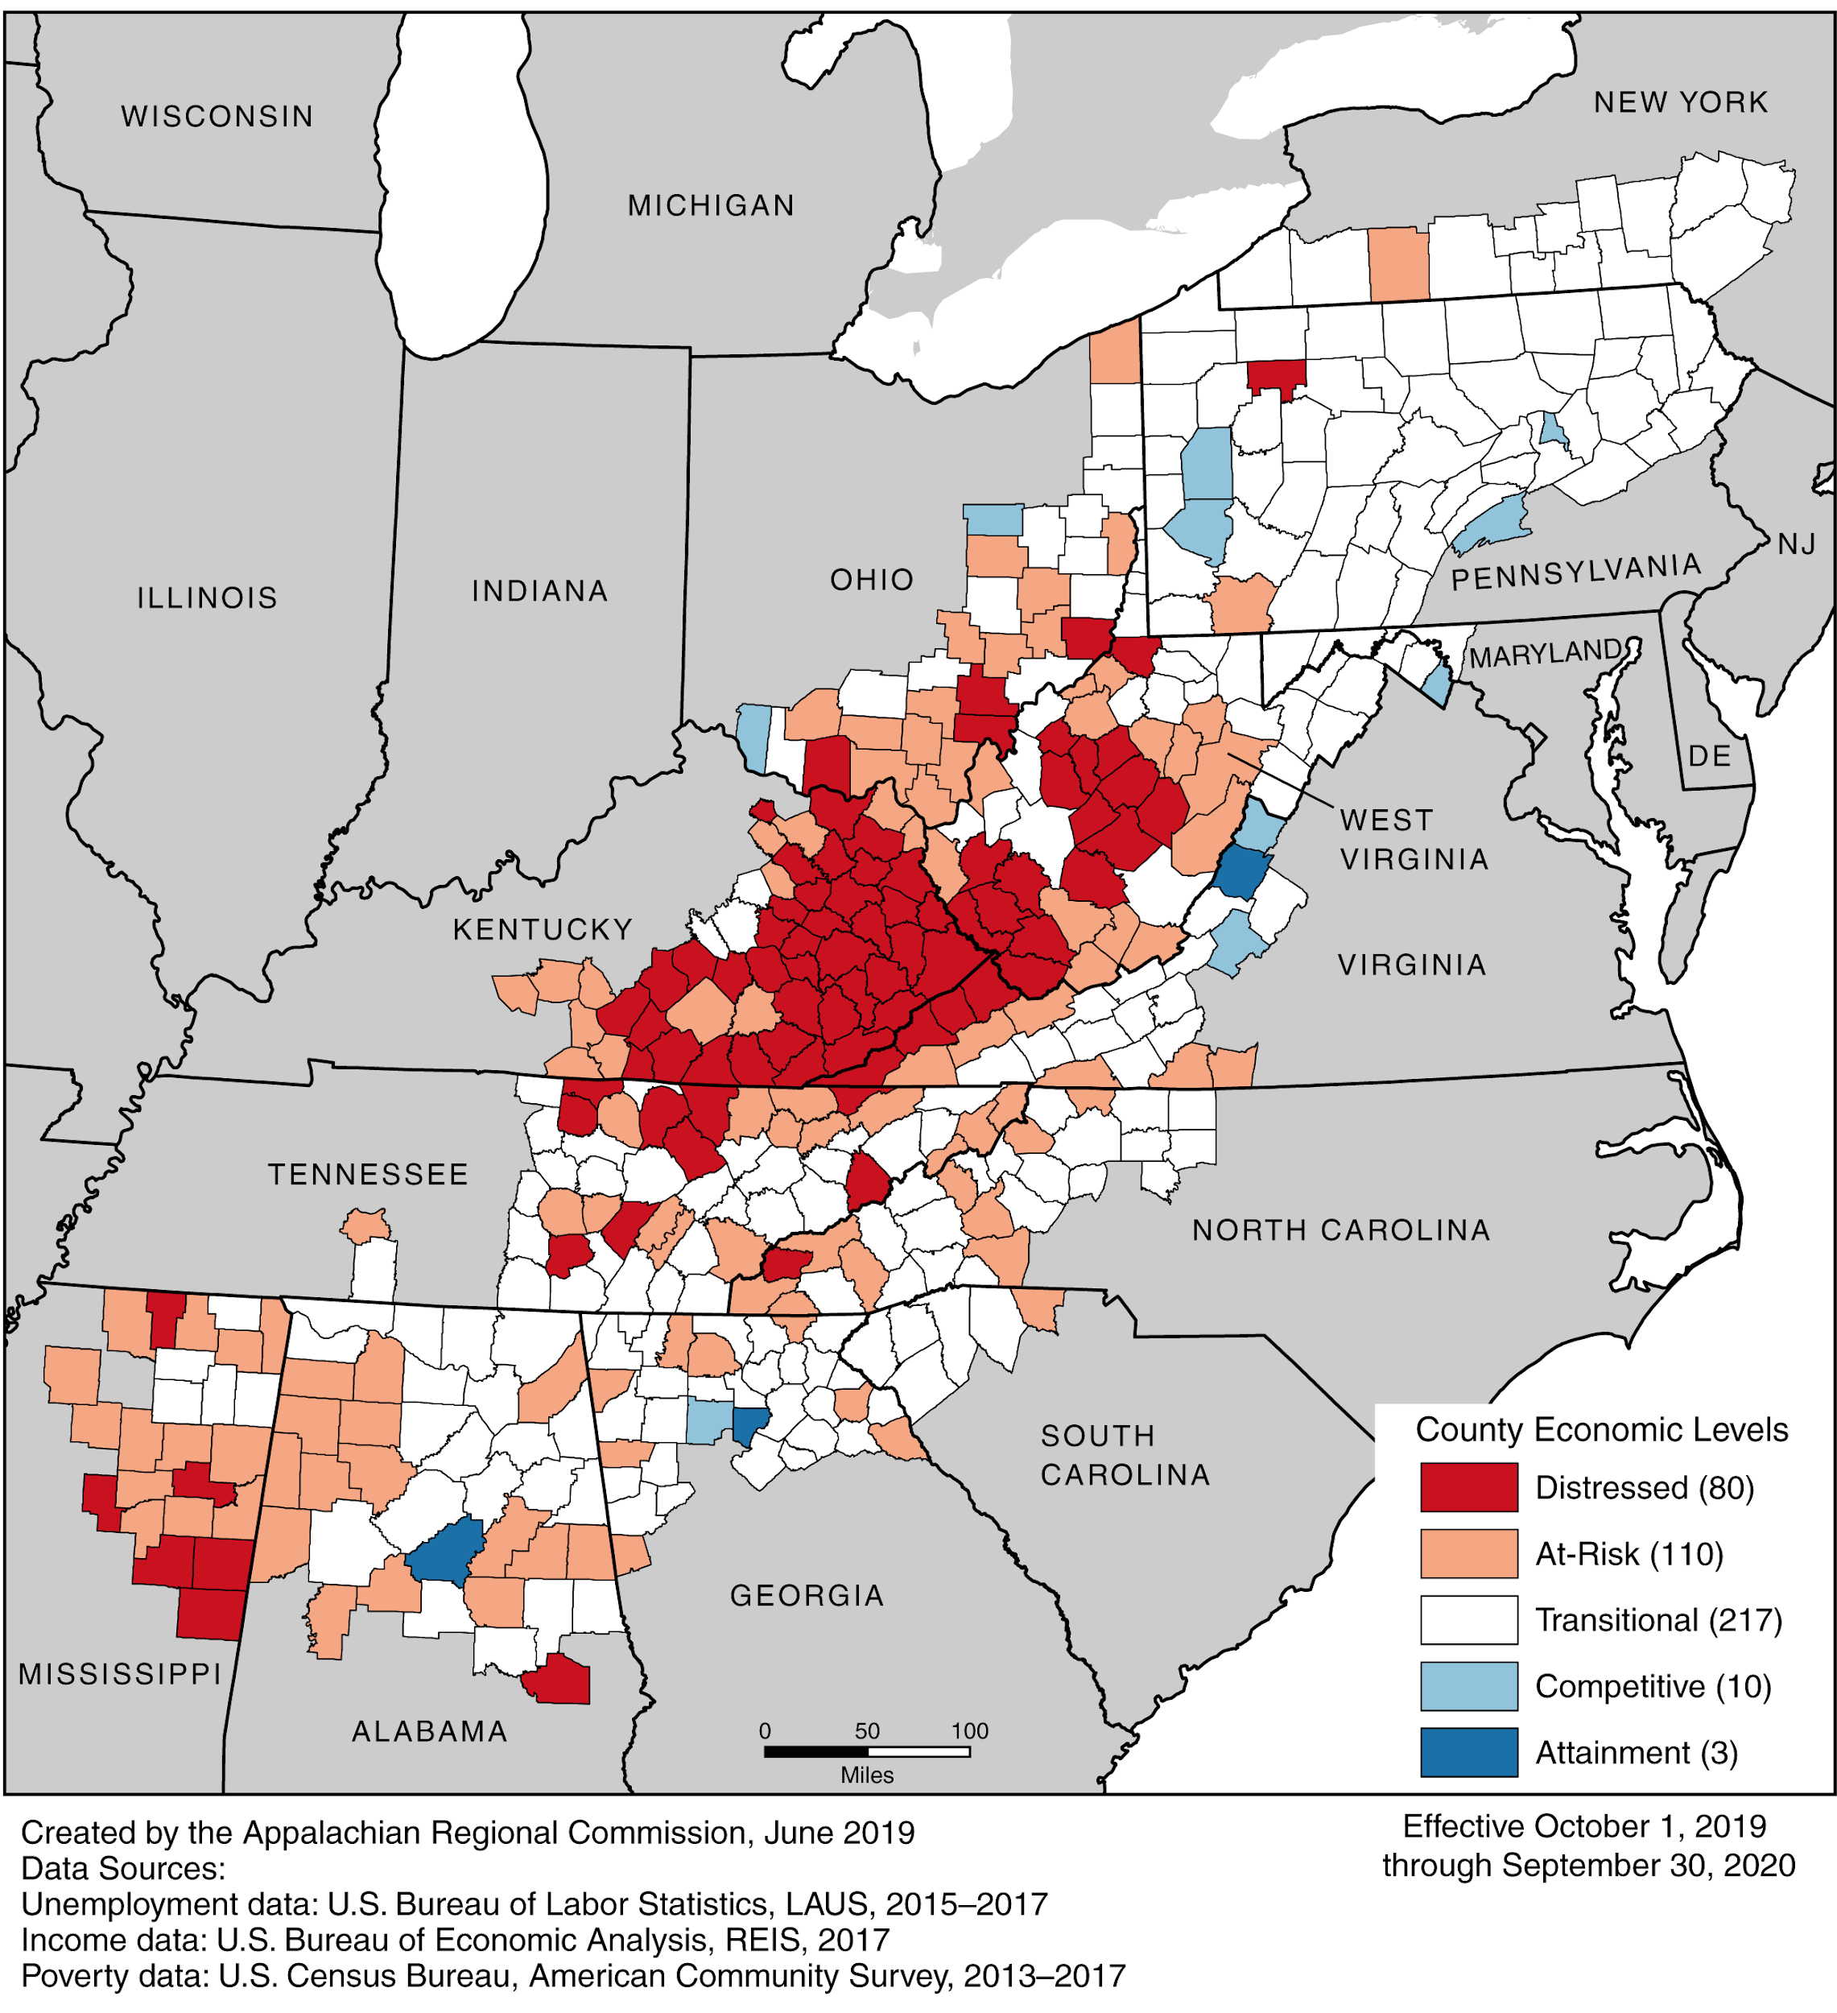
Map
Notes:
And this poverty remains to this day. This map shows economic conditions at the county level for this year. Some areas show promise for economic transition but close to half of all Appalachian counties remain distressed or at-risk (red and lighter orange colors). The reasons for persistent economic insecurity in the region are complex.

Slide 12
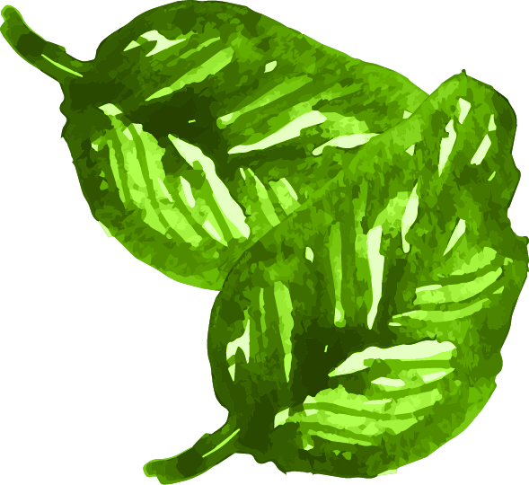




Sustainable Agriculture Program
Food Hub Development
Farmer Support
Farm to Institution
Local Food Access
Appalachian Staple Foods Collaborative

Slide 13
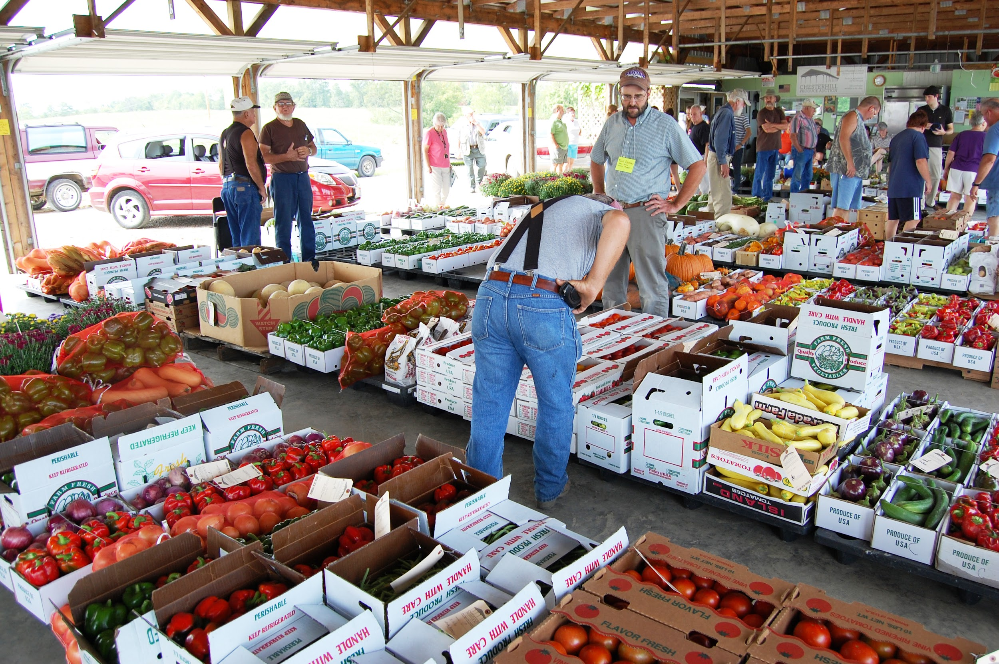

Produce Auction
Notes:
Here is a view of the Chesterhill Produce Auction in the peak season - late July or August. You can see the variety of product and large volume for sale. The produce auction model is used through much of Appalachia (especially Ohio, Pennsylvania, and Kentucky) to bring together large amounts of fresh fruits and vegetables. Outside of California and Florida, these are the produce growing hot spots in the U.S. And the best part of this model for produce growers - especially new farmers? Everything will sell. All they have to do is drop off their product for sale. A small commission fee on sales covers business expenses.

Slide 14
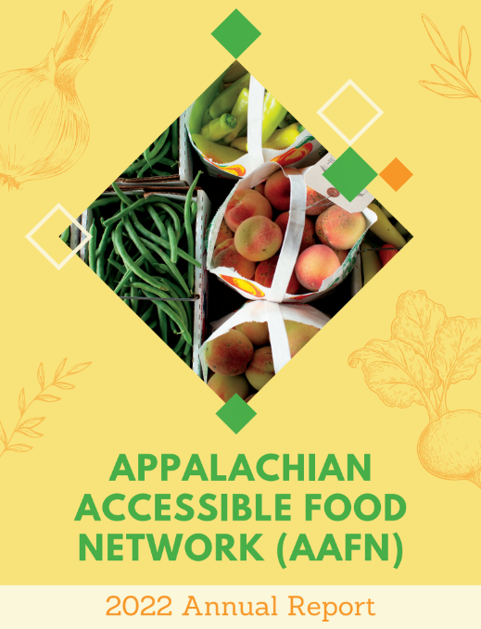
Local Food Access
Appalachian Accessible Food Network (AAFN)
  Three partnering non-profits
  Southeast Ohio Food Bank
Projects include:
  Farm to School
  Produce Prescriptions
  Country Fresh Stops
  Buying Club - Local Food for All
“It is a significant challenge for Ohio to acknowledge that more than one quarter of the population, in a prominent farm state, is unable to afford the food they need.” - Ken Meters

Slide 15
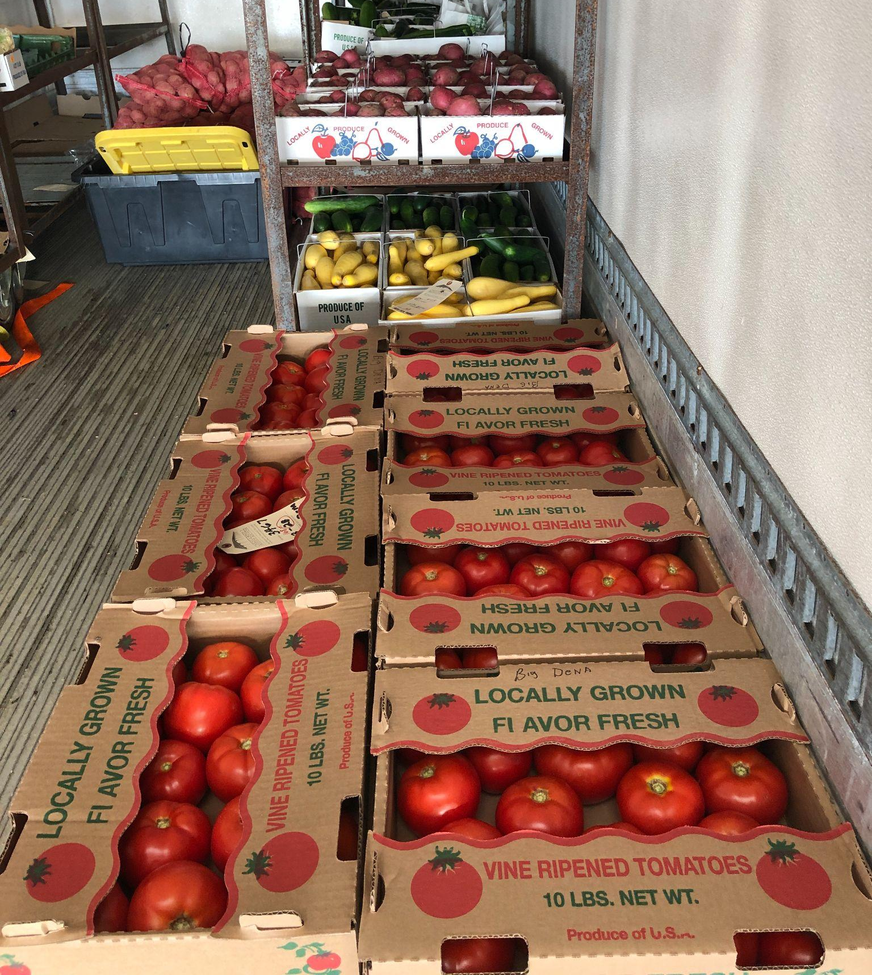
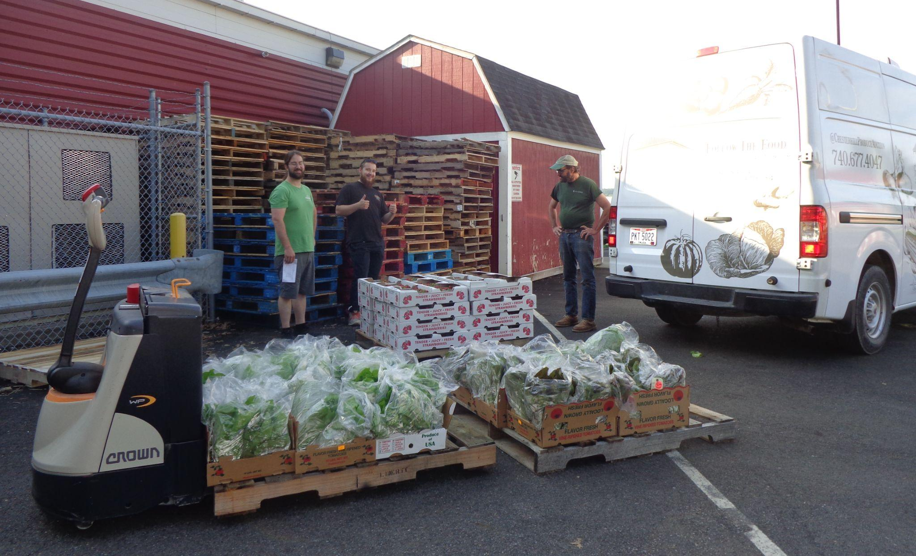
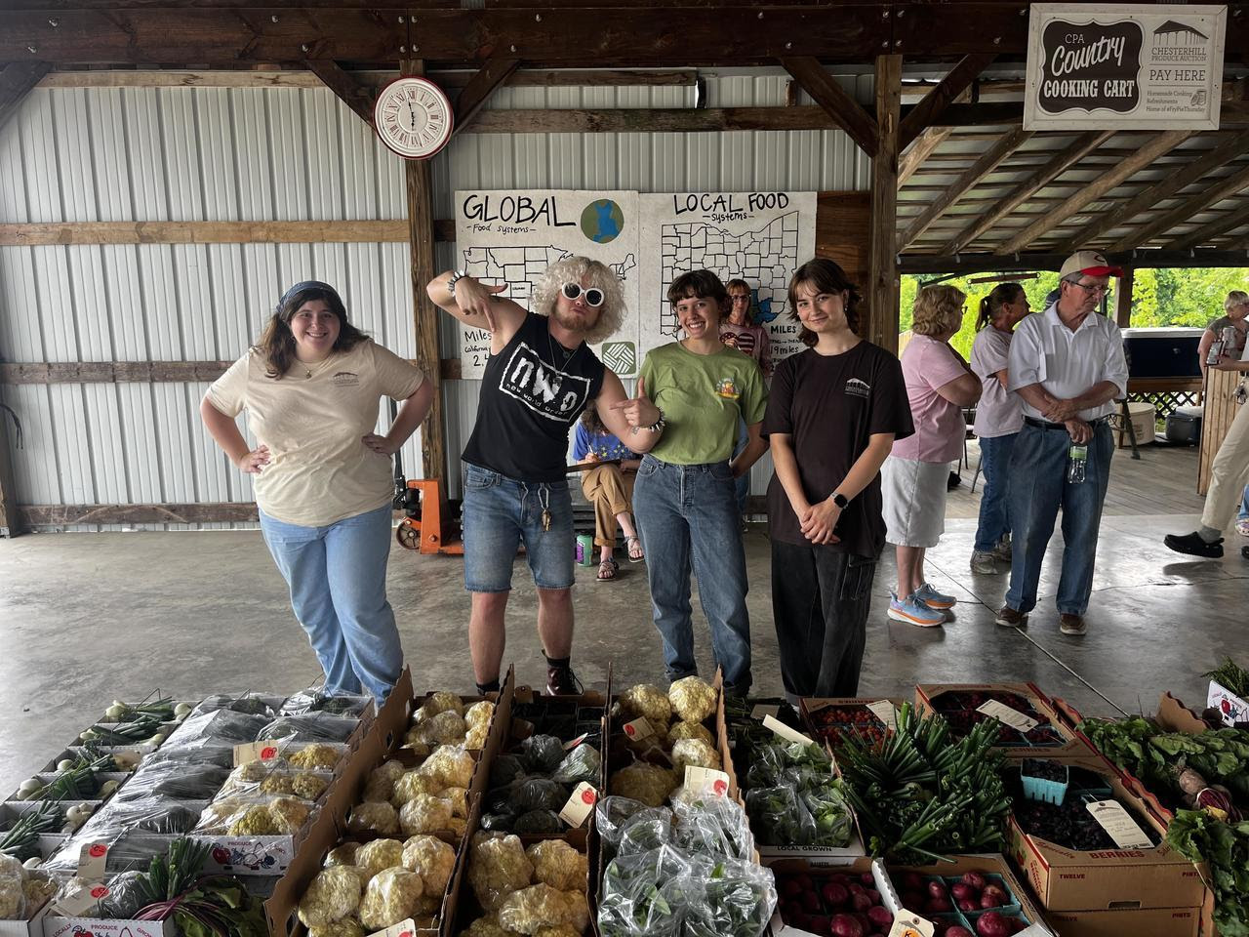
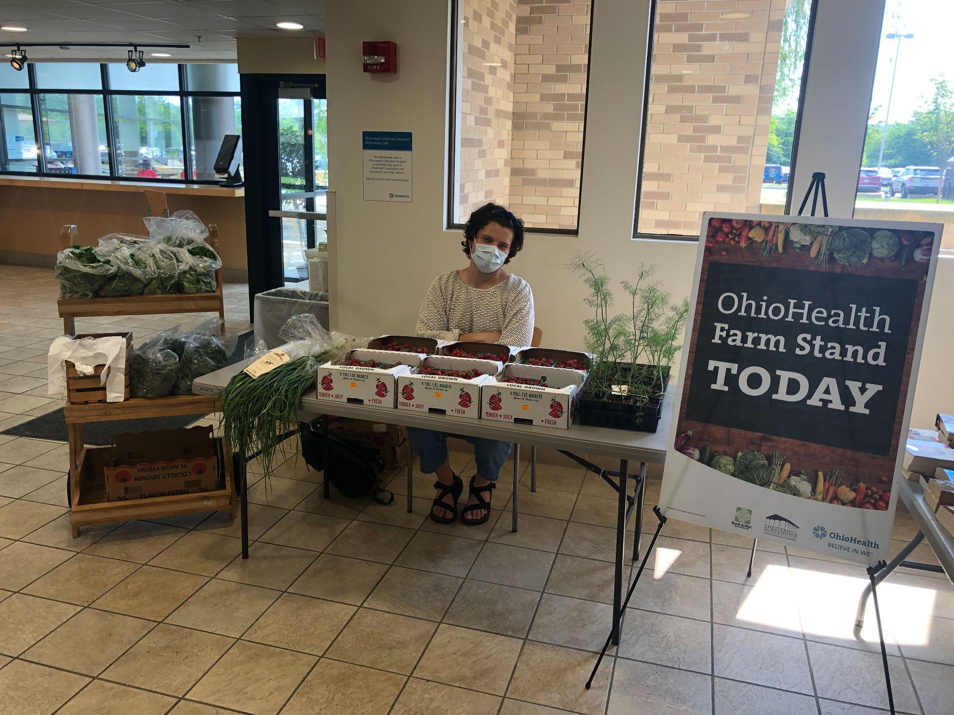
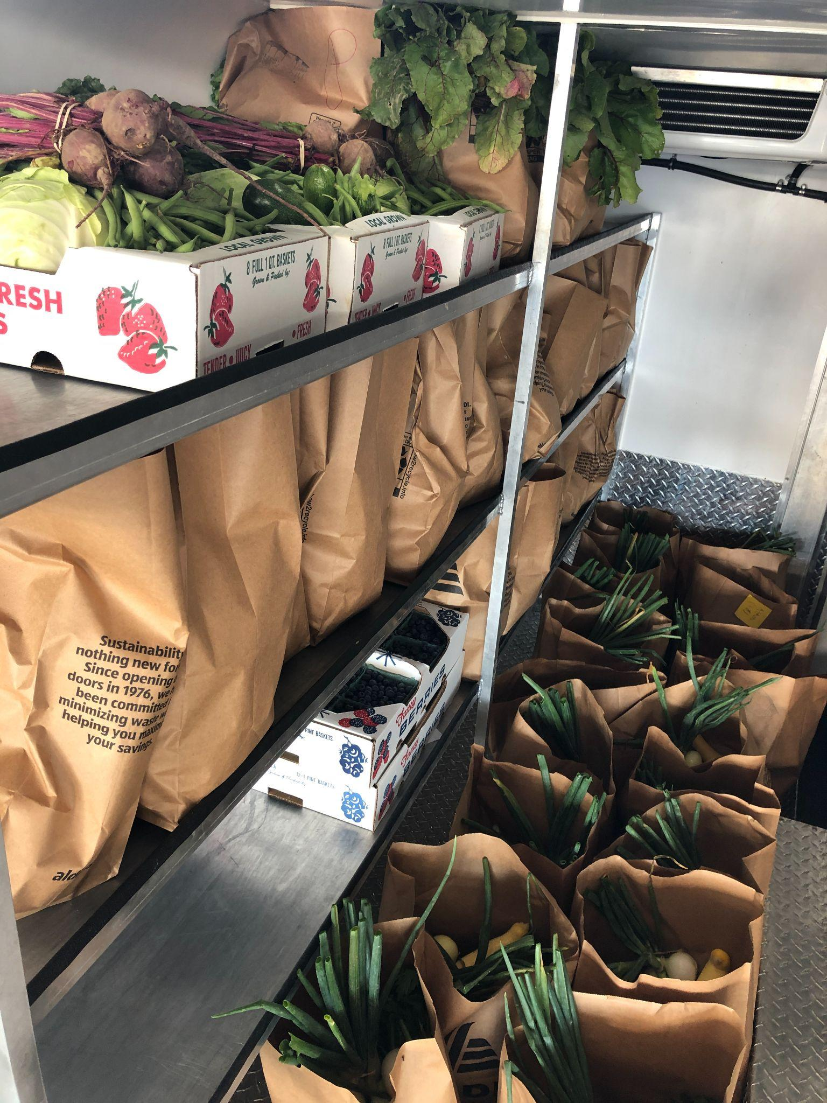
What is your favorite item of produce that grows locally near you?
Notes:
TOM

Slide 16
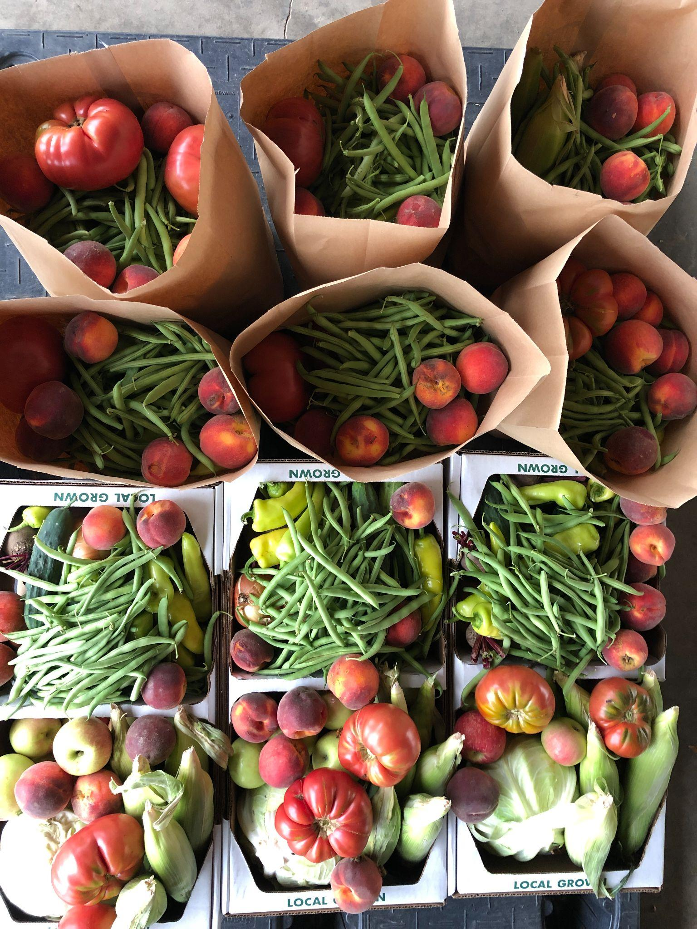
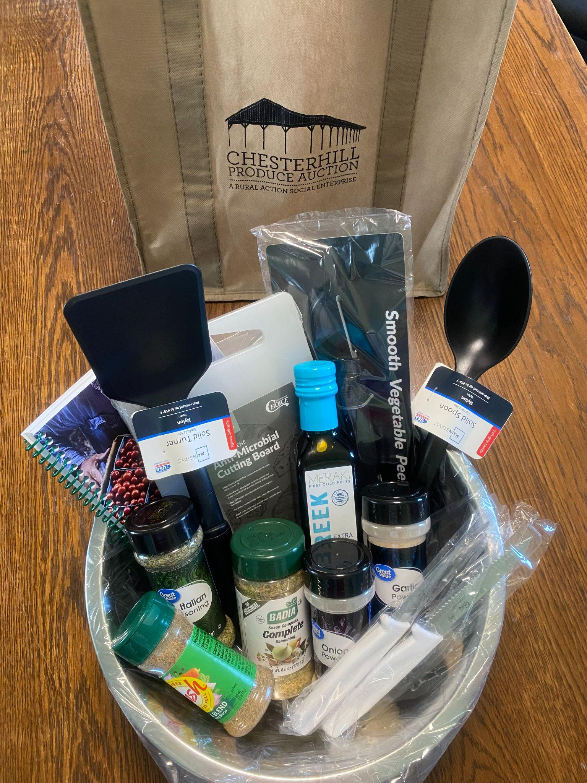
Produce Prescriptions
Weekly shares of seasonal, local produce for healthcare patients managing difficult health conditions and/or experiencing food insecurity.
Rural Action’s role is to…
  purchase bulk amounts of local produce from the Chesterhill Produce Auction and other local producers
  package the produce into mixed bags of seasonal fruits and vegetables
  deliver them weekly to clinics that serve as pickup sites
Healthcare provider's role is to…
  refer patients to the program
  communicate with patients about pickup times and reminders
  track data for evaluation

Slide 17
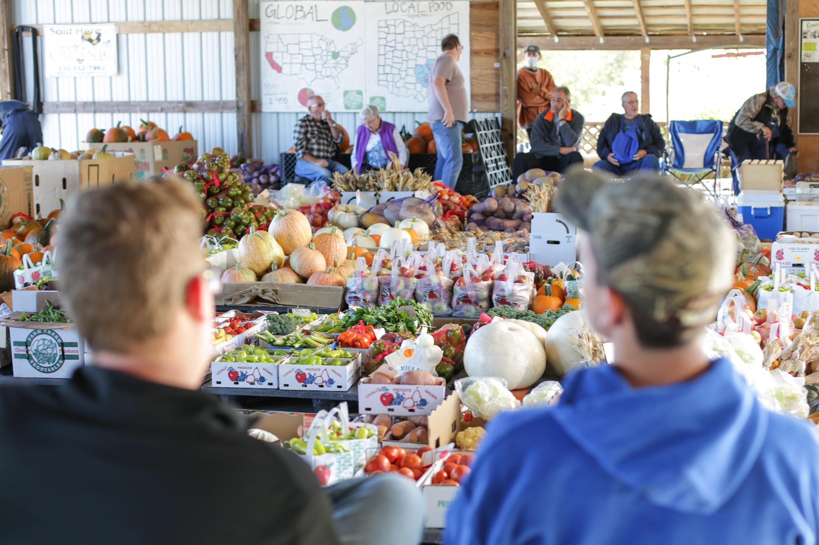
1. Procure local produce
Notes:
2023: Purchased $41,077 of produce from local farmers

Slide 18
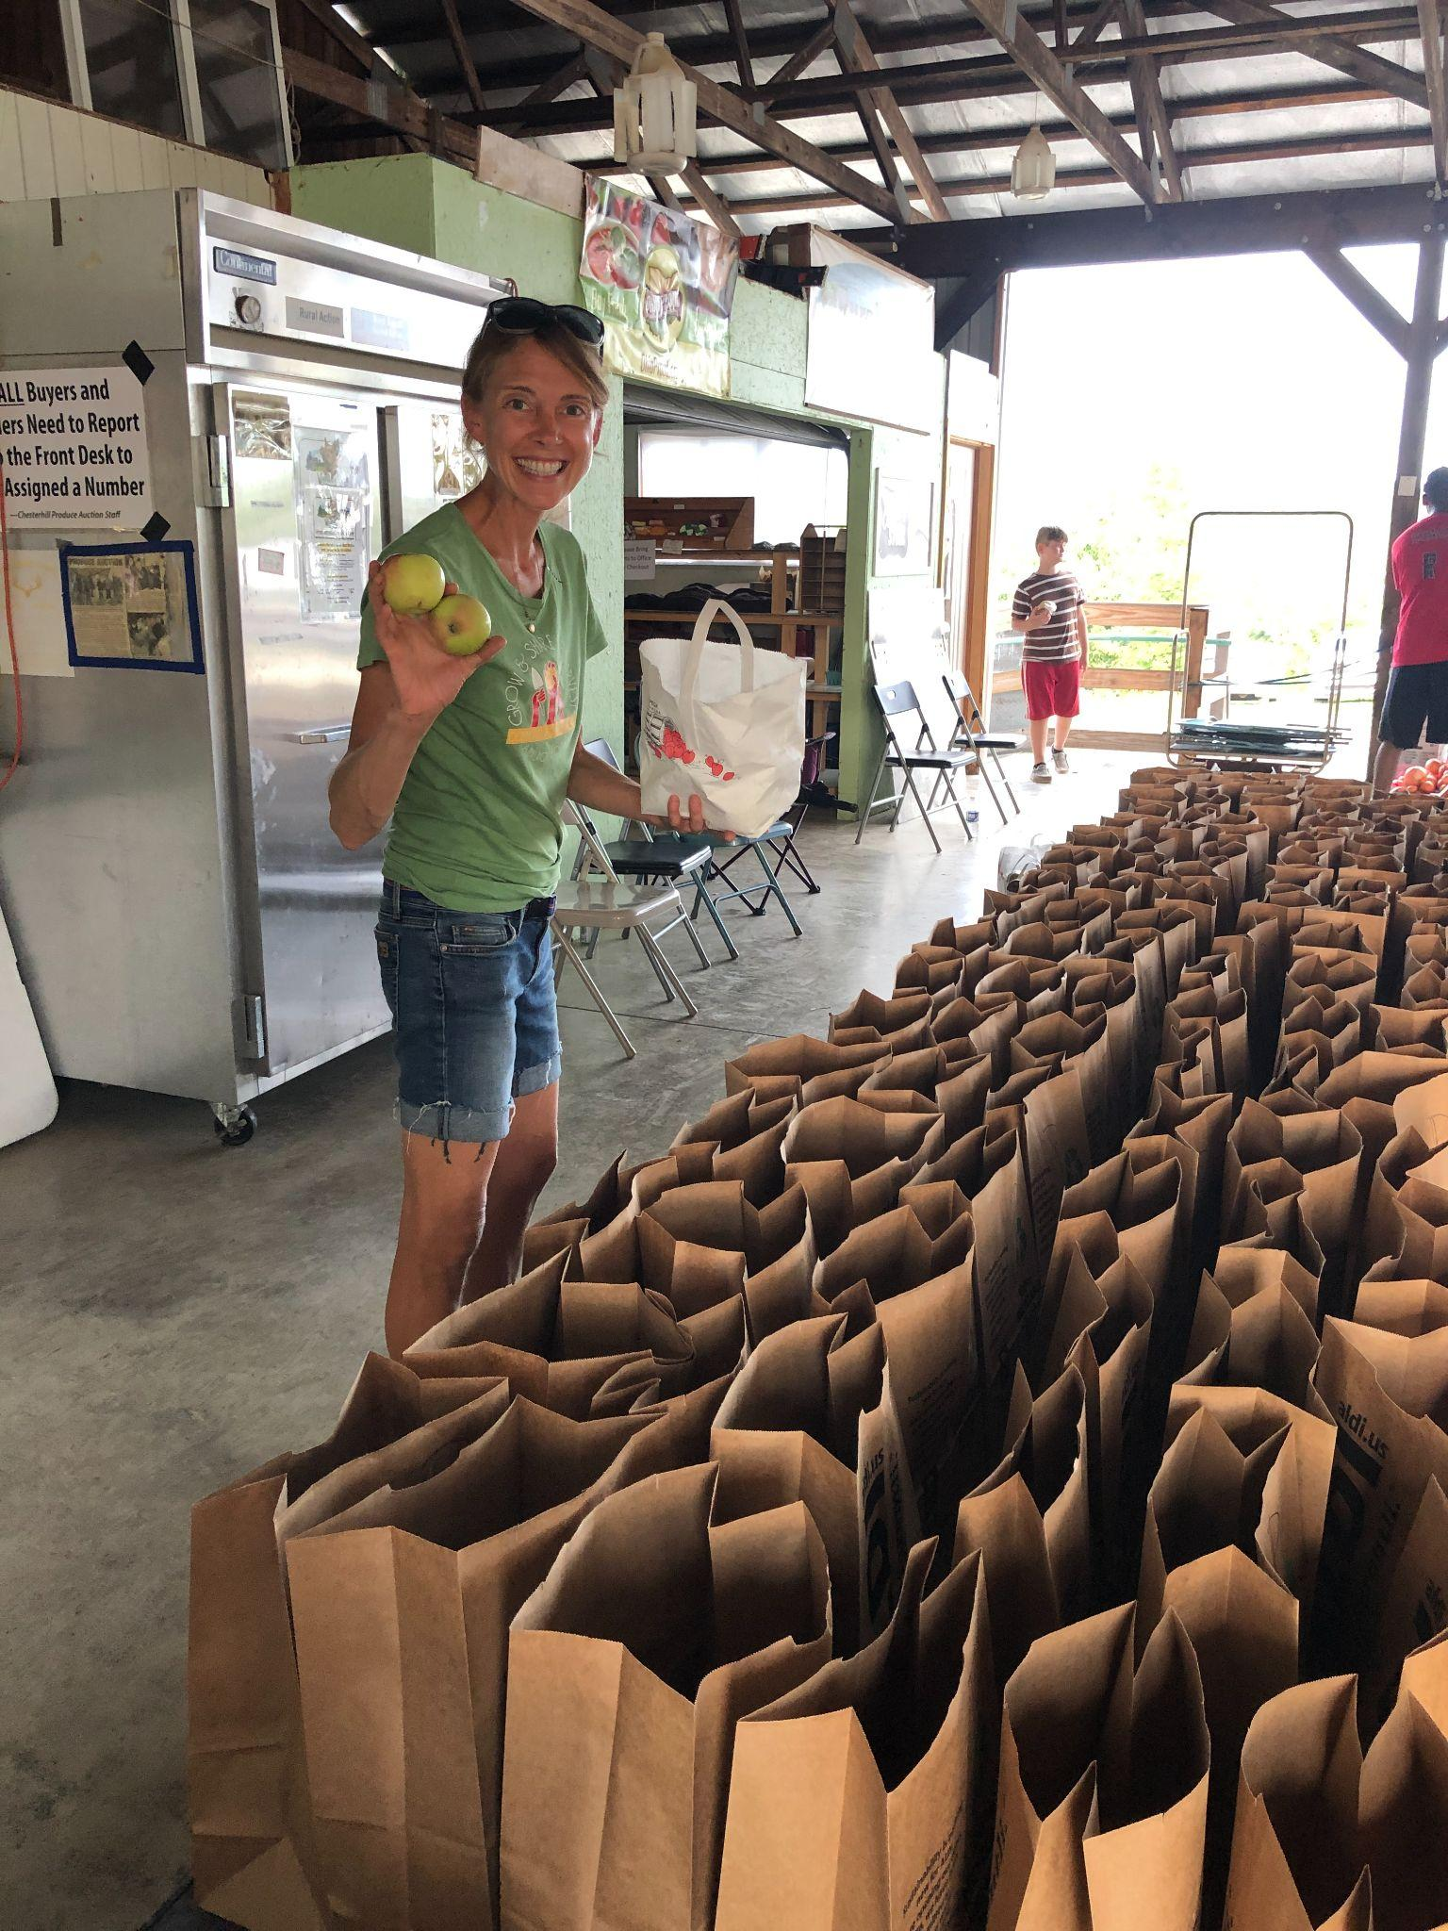
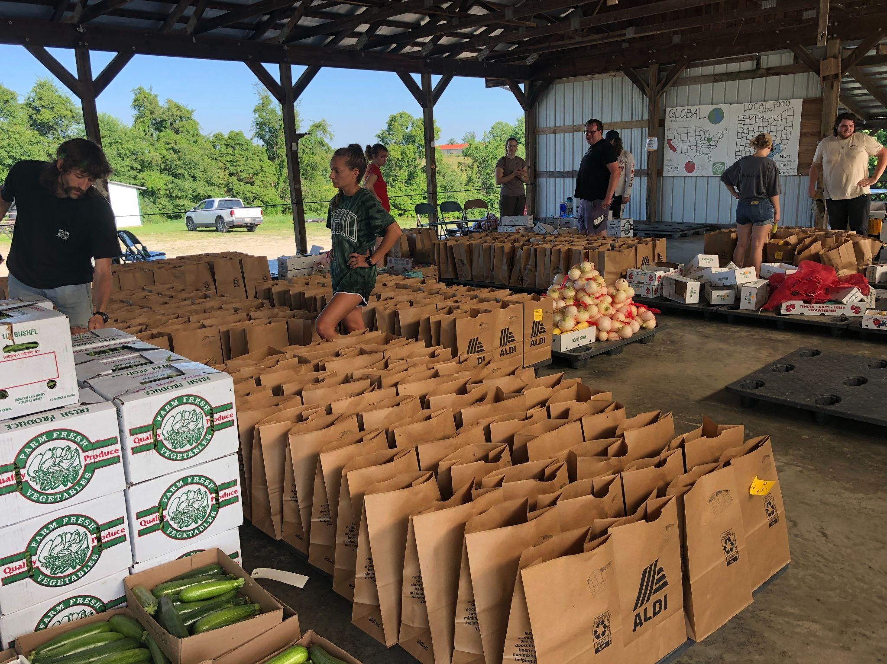
2. Pack shares

Slide 19
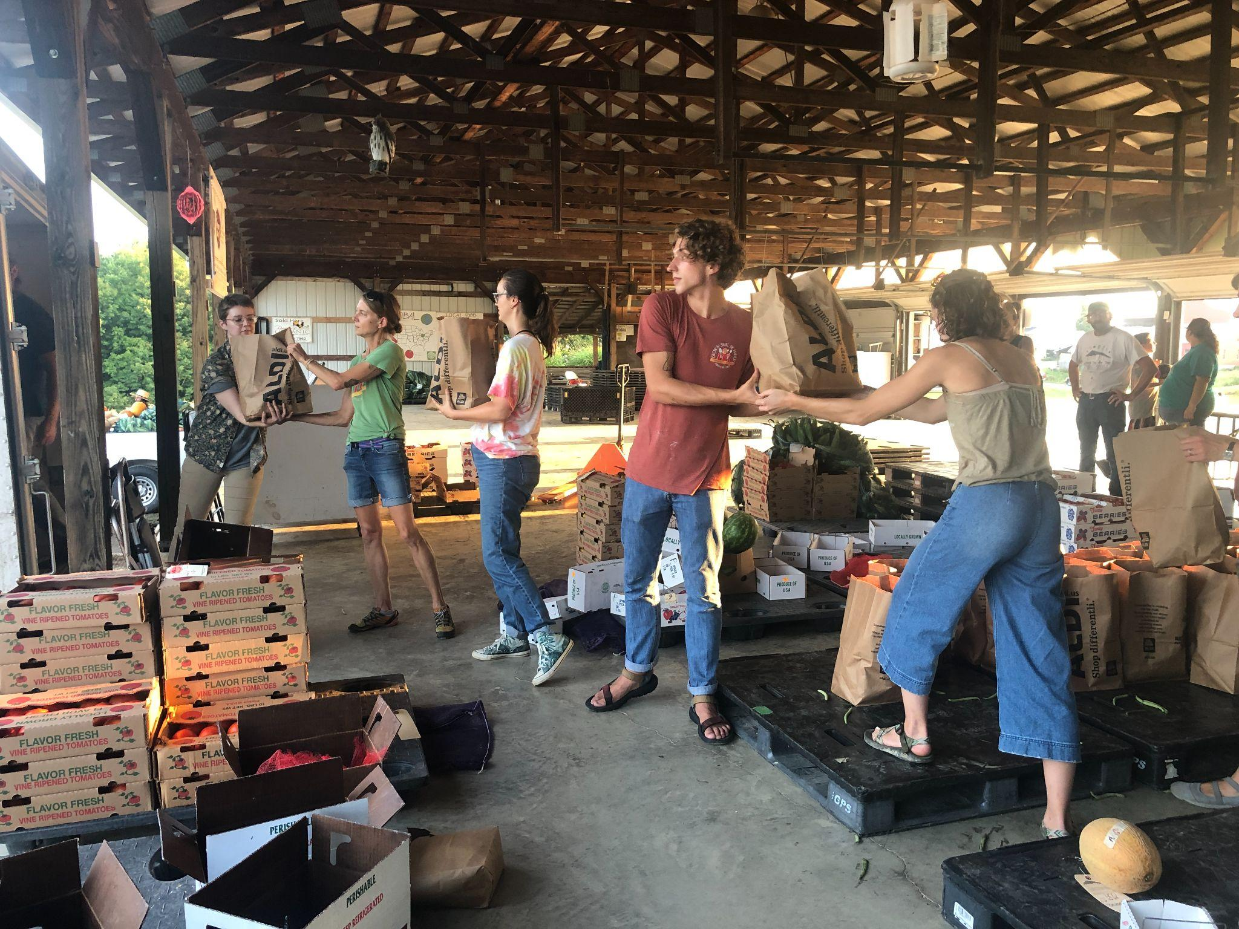
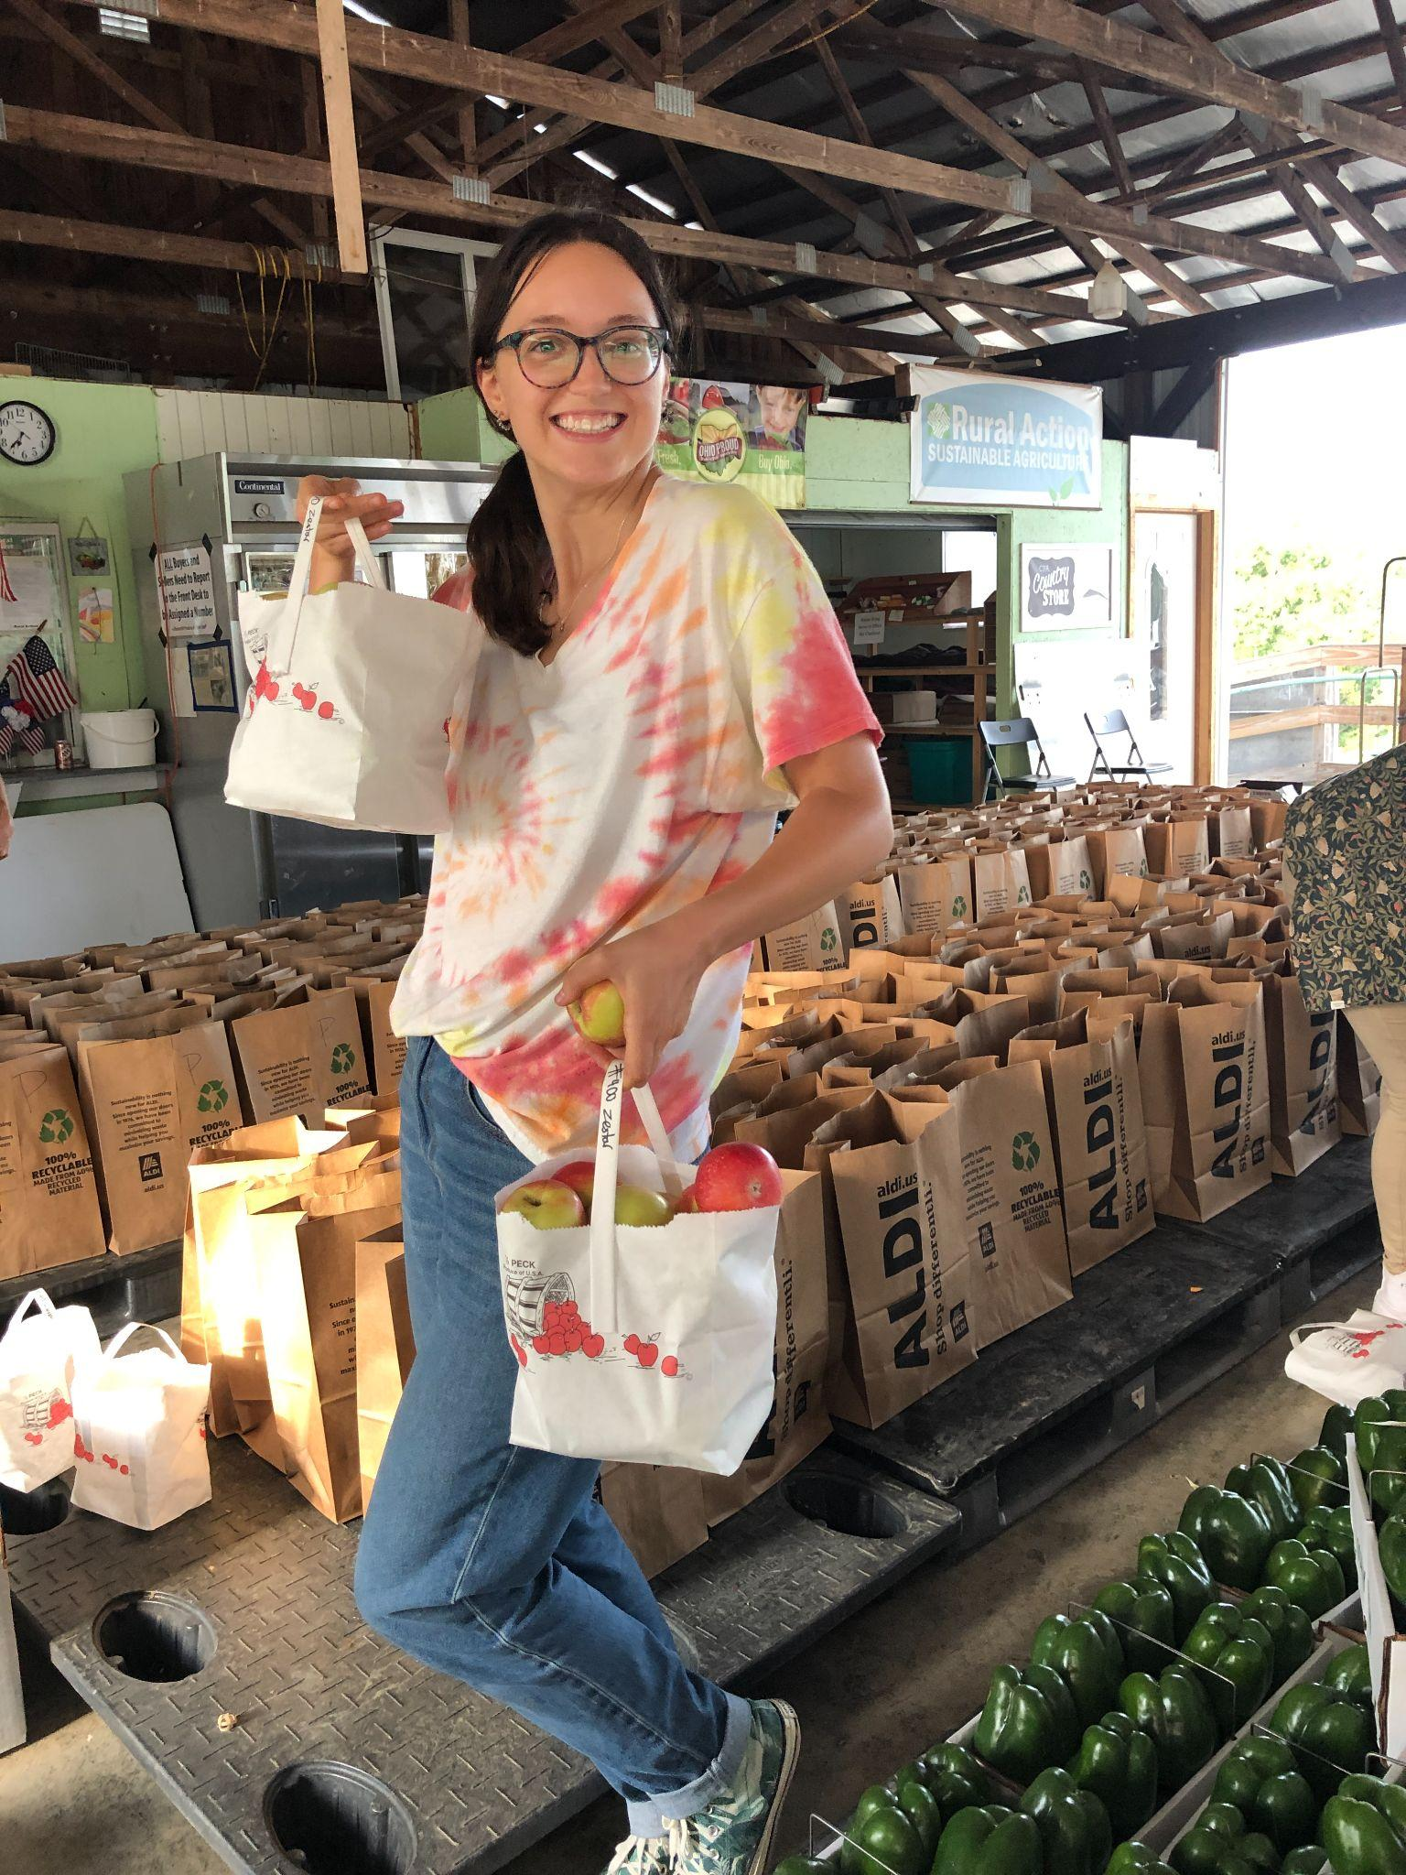
3. Load vehicles

Slide 20
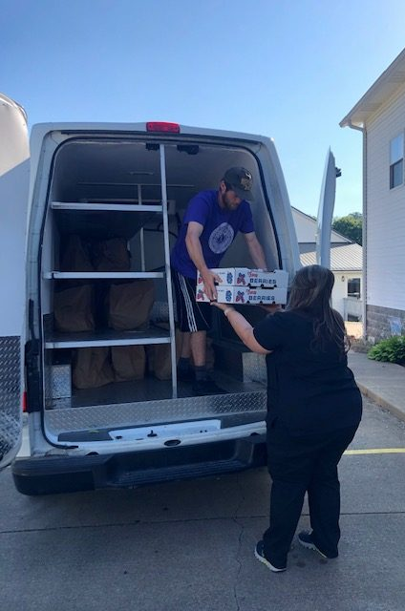
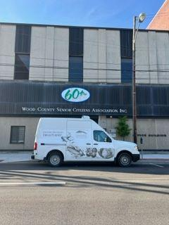
4. Deliver to 7 clinics (6 counties)

Slide 21
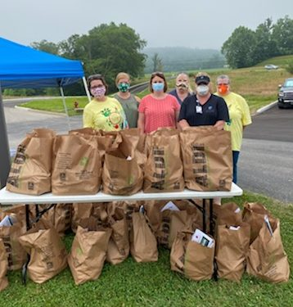
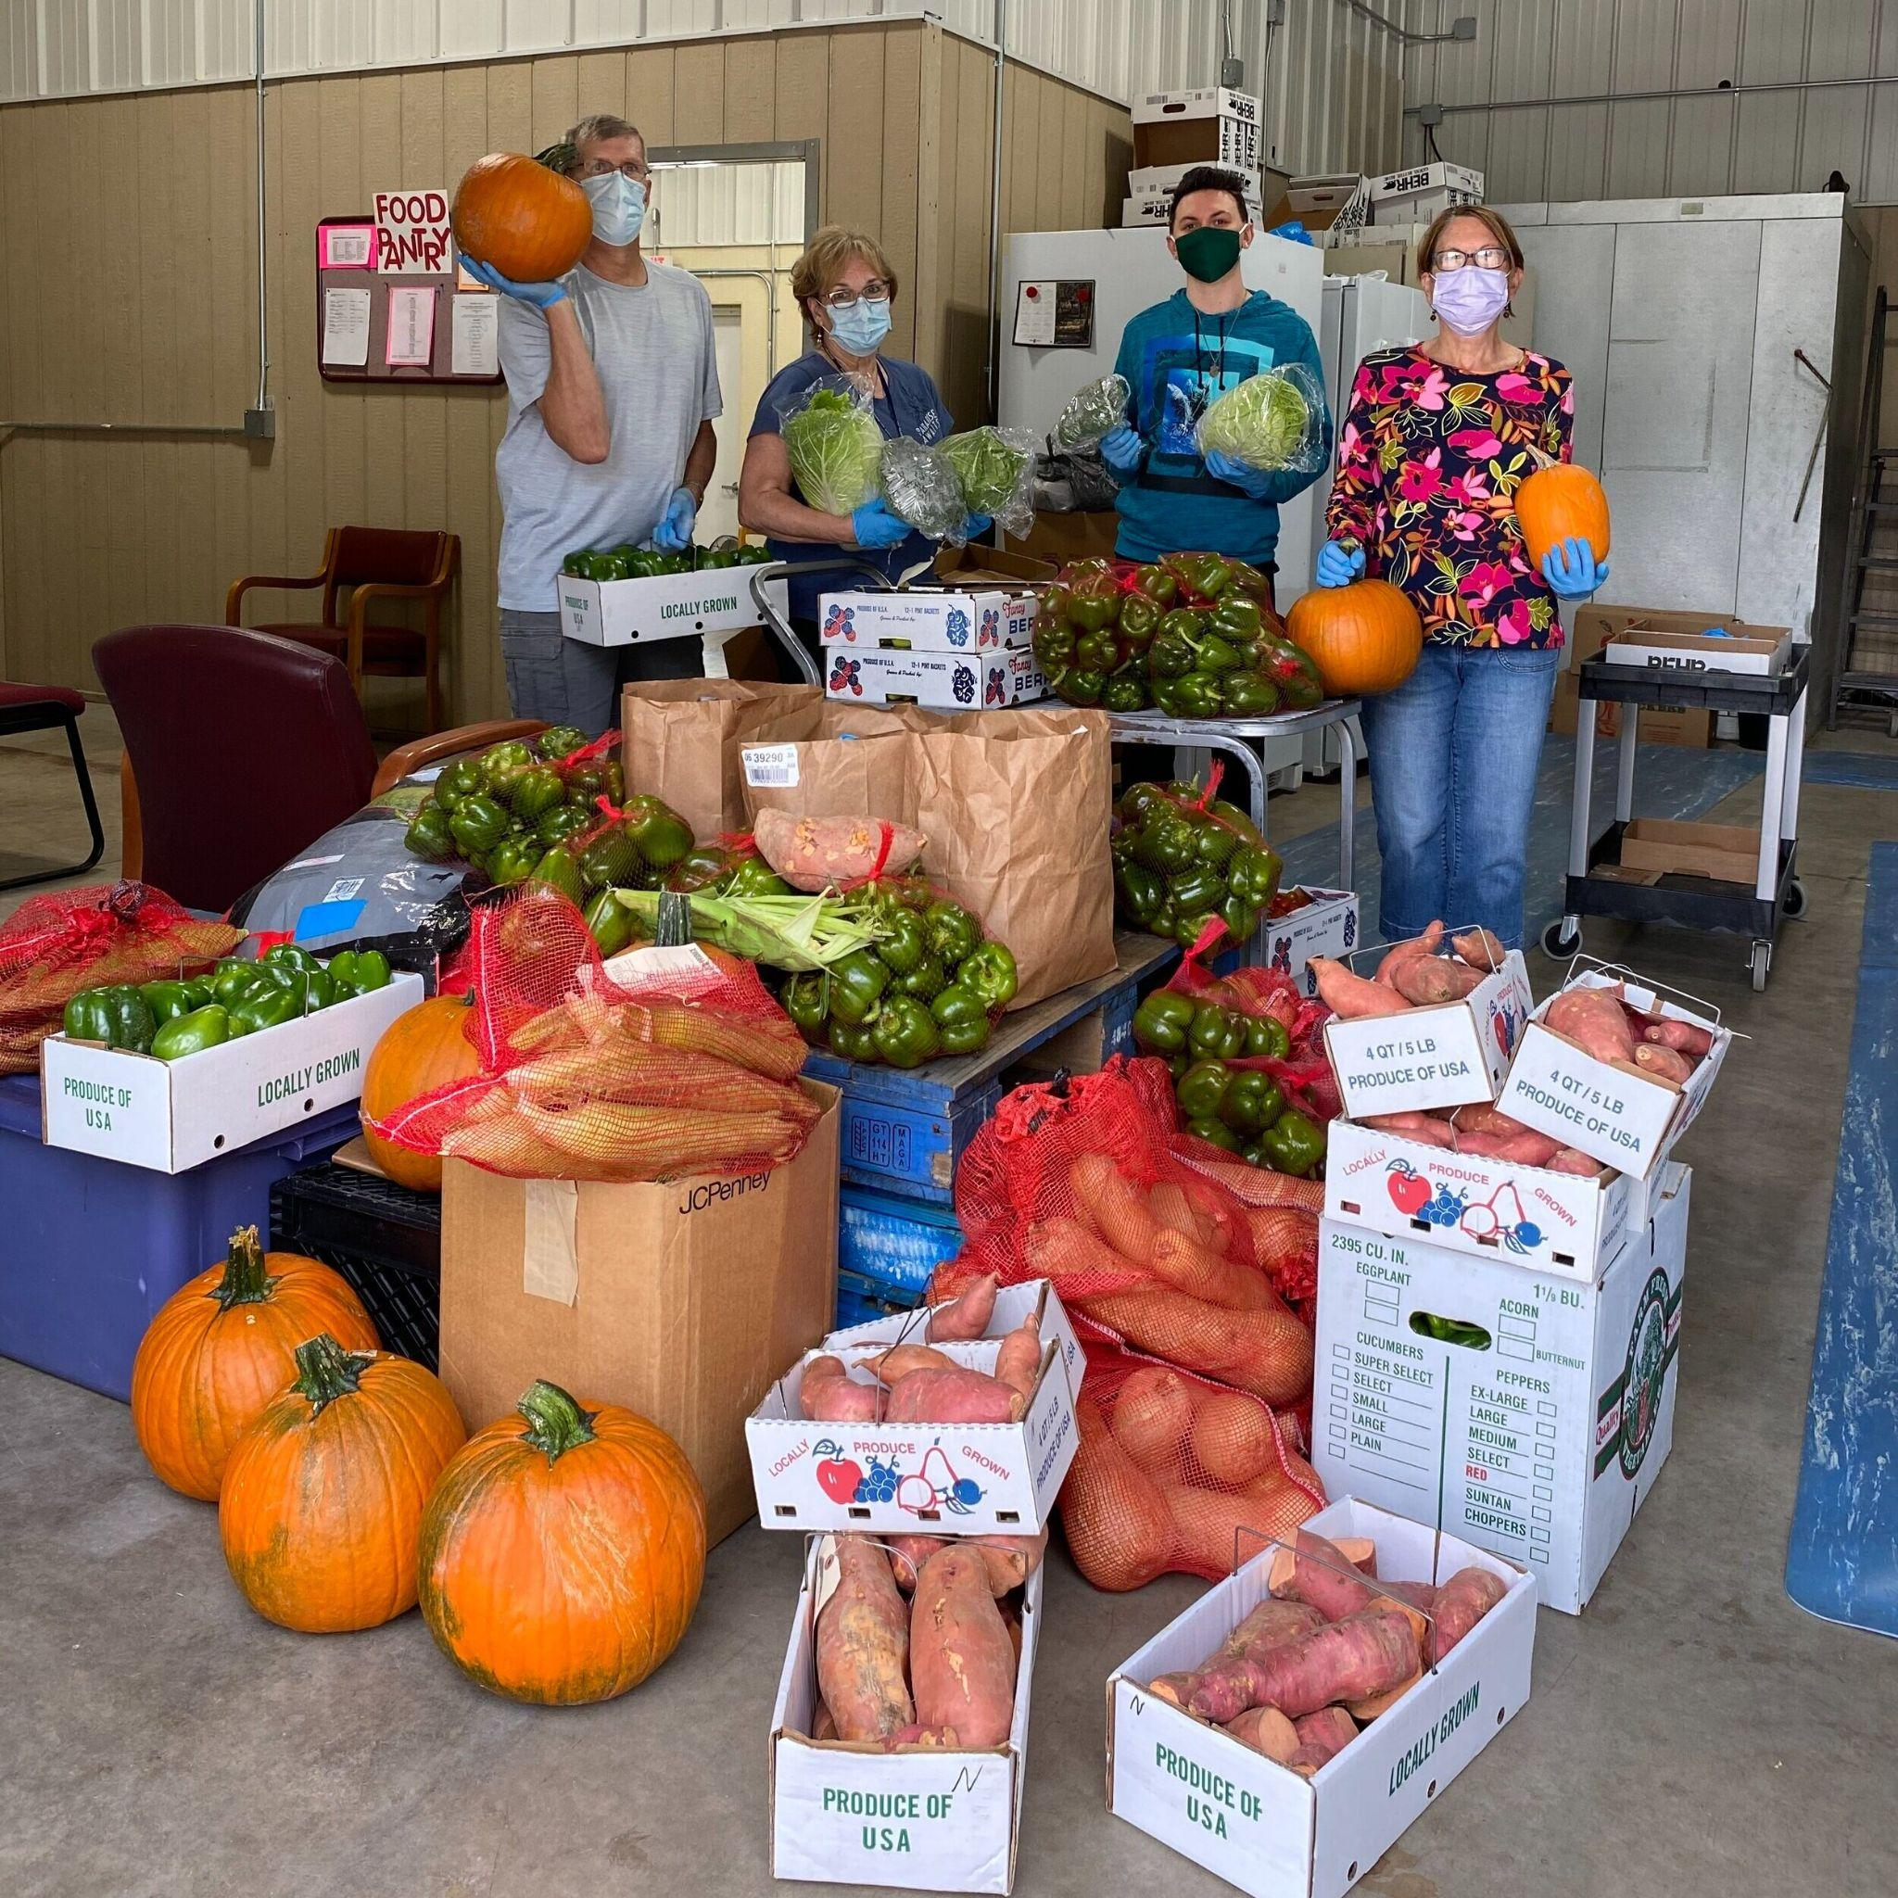
5. Healthcare clients pick up produce share
Notes:
2023: Served 195 households weekly for 11-19 weeks (105 in Ohio, 90 in West Virginia)

Slide 22
What makes it work?
Our strength is our deep partnerships.
  Going back 30 years in some cases → collaboration, trust take time
  Trusting relationships with farmers, other non-profits, healthcare providers
  We depend upon each other.
We have had to work through challenges over the partnership’s lifecourse.
  Strategy 1: Formalizing the partnership → Appalachian Accessible Food Network
    Common vision + mutually-reinforcing activities + shared impact reporting
  Strategy 2: Regular AAFN meetings/continuous communication
  Strategy 3: Staff liaison that works at the intersection of multiple organizations
We have leveraged unique assets and opportunities:
  Local food sourcing as a “leader in the state” according to Ohio Dept of Ag.
  Strong local growers with a food hub to aggregate produce

Slide 23
What makes it work? challenges
Our strength is our deep partnerships.
  Going back 30 years in some cases → collaboration, trust take time
  Trusting relationships with farmers, other non-profits, healthcare providers
  We depend upon each other.
We have had to work through challenges over the partnership’s lifecourse.
  Strategy 1: Formalizing the partnership → Appalachian Accessible Food Network
    Common vision + mutually-reinforcing activities + shared impact reporting
  Strategy 2: Regular AAFN meetings/continuous communication
  Strategy 3: Staff liaison that works at the intersection of multiple organizations
We have leveraged unique assets and opportunities:
  Local food sourcing as a “leader in the state” according to Ohio Dept of Ag.
  Strong local growers with a food hub to aggregate produce

Slide 24
What makes it work? Unique assets
Our strength is our deep partnerships.
  Going back 30 years in some cases → collaboration, trust take time
  Trusting relationships with farmers, other non-profits, healthcare providers
  We depend upon each other.
We have had to work through challenges over the partnership’s lifecourse.
  Strategy 1: Formalizing the partnership → Appalachian Accessible Food Network
    Common vision + mutually-reinforcing activities + shared impact reporting
  Strategy 2: Regular AAFN meetings/continuous communication
  Strategy 3: Staff liaison that works at the intersection of multiple organizations
We have leveraged unique assets and opportunities:
  Local food sourcing as a “leader in the state” according to Ohio Dept of Ag.
  Strong local growers with a food hub to aggregate produce

Slide 25

Working toward cross-sector collaborations: strategies for trainees
Kate Garrity, MS, RD
Ph.D. Candidate
University of Michigan’s School of Public Health
Department of Nutritional Sciences
Notes:
Good afternoon everyone, my name is Kate Garrity. I am a Ph.D. candidate at University of Michigan’s School of Public Health in the Nutritional Sciences department. And, I am also a registered dietitian. Today, I’m excited to share how, as trainees, we can get involved in cross-sector work and develop the essential skills needed to succeed in these collaborations.

Slide 26
Strategies for Trainees
Be Proactive in building your network
  Reach out to scholars who inspire you (e.g., after conference or webinar)
  Join relevant organizations/associations and participate in their activities
  Expand your mentoring committee to include non-academics
Develop foundational skills
  e.g., effective communication, community-engaged research, project management
Show up and be engaged
  Be present in meetings! Take notes, speak up
  Observe how things work in practice → flexibility, adaptability are key
These strategies can be accomplished via classes, webinars, trainings, involvement in associations, internships, and hands-on project experiences!
Notes:
Listed on this slide are strategies for successful cross-sector collaborations as a trainee. I’ve included strategies for getting involved as well as strategies for building the skills necessary to successful collaboration. And while we are focusing on cross-sector collaboration, please note that these strategies are helpful in any collaborative work.

Slide 27
Strategies for Trainees cont
Be Proactive in building your network
  Reach out to scholars who inspire you (e.g., after conference or webinar)
  Join relevant organizations/associations and participate in their activities
  Expand your mentoring committee to include non-academics
Develop foundational skills
  e.g., effective communication, community-engaged research, project management
Show up and be engaged
  Be present in meetings! Take notes, speak up
  Observe how things work in practice → flexibility, adaptability are key
These strategies can be accomplished via classes, webinars, trainings, involvement in associations, internships, and hands-on project experiences!
Notes:
Listed on this slide are strategies for successful cross-sector collaborations as a trainee. I’ve included strategies for getting involved as well as strategies for building the skills necessary to successful collaboration. And while we are focusing on cross-sector collaboration, please note that these strategies are helpful in any collaborative work.

Slide 28
Strategies for Trainees cont.
Be Proactive in building your network
  Reach out to scholars who inspire you (e.g., after conference or webinar)
  Join relevant organizations/associations and participate in their activities
  Expand your mentoring committee to include non-academics
Develop foundational skills
  e.g., effective communication, community-engaged research, project management
Show up and be engaged
  Be present in meetings! Take notes, speak up
  Observe how things work in practice → flexibility, adaptability are key
These strategies can be accomplished via classes, webinars, trainings, involvement in associations, internships, and hands-on project experiences!
Notes:
Listed on this slide are strategies for successful cross-sector collaborations as a trainee. I’ve included strategies for getting involved as well as strategies for building the skills necessary to successful collaboration. And while we are focusing on cross-sector collaboration, please note that these strategies are helpful in any collaborative work.

Slide 29
Q&A
Notes:
Moderator to lead Q/A

Slide 30
Breakout Rooms
Notes:
Moderator to lead breakout session

Slide 31
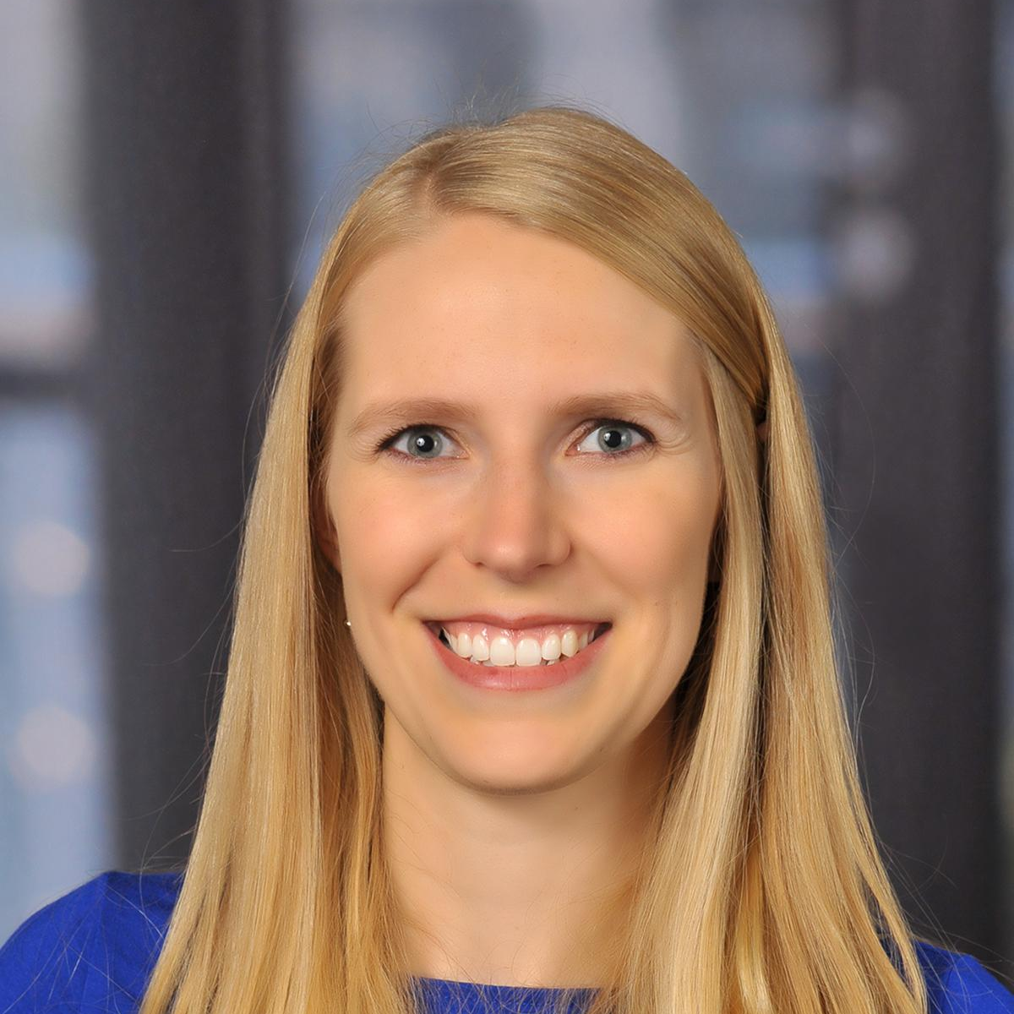
Choose Your Room - Discuss Strategies for Success…
Molly Sowash
Practitioner/Org Perspective
Kate Garrity
Trainee Perspective
Jennifer Garner
Researcher Perspective
Notes:
Speaker Two (if applicable) to input slides

Slide 32
Bringing it all together…
Cross-Sector Collaborations
Summer Speaker Series 2024:
June 12: Food Policies in Schools
June 26: Food is Medicine
July 10: University-based Food Service
July 24: PSE Strategies for Child Health
Public / Government
Nutrition Security
Private / Business
Non-profit / Community
Notes:
Speaker Two (if applicable) to input slides

Slide 33
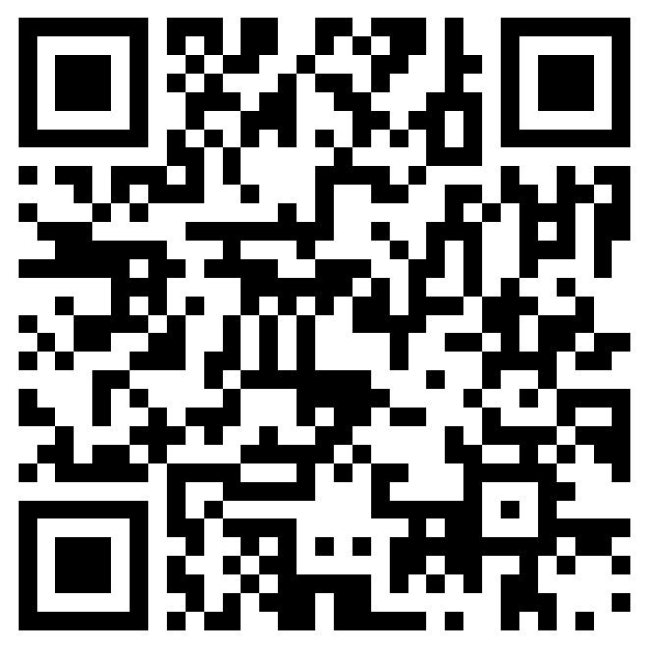
Announcements
Please fill out the session evaluation after today’s session.
You should be directed to fill it out after the call ends OR you may scan the QR code on the right.
Join us for the next session of the speaker series!
Wednesday, August 14 from 4:00 - 5:00 PM ET
Student Presentations and Posters
To view past recordings, visit https://nopren.ucsf.edu/her-nopren-summer-speaker-series-students-2024
Notes:
Thanks to our speakers and to everyone for joining us today. Reminder to please fill out the evaluation for today’s session which can be found at the QR code here or in the link in chat. Also a reminder again that our last session is next week August 14th and that will be our student presentations and posters session. Thanks everyone!
Reminder: please fill out the session evaluation for today: https://duke.qualtrics.com/jfe/form/SV_4SmhYaB4MN4pdn8

